Slide 1

METS and the Peel’s Prairie Provinces Project
http://peel.library.ualberta.ca
Susan Dahl
University of Alberta

Slide 2
Peel's Bibliography of the Canadian Prairies to 1953
Monographs and pamphlets
Newspapers and serials, photos, archival manuscripts, maps
Adding both pre and post 1953 imprints
Searchable bibliography and full-text database

Slide 3
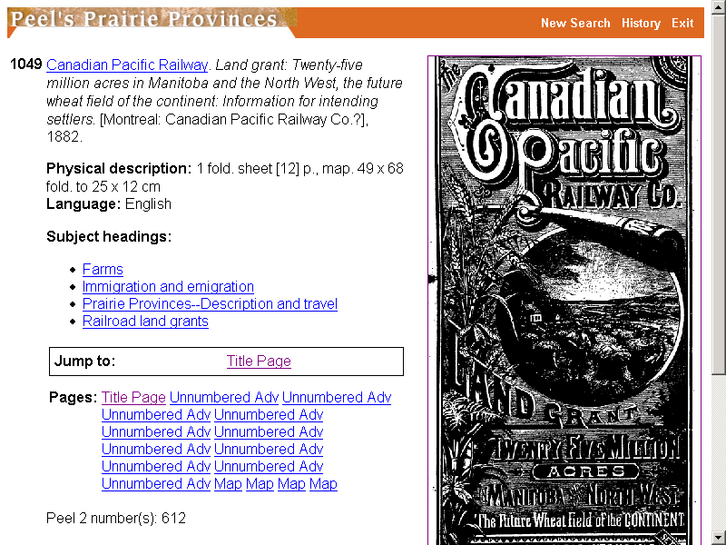

Slide 4
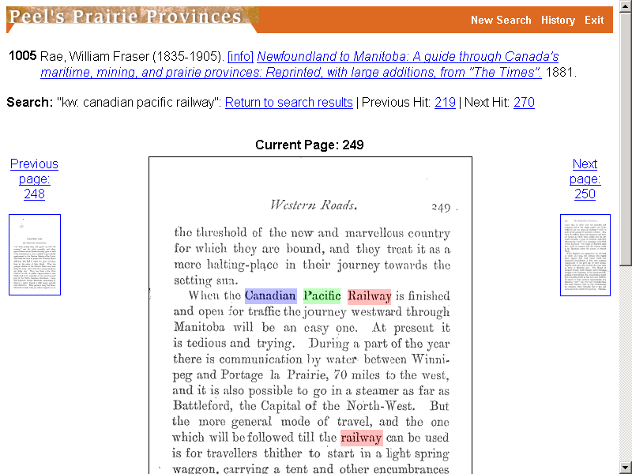

Slide 5
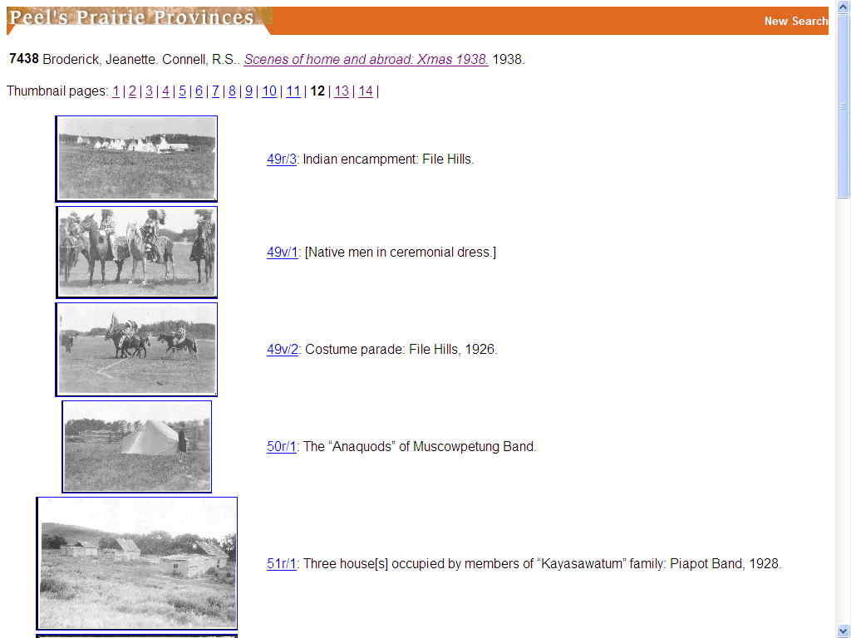

Slide 6
Standards
DC-Library Application Profile
MODS
METS

Slide 7
Technology
OCLC SiteSearch  Lucene
Cocoon
eXist
Olive’s ActivePaper Archive software

Slide 8
Olive
Recreates look and feel of source document
Intended for newspapers—searchable to article level
Transforms source documents into image and XML files
Interface on standard web browser
Distillation—OCR & XML encoding

Slide 9
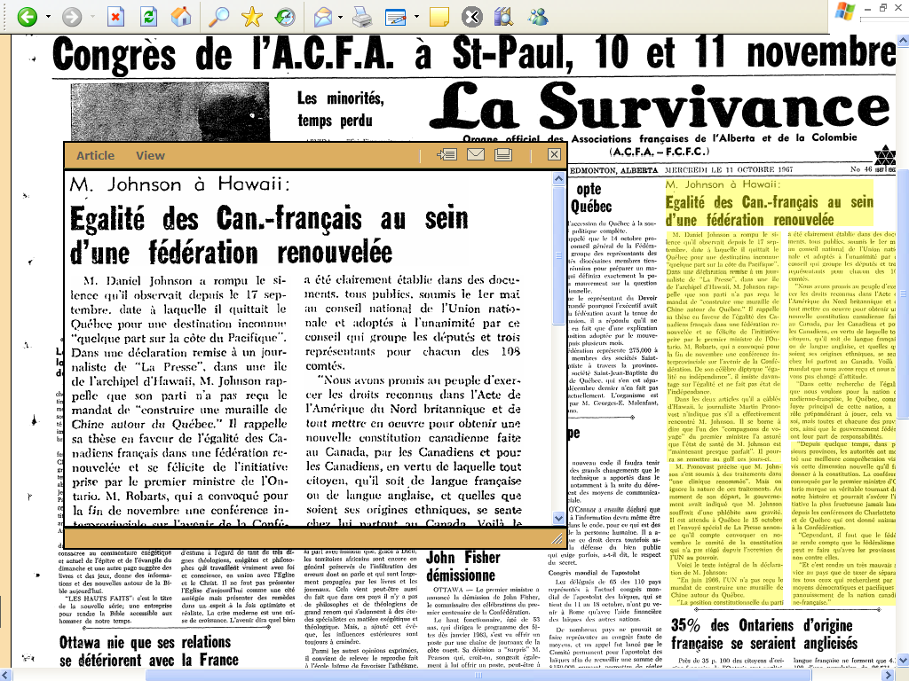

Slide 10
Olive files
Source PDF file
TOC xml file
Images:
  Page
  Thumbnail
  Sections
XML files:
  Page
  Section

Slide 11
METS
Binds together all types of metadata about a digital object: descriptive, administrative, technical, structural
Describes the object’s structure
Lists all files associated with the object

Slide 12
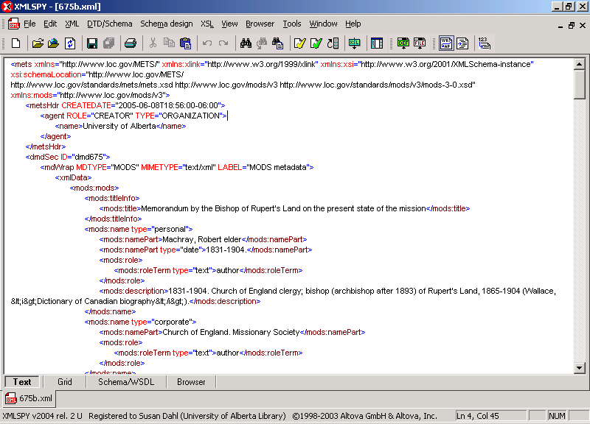
Descriptive metadata

Slide 13
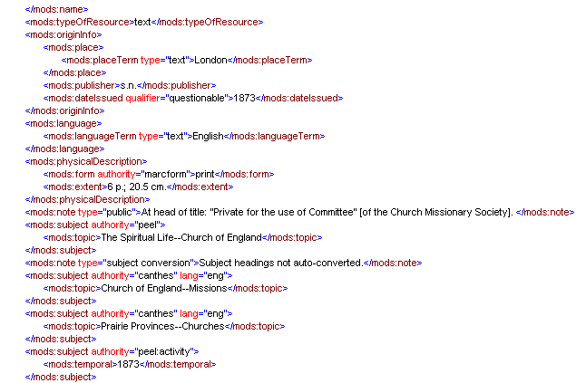

Slide 14
Administrative metadata
Technical—scanning information, file format, creation dates
Copyright
Source metadata—original material
Digital provenance—migrations/transformations

Slide 15
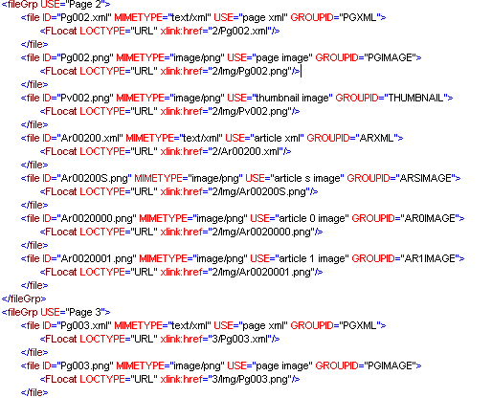
File Groups

Slide 16
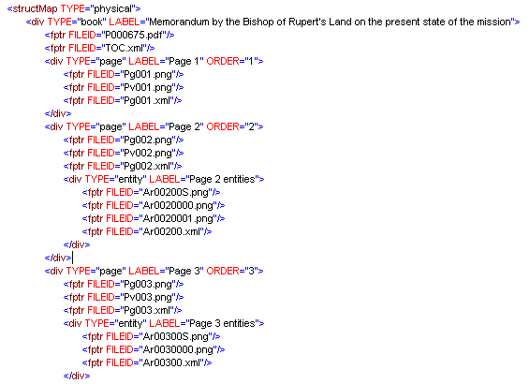
structMap

