Slide 1

From DB to METS
Eric Stedfeld
New York University

Slide 2

Goals
Simple database structure for the most common METS needs
Simple interface to take user input, generate METS and return results
XML processing to convert and display selected material in a web environment
Future extensions for more complicated media types and metadata

Slide 3
Tools
MySQL database to store structural, descriptive and image technical metadata
Perl to take user input, query database, build METS file and return Web “success” page
XT to transform METS XML to HTML using XSLT
Tomcat to call XT servlet and display HTML to user

Slide 4
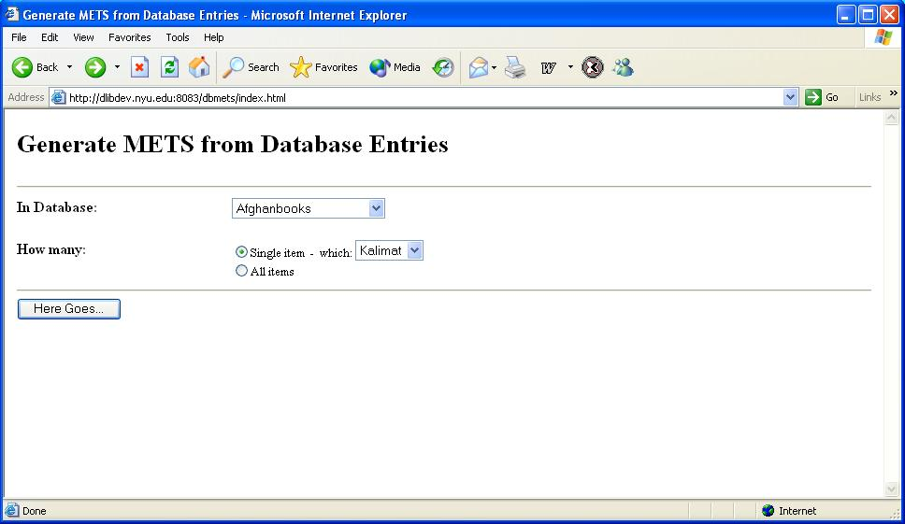
Web Interface – Generate METS

Slide 5
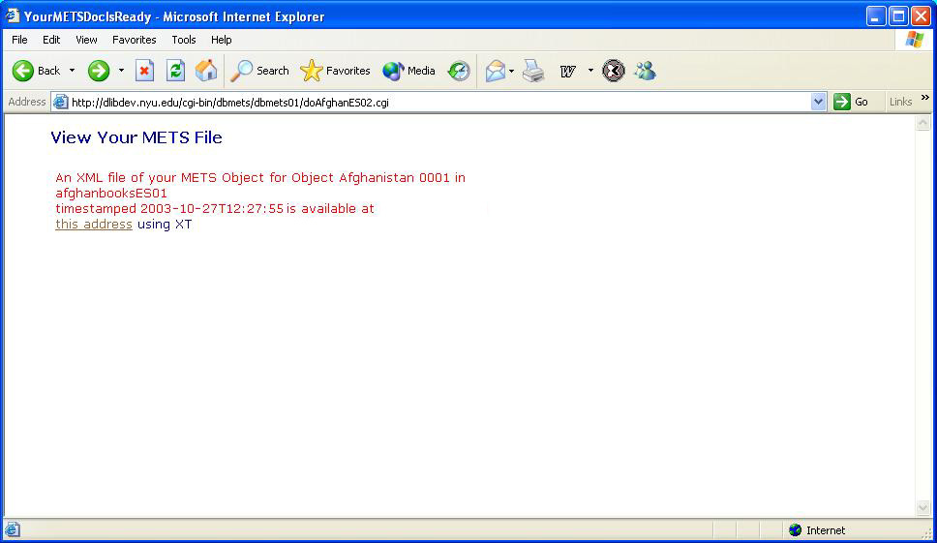
Web Interface – Success

Slide 6
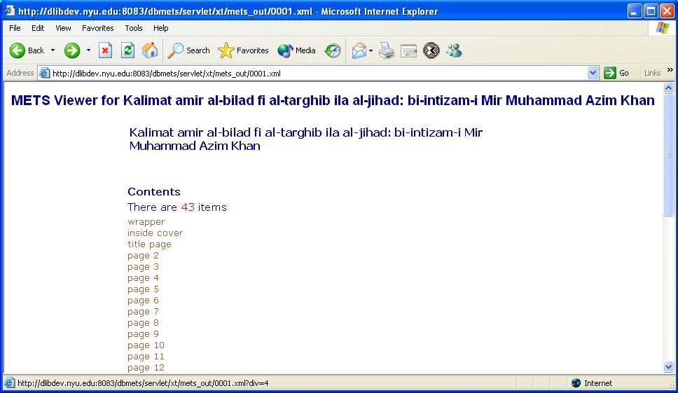
Web Interface – Return Results

Slide 7
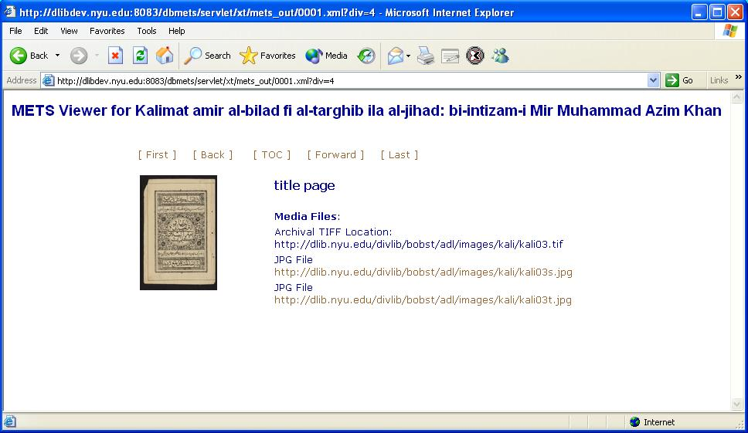
Web Interface – Select Page

Slide 8
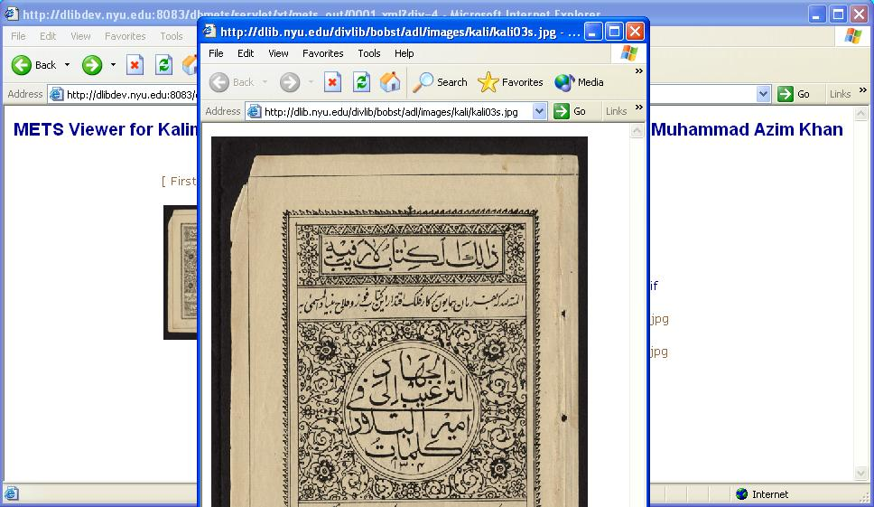
Web Interface – View Closeup

Slide 9
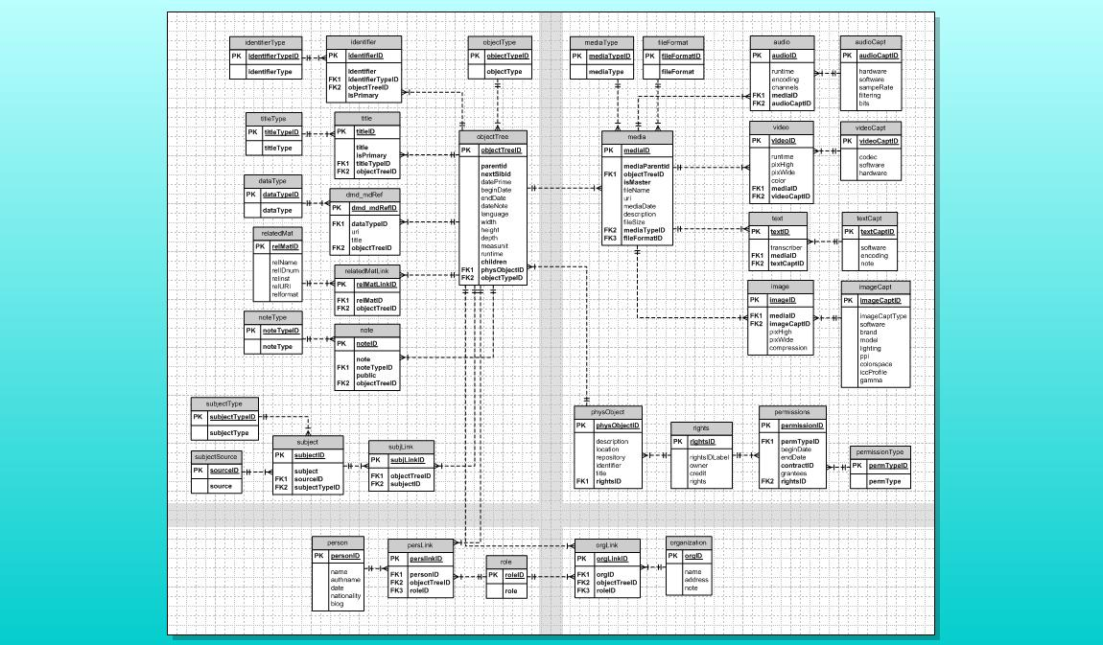
Database Schema – ZeroDB

Slide 10
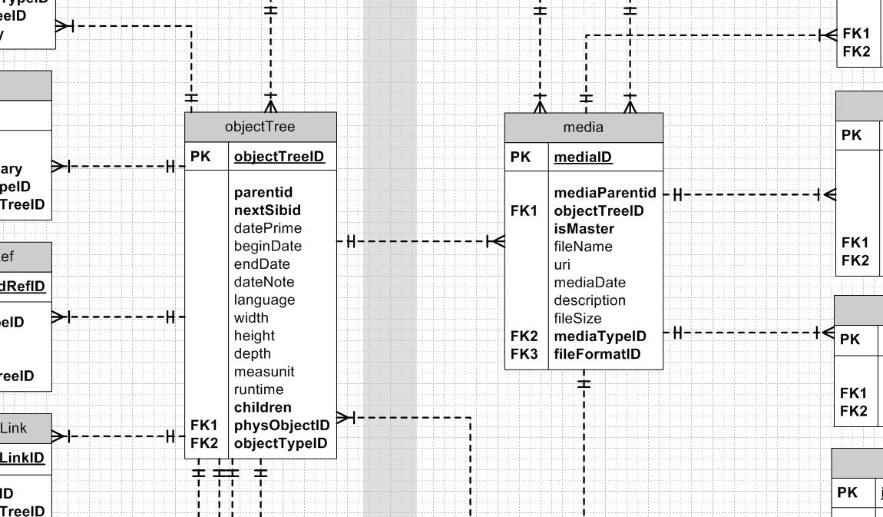
Database Schema – Center

Slide 11
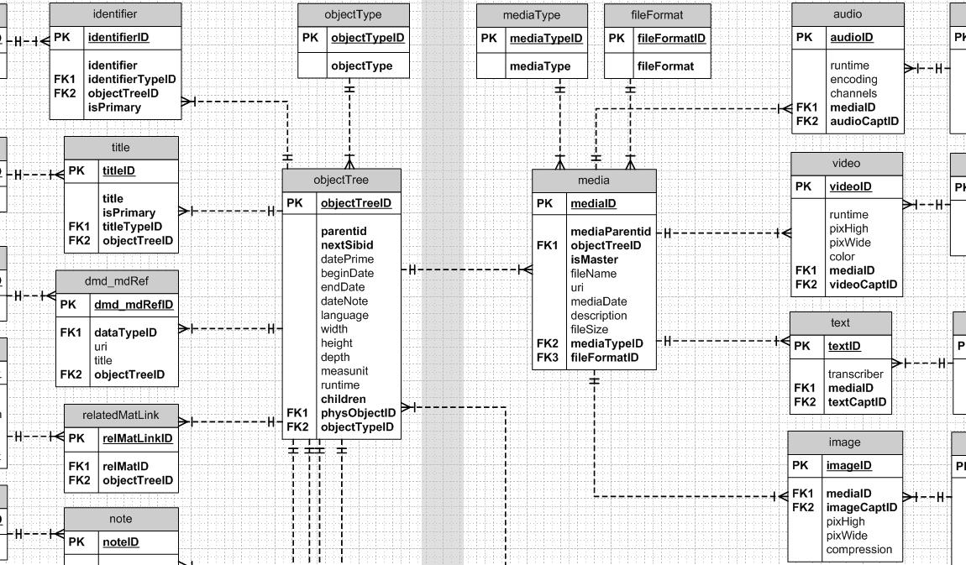
Database Schema – Center

Slide 12
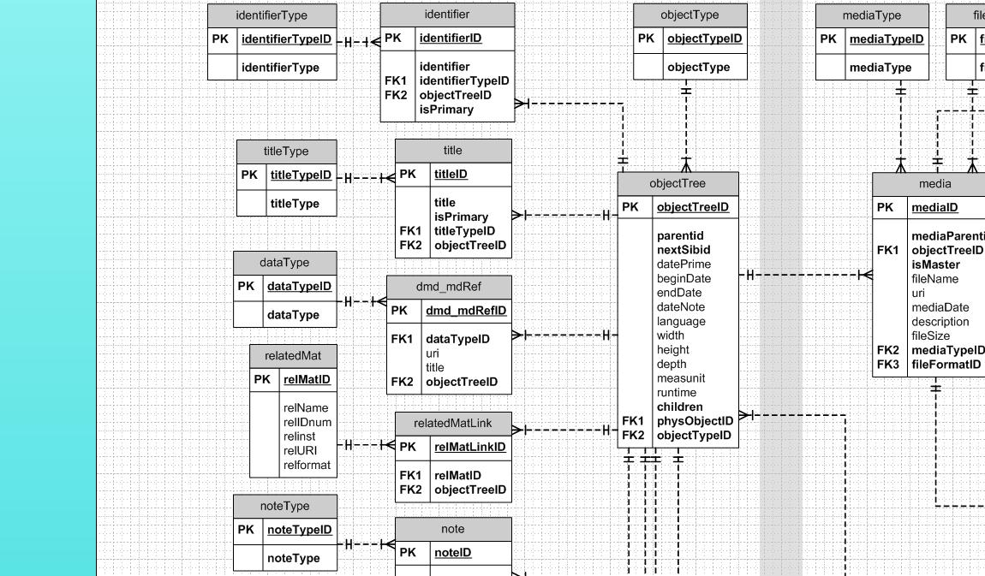
Database Schema – Object Tree

Slide 13
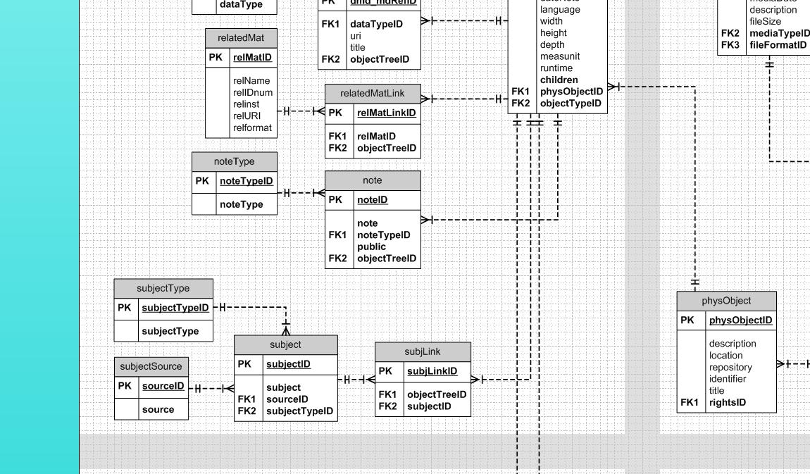
Database Schema – Subject

Slide 14
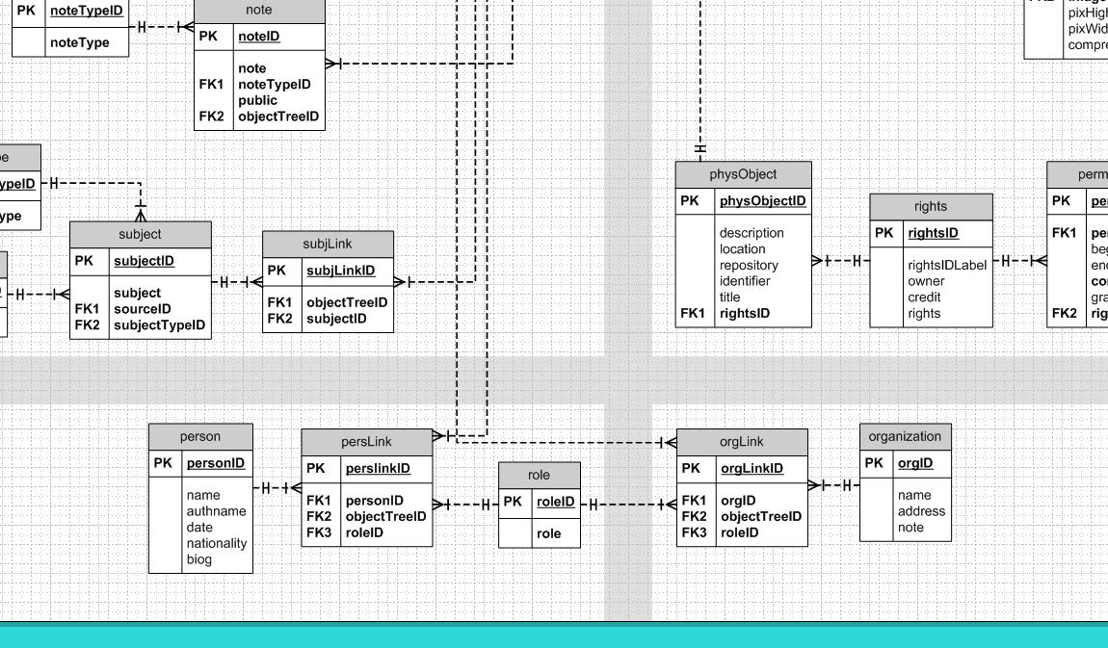
Database Schema – Name

Slide 15
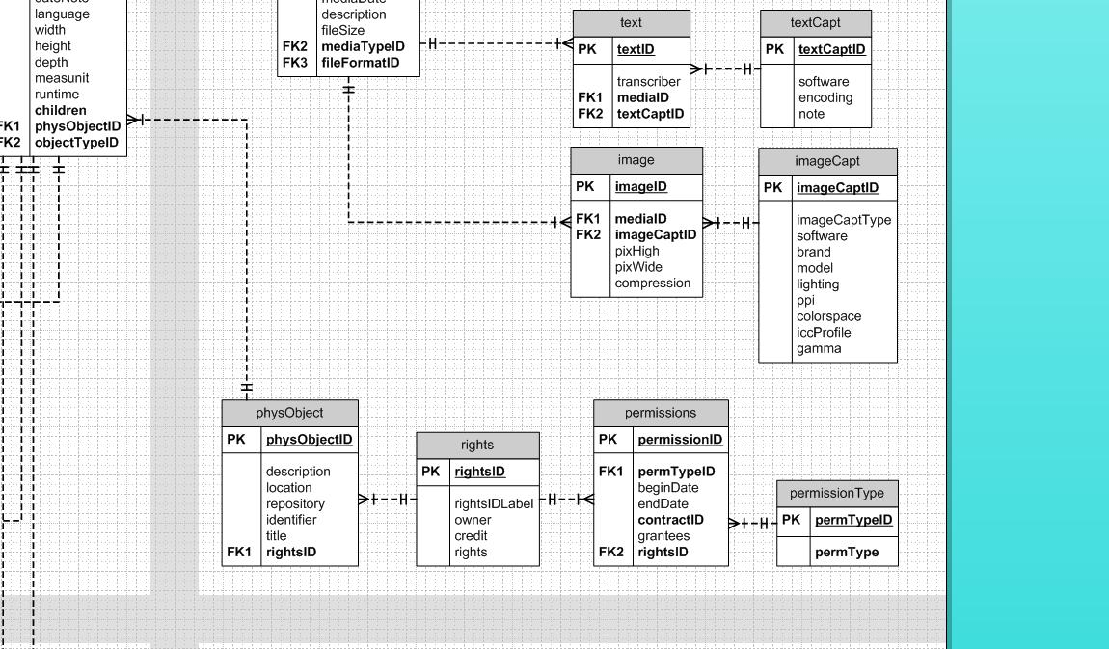
Database Schema – Phys. Object

Slide 16
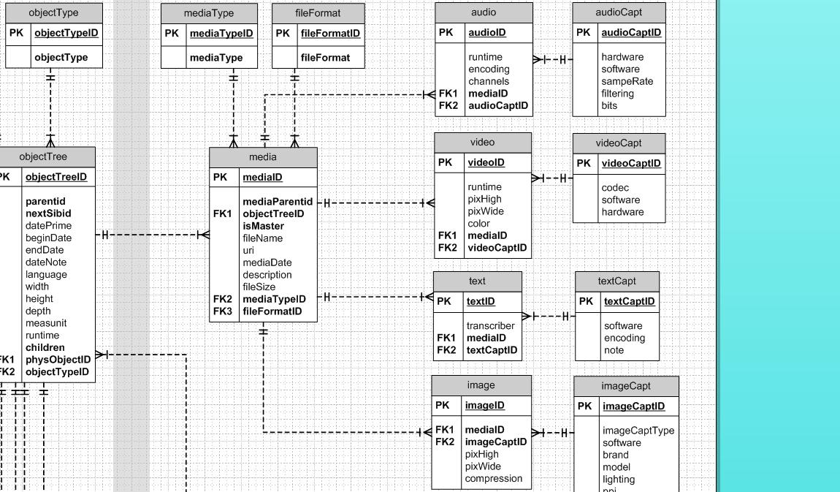
Database Schema – Media

Slide 17
App Code – Main Routine
use DBI;
...
# Set query, path and database variables
&print_head; # Start "Success" HTML page
$dbh = DBI->connect("DBI:mysql:$database",
$dbuser, $dbpass);
&do_one;
$dbh->disconnect;
&return_to_browser;
&print_footer; # Finish "Success" HTML page

Slide 18
App Code – Do One
sub &do_one {
$objectTreeID = $fetchme;
# Set up file and path variables using $objectTreeID
&get_children; # create array of objectIDs
open (OUTFILE, ">$path");
&print_xml;
close (OUTFILE);
}

Slide 19
App Code – Get Children
sub &get_children {
$SQLstmt = "SELECT o.objectTreeID, o.parentID
FROM objectTree AS o
WHERE o.parentID = $objectTreeID
ORDER BY o.objectTreeID";
$sth = $dbh->prepare($SQLstmt);
$sth->execute;
while (@row = $sth->fetchrow_array){
$childID = $row[0];
@children = $childID;
}
$sth->finish;
}

Slide 20
App Code – Print XML
sub &print_xml {
print OUTFILE<<EOF;
# XML header here
EOF
# SQL to fetch METS header info
&print_METSHeader;
&print_dmdSecDM;
&print_amdSec;
&print_fileSec;
&print_structMap;
print OUTFILE<<EOF;
# METS close file stuff here
EOF
}

Slide 21
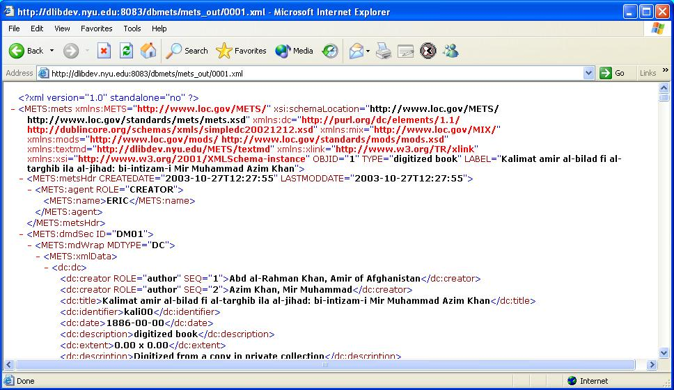
XML – Descriptive Metadata

Slide 22
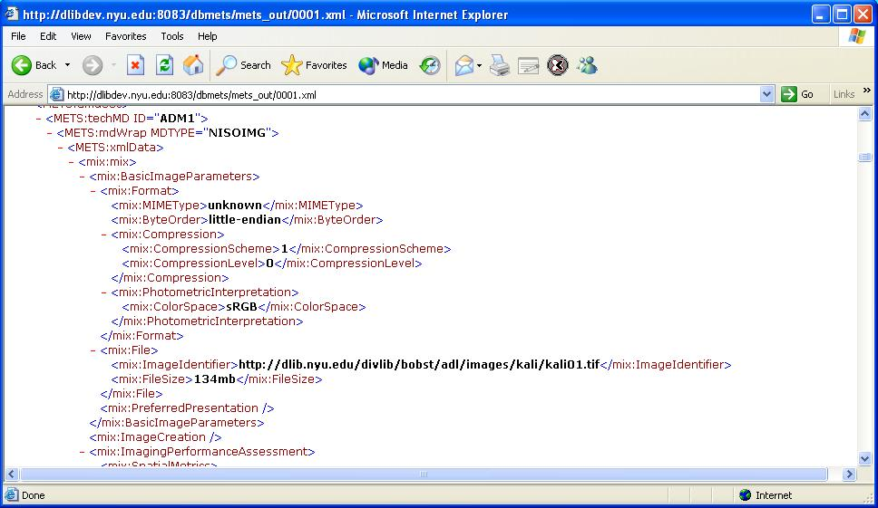
XML – Technical Metadata

Slide 23
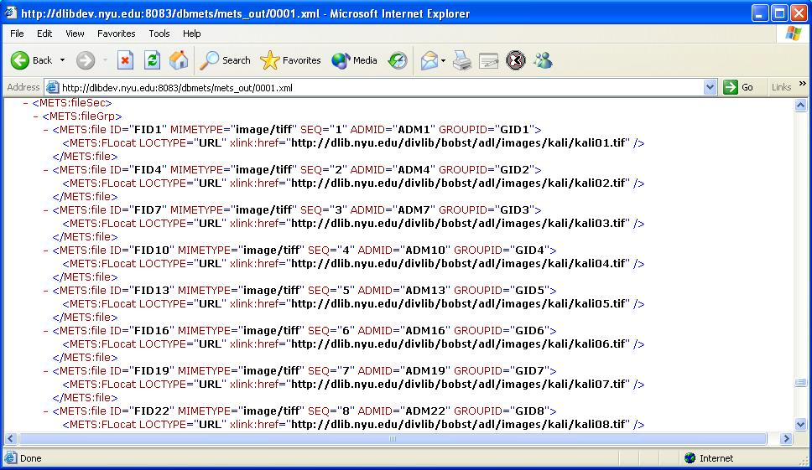
XML – File Section

Slide 24
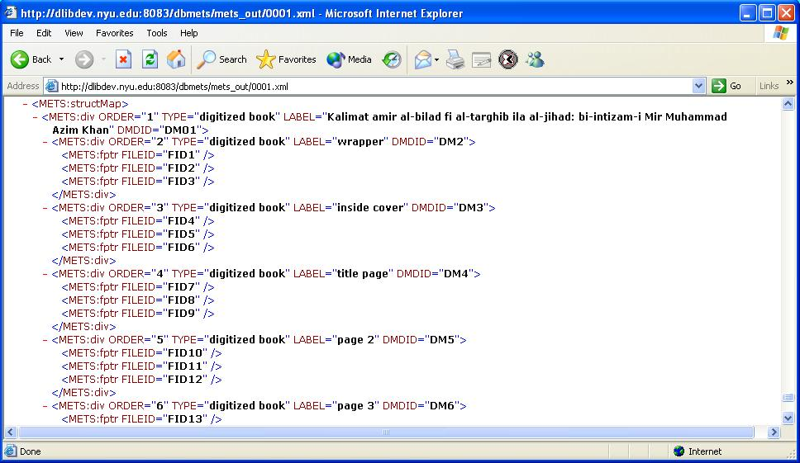
XML – Structural Map

Slide 25
Web Interface – Select Page

Slide 26
Issues
Database capability vs. METS flexibility
Normalized vs. efficient database schema
General vs. specialized approach for many METS types
Hard areas such as rights metadata
Data synchronization
Consistency across institution(s)

Slide 27
Future
“Meta-programming” – programs to create programs, database schemata and stylesheets
Consistent utilization and implementation of Profiles
Down-streaming more of the work – less specialized skill sets required, less “boutique-y”

Slide 28
From DB to METS
Eric Stedfeld
New York University

