Slide 1
METS in the OCLC Digital Archive
Taylor Surface
Director, Digital Content Management Services
October 27, 2003

Slide 2
Agenda
OCLC’s Digital Archive
Our METS implementation
Extension schemas
Description, vocabularies, requirements
Notes:
OCLC uses METS in accordance with the last two initials of the name … “Metadata Encoding Transmission Standard”. In other words, as an operational digital repository, the OCLC Digital Archive needs to have the ability to exchange digital objects with other repositories in a standard manner. In order to promote trust in a digital repository the repository operator needs to re-assure you that if you entrust something to them that you’ll be able to get it back. One element of that trust is built around openly-defined input streams for submission of objects to the repository as well as output streams for dissemination of objects to users or external systems.

Slide 3
OCLC Digital Archive Tools
Web Archiving
Item-by-item archiving of web pages and web documents
HTML and PDF and associated files
DIP uses METS; SIP is constructed on the fly
Batch Ingest
Collection-based archiving of resources library has saved onto server, disc, or tape
Primarily TIFFs
SIP uses METS; DIP not implemented at this time

Slide 4
Implications for OCLC’s METS Implementation
Different profiles needed for batch ingest and web tool
Batch ingest currently accepts nonhierarchical objects only
Notes:
So, the two channels of object ingest that we’ve developed lend themselves to different specializations. Serving these communities required us to develop with a different emphasis in each area.
We fully anticipate that there are standard profiles that we’ll be able to utilize or develop with others in the community. Presently we have not published profiles for any formats or for the digital archive service as a service.
As I progress through the remainder of this presentation you’ll get a feel for how the profiles will be developed and what they’ll look like.

Slide 5
METS in Batch Ingest
Downloadable Submission Builder application creates SIP
Submission Builder creates METS document based on user’s tab-delimited metadata file and manifest file (list of filenames)
Manifest file, also part of SIP, is encoded in METS and has links to object-level METS file

Slide 6
METS in Batch Ingest (SIP)
METS document (one per object) sent to OCLC as part of SIP, along with content objects for batch ingest
Objects are ingested and preservation metadata records are generated automatically based on the information in SIP

Slide 7
Submission Builder Requirements
Windows 2000, NT4, or XP
Intel Pentium III, 864MzH or higher
At least 256 MB RAM
8.5 MB disk space
Internet connection active during SIP creation (validates against METS at LC web site)

Slide 8
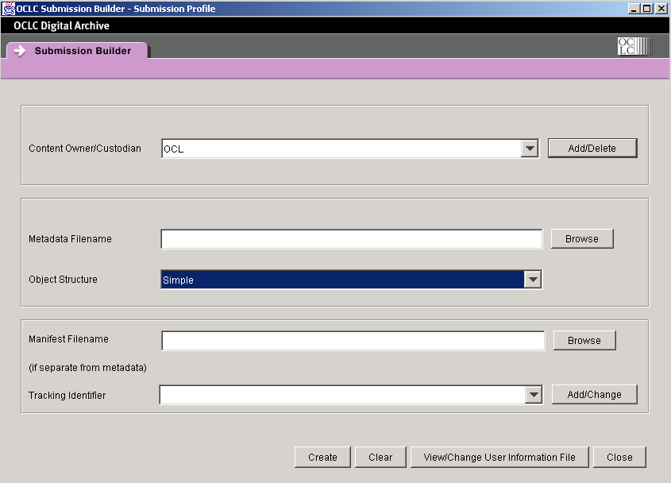
Submission Builder

Slide 9
METS in Web Archiving Tools (DIP)
The dissemination of content objects ingested on an object-by-object basis results in a METS document.
Hierarchical as well as non-hierarchical objects are encoded in METS for use as a DIP from OCLC Digital Archive.

Slide 10
Development Plans
METS-based batch dissemination for both batch ingest and web tools
Acceptance of hierarchical objects in batch ingest
Keeping profiles updated as tools change

Slide 11
METS Extension Schemas
Header - No extension
Descriptive Metadata Section - OCLC descriptive schema http://digitalarchive.oclc.org/schemas/oclc_dm.xsd
File Section - No extension
Structural Map Section - No extension
Behavior Section - No extension

Slide 12
More Extension Schemas
Administrative Metadata Section –
MIX schema http://www.loc.gov/standards/mix/mix.xsd
textMD schema http://dlib.nyu.edu/METS/textmd.xsd
OCLC provenance schema http://digitalarchive.oclc.org/schemas/oclc_prov.xsd

Slide 13
Rules of Description, Controlled Vocabularies
Date: Must be in W3C-DTF format
Language: Must be in ISO 639-2 format

Slide 14
Some of Our Structural Requirements
Every METS document must have <metsHdr>
Descriptive section: METS document for each object contains one <dmdSec>; metadata conforms to oclc_md schema
Administrative section: MIX used for image technical metadata; textMD used for text; section also contains provenance information using oclc_prov.xsd OCLC extension schema

Slide 15
Technical Requirements
Any version of these formats:
HTML (including .css and .js)
PDF
TXT
TIF
JPG
GIF
BMP

Slide 16
Resources
Digital Archive web site: http://www.oclc.org/digitalarchive/default.htm
Navigate to Support,
then Documentation
for “Batch Ingest Guide,” and “Learning to Use Web Archiving Tools”: each is a comprehensive guide to that part of the system

Slide 17
Questions?

