Slide 1
10 minute repository talk
Brian Tingle
California Digital Library
METS Opening Day
Library of Congress
2003/10/28

Slide 2
Repository Features
Persistent object identification
XSLT transformation of METS
Generic Dublin Core search of METS
Customizable search results power multiple collections projects

Slide 3
Object Assumptions
Every object has a METS Document (/mets)
Every object has an ARK (/mets/@OBJID)
Every object has a profile (/mets/@PROFILE)

Slide 4
PROFILE for profiles
Every profile has a METS document matching the Identity Profile (ark:/13030/kt8s20152f)
These METS use the METS_Profile schema for the dmdSec
//file[@ID='toHTML'] = display xslt
//file[@ID='toQDC'] = Dublin Core xslt

Slide 5
http://ark.cdlib.org/mets/profiles
ark:/13030/kt8s20152f Profile for profiles
ark:/13030/kt400011f8 MODS OAC image
ark:/13030/kt5k40135s MODS OAC text
ark:/13030/kt5z09p6zn MODS eSch text (oceans)
ark:/13030/kt667nb8wm pre MODS (crs reports)
ark:/13030/kt4k40124g submission package profile
ark:/13030/kt1g5010zb DDI table
ark:/13030/kt3v19p5bk UCPEE netlib book
ark:/13030/kt0t1nb6x7 OAC EAD finding aid
ark:/13030/kt3q2nb7vz OAC EAD extracted object
ark:/13030/kt4g5012g0 DC OAC image (OAC-LSTA-DC)
ark:/13030/kt7j49p867 DC OAC text (OAC-ETEXT)

Slide 6
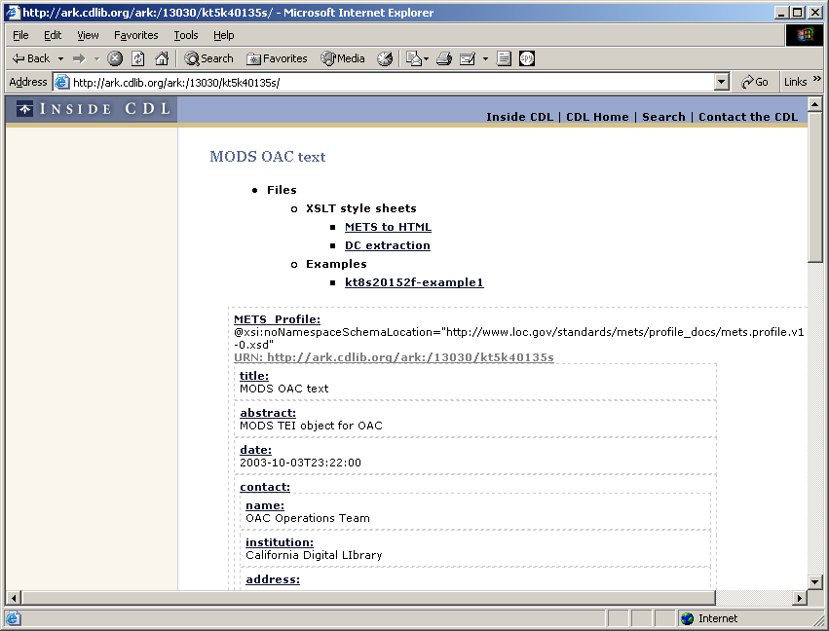

Slide 7
ARK resolution
User agent issues GET request for http://ark.cdlib.org/ark:/13030/ft4g5005fh
/ark/data/mets/fh/ft4g5005fh.mets.xml
/mets/@PROFILE parsed
xslt for display looked up
xslt for that profile applied
HTML returned to user
(implemented with mod_rewrite and custom AxKit provider)

Slide 8
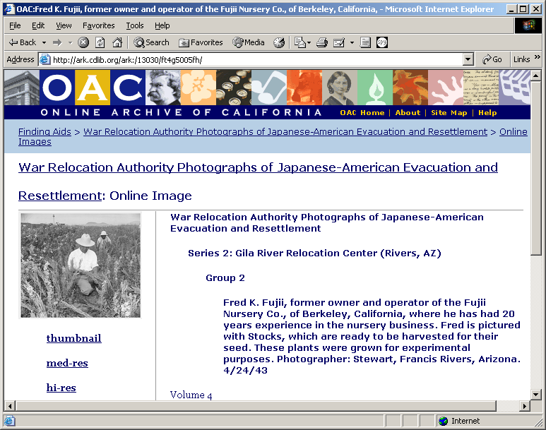

Slide 9
ARK resolution
User agent issues GET request for http://ark…/ark:/13030/ft4g5005fh/med-res
/ark/data/mets/fh/ft4g5005fh.mets.xml
//file[@ID='med-res'] looked up
Redirect to Flocat/@xlink:href

Slide 10
XSLT for DC index
All METS get processed in a batch
Indexer looks at /mets/@PROFILE
Indexer picks xslt based on PROFILE
Dublin Core record extracted from object

Slide 11
generic-search
?search=roman;xslt=raw+xml
?mode=ucpress;bsubject=%22Architectural%20History%22
?mode=moac-content&xslt=moac&core=creator&search=cha

Slide 12
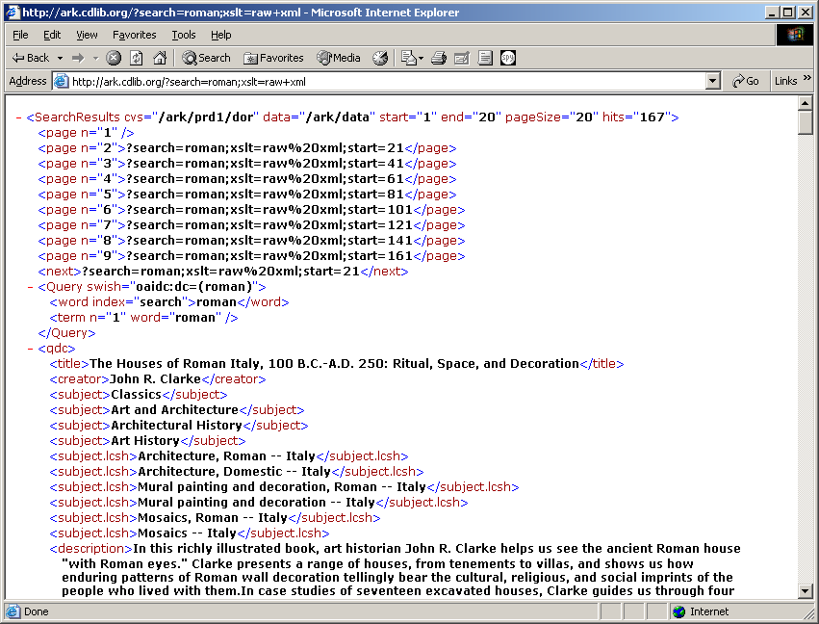

Slide 13
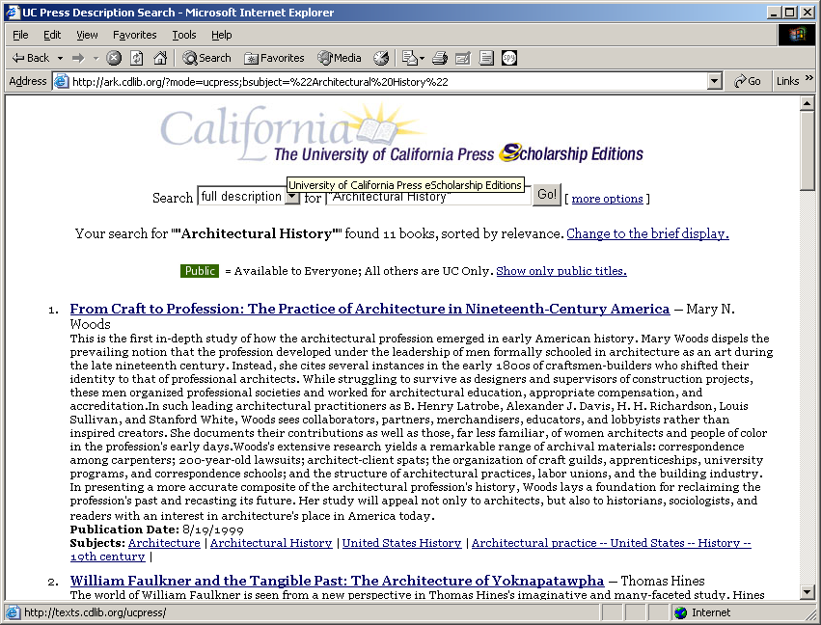

Slide 14
