Slide 1
No hession

Slide 2
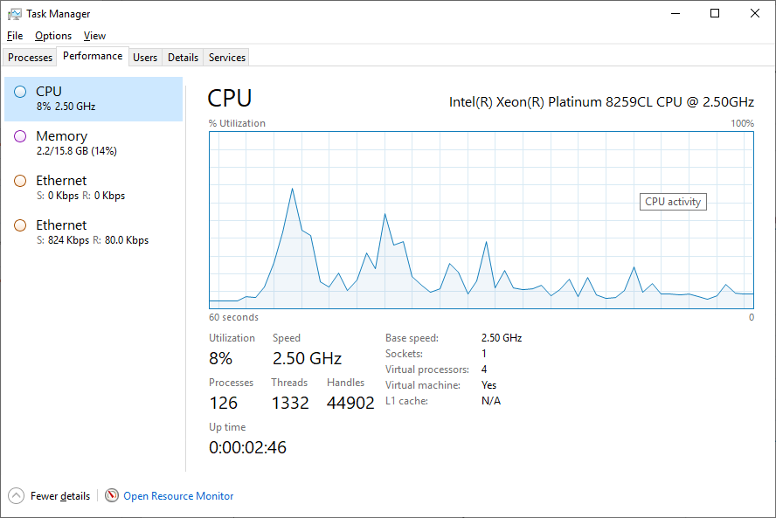
standard

