Slide 1
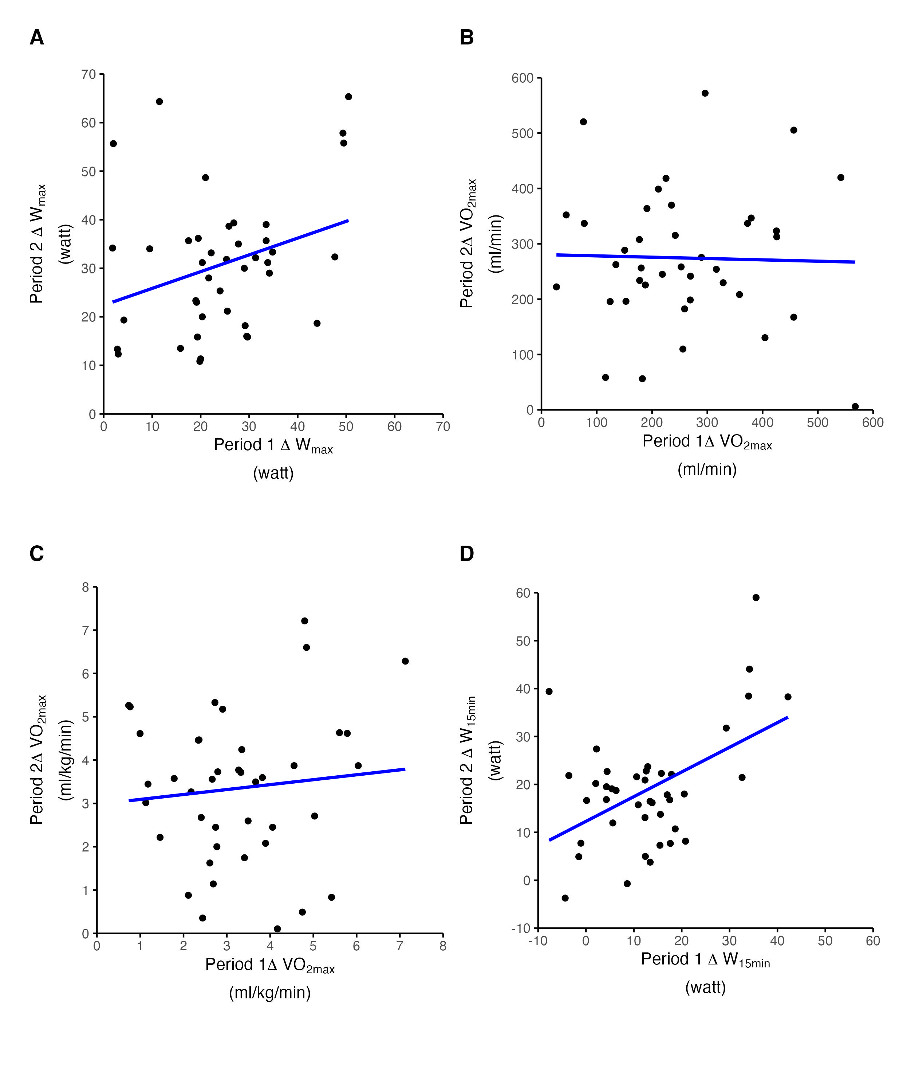
ICC = 0.38 [0.13, 0,59]
ICC = 0.20 [0, 0.47]
CV = 41.31
CV = 48.68
ICC = 0.12 [0, 0.34]
ICC = 0.25 [0, 0.55]
CV = 48.79
CV: 69.13

Slide 2
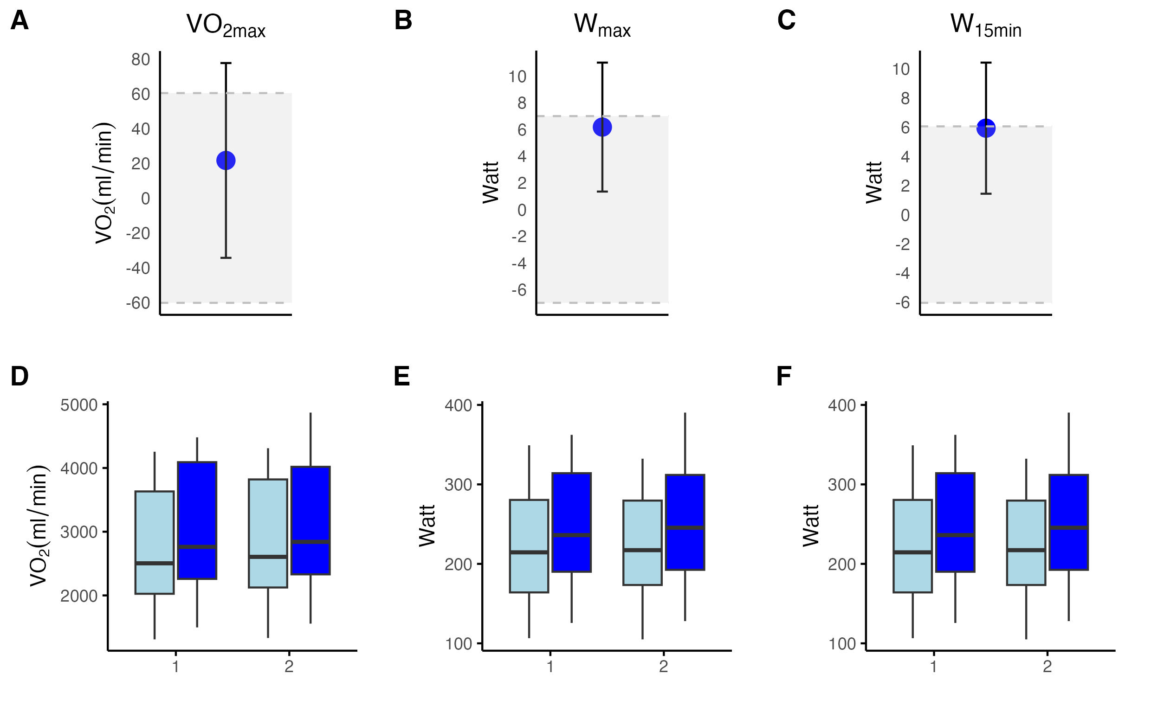
Difference in mean change scores between P1 and P2
Pre Vs. Post in P1 and P2
Period
Period
Period
Pre
post

Slide 3
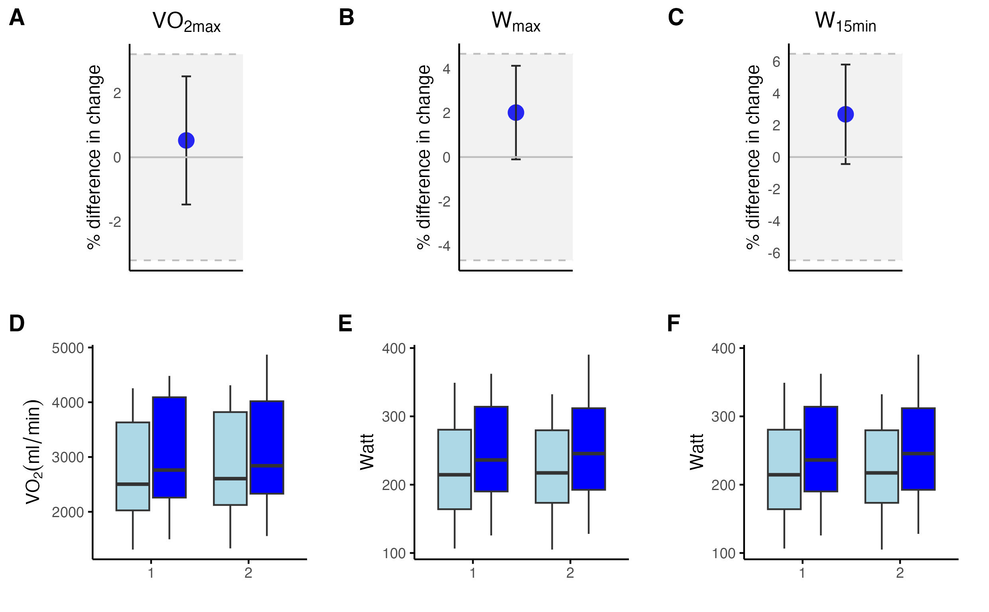
% difference in mean change scores between P1 and P2
Pre Vs. Post in P1 and P2
Pre
post

