Slide 1


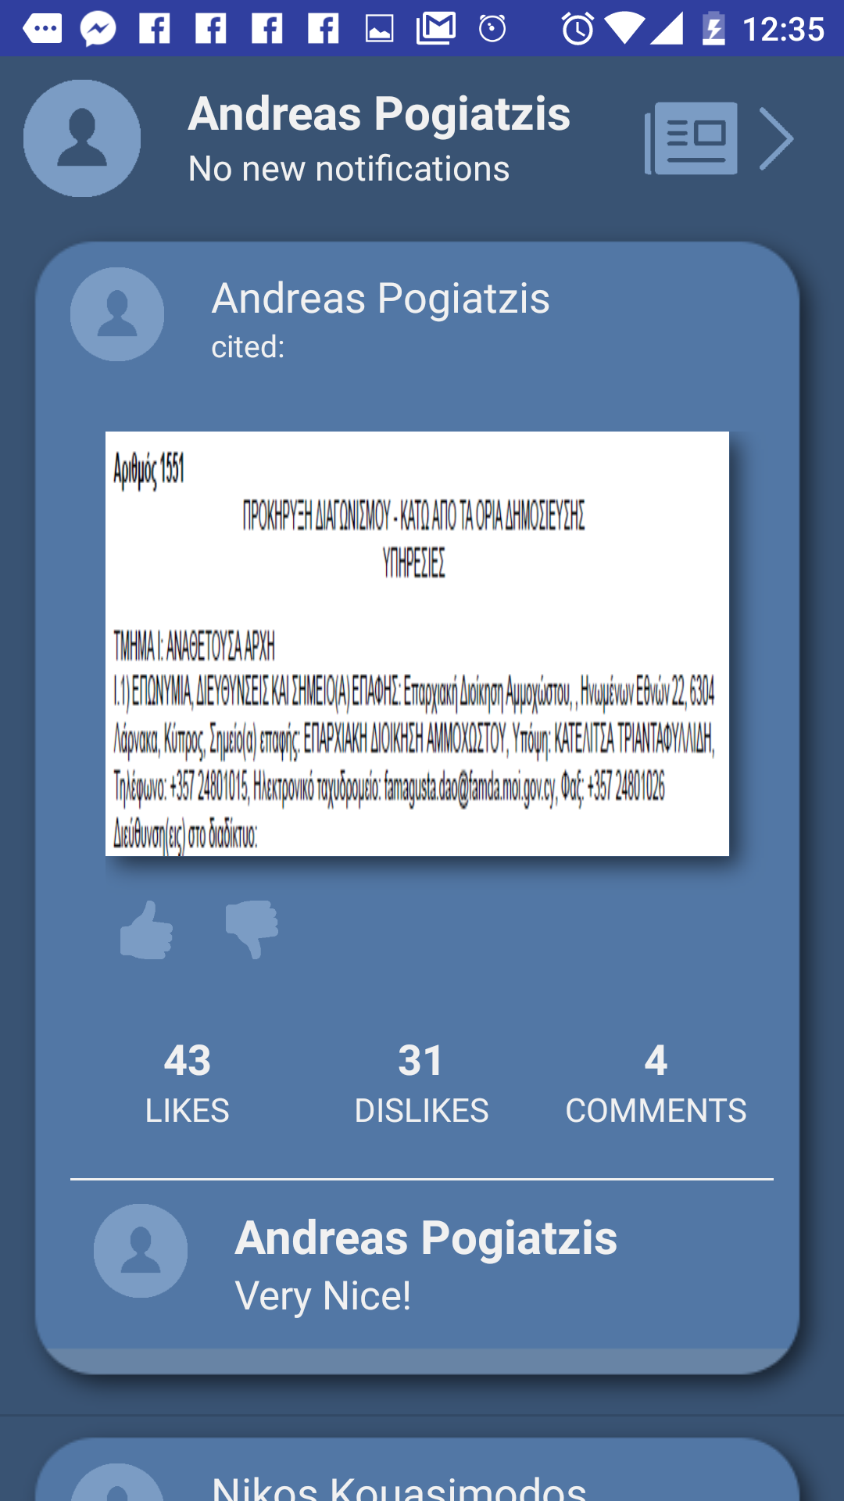
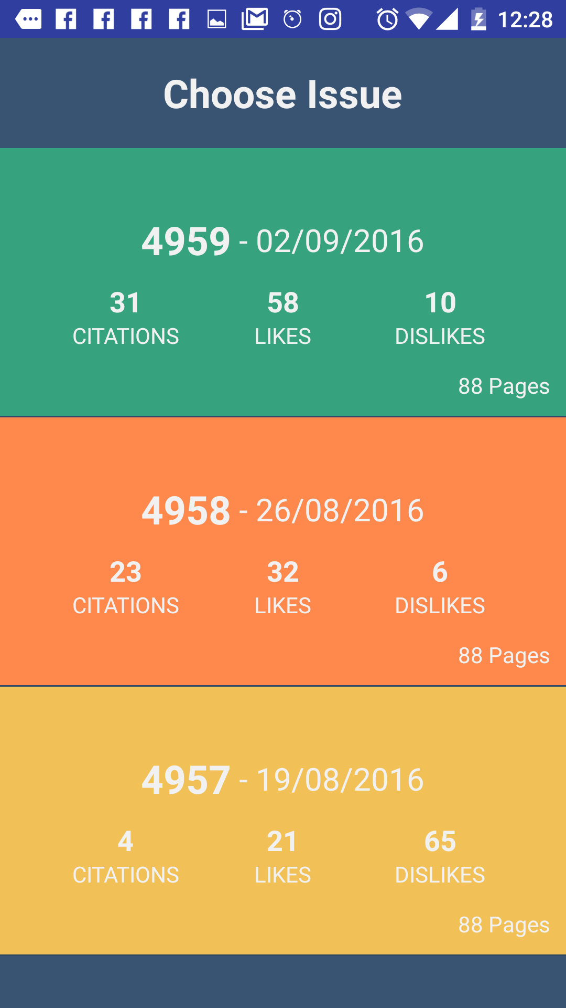
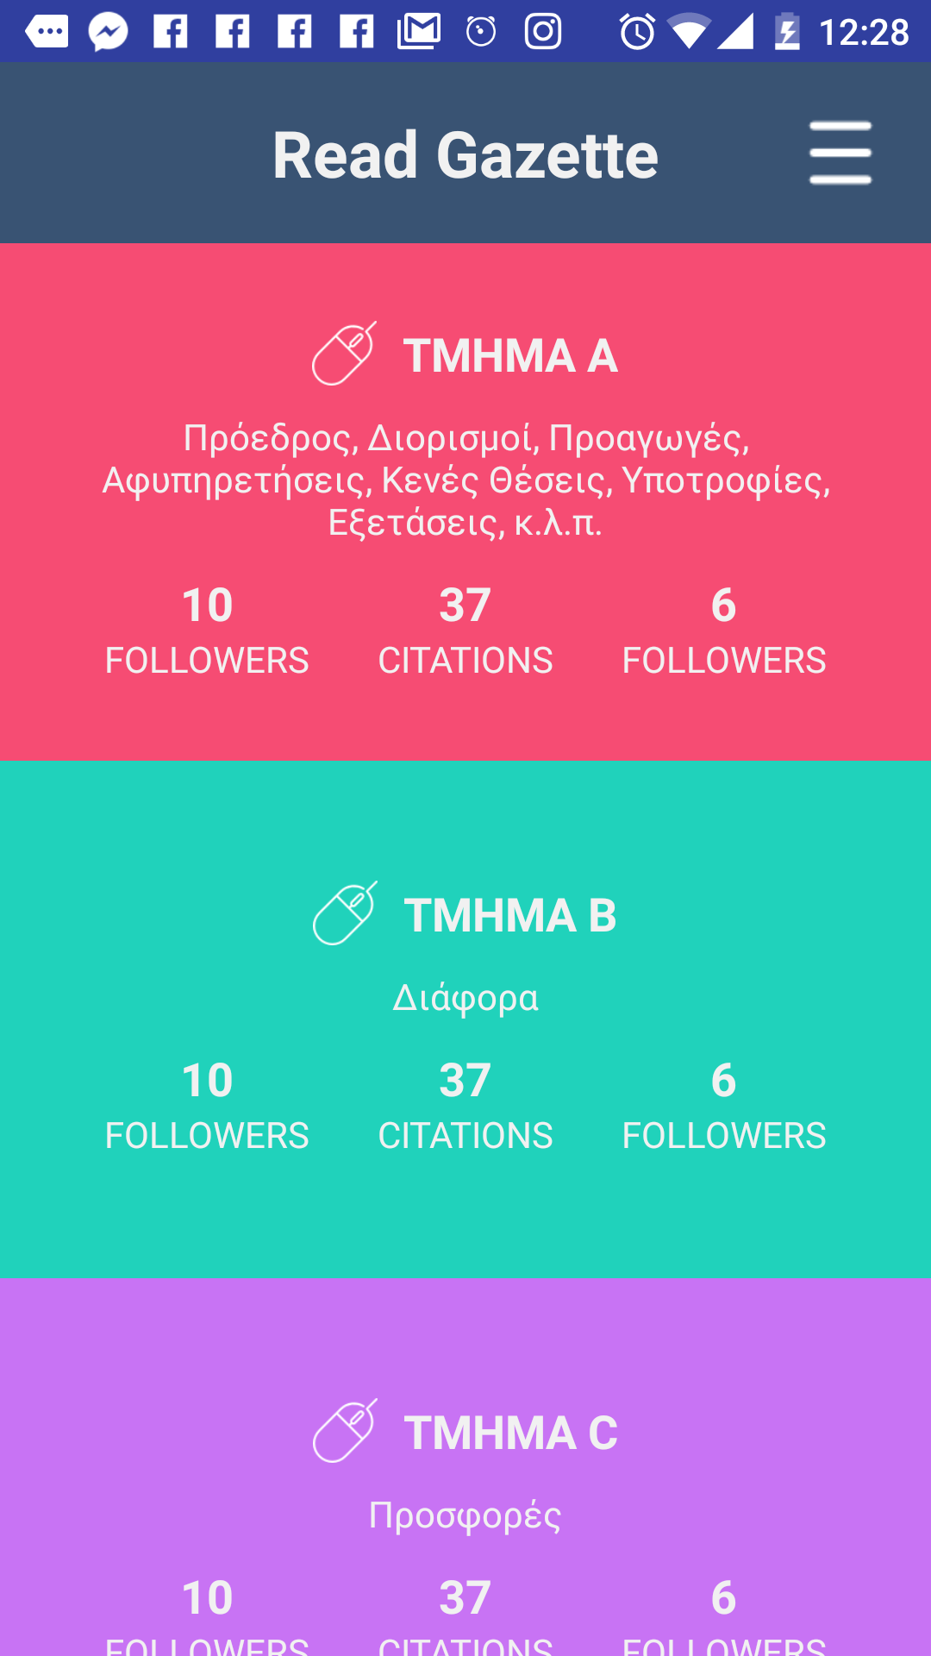
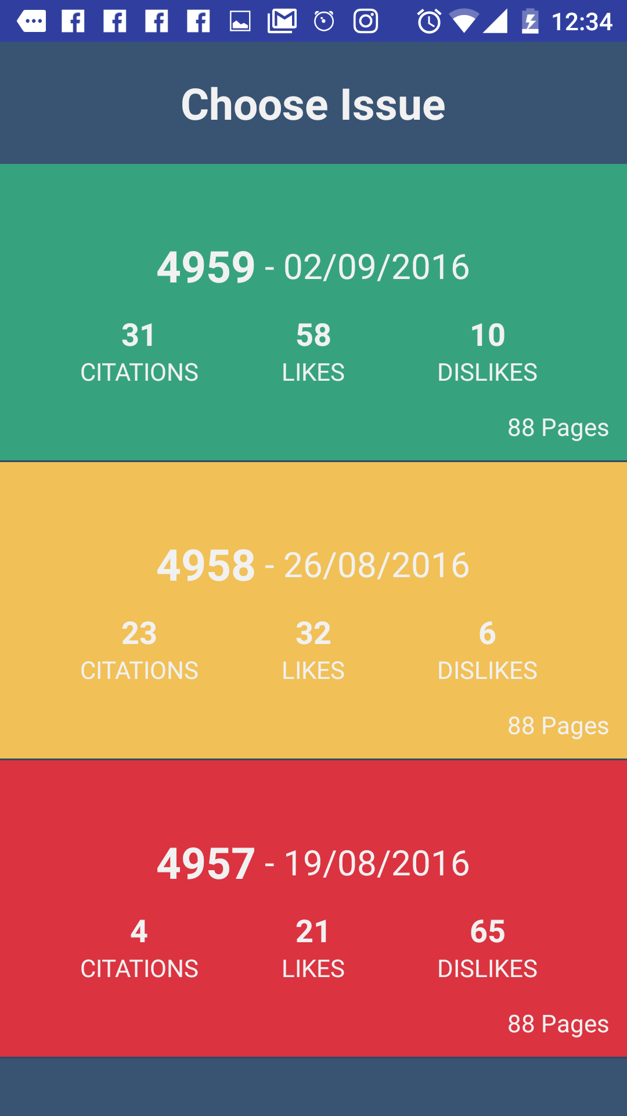
CY GAZETTE APP

Slide 2
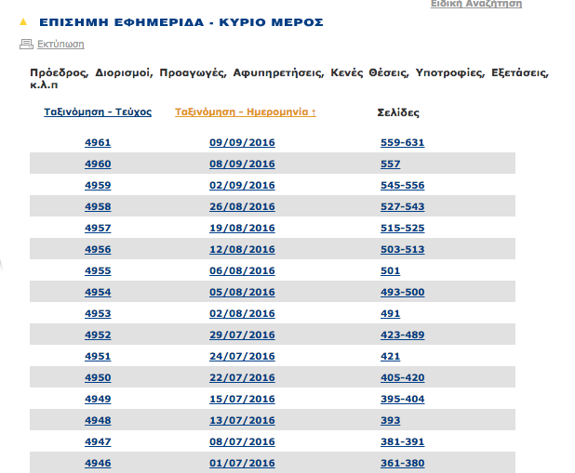
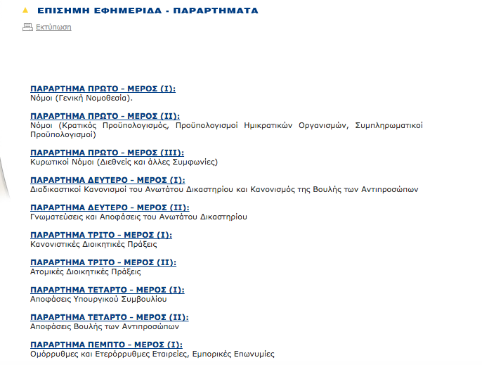
What is the main problem?
Usability Issues | Lack of User-Friendliness
http://www.mof.gov.cy/mof/gpo/gpo.nsf/dmlindex_gr/dmlindex_gr?OpenDocument

Slide 3

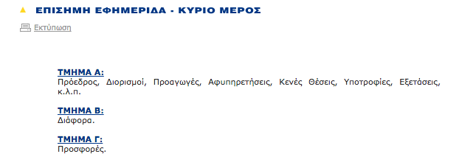
The Solution: CY Gazette App

Slide 4

The Solution: CY Gazette App

Slide 5
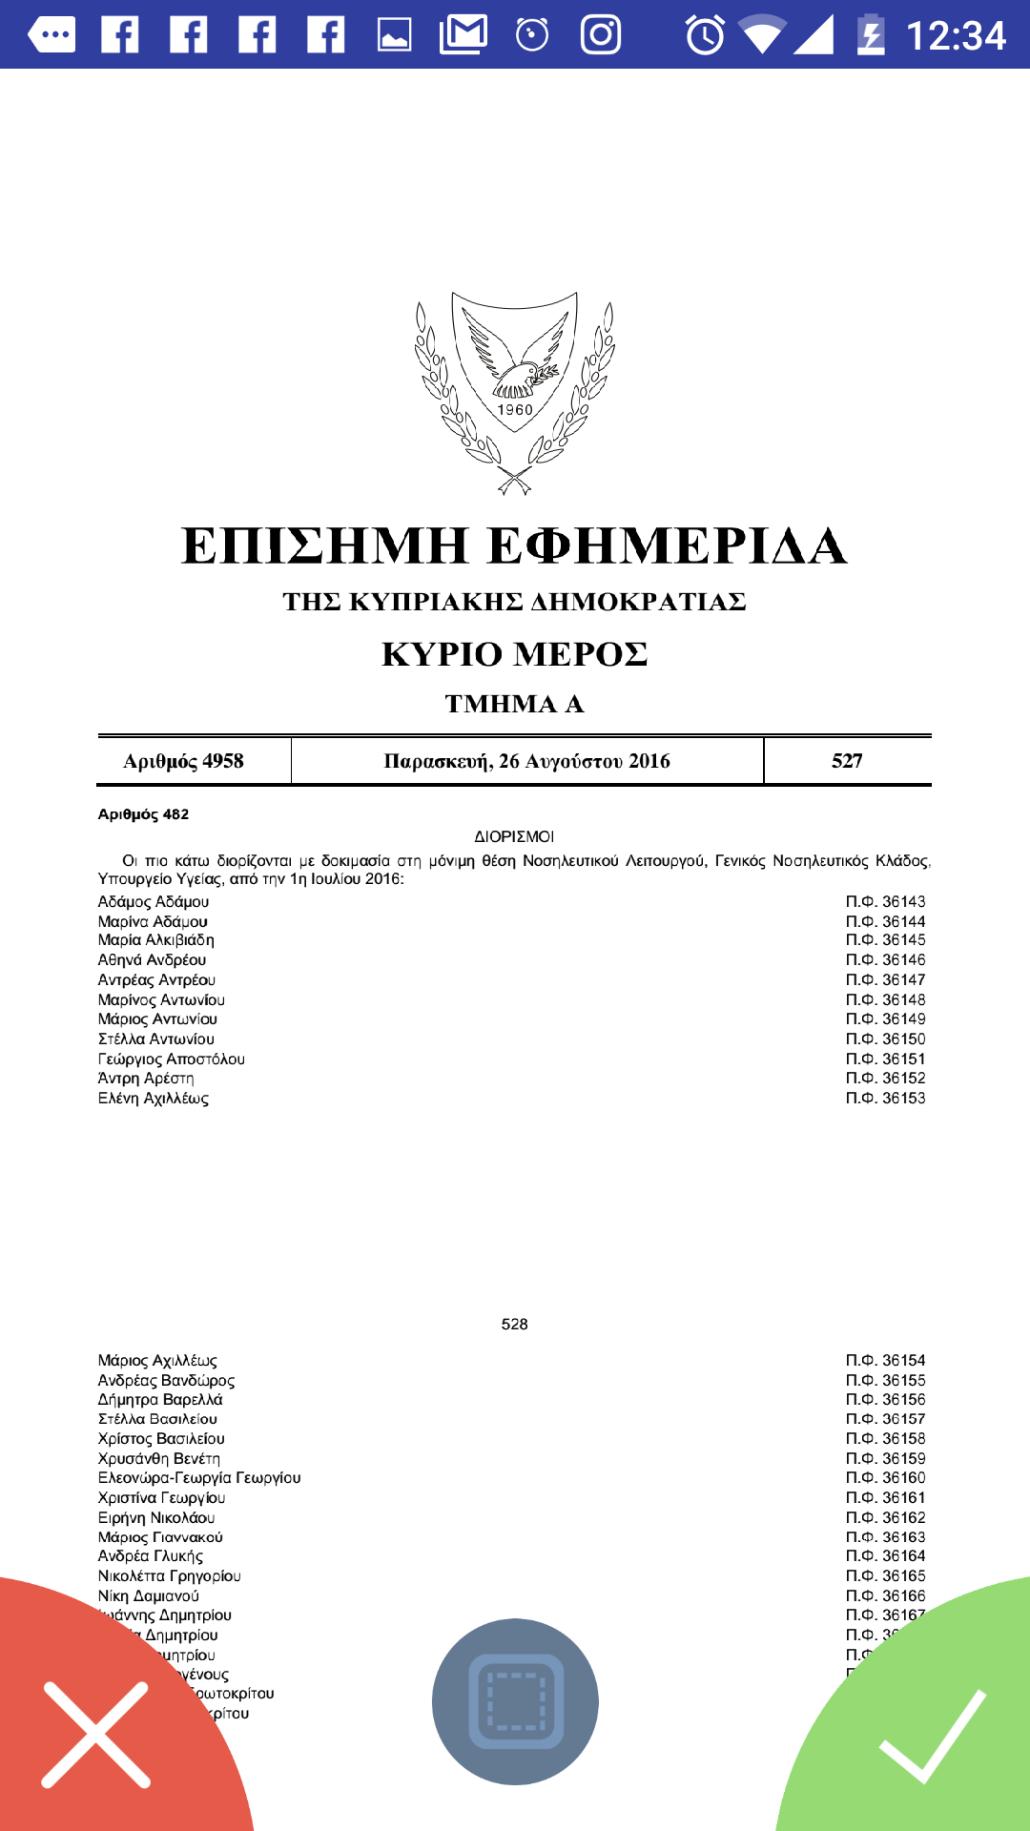
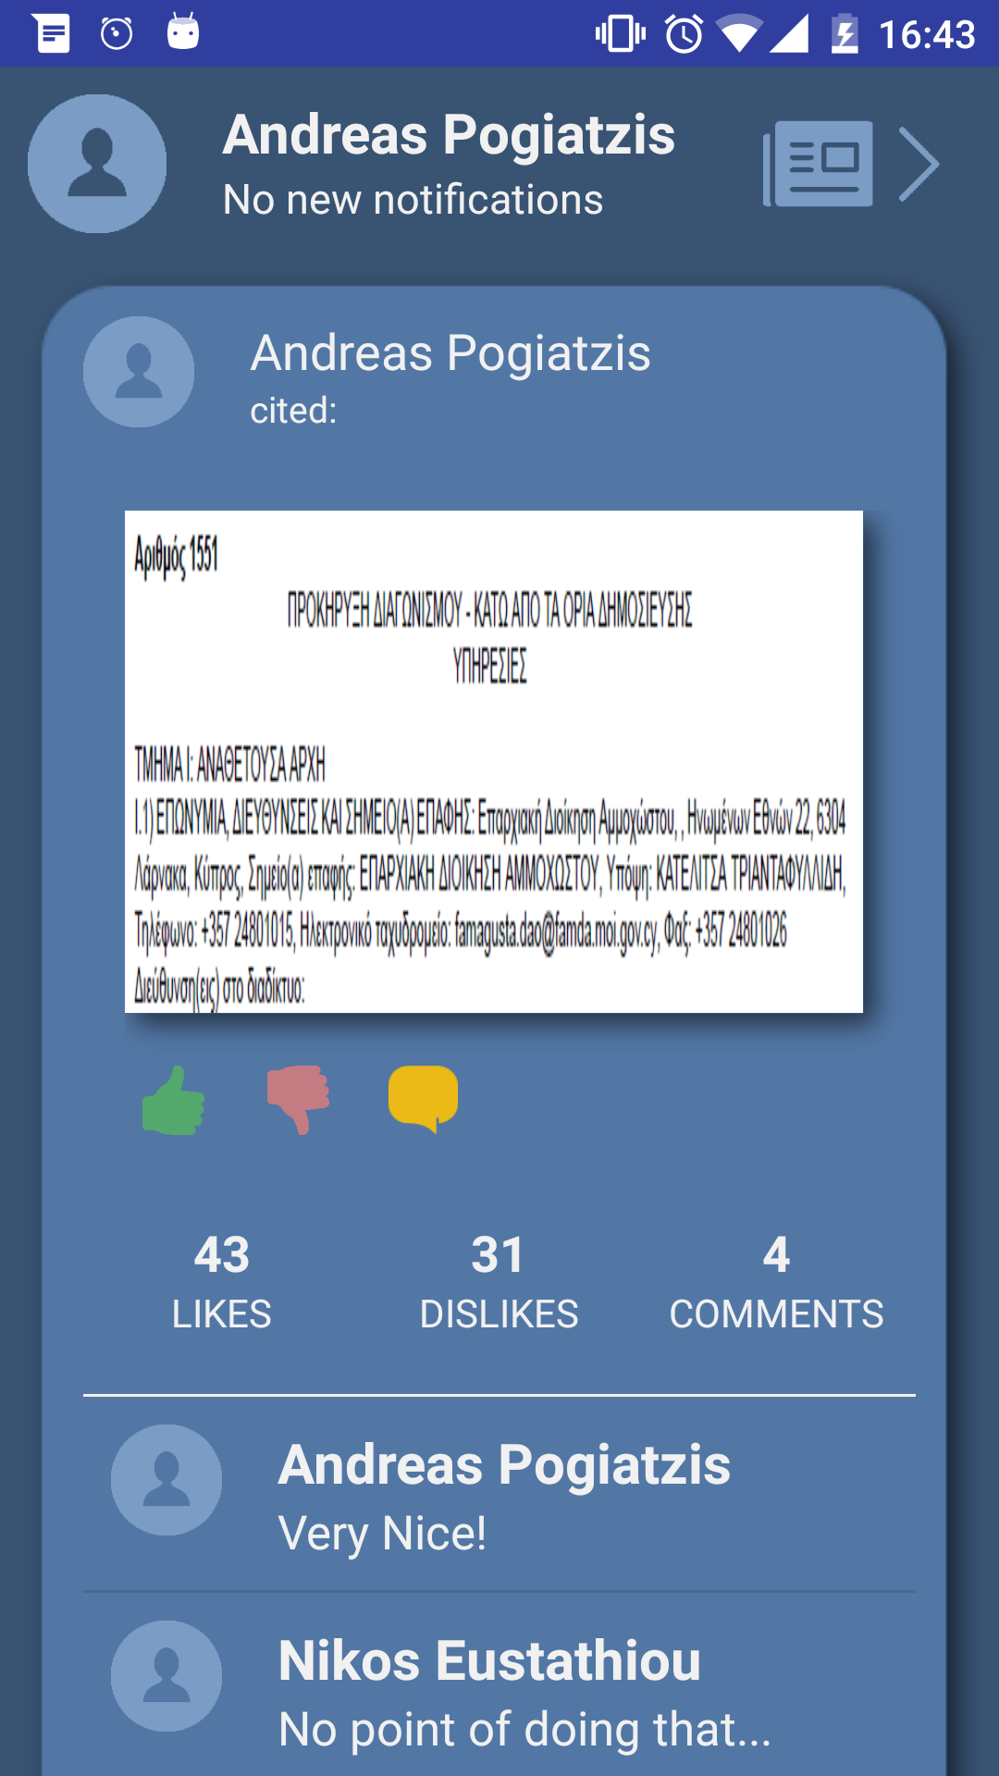
Feature: User Generated Content
(Evaluation / Comments)

Slide 6
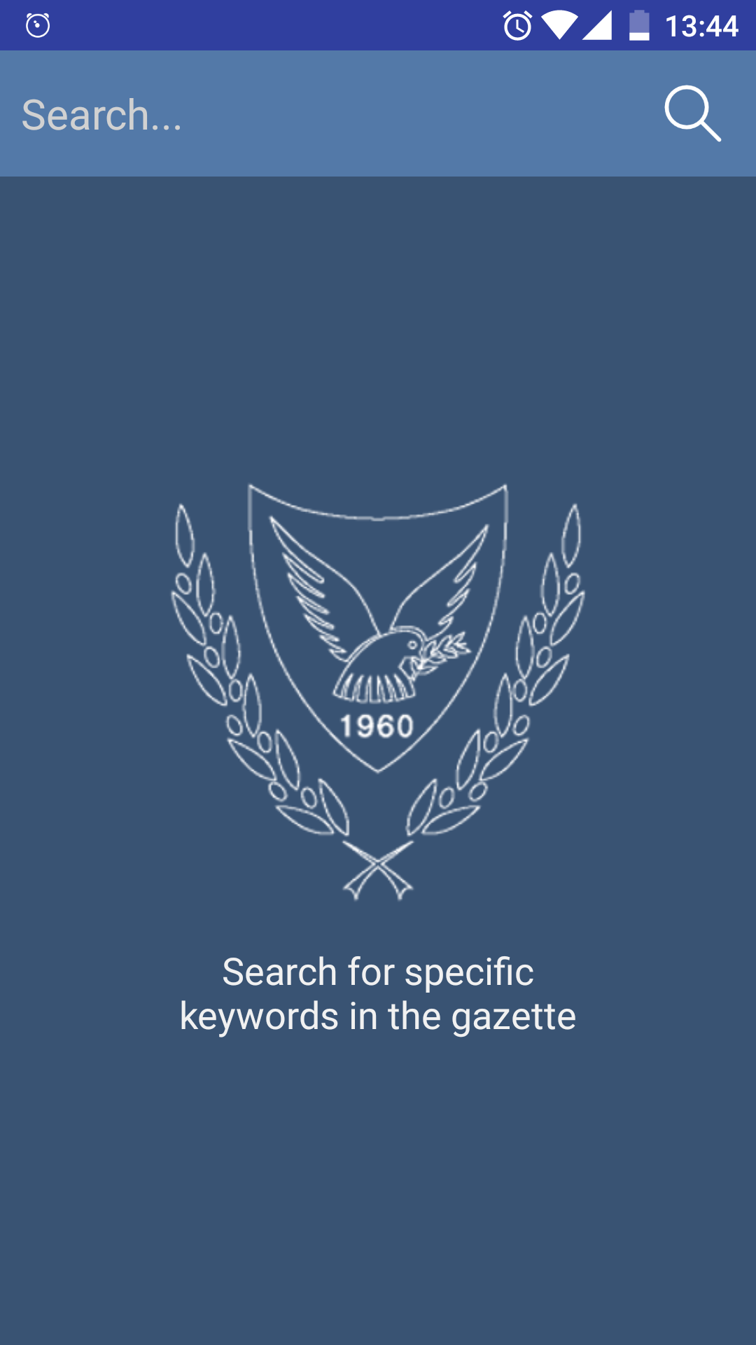
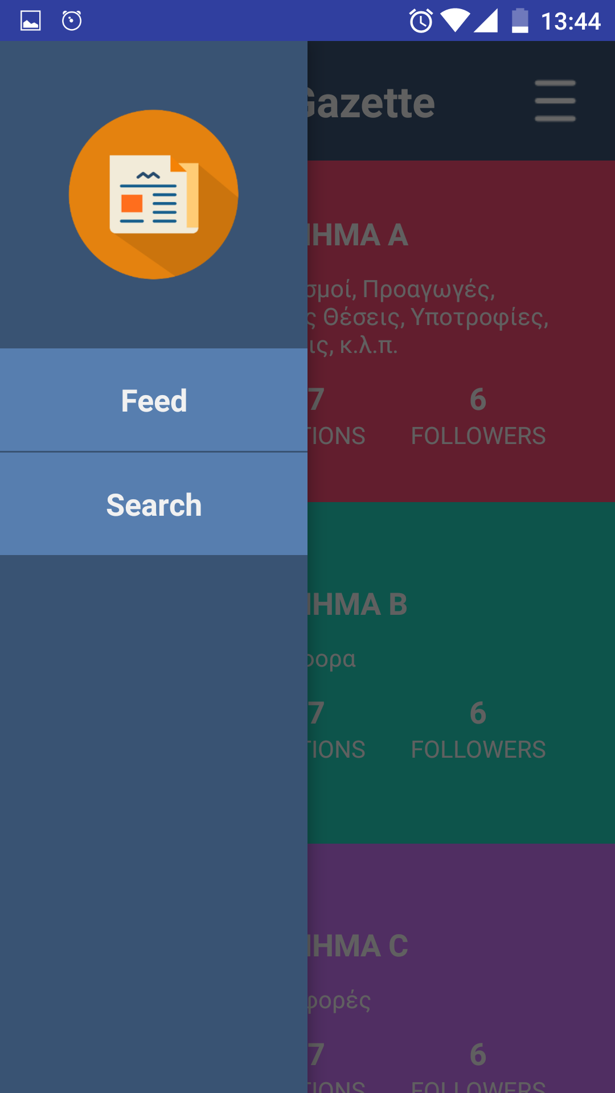
Feature: Keyword Search (Parsing)

Slide 7
Freemium Business Model
CY Gazette App is going to operate on:
a freemium business model.
BASIC FEATURES
PREMIUM FEATURES
Keyword Search (parsing)
Data Collection
User-Friendly Access
User Generated Content (Comments/Ratings)
Application Feed

Slide 8
Target Groups?
Active Citizens for information purposes
Consultation Firms / Companies for trademark searches / information on mergers and acquisitions etc.
Other Firms/Institutions
People interested in work positions, scholarships etc

Slide 9
Scalability
Data collection Analytics in the long term
Government - Publication of the CY Gazette directly to the Application
Stakeholders
Improve e-governance
AI

