Slide 1

Rock-Paper-Lose
Rigged rock-paper-scissors project on a
Raspberry PI 3
EAI - Project
Dilyara Kerimova, Peter Keszei, Andreas Ranzmaier, Raphael Suchomel
2026
Notes:
andi

Slide 2
Project overview
Rigged rock-paper-scissors: the Pi looks fair, but the outcome is decided by an accessory
Player visible to the camera, gesture classified per round
Accessory visible (default: pink wristband) -> Pi picks the gesture that loses
No accessory -> Pi picks the gesture that wins
Sense HAT LED matrix shows: countdown, Pi's pick, then full-screen green/red result
Anti-motion safeguard: countdown + sliding-window stability check

Slide 3
Hard constraints
Application implemented entirely in C++ on Raspberry Pi 3
Auto-start via systemd service (offline-capable)
All TFLite model files <= 100 MB total
Application sustains >= 30 inference runs per second
Dataset must cover different group contributes
Notes:
We will get to our stats later

Slide 4
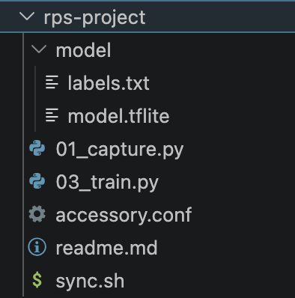
Application architecture
Python pipeline (rps-project/)
01_capture.py - Picamera2 still capture on the Pi
03_train.py - MobileNetV3Small transfer learning + int8 TFLite export
accessory.conf - HSV bounds, calibration knobs
sync.sh - rsync rps-project/ to/from Pi
systemd unit + install_service.sh for boot autostart

Slide 5
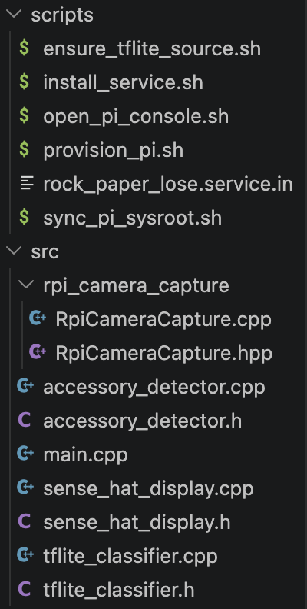
Application architecture
C++ components (src/)
main.cpp - game loop + CLI + rigging logic
RpiCameraCapture - rpicam-vid -> RGB888 frames (async)
TfliteClassifier - thin wrapper, accepts raw 0-255 RGB
AccessoryDetector - HSV mask, calibration baseline
SenseHatDisplay - direct framebuffer (RGB565), no Python
Notes:
Bis hier andi

Slide 6


Model architecture
Backbone: MobileNetV3Small (ImageNet, fine-tuned)
Input: 160x160 RGB, include_preprocessing=True (norm baked in)
Head: GAP -> Dense(64, L2) -> Dropout(0.5) -> Dense(3, softmax)
Output: rock / paper / scissors (no garbage class)
Notes:
peter

Slide 7
training
rps-project/03_train.py
Train/val split 80/20, stratified by class
Oversample minority classes to balance training set
Augmentation: random rotation/translation/zoom/brightness/contrast
Optimizer: Adam + cosine LR decay, class weights, early stopping
Export: int8 TFLite (uint8 I/O), softmax baked in -> 1.3 MB file
Notes:
peter

Slide 8
TFLite size & inferences/sec
Model file: model/model.tflite = 1.28 MB / 100 MB budget (~1.3 % used)
Headroom for adding a second .tflite (e.g. an accessory classifier) without changes
Per-round perf log printed by the binary:
[perf] 41 inferences in 1320 ms (31.1 inf/s, classify avg=22.18 ms max=31.40 ms)
Tag flips to [perf-warn] when rate falls below 30 -> trivial to grep in journalctl
Measured on Raspberry Pi 3 (Cortex-A53, 4 threads via Interpreter::SetNumThreads(4)

Slide 9
Accuracy: training vs real world
Training run summary (printed at end of 03_train.py):
Train Loss: 0.5232 | Train Accuracy: 0.7783
Val Loss: 0.7143 | Val Accuracy: 0.7535
With only 10 epochs and a batch size of 32
Stability gate hides occasional single-frame mis-reads from the user
For real world testing with group members we checked the logs and it was working good about 85% of the times
Notes:
End peter

Slide 10
Dataflow per round
1. Countdown 3 -> 2 -> 1 on LED matrix (kCountdownStepMs = 700 ms)
Player has a known moment to commit to a steady gesture.
2. Sliding-window read (kWindowSize = 8, kMinAgreeing = 5)
Skip low-confidence frames, accept once 5 of last 8 confident frames agree.
3. HSV accessory check on the same frames
Cheap cv::inRange + countNonZero -> 'present' if count > baseline * 10.
as well as a floor of pixels found at 1000
4. Pi picks based on accessory state
Accessory present -> kBeats[player]; absent -> kLosesTo[player].
5. Sense HAT: Pi's symbol (2 s) -> full green (won) / red (lost) / blue (tie) (1.5 s)
Pause 800 ms, then loop back to the countdown.
Notes:
Ab hier raphi

Slide 11
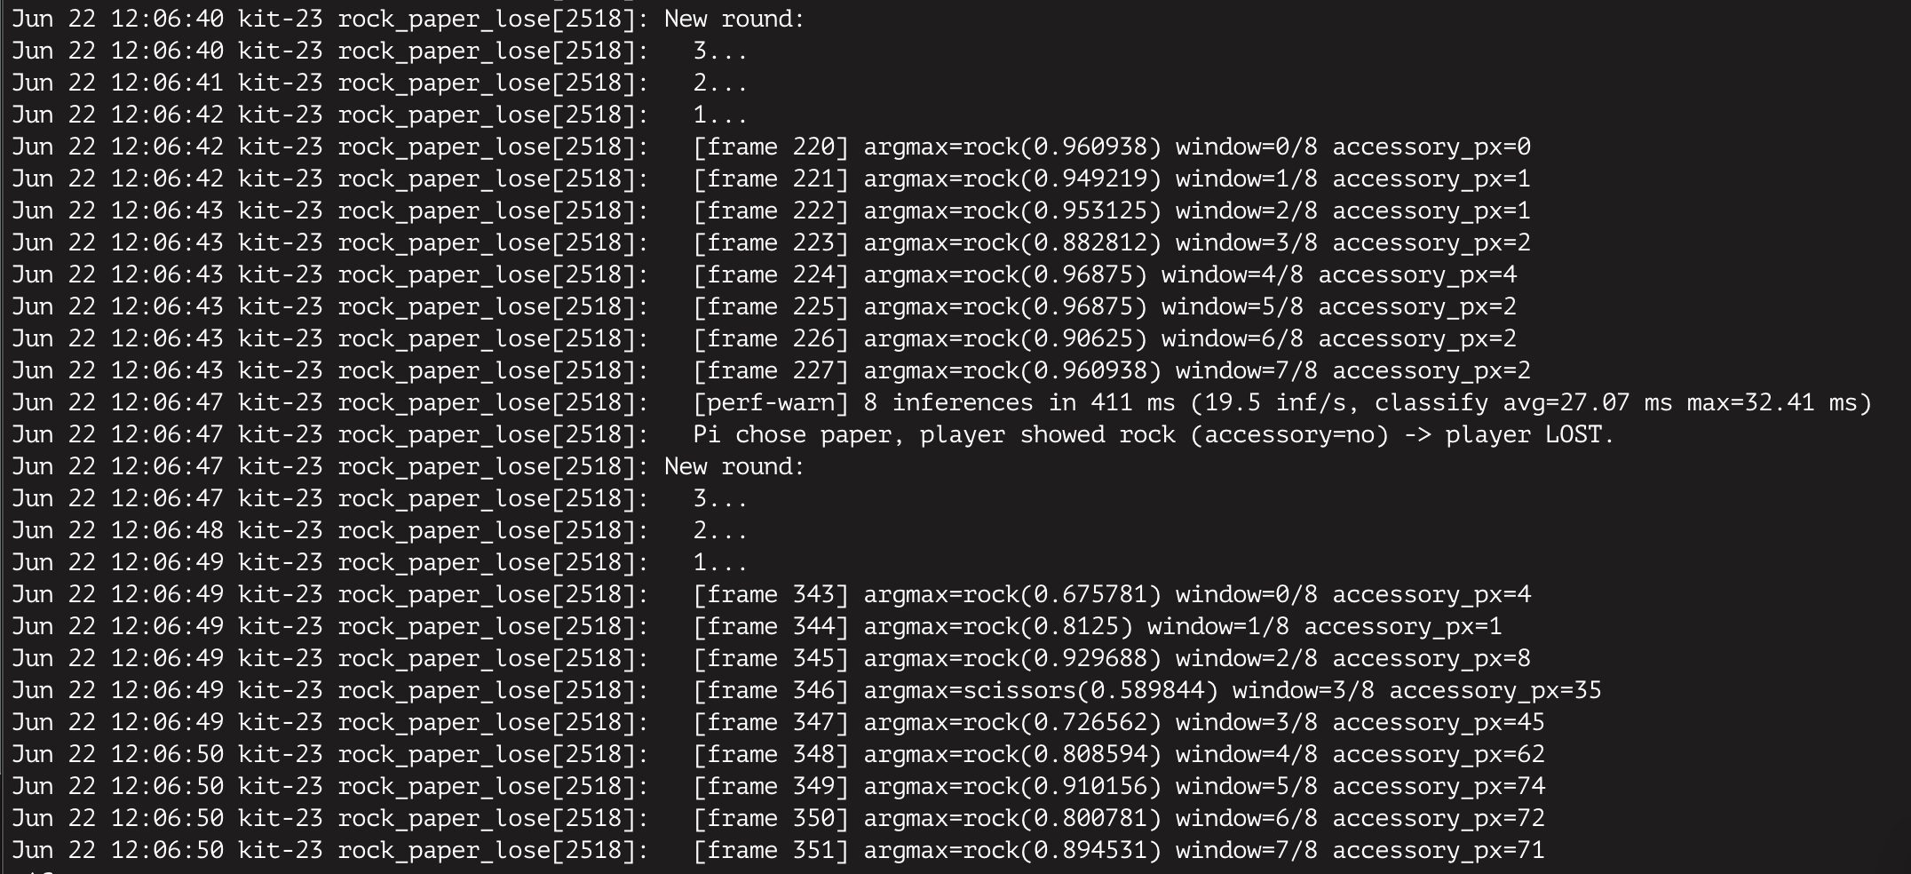
logging
Notes:
Bis hier raphi

Slide 12
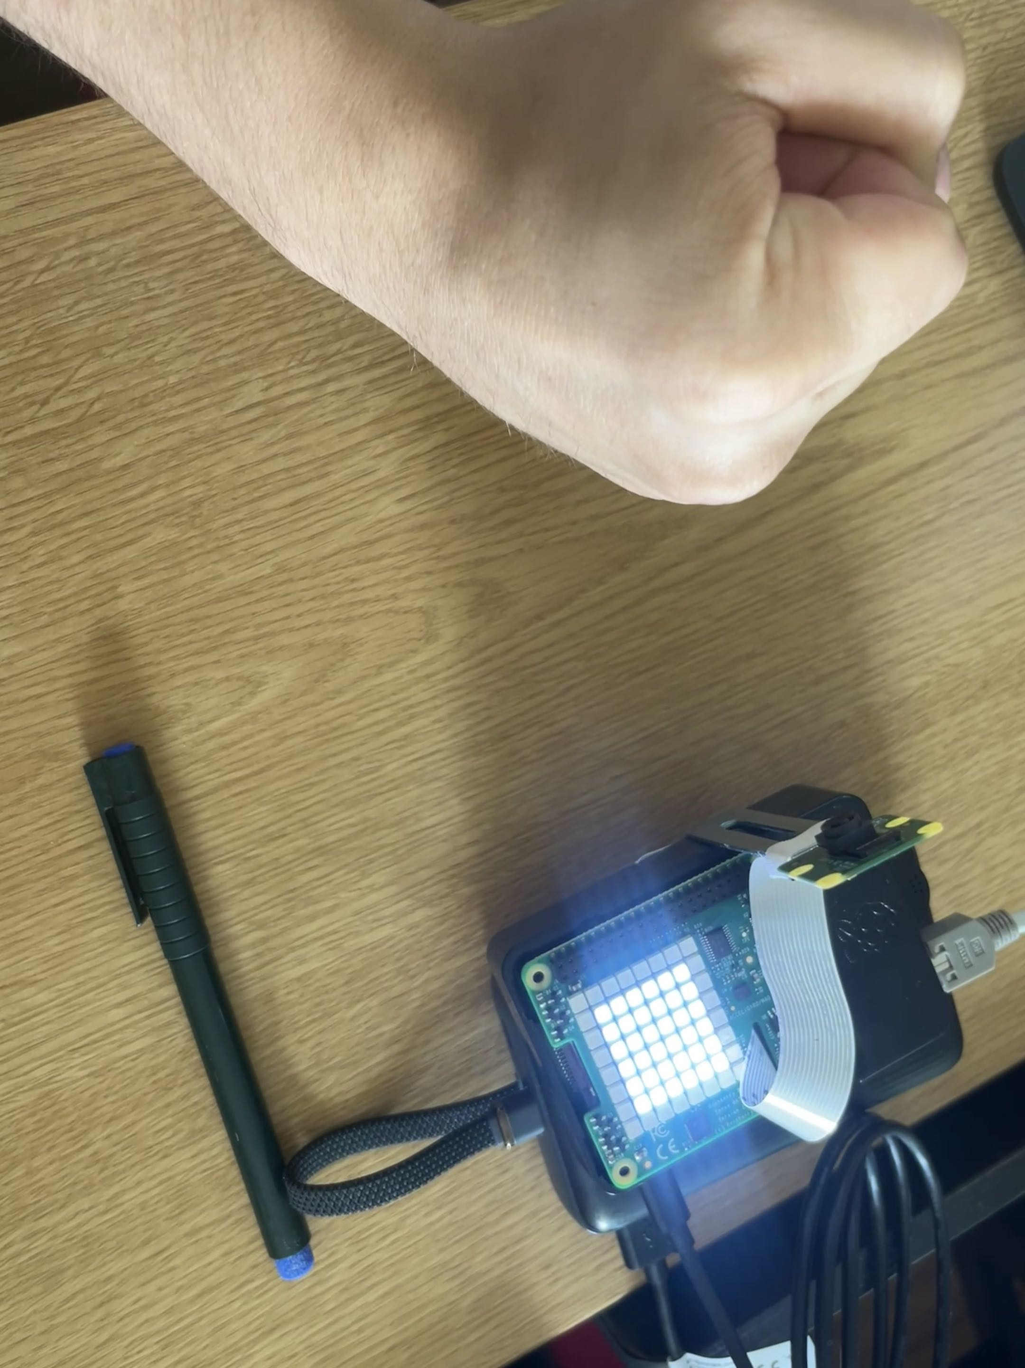
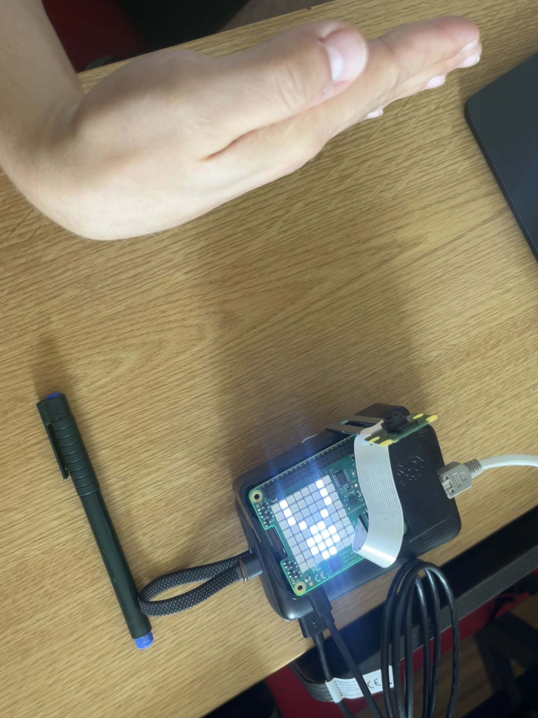
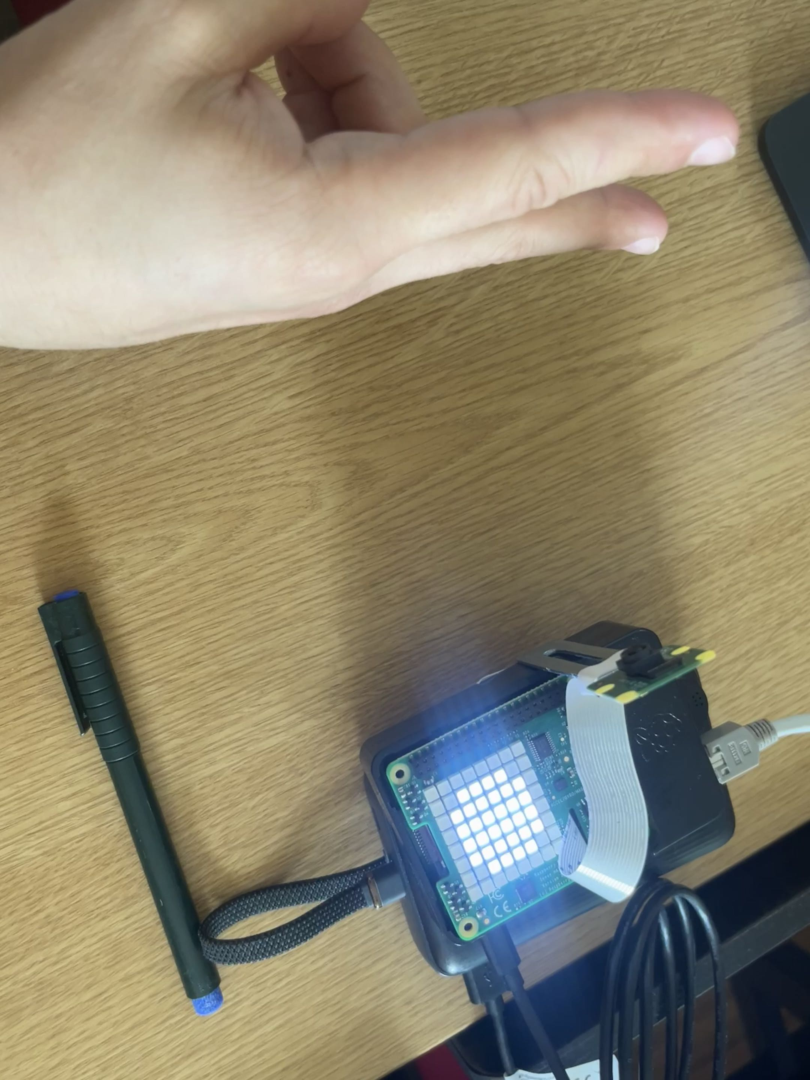

Slide 13
Accessory detection (rigging)
Goal: ONLY the chosen pink accessory enables wins
Approach: HSV mask + per-startup baseline + per-round majority vote (no second neural network needed)
Per-frame trigger: 'present' if count > max(baseline * threshold_multiplier, min_threshold)
Per-round smoothing: the gesture window also majority-votes the accessory bool, so one glitched frame cannot flip the rigging
Tunable without rebuild via accessory.conf:
Current values (pink wristband, ): H 120-175, S 35-255 V 31-183, 60 frames, multiplier 10, floor 1000 px
--no-accessory flag falls back to a fair (random) game for A/B testing
Notes:
dilyara

Slide 14
Issues & pitfalls encountered
First model (tiny custom CNN, 96x72 grayscale + CLAHE + Otsu) struggled to generalise
Swapped to MobileNetV3Small transfer learning; accuracy jumped, code path simplified
TF 2.16 TFLite converter dropped final softmax silently on Keras 3 Sequential models
Confidence scores were not normalised -> our threshold logic was off
Re-baked softmax into the new export; C++ stopped applying its own softmax
Picamera2 'RGB888' format actually returns BGR; reference Python used BGR2HSV
Our C++ uses RGB2HSV correctly -> HSV defaults need re-tuning here
Strict 4-consecutive-frame consensus was too brittle (one blurry frame reset count)
Replaced with sliding window of 8, accept >=5 agreeing, skip low-confidence frames
Devcontainer cannot reach the Pi network -> Mac drives all rsync/ssh; sysroot pulled once

Slide 15
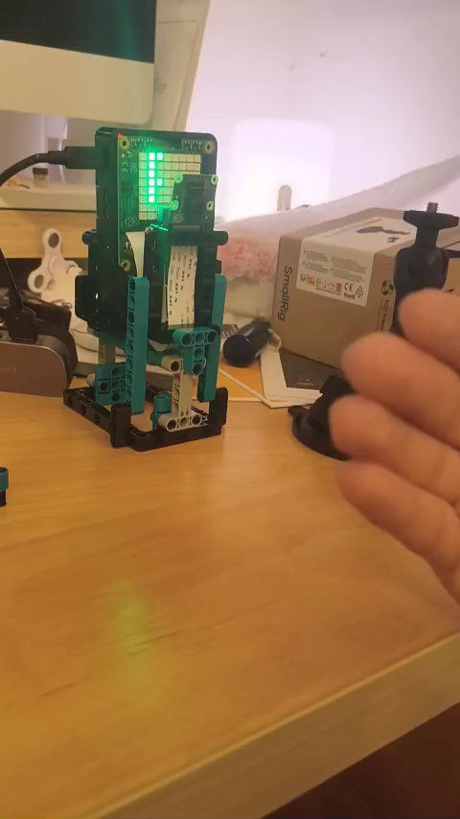
demo

Slide 16
Thanks for your attention!

