Slide 1
Capstone Project Coffee, Tee, Mate and Seasoning Import and Export Austria Prediction
Andreas Ranzmaier and Lea Treml
Second DRAFT

Slide 2
Team
Andreas
Data Preprocessing
ML & Neural
Analysis
Main Coder
Lea Treml
Baseline & Statistical
Documentation
Analysis
Pitchdeck

Slide 3
Problem
Import values rising – why?
Demand growth vs. price inflation unclear
No reliable short-term forecast for planning
Risk of wrong economic & business desc

Slide 4
Solution
Clean & Inflation-adjusted data
Analyze seasonality, trend and stationairy
Compare baseline, statistical, ML and neural models
Product short-term forecasts up to Jan 2026

Slide 5
Data Source
https://www.statistik.at/statistiken/internationaler-handel/internationaler-warenhandel/importe-und-exporte-von-guetern
STATcube Außenhandle ab 2007; KN 2-Steller
We decided to go for 5 years (except the 3 months that were not yet available for 2025) so 2021 to 2025 monthly data
Section 9: Coffee, Tea, Mate, Spices
Quantities (kg) and values (EUR)

Slide 6
Data Engineering
Cleaned raw CSVs and reordered months
Standardized timestamps and column names
Converted values to real 2025 value of euro

Slide 7
Modelling
Baseline: Naive, Seasonal Naive, Historic Average
Statisitical: Random Walk, ARIMA, Auto-ARIMA
ML: Linear, Ridge, Random Forest, Gradient Boosting
Neural: RNN, MLP, N-Beats, NHITS
Baseline for performance floor
Stat fr trend & seasonality
ML nonlinear
Neural more complex dynamically (?)

Slide 8
Evaluation
Time-based split
Train, Val, Test splits
Metrics: MAE, RMSE, MAPE, R2, OPE
Visual forecast comparison

Slide 9
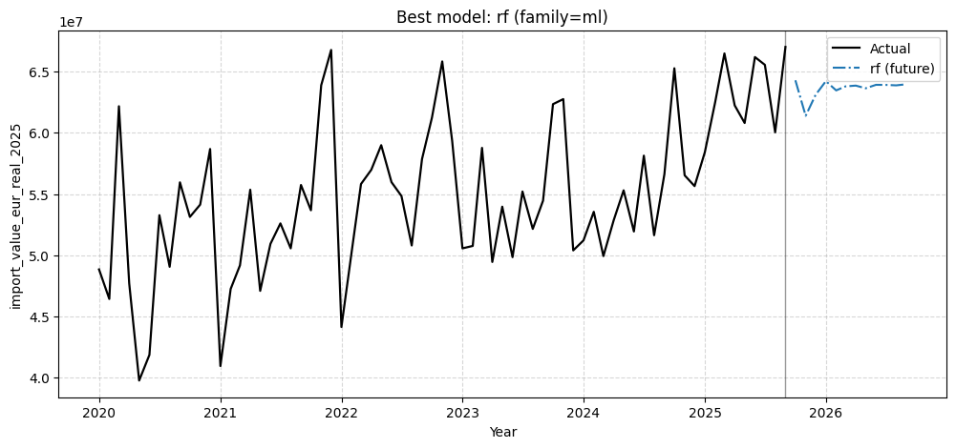
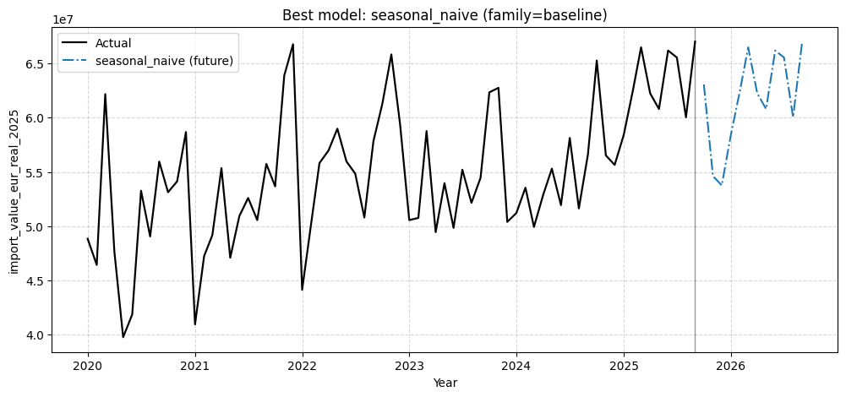
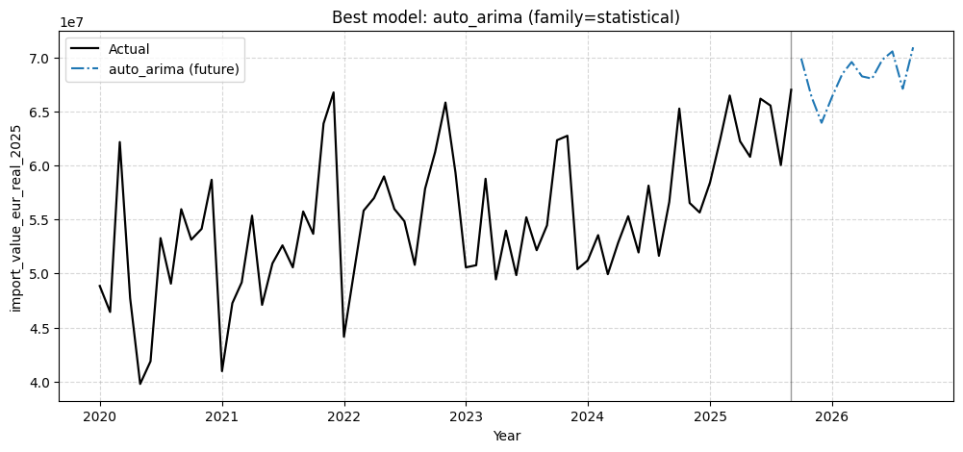
Best Performing Models
Auto-ARIMA
Random Forest
Seasonal Naive

Slide 10
Forecast
Auto-ARIMA: seasonal decline
RF: smooth, conservative forecasts
Seasonal Naive: strong monthly swings
Higher uncertainty at seasonal transitions
Strong historical seasonality
October 2025 data enables partial validation
Multiple models provide robustness

Slide 11
Value
Better import planning
Seperation on demand vs. price effects
Reduced risk from assumptions
Data-driven economic interpretation

Slide 12
Thx for attention
Notes:
Inflation drives value growth more than demand
Simple models can be surprisingly strong
Combining model families yields reliable forecasts
Clear value for policy and business decisions

