Slide 1
Neo4j.rb
The Revival of a New Type of Object Database
Andreas Ronge
@ronge

Slide 2
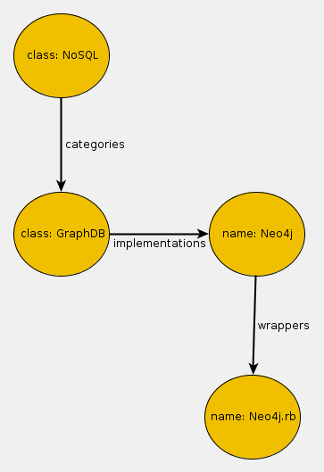
Neo4j, Graph Database ?

Slide 3
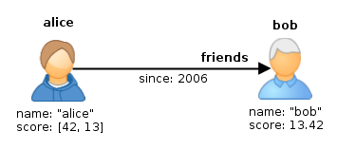
Graph Database:
Node, Relationship & Properties

Slide 4

Graph DB vs. RDBM
People
name: andreas
a=
id | name
1 | andreas
2 | peter
Friends
friend
since: 2002
id | p1_id | p2_id | since
1234 | 1 | 2 | 2002
name: peter
b=

Slide 5
So what ?

Slide 6
NO JOINs
Efficient Retrieval of Relationships of any Depth
alice.outgoing(:friends).incoming(:knows).depth(:all)
Speed Independent of Database Size !

Slide 7
NO foreign keys
Natural API to persist relationships:
Relationship.new(:friends, alice, bob)
# same as
alice.outgoing(:friends) << bob

Slide 8
NO need to declare two way relationships
r = Relationship.new(:friends, a, b)
# A relationship has always a start and end node
r.start_node => a
r.end_node => b
# A node has incoming and outgoing relationships
r == b.rel(:incoming, :friends)
r == a.rel(:outgoing,:friends)

Slide 9
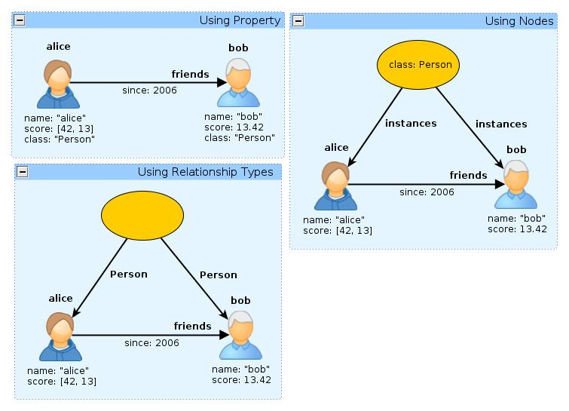
NO Schema
Self Describing Structures

Slide 10
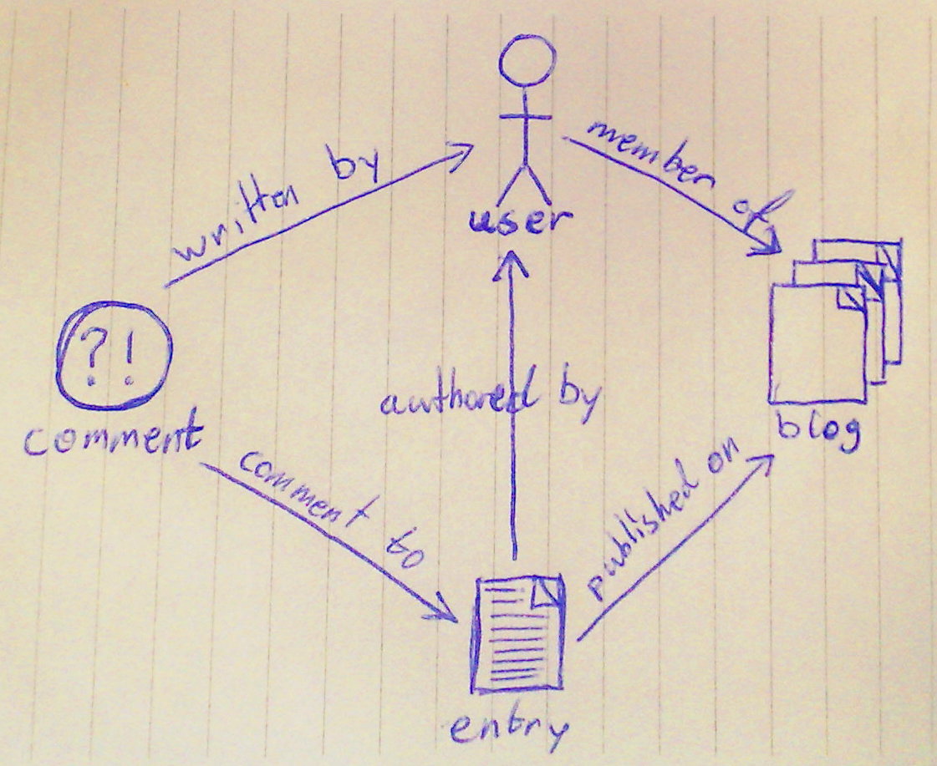
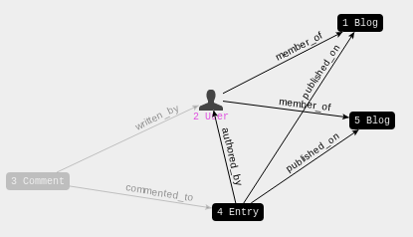
NO Schema
Self describing structures
White board friendly
Pen and Paper
neo4j-admin gem

Slide 11
NO Schema
Self describing structures
Less need to know the structure in advanced
  Can add relationships/properties on any node at any time.
Less migration of data pain
  No need to update everything because a schema has changed.

Slide 12
NO Problem Storing
Data Structures
Easy to store any Data Structures as Graphs
  Forest/Trees, linked list, hash maps …
  Product Trees, Waiting lists, …

Slide 13
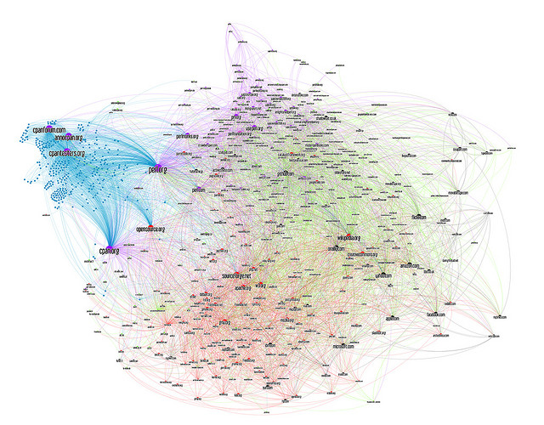
NO problem storing Graphs :-)

Slide 14
What can I use a Graph Database for ?

Slide 15
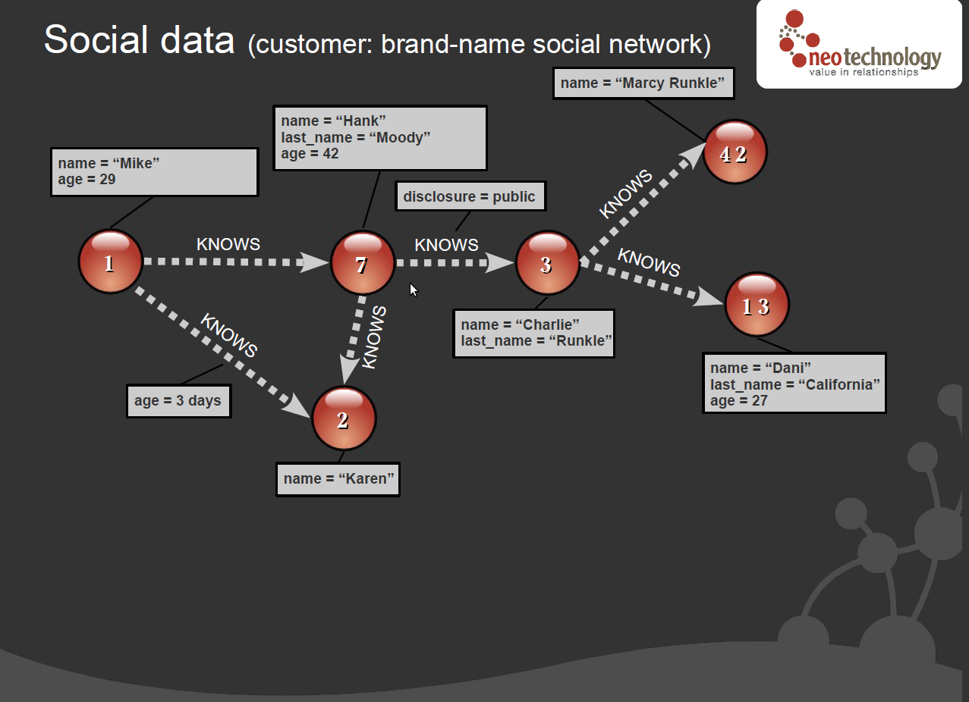

Slide 16
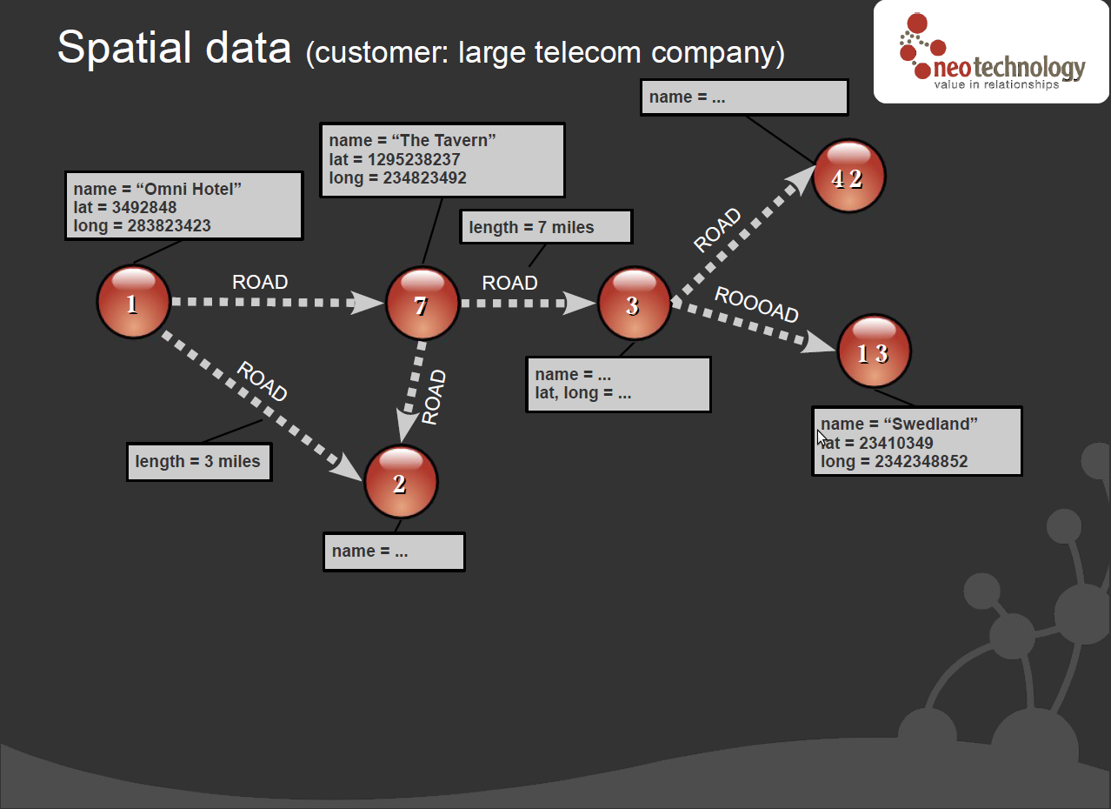

Slide 17
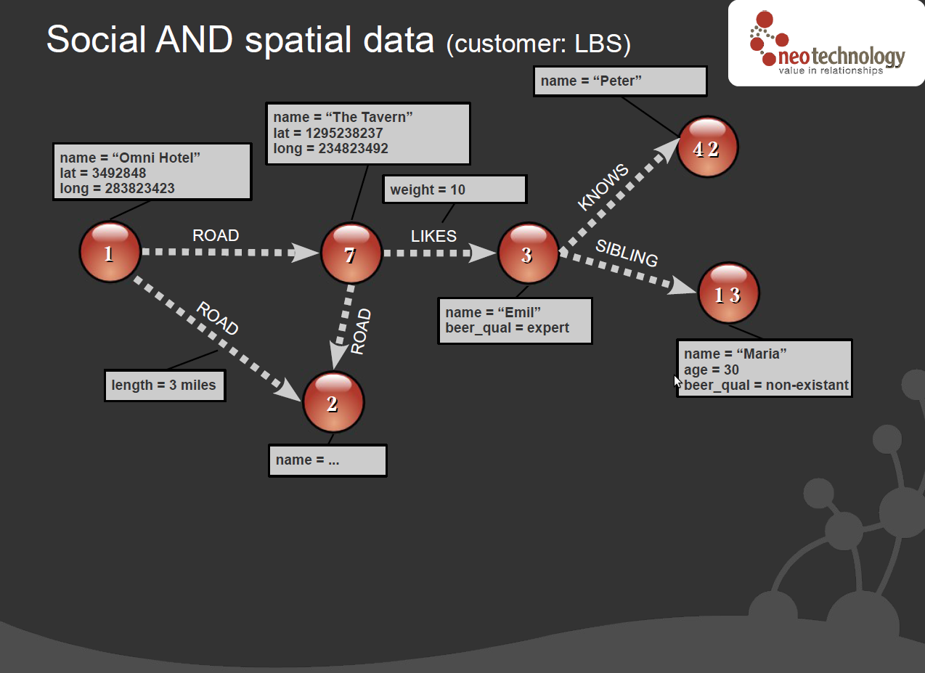

Slide 18
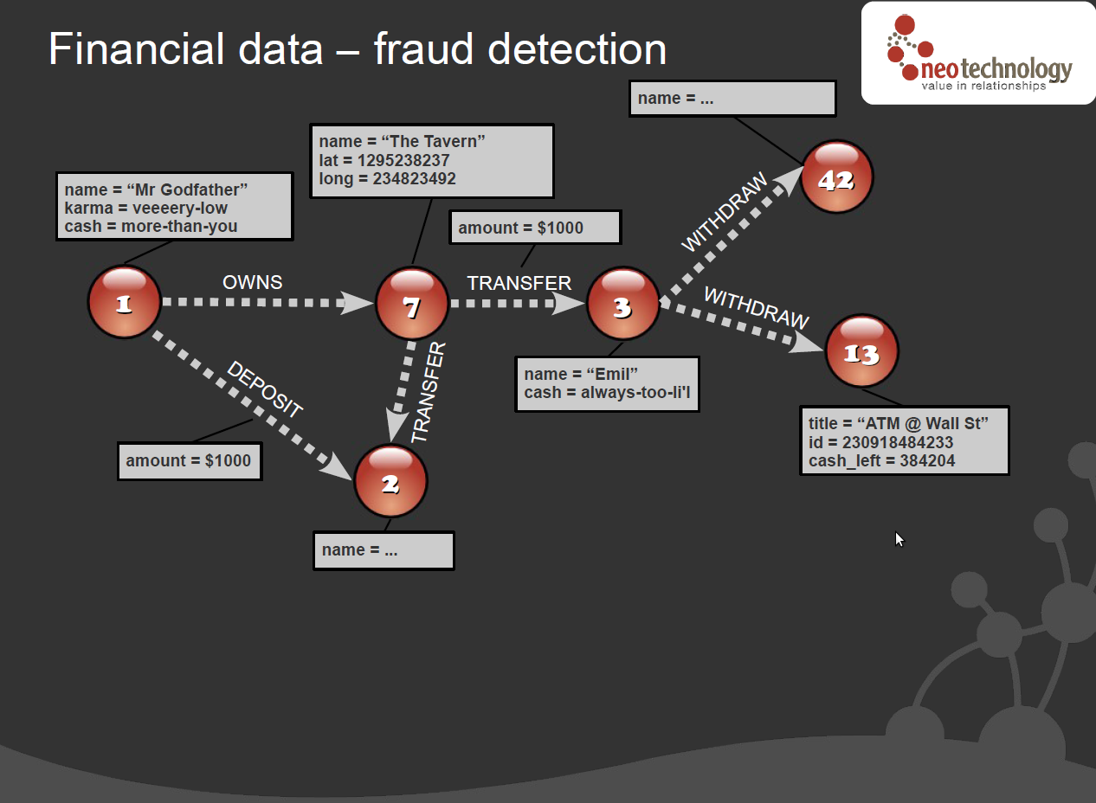

Slide 19
What does Neo4j Provide ?
Neo4j Embedded Database, API: Java
  Used by Neo4j.rb
  No database server needed - it's embedded !
Neo4j-Server, API: REST
  Used by the neography gem and other languages bindings
ACID transaction
Lucene Document DB
Graph Algorithms
Cypher Query Language
High Availability Clustering

Slide 20
Why Neo4j.rb
Why not call the Java API directly ?
db =Java::OrgNeo4jKernel::EmbeddedGraphDatabase.new
db.create_node
It should:
  Feel Rubyish (neo4j-core)
  Be an Object Oriented DB (neo4j-wrapper)
  Implement Rails Active Model (neo4j)

Slide 21
Neo4j.rb Architecture
Active Model Compliant API
Neo4j::Rails::Model
Neo4j::Rails::Relationship
neo4j
An Active Model impl.
Active Record subset
neo4j-wrapper
Mapping Layer to Ruby Classes
Neo4j::NodeMixin
Neo4j::RelationshipMixin
Neo4j as an Object Database
Nice Ruby API,
Traversals
Graph Algorithms, Cypher DSL
Mapping to Java API
Neo4j::Node
Neo4j::Relationship
neo4j-core

Slide 22
How I wrap the Neo4j Java API
Step 1, the new method
module Neo4j
class Node
def self.new(props)
@db ||= Java::OrgNeo4jKernel::EmbeddedGraphDatabase.new(..)
@db.create_node(props)
end
end
Node.new #=> returns a Java Neo4j Node object

Slide 23
How I wrap the Neo4j Java API
Step 2, Java → Ruby Feel
Java::OrgNeo4jKernelImplCore::NodeProxy.class_eval do
include NodeMethods
end
module NodeMethods
def class
Neo4j::Node
end
def [](prop_name) ...
End
Node.new.class #=> Node :-)

Slide 24
How I wrap the Neo4j Java API
Step 3 - Pretend we don't do any magic
Java::OrgNeo4jKernelImplCore::NodeProxy.class_eval do
include NodeMethods
end
# include the mixin twice !
class Node
include NodeMethods
def self.new ...
end

Slide 25
How I wrap the Neo4j Java API
Step 4, Java Doc => YARD/RDoc
class Node
# @params ...
def get_relationships; end
end

Slide 26

ACID Transactions

Slide 27
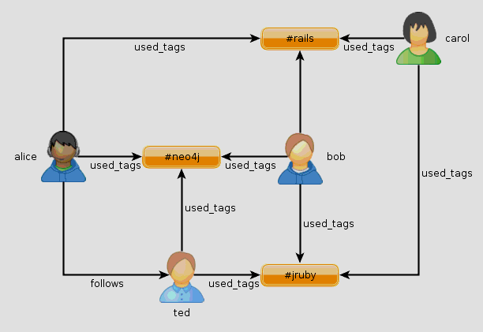
Example using neo4j-core
Recommendation

Slide 28
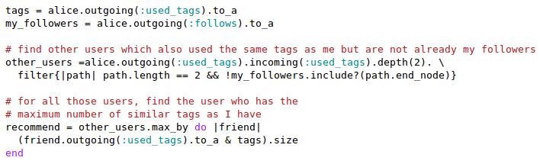

Slide 29

Using Cypher or Cypher DSL
START alice=node(1)
MATCH alice-[:used_tag]->(tag)<-[:used_tag]-user
WHERE not(alice-[:follows]-user)
RETURN user, count(tag) ORDER BY count(tag) DESC
Test it ! http://tinyurl.com/7zzad7t

Slide 30
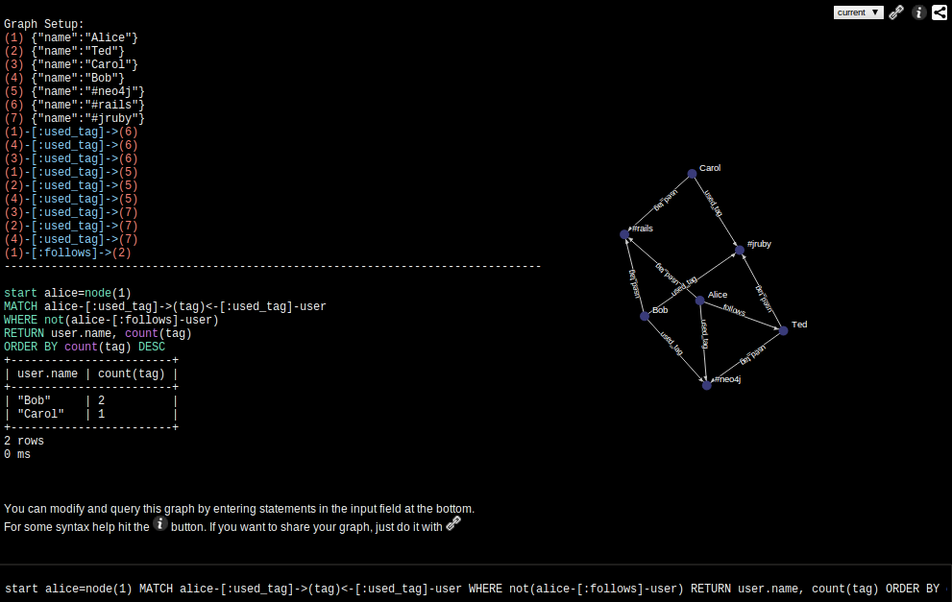
http://tinyurl.com/7zzad7t

Slide 31
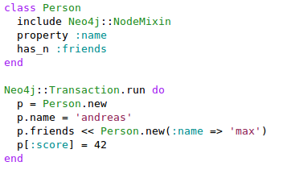
Neo4j – Object Oriented DB ?
Neo4j-wrapper

Slide 32
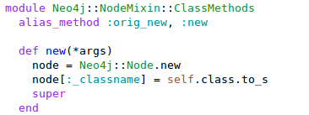
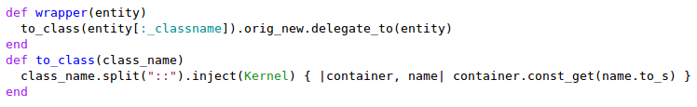
How is this implemented ?
Writing Nodes/Relationships Relationships
Loading Nodes

Slide 33
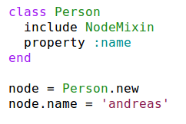
Object Oriented Mapping
A Neo4j Node
Ruby Class
_classname: "Person"
name: "andreas"

Slide 34
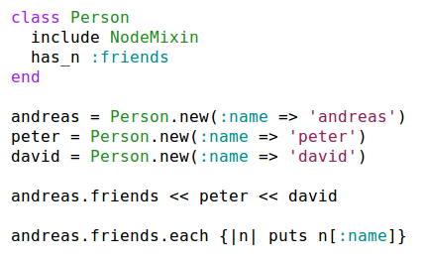
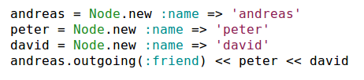
Ruby Class Mapping:
Relationships
name andreas
friend
friend
name peter
name david

Slide 35




Incoming Relationship
Same relationship different direction
_class = Actor
name = 'keanu'
_class = Movie
name = 'matrix'
acted_in
Same

Slide 36
Optional - Declaring a Type
class Person
include Neo4j::NodeMixin
property :age, :type => Fixnum
has_n(:friends).to(“Person”)
end

Slide 37
How do I find things ?
Start from Reference Node and Traverse
Create an (domain) in-graph index
Use Lucene

Slide 38
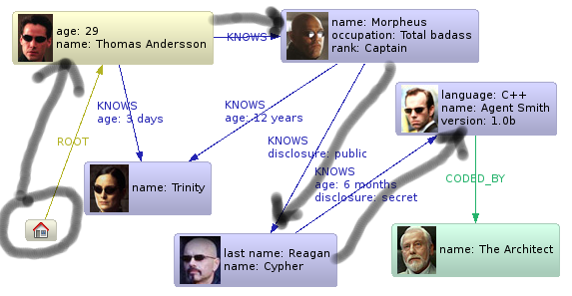

Reference Node and Traverse
Example: Find Thomas Andersson

Slide 39
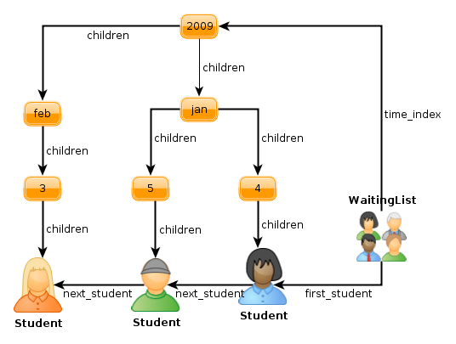
In-Graph Index
Add Extra Nodes/Relationship to guide Traversing

Slide 40
Lucene
Full-featured text search engine
Features
    Phrase queries, wildcard queries, proximity queries, range queries and more
    Ranked searching
    Sorting
    Date-range
    Sorting by any field

Slide 41
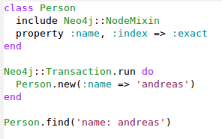
Lucene in Neo4j.rb

Slide 42
Neo4j gem - Active Record
“drop in” replacement (almost)
Callbacks, Observers
Validation
Timestamps
accepts_nested_attributes_for
Aggregations#composed_of
Similar finder syntax, e.g. find_or_create_by

Slide 43
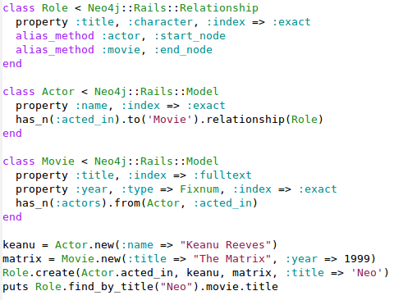

Slide 44
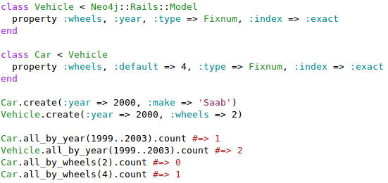
Inheritance

Slide 45
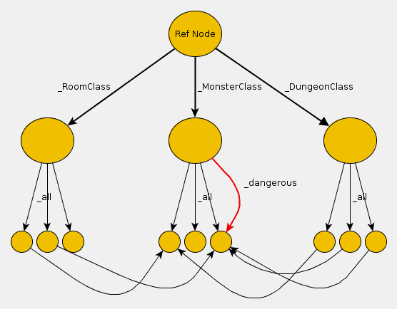
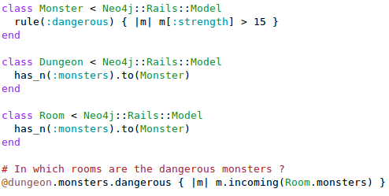
Rules and Cypher

Slide 46
Summary
New way of Thinking
  Your graph/domain is your index
  Fun – lots of possibilities
When should I use Neo4j ?
  Example: Query Problem ? Can it be solved by traversing a graph instead ?
Use Neo4j as a Object Database ?
  Pros: No migrations, natural mapping, query by using plain Ruby
  Cons: Less Tool Support, e.g. all gem doesn't works with neo4j
Future for Neo4j.rb ?
  Improve the Neo4j-Rails integration
  In-graph indices, e.g. sorted trees, spatial index, linked list
Notes:
As you can see Neo4j.rb is like an Object Database
except that it does not have a query language
The two main benefits of the Graph Database are that it's natural to express the requirements in code (just like an Object Database) since often the real world is best expressed as a graph. You don't need to ruin model that the customer described by putting it in tables.
The other benefit is the traversal pattern. As you saw in the previous slide it is easy to express algorithms for things like an recommendation engine with traversals. It is still possible to do this in SQL (since you only need two joins) but I think it is more natural expressed as traversals. Also the traversal speed will remain the same regardless of the depth of traversal or the number of nodes.

Slide 47
When should I use a Graph Database ?
Many optional attributes or many different relationships ?
Need to persist data structures ?
SQL queries that span many table joins ?
Need to solve graph related problems ?

Slide 48
Kvitter Domain
Tweet
User
tweeted
mentions
(mention_from)
links
used_tags
tags
(tweets)
(tweets)
(redirected_link)
Tag
Link

Slide 49
Kvitter Domain
Tweet
User
tweeted
mentions
(mention_from)
links
used_tags
tags
(tweets)
(tweets)
(redirected_link)
Tag
Link

