Slide 1

Neo4j.rb
Graph Database
The Natural Way to Persist Data ?
Andreas Ronge
Notes:
I'm going to talk about one of the most popular graph databases - neo4j, and of course the ruby binding - neo4j.rb which I have written over the last few years.

Slide 2
Agenda
Background, NOSQL and Neo4j
The Graph Database Foundation
The Neo4j.rb API
Demo

Slide 3
NOSQL
The problem with SQL: not designed for
    Accelerating growth of data
    Huge clustered environments
    Complex and evolving data models
Choose the right tools - Not Only SQL

Slide 4
The CAP Theorem
Can't achieve all three, pick two
    Consistency – all readers will see the same write
    Availability – tolerant of node failures
    Partition tolerant – if lost interconnect between nodes
Many NOSQL databases choose
    Sacrifice consistency over availability
    Eventual consistency instead of ACID (but not Neo4j)

Slide 5
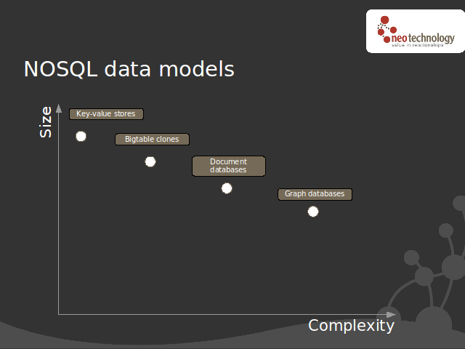

Slide 6
Some Neo4j.rb Use Cases
My last 3 projects using Rails & Neo4j.rb:
  Optimization in an organization
    Organization Facilities Users Work Orders
  Analysis complex & huge amount of data
    Evaluate the quality of a mobile network from drive tests
  Simulation
    Risk assessment of critical infrastructures contingency plans
Complex graphs are easy to find

Slide 7
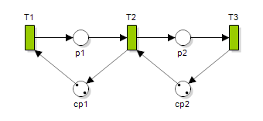
Petri Nets
Nodes represent transitions
  Events that may occur, signified by bars
  Places (i.e. conditions, signified by circles).
The directed arcs describe which places are pre- and/or postconditions for which transitions (signified by arrows).

Slide 8
How can I talk to Neo4j ?
Embedded with JRuby
  Ruby Gems: neo4j.rb, neo4jr-simple
  Ruby Gems: pacer
    friends.out_e(:friend).in_v(:type => 'person').except(friends).except(person).most_frequent(0...10)
Neo4j Server - HTTP/REST
  Ruby Gems: neography

Slide 9
Ruby Crash Course
[] - new Array
{} - new Hash, ex. {'a' => 1, :b=> 'foo'}
[]= Assignment, ex. a={}; a['foo']=2
Symbols, ex. a={}; a[:foo] = 2
Blocks, ex. Transaction.run {}
def foo
yield 1
yield 2
end
foo {|x| puts x } # skriver ut 1 och 2

Slide 10
What is a Graph Database ?

Slide 11

Graph DB vs. SQL
People
name: andreas
id | name
1 | andreas
2 | peter
Friends
friend
since: 2002
id | p1_id | p2_id | since
1234 | 1 | 2 | 2002
name: peter

Slide 12

Graph DB vs SQL

Slide 13
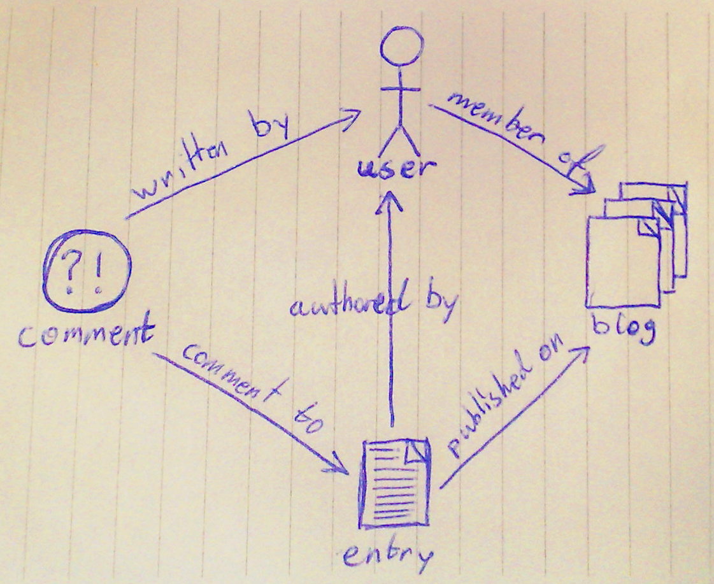
Benefit 1
Domain Modeling

Slide 14
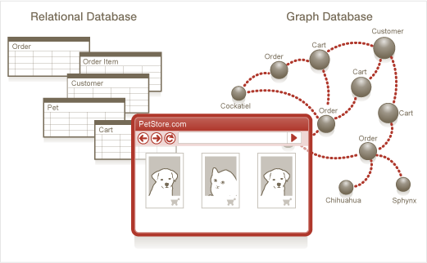
Benefit 2
No O/R mismatch
Notes:
The left picture is actually a picture generated by the NeoEclipse – a tool for visualize the graph

Slide 15
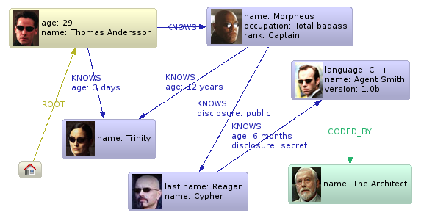
Benefit 3
Semi-structured information

Slide 16
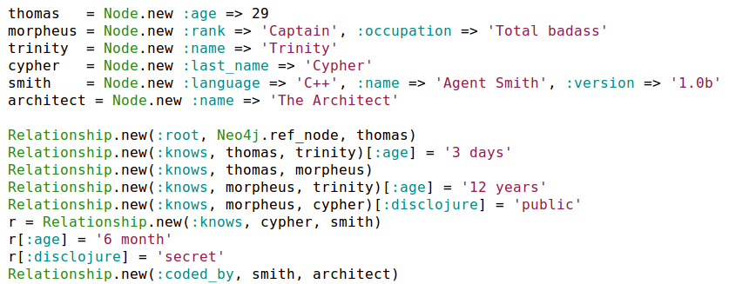

Slide 17
Benefit 4
No Schema

Slide 18
Benefit 5
Deep traversals
Does Thomas Andersson know someone [who knows]* called Agent Smith ?
thomas.outgoing(:knows).depth(:all).find{|node| node[:name] == 'Agent Smith'}

Slide 19
What does Neo4j.rb provide ?
The Embedded Java Neo4j
    Nodes, Properties, Relationship, Traversals
    ACID Transactions
    Lucene Integration
    Graph Algorithms
    High Availability Clustering
Neo4j.rb
    Object Oriented Mapping
    “Drop in” replacement for Rails Active Model
    Improved/extended API (lucene, rules, migrations,...)

Slide 20
Neo4j.rb Architecture
Active Model Compliant API
Neo4j::Rails::Model
Neo4j::Rails::Relationship
Mapping Layer to Ruby Classes
Neo4j::NodeMixin
Neo4j::RelationshipMixin
Mapping to Java API
Neo4j::Node
Neo4j::Relationship

Slide 21
Kvitter Domain
Tweet
User
tweeted
mentions
(mention_from)
links
used_tags
tags
(tweets)
(tweets)
(redirected_link)
Tag
Link

Slide 22
Embedded
Easier to install, deploy & test
Is running in same thread as your application
No network connection to DB needed
No Database Tier

Slide 23
Embedded DB =
Direct Access to Data
With Neo4j::NodeMixin
Neo4j::Transaction.run do
Person.new(:name => 'foo')
end
With Neo4j::Rails::Model
person = Person.new(:name => 'foo')
person.save # callbacks/validation

Slide 24

Transactions
ACID
    atomicity, consistency, isolation, durability
    only write locks, no read locks

Slide 25
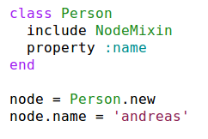
Object Oriented Mapping
A Neo4j Node
Ruby Class
_class: Person
name: andreas

Slide 26
How do I find things ?
Start from Reference Node
Graph as an Index
Use Lucene

Slide 27
Reference Node
Find Thomas Andersson
Neo4j.ref_node.outgoing(:root).first
REF_NODE
Thomas
Andersson
root

Slide 28
Use the Graph as an Index
RefNode
B
A
A
name andreas
name anders
name bertil
Neo4j.ref_node.outgoing('A').each {...}

Slide 29
Lucene
Full-featured text search engine
Features
    Phrase queries, wildcard queries, proximity queries, range queries and more
    Ranked searching
    Sorting
    Date-range
    Sorting by any field

Slide 30
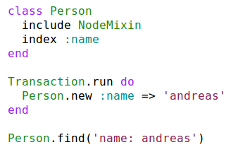
Lucene in Neo4j.rb

Slide 31
NodeMixin
Lucene Integration
Accessors for properties
Accessors for relationships
Migrations
Works with inheritance

Slide 32
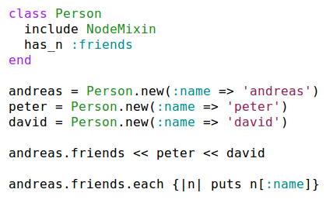
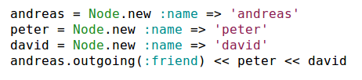
Ruby Class Mapping:
Relationships
name andreas
friend
friend
name peter
name david

Slide 33




Incoming Relationship
Same relationship different direction
_class = Actor
name = 'keanu'
_class = Movie
name = 'matrix'
acted_in
Same

Slide 34
Ruby on Rails/Active Record
“drop in” replacement

Slide 35
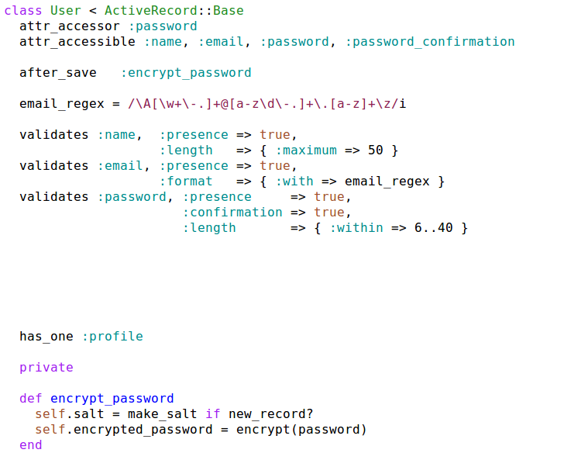

Slide 36
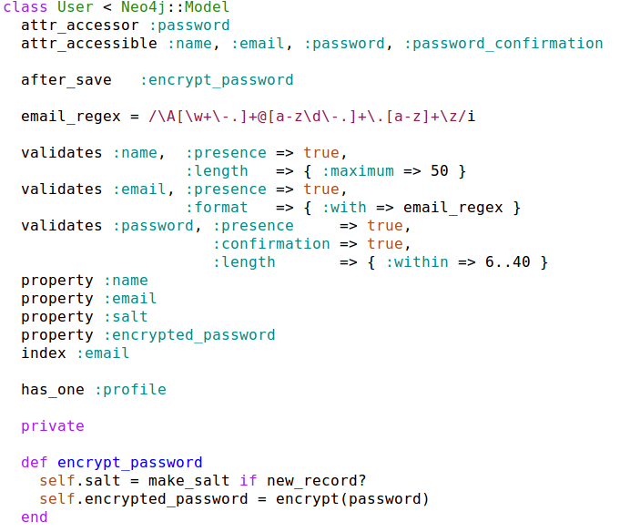

Slide 37
Active Record like API
Examples:
Create Relationship
actor = Actor.new
matrix = actor.acted_in.build(:title => 'matrix')
actor.save
Find Relationships
rel = actor.acted_in.find(matix) # ret Neo4j::Rails::Relationship
rel[:role] = 'trinity'
actor.save
Delete Relationship
actor.acted_in.delete(matrix)
actor.acted_in.destroy_all
Updated relationships in nested forms
using accepts_nested_attributes_for :acted_in
actor.update_attributes(:acted_in_attributes => {...})

Slide 38
Mapping Relationships
class Role < Neo4j::Rails::Relationship
property :role_name
index :role_name
end
class Actor < Neo4j::Rails::Model
has_n(:acted_in).relationship(Role)
end
actor = Actor.new
# create a node but return the relationship -
# use the “_rels” accessor
role = actor.acted_in_rels.build(:title => 'matrix')
role.role_name = 'trinity'
role.save!
role = Role.find_by_role_name('trinity')
role.start_node #=> actor
role.end_node #=> the created matrix node

Slide 39
A Common Problem
I have a
    System already in production
    Huge database
I need to
    Change the structure of the database
Solution:
    Migrations

Slide 40
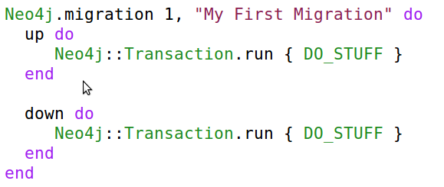
Migrations: Direct

Slide 41
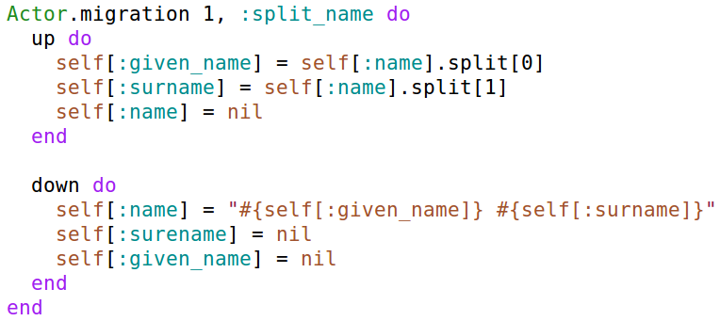
Migrations: Lazy
(Neo4j::LazyMigrationMixin)

Slide 42
Migrations is NOT needed
when developing
unlike Active Record migrations

Slide 43
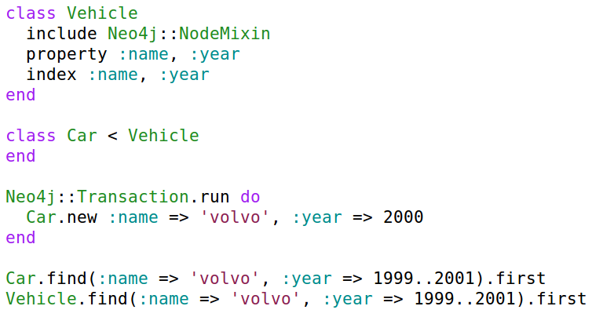
Inheritance

Slide 44
Recommendation Engine
Adam
Recommend This
Likes
5
1
2
3
4
Likes
Likes
Bertil
Caesar

Slide 45
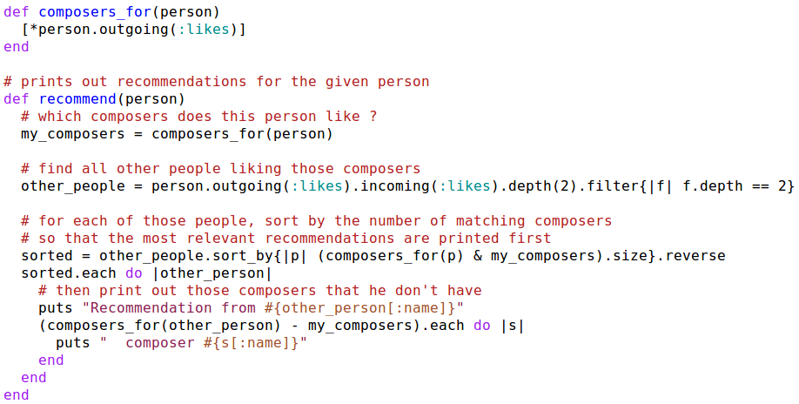
Example, Recommendation
likes
1
2
3
4
5
other_people
Notes:
Often you don't need to create your own search tree or index since the domain it self contains a search tree.
For an recommendation algorithm it is enough to traverse only a limited number of node of a given distance from one node.

Slide 46
Using Pacer Instead
Friend recommendation algorithm expressed in basic traversal functions:
friends = person.out_e(:friend).in_v(:type => 'person')
friends.out_e(:friend).in_v(:type => 'person').except(friends).except(person).most_frequent(0...10)

Slide 47
Aggregation/Rules
How to make a flat structure into a graph ?
    Use the Graph DB as an index
a.outgoing(:friends).find_all{|f| f.age > 20}
class Person < Neo4j::Rails::Model
property :age
rule(:old) {age > 20)}
end
Person.old

Slide 48
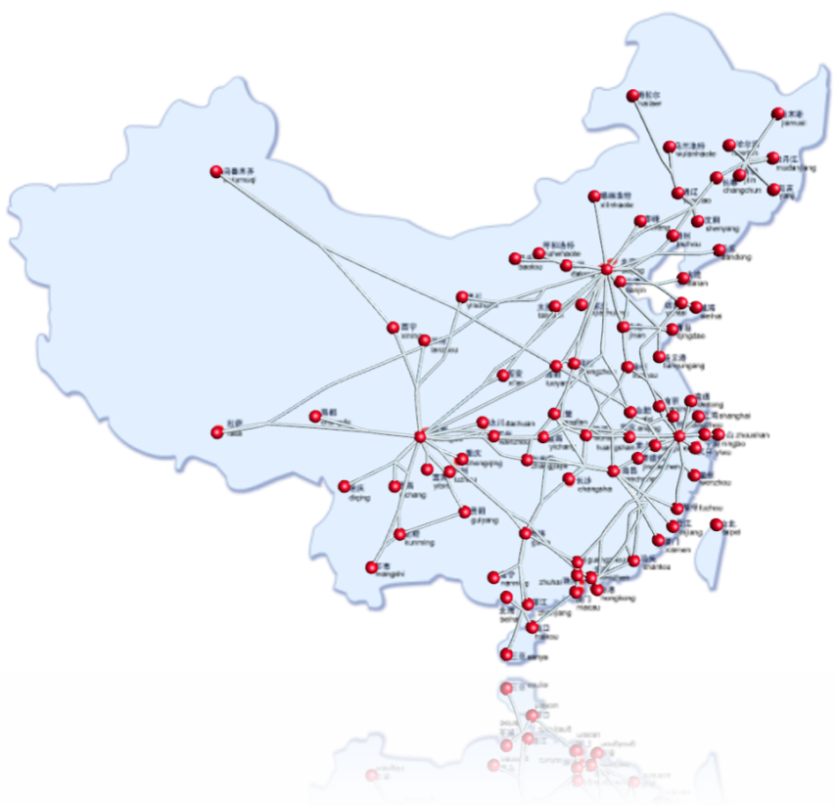
Included Graph Algorithms
Shortest paths, Simple paths, Graph measures ...
node1
node2

Slide 49
High Availability
Online Backup - hot spare
Read-slave replication
Write master election

Slide 50
Neo4j – An Object DB ?
Neo4j has very fast traversals
    Avoids loading properties
No need to declare two way relationships
    A relationship has a start and end node
Does have two ways of finding objects
    Traversals
    Lucene
Optimized for Graph Algorithms

Slide 51
Conclusions: Benefits
Express your domain as a Graph
    Domain Modeling
    No O/R mismatch
    Efficient storage of Semi Structured Information
    Schema Less
Express Queries as Traversals
    Fast deep traversal instead of slow SQL queries that span many table joins
Notes:
As you can see Neo4j.rb is like an Object Database
except that it does not have a query language
The two main benefits of the Graph Database are that it's natural to express the requirements in code (just like an Object Database) since often the real world is best expressed as a graph. You don't need to ruin model that the customer described by putting it in tables.
The other benefit is the traversal pattern. As you saw in the previous slide it is easy to express algorithms for things like an recommendation engine with traversals. It is still possible to do this in SQL (since you only need two joins) but I think it is more natural expressed as traversals. Also the traversal speed will remain the same regardless of the depth of traversal or the number of nodes.

Slide 52
When NOT use Graph DB
Don't have a graph related problem ?
Not too much changing requirements ?
Easy to organized data into:
    Tables, Documents or Key-Value models ?
Few & well defined relationships in the domain ?
Don't have SQL queries that span many table joins ?
Many YES => maybe Graph DB not a good choice

Slide 53
When should I use a Graph DB ?
Need to solve a graph related problem ?
    Recommendations, Shortest path, Social Networks
Have a complex and evolving data model ?
Few mandatory and many optional attributes ?
Big part of domain is expressed as relationships ?
Have SQL queries that span many table joins ?
Many YES => maybe a Graph DB is a good choice

Slide 55
Neo4j Spatial.rb
A wrapper around Java Neo4j Spatial using Neo4j.rb
git clone git@github.com:craigtaverner/neo4j-spatial.rb.git
cd neo4j-spatial.rb/examples
jruby osm_import.rb map2.osm
jruby osm_layer.rb map2.osm highway highway-residential waterway natural natural-water
jruby osm_layer.rb -l
jruby export_layer.rb highway-residential
jruby export_layer.rb -F shp highway-residential natural

Slide 56
Neo4j Spatial Queries
AbstractSearchIntersection
SearchAll
SearchClosest
SearchContain
SearchCover
SearchCoveredBy
SearchCross
SearchDisjoint
SearchEmpty
SearchEqual
SearchInRelation
SearchIntersect
SearchIntersectWindow
SearchInvalid
SearchOverlap
SearchPointsWithinOrthodromicDistance
SearchTouch
SearchWithin
SearchWithinDistance

Slide 57
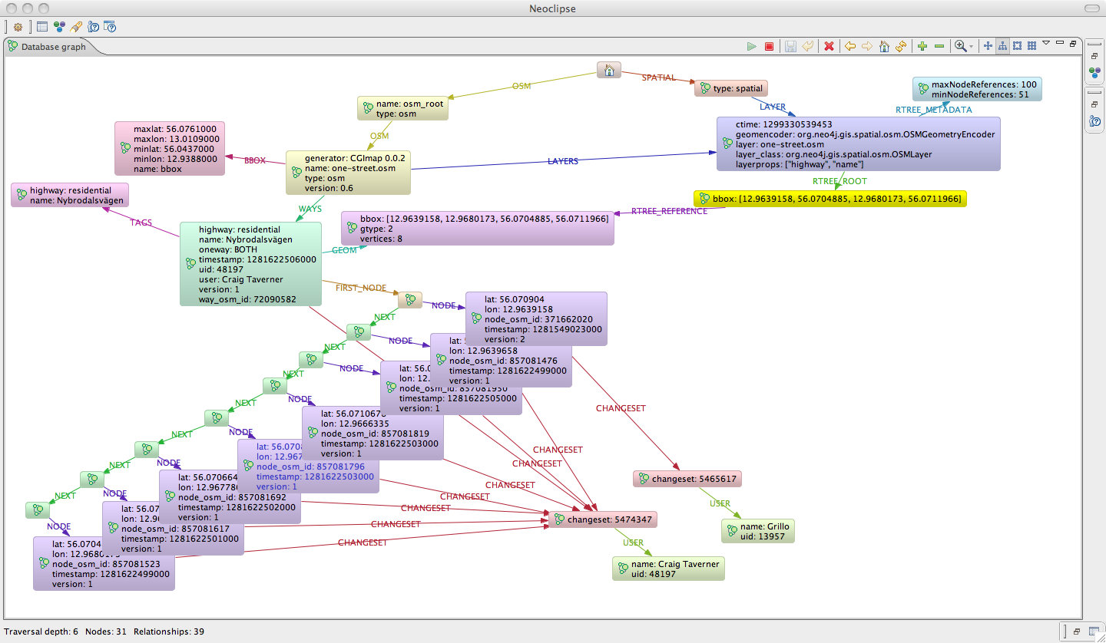
Spatial Graph

Slide 58
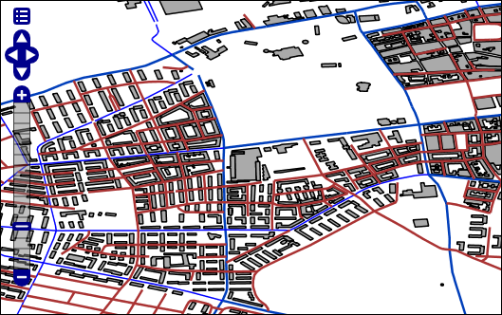
GeoServer
Neo4j Spatial includes built-in support for a GeoTools data store
GeoServer is an open source software server written in Java that allows users to share and edit geospatial data. Designed for interoperability, it publishes data from any major spatial data source using open standards.

Slide 59
GraphDatabaseService database = new EmbeddedGraphDatabase(storeDir);
try {
SpatialDatabaseService s = new SpatialDatabaseService(database);
Layer layer = s.getLayer("layer_roads");
SpatialIndexReader index = layer.getIndex();
Search q = new SearchIntersectWindow(new Envelope(xmin, xmax, ymin, ymax));
index.executeSearch(searchQuery);
List<SpatialDatabaseRecord> results = q.getResults();
} finally {
database.shutdown();
}

