Slide 1
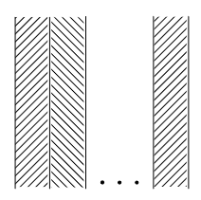






$$d_{1}≠d_{2}…≠d_{n}$$
$$T_{Left}$$
$$T_{Right}$$
$$R_{Left}$$
$$R_{Right}$$
1
2
n
x
$${Δx}_{1}≠{Δx}_{2}…≠{Δx}_{n}$$

