Slide 1
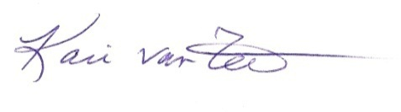
Certificate of Participation
Presented to
For the successful completion of
Climate Change
a Workshop for STEM Educators
August 11, 2015
6 contact hours
Sponsored by the Scientists and Teachers in Education Partnerships Program (STEPs) at Oregon State University with funding from the National Science Foundation grant to
Dr. Andreas Schmittner.
Kari van Zee, Ph.D.
STEPs 6-12 Program Coordinator
vanzeek@science.oregonstate.edu

