Slide 1
Are the tides turning for microservices?
Meilenstein 1
Andreas Wallnöfer
WS 2024

Slide 2
Theoretischer Teil

Slide 3
Sentiment Analyse
klassifizieren, ob ein Text positive, negative oder neutrale Meinungen enthält
Out of the box tools unzureichend für SE domain
Breite an SE spezifischen Tools verfügbar, Akkuratheit unterschiedlich
Data Preprocessing
Entfernen von Elementen wie Urls, Sonderzeichen und HTML-Tags
Lowercasing
Tokenization, stop-word removal und lemmatization (machen manche Tools selbst)
Sentiment Skala
Tool abhängig
Weit verbeitet: negative (-1), neutral (0), positive (1)

Slide 4
Related Work
Microservices als Trend [1]
Steiler Aufstieg
Erste große Unternehmen wechseln wieder weg von MSA
Microservice Diskussionen auf StackOverflow [2]
Worüber wird auf SO diskutiert
Sentiment Analysis in Software Engineering [3], [4]
Out of the Box Tools nicht akkurat für SE
Manche Begriffe haben in SE andere Bedeutung als sonst. Z.B. „bug“
Lösungen wie „Sentistrength-SE oder „EASTER“
[1] Zhongshan Ren, Wei Wang, Guoquan Wu, Chushu Gao, Wei Chen, Jun Wei,and Tao Huang. Migrating web applications from monolithic structure tomicroservices architecture. In Proceedings of the 10th Asia-Pacific Symposiumon Internetware, Internetware ’18, New York, NY, USA, 2018. Associationfor Computing Machinery.
[2] Alan Bandeira, Carlos Alberto Medeiros, Matheus Paixao, and Paulo Hen-rique Maia. We need to talk about microservices: an analysis from thediscussions on stackoverflow. In 2019 IEEE/ACM 16th International Confer-ence on Mining Software Repositories (MSR), pages 255–259, 2019
[3] Bin Lin, Fiorella Zampetti, Gabriele Bavota, Massimiliano Di Penta, MicheleLanza, and Rocco Oliveto. Sentiment analysis for software engineering: howfar can we go? In Proceedings of the 40th International Conference onSoftware Engineering, ICSE ’18, page 94–104, New York, NY, USA, 2018.Association for Computing Machinery.
[4] Kexin Sun, Xiaobo Shi, Hui Gao, Hongyu Kuang, Xiaoxing Ma, GuopingRong, Dong Shao, Zheng Zhao, and He Zhang. Incorporating pre-trainedtransformer models into textcnn for sentiment analysis on software engineeringtexts. In Proceedings of the 13th Asia-Pacific Symposium on Internetware,Internetware ’22, page 127–136, New York, NY, USA, 2022. Association forComputing Machinery.

Slide 5
Research Questions
RQ1: Which data sources are the most relevant for analyzing developer sentiment towards microservice architecture?
RQ2: Are there suitable tools for performing sentiment analysis on developer community content?
RQ3: Is it possible to detect any developer sentiment from community discussions on microservice architecture?

Slide 6
Praktischer Teil

Slide 7
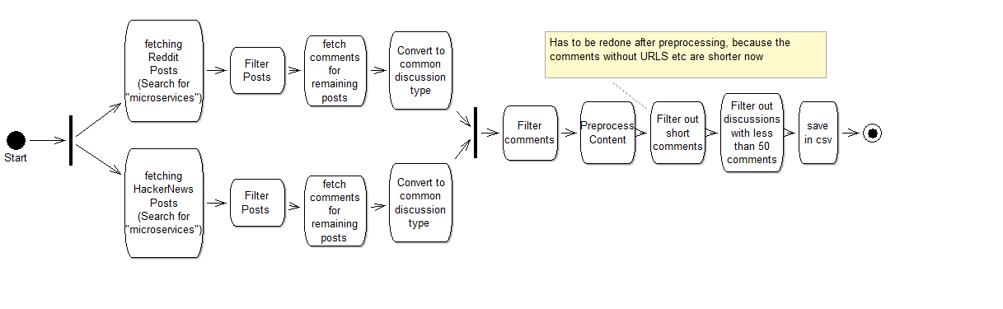
Hauptablauf

Slide 8
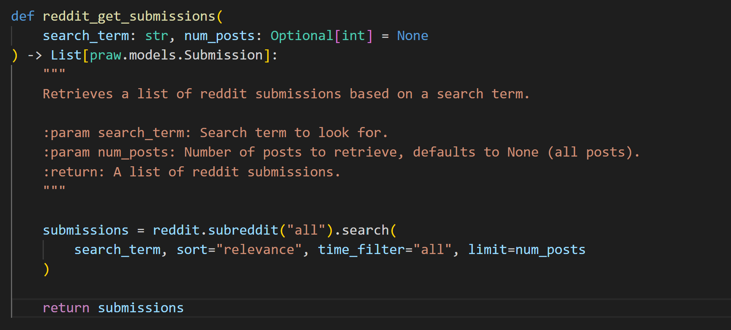
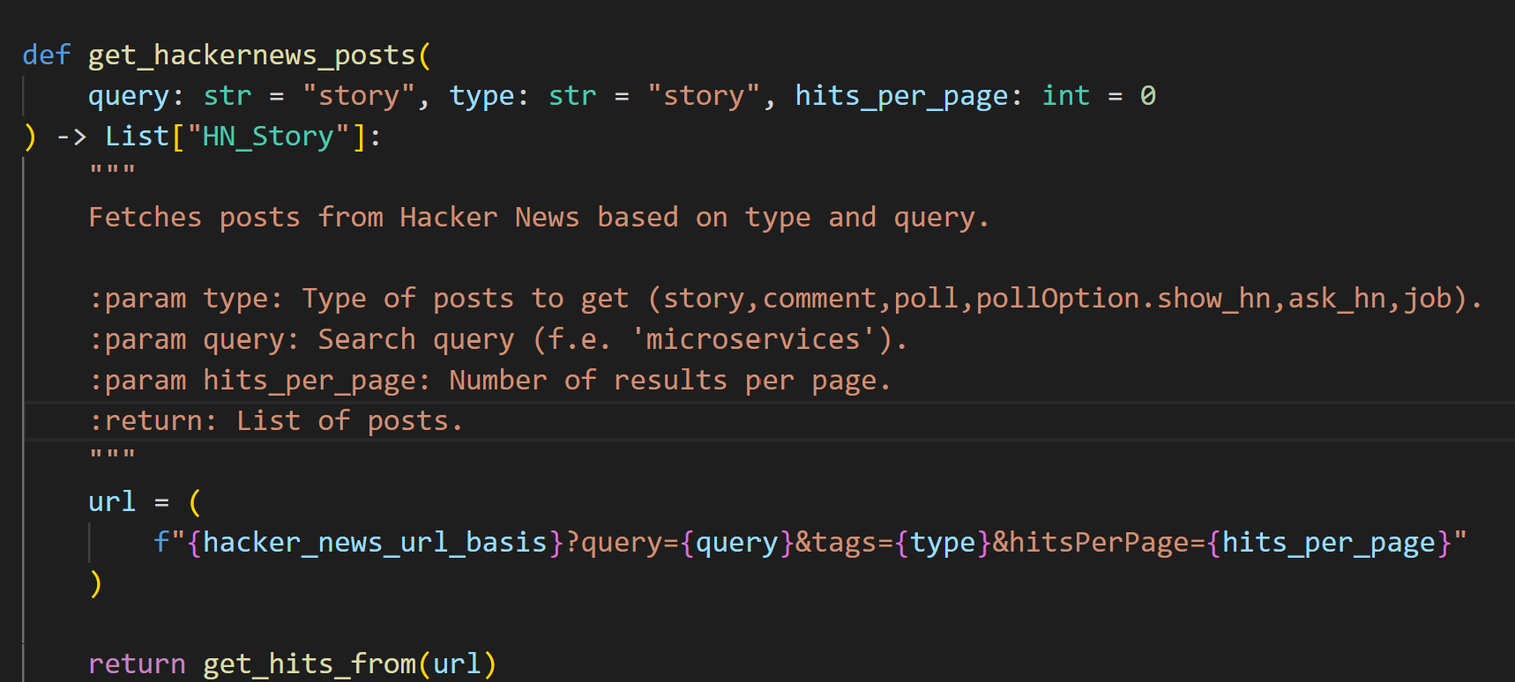
Post Fetching

Slide 9
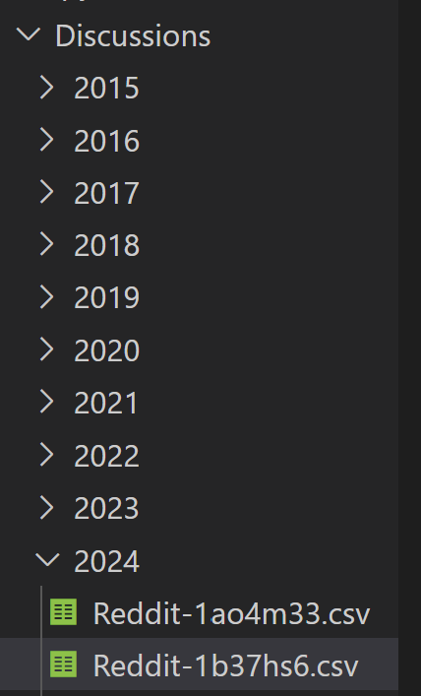
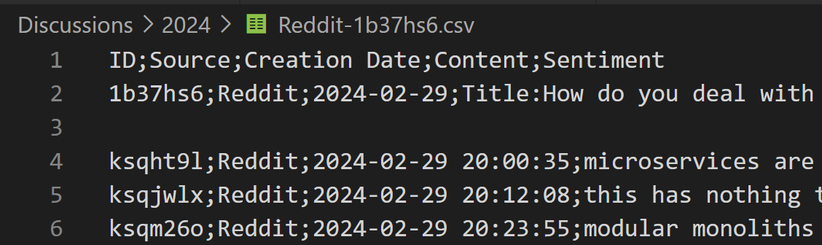
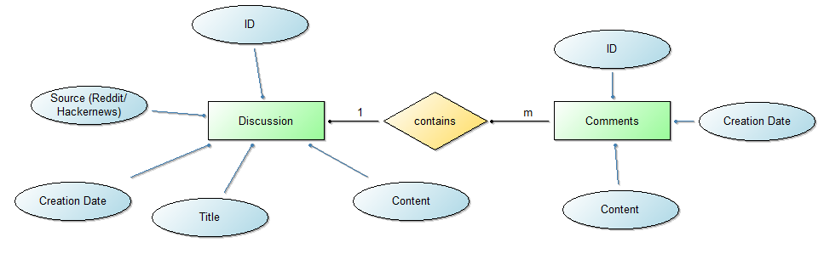
Datentyp

Slide 10
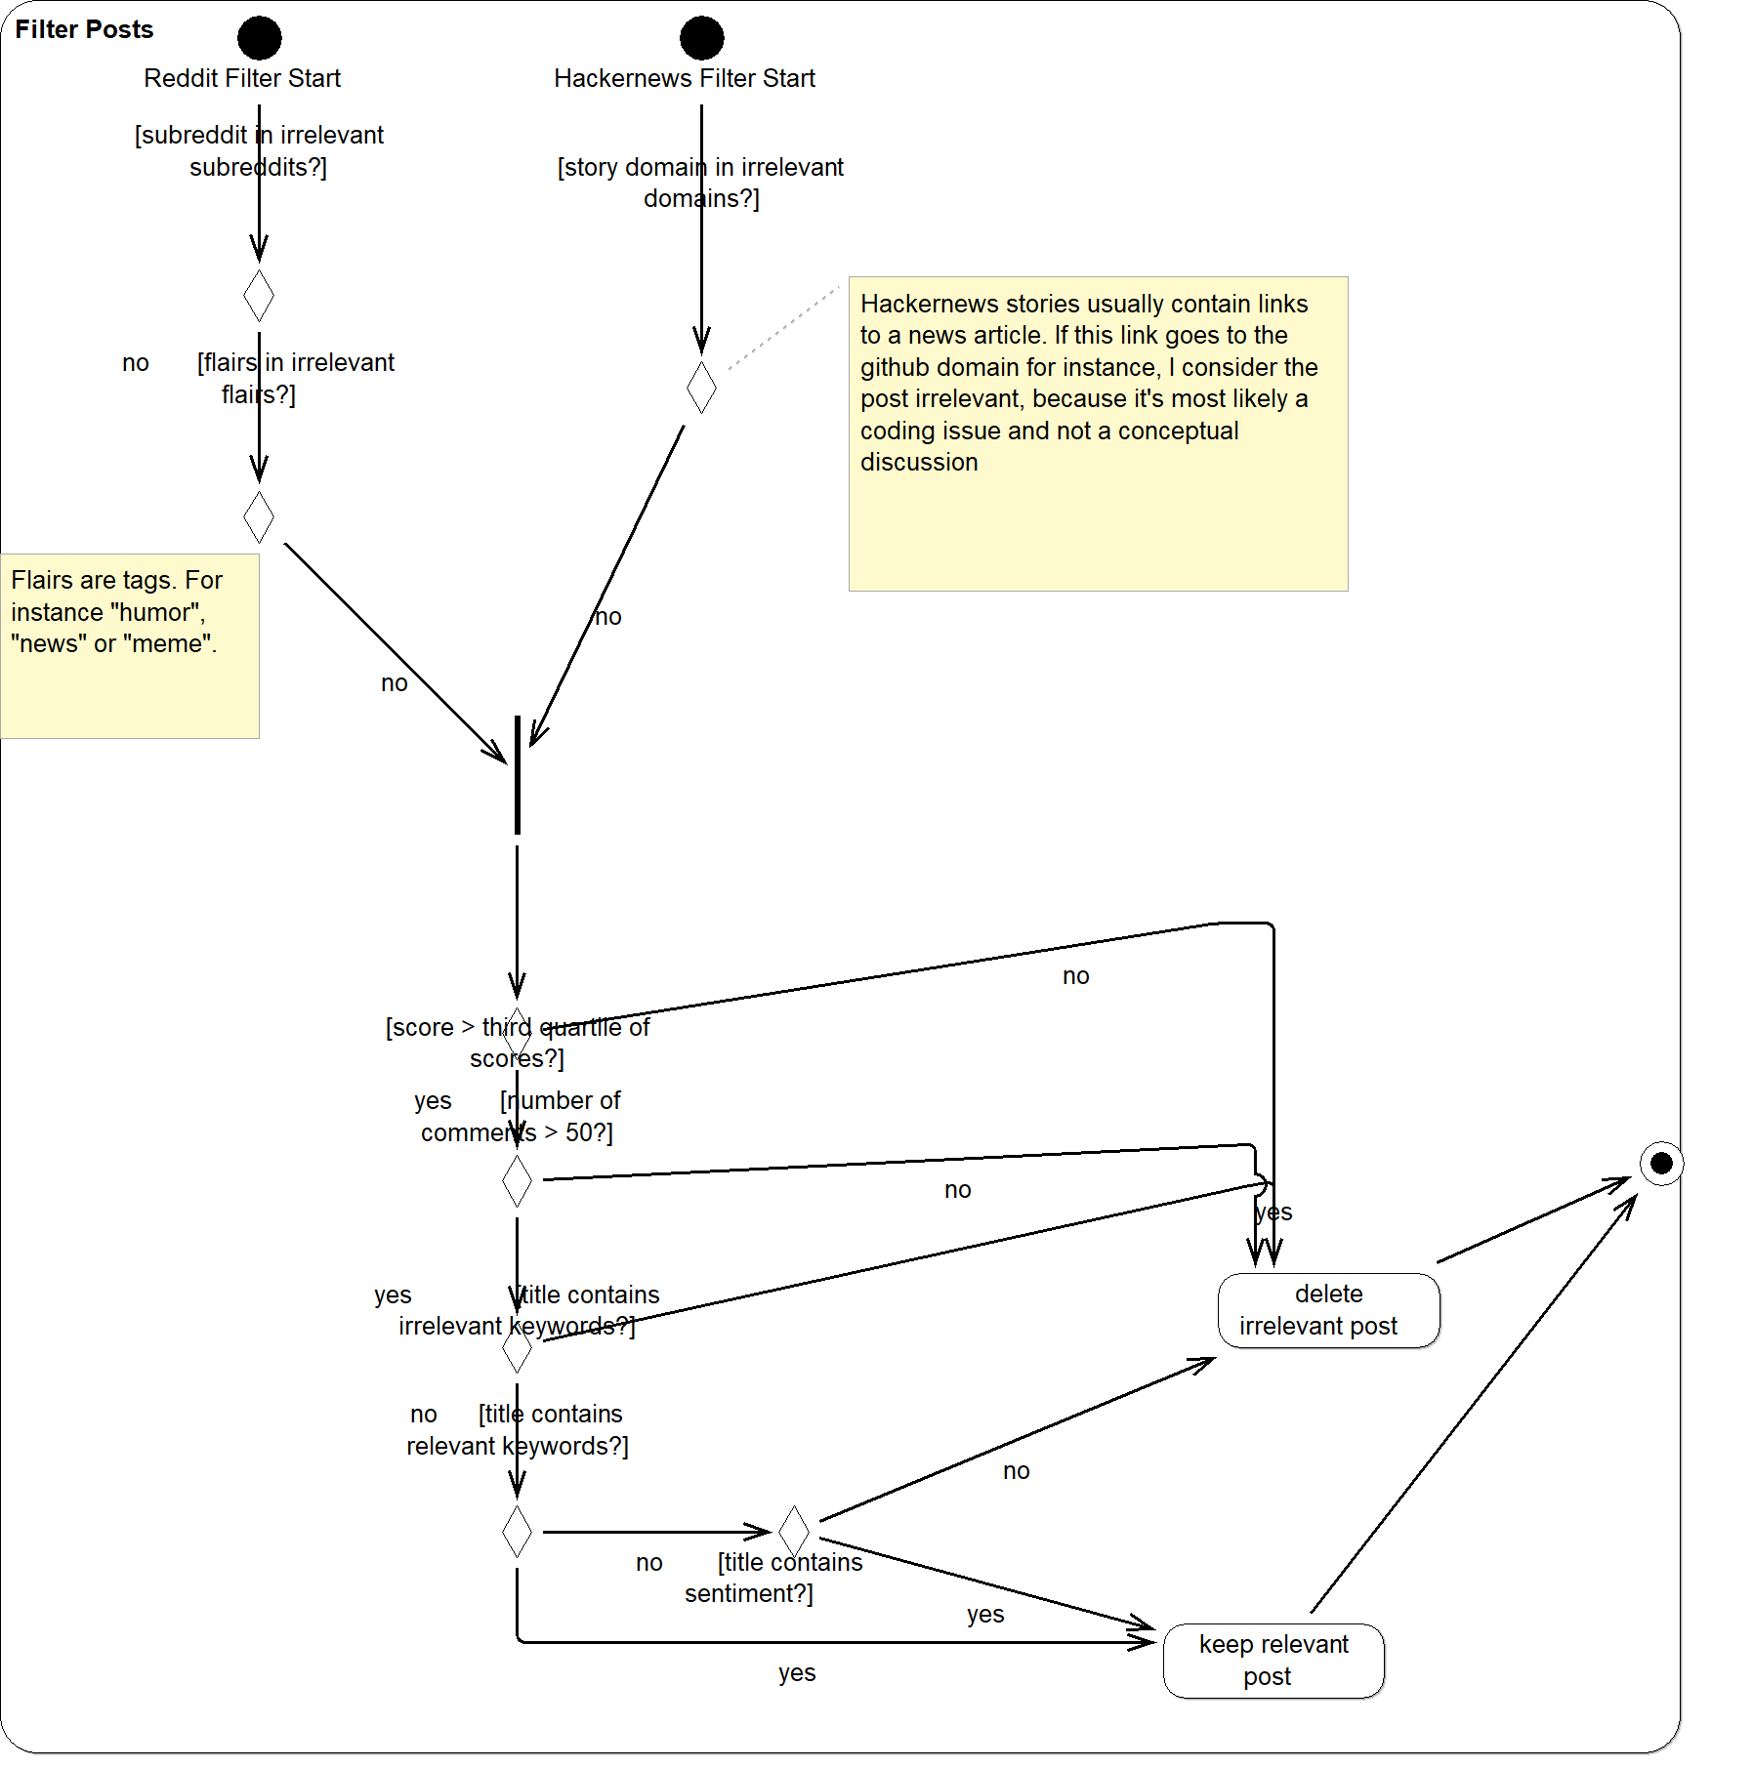
Filter Posts

Slide 11
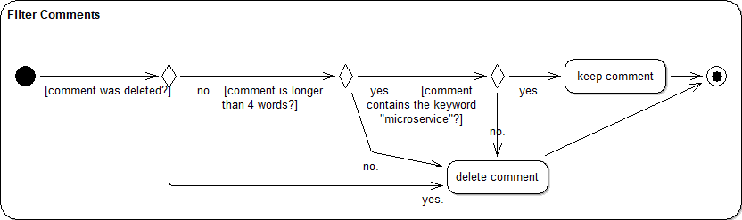
Filter Comments

Slide 12
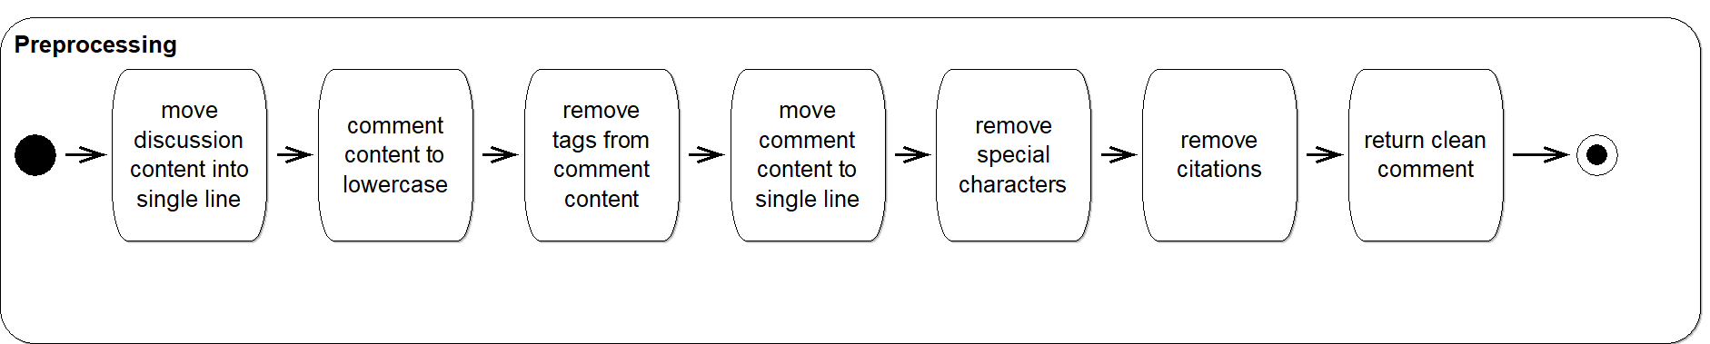
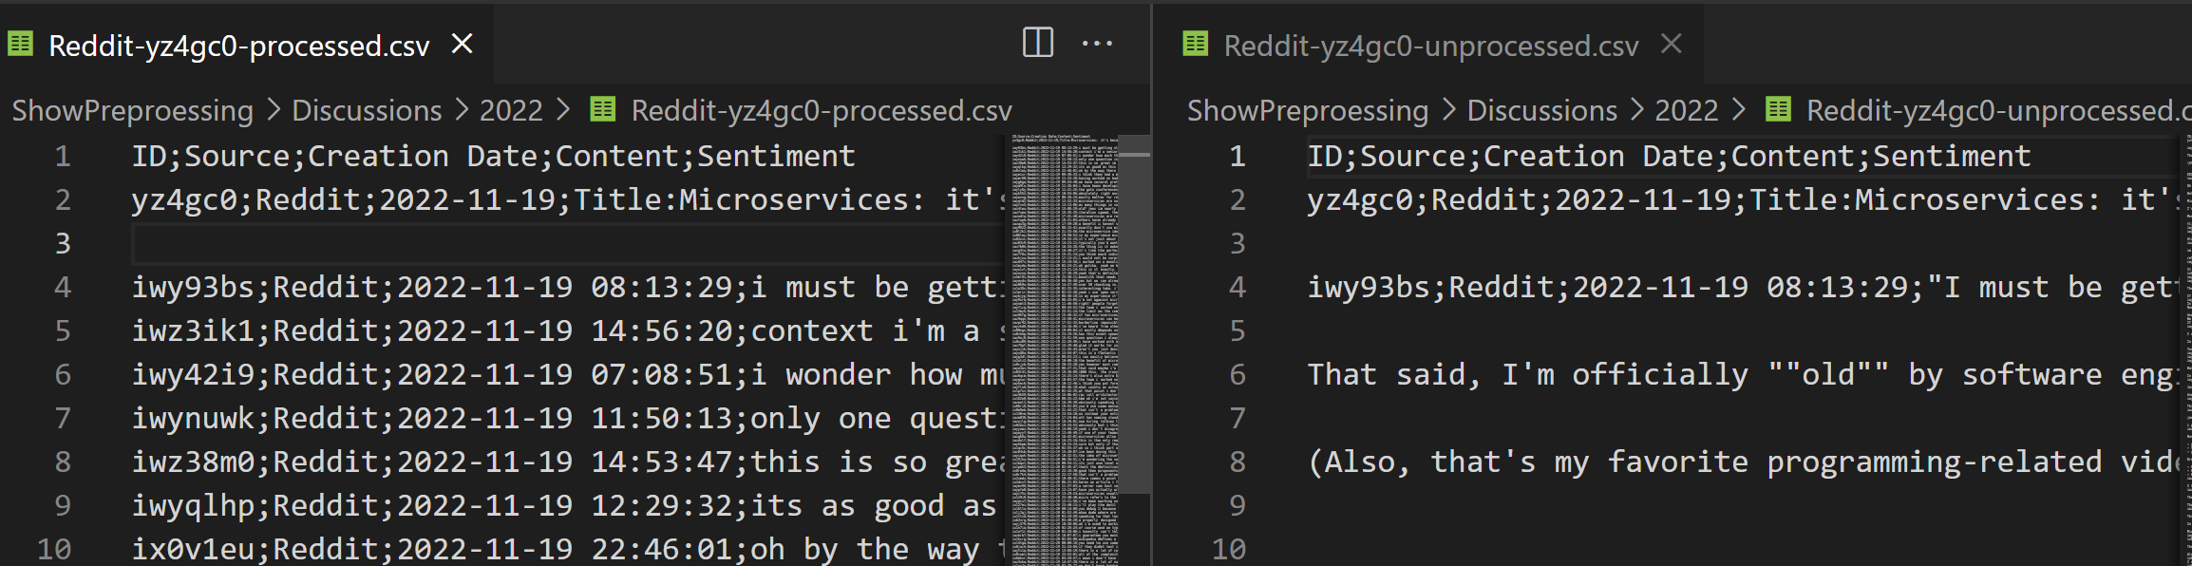
Preprocessing

