Slide 1
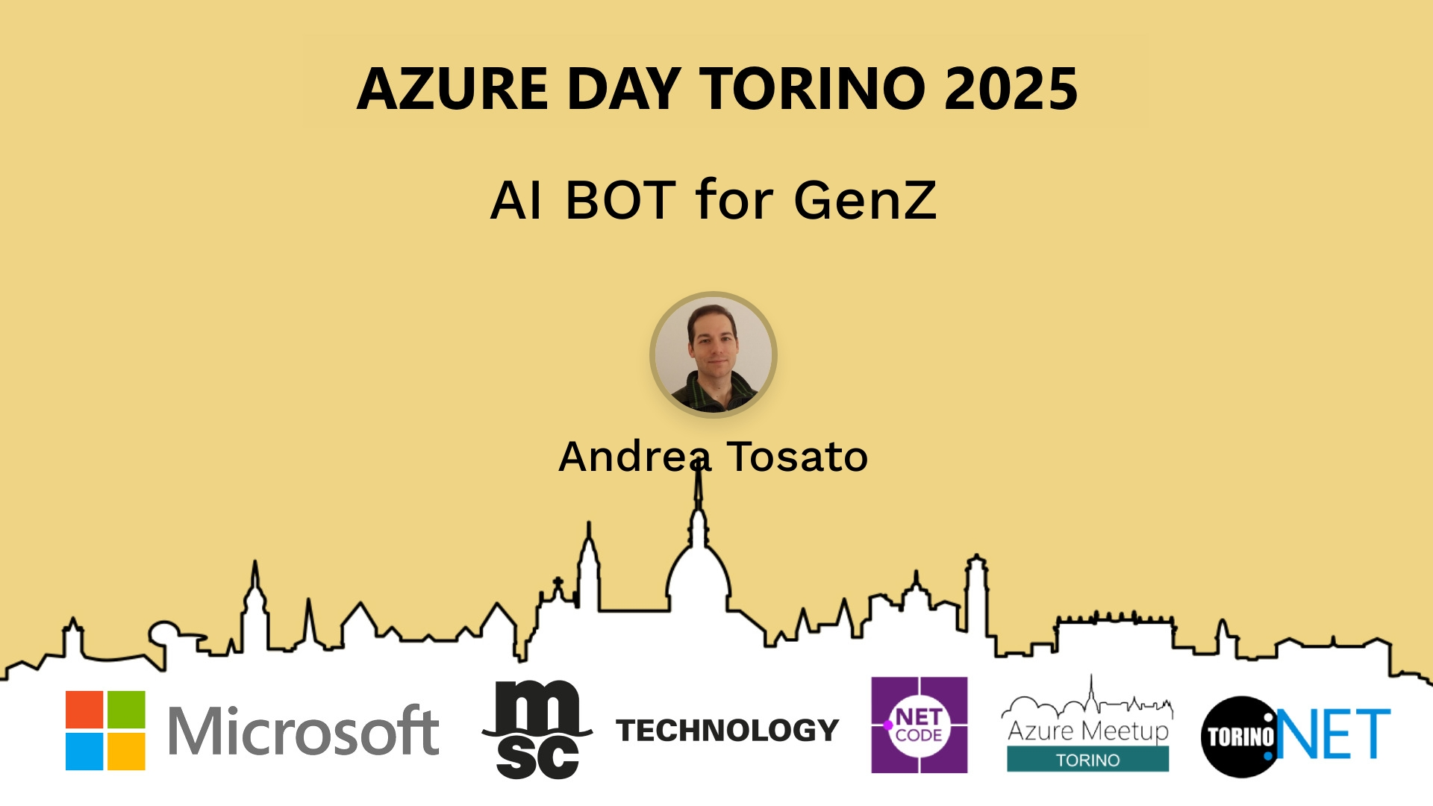
Session Banner - AI BOT for GenZ
Notes:
This is the opening banner slide for 'AI BOT for GenZ'. The session is presented by: Andrea Tosato. This slide sets the visual theme for the presentation.

Slide 2
Event Sponsors
Notes:
Sponsor acknowledgment slide. Take a moment to thank the event sponsors and explain their support for the conference.

Slide 3
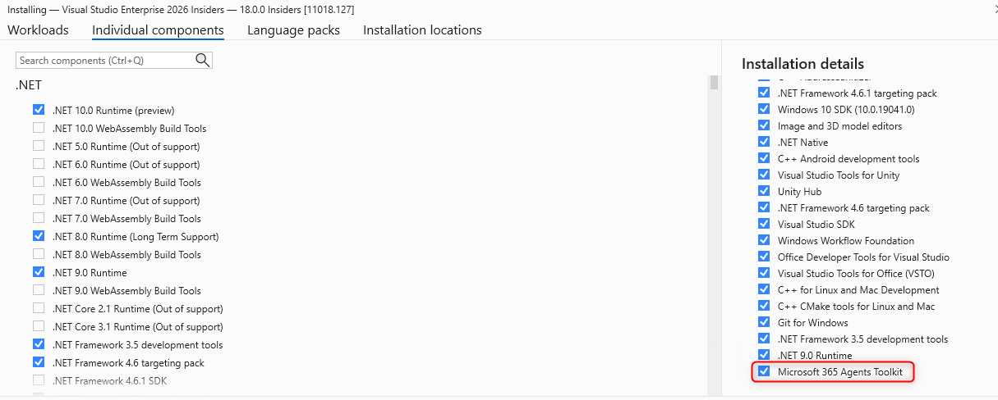
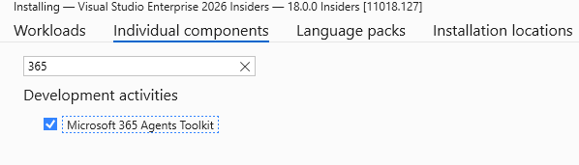
Da dove partire
Notes:
Main title slide displaying 'AI BOT for GenZ'. Presented by: Andrea Tosato. Use this slide to introduce the session topic.

Slide 4
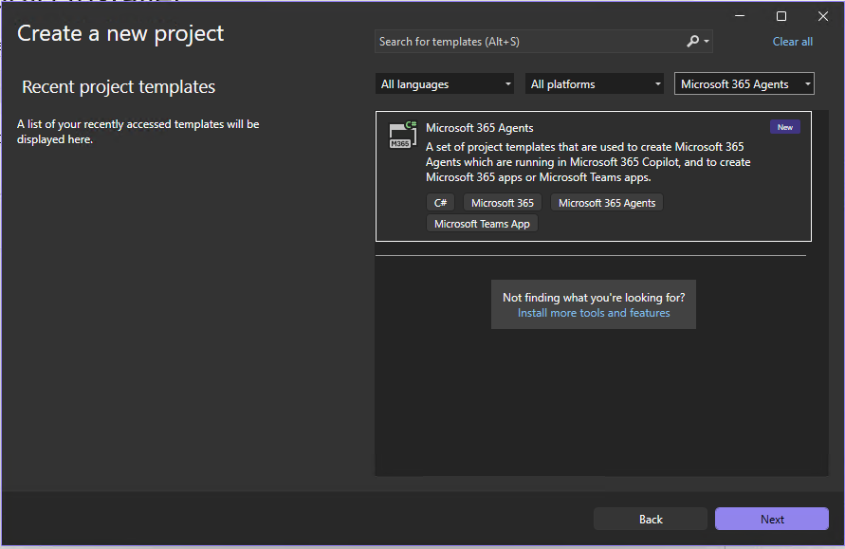

Slide 5
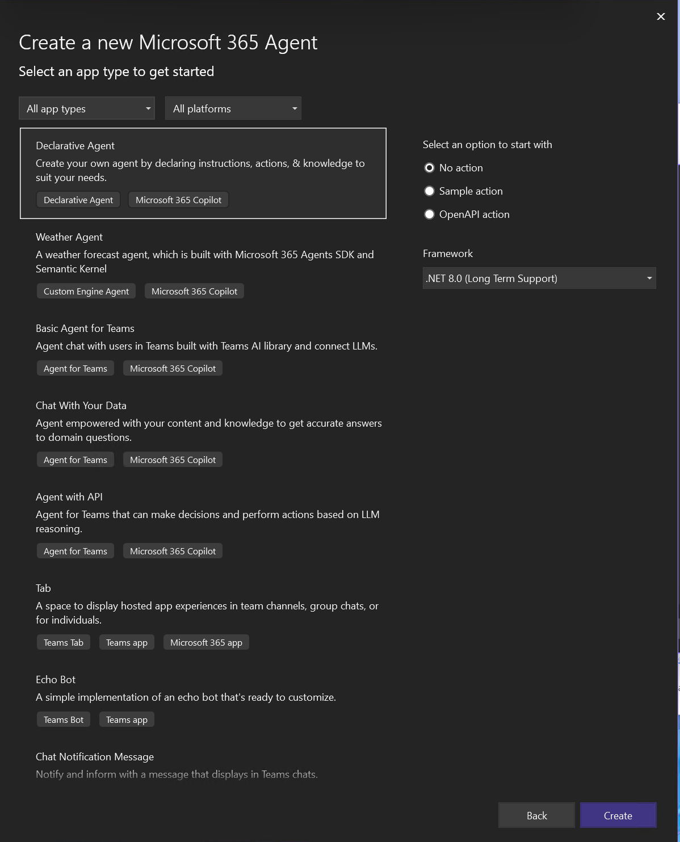

Slide 6
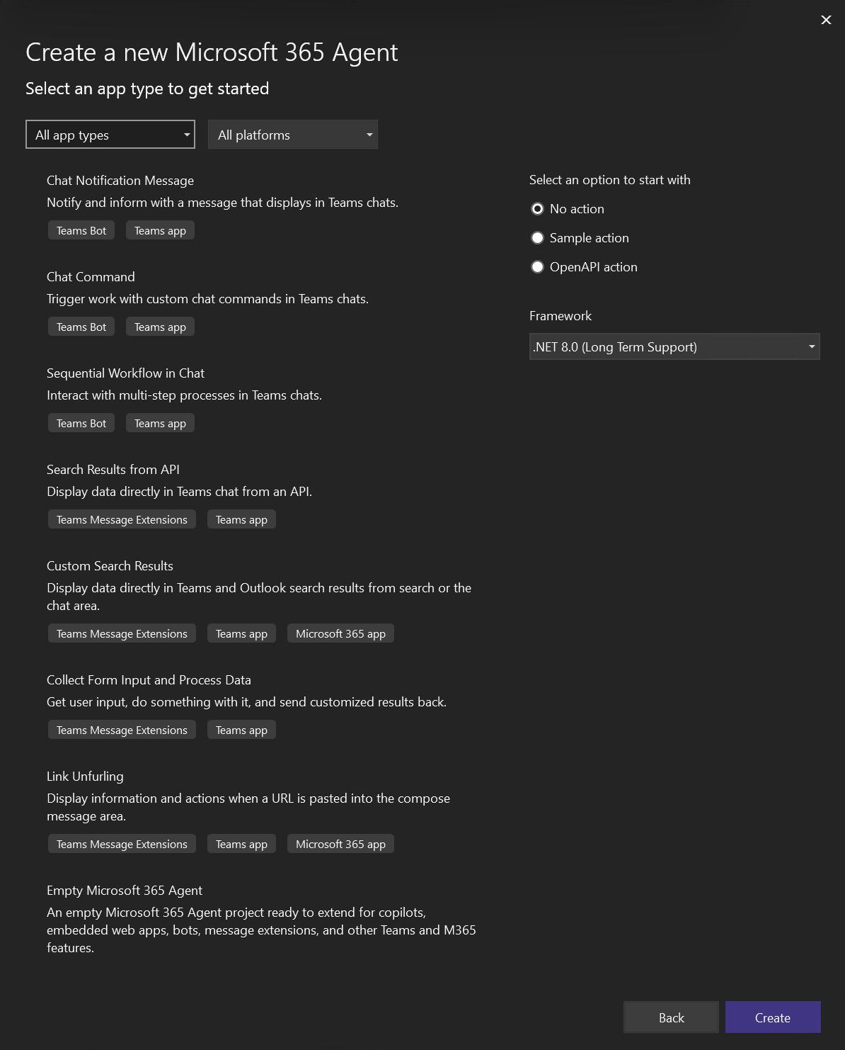

Slide 7
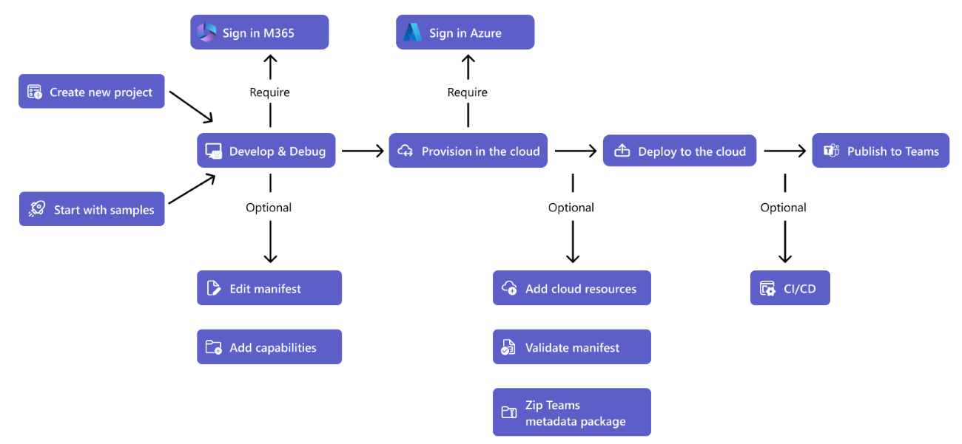
L’ecosistema che mancava

Slide 8
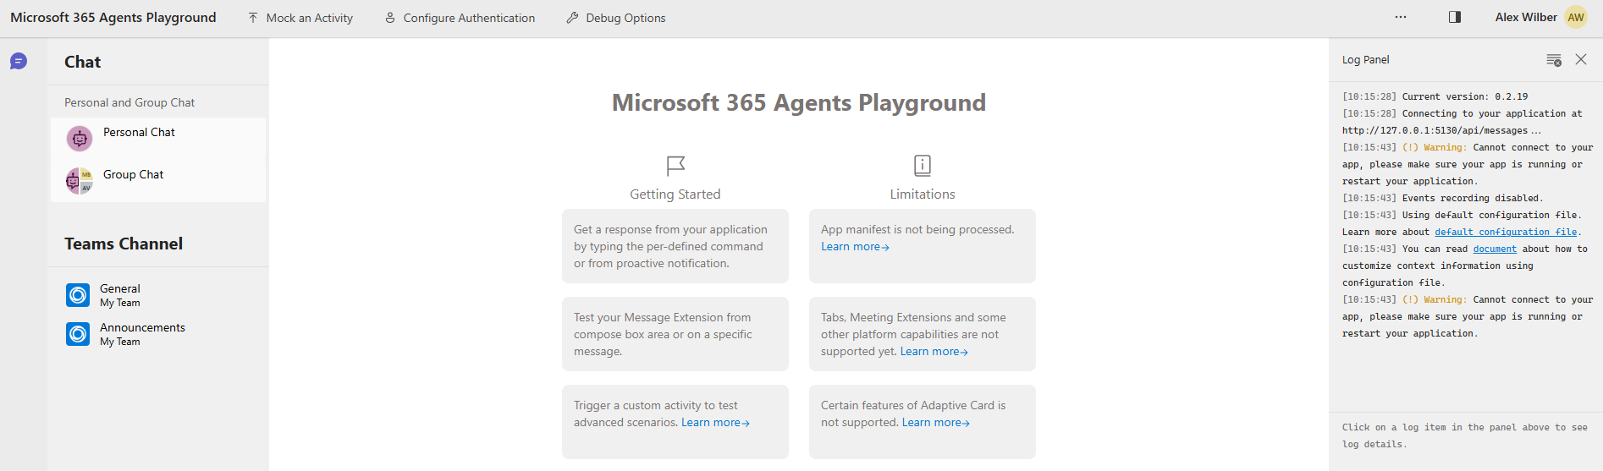
Microsoft 365 Agents Playground
winget install agentsplayground
npm install -g @microsoft/m365agentsplayground
https://learn.microsoft.com/en-us/microsoftteams/platform/toolkit/debug-your-agents-playground

Slide 9
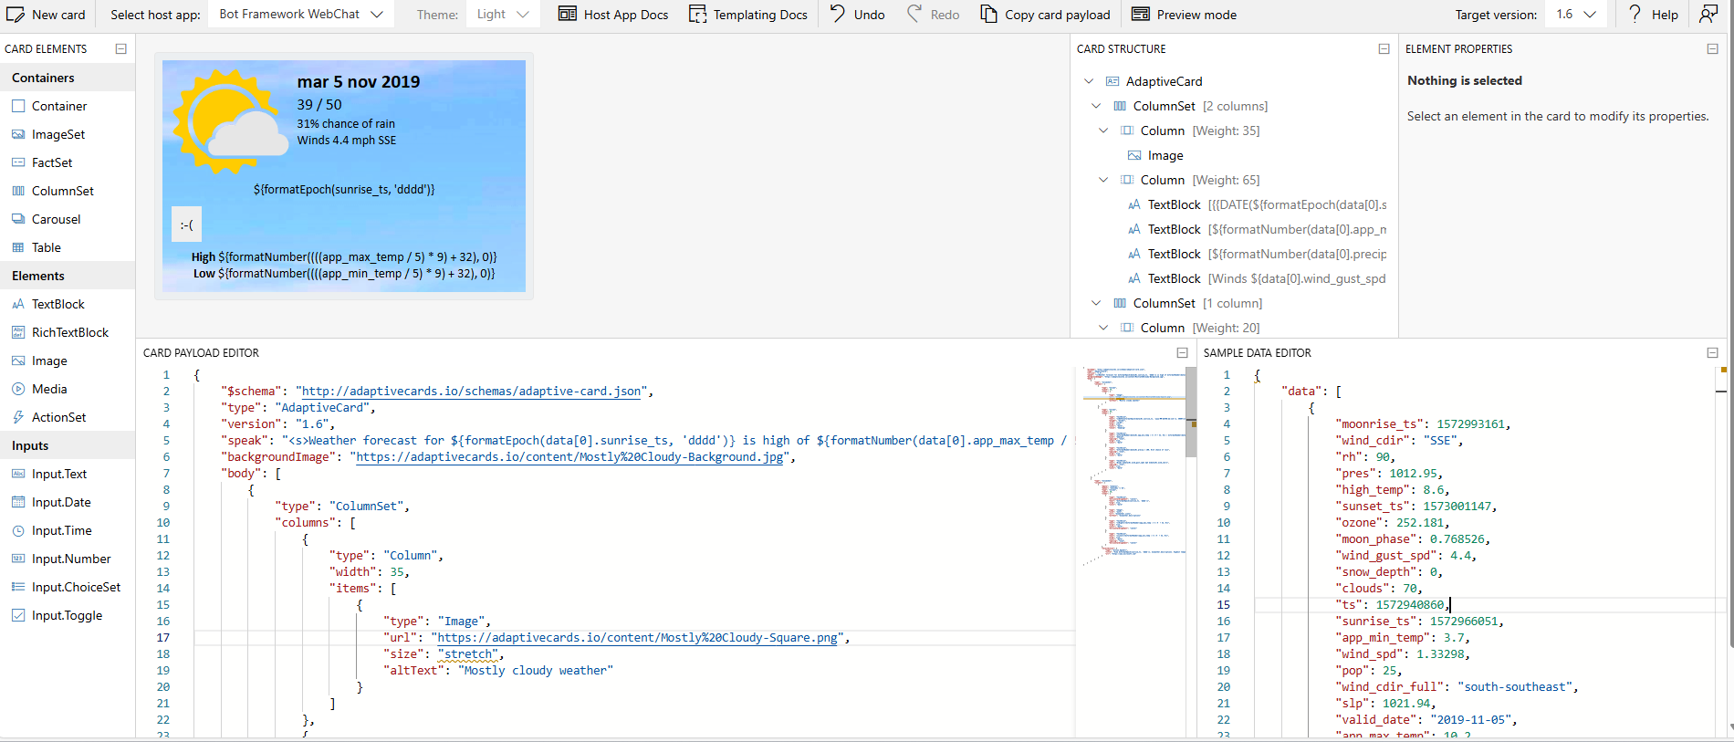
Adaptive Card
Notes:
Samples and Templates | Adaptive Cards
Designer | Adaptive Cards
Adaptive Card Designer

Slide 10
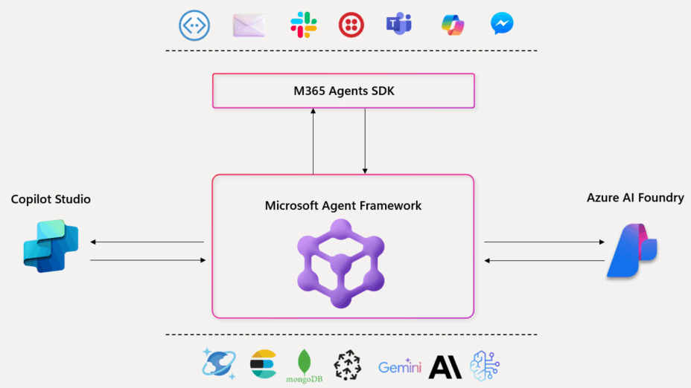
Microsoft Agent Framework (MAF)
Microsoft Agent Framework doesn’t replace Semantic Kernel and AutoGen — it builds on them

Slide 11
Reference
https://learn.microsoft.com/it-it/microsoftteams/platform/toolkit/agents-toolkit-fundamentals#install-teams-toolkit-for-visual-studio
https://learn.microsoft.com/it-it/microsoftteams/platform/concepts/build-and-test/adaptive-card-previewer-vs
https://learn.microsoft.com/en-us/adaptive-cards/templating/
https://learn.microsoft.com/en-us/microsoft-365/agents-sdk/test-with-toolkit-project?tabs=windows

Slide 12
Demo: AI BOT for GenZ
Notes:
Demo section for 'AI BOT for GenZ'. This slide is for live demonstrations. Ensure all demo materials are prepared and tested.

Slide 13
Questions & Discussion
Notes:
Q&A slide for 'AI BOT for GenZ'. This is time for audience questions and discussion. Prepare to address common questions about the topic and invite participation.

Slide 14
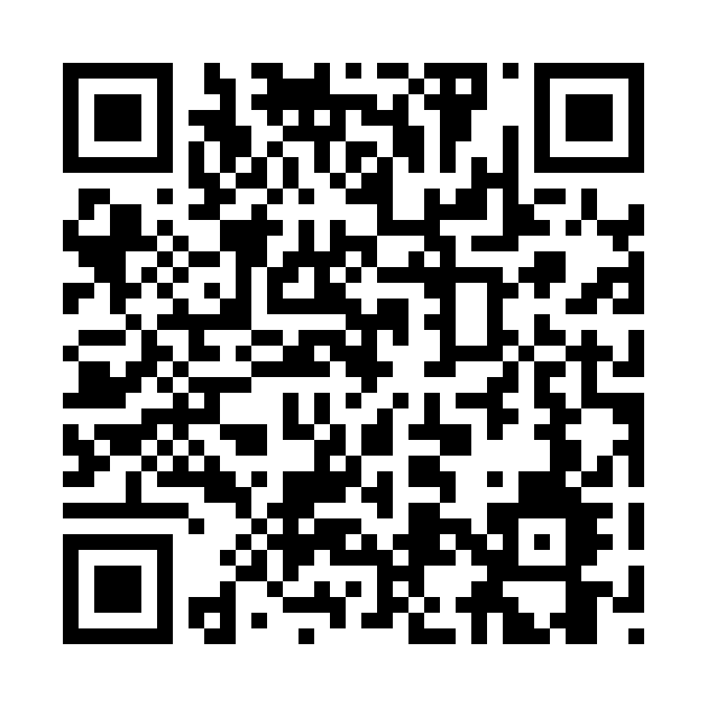
Please Vote for This Session
Vote for Session - AI BOT for GenZ
Notes:
Voting slide for 'AI BOT for GenZ'. Ask audience to scan the QR code or visit https://vote.dotnetdev.it/vote/7kjar40q/1025258 to vote. Emphasize the importance of feedback.

