Slide 1
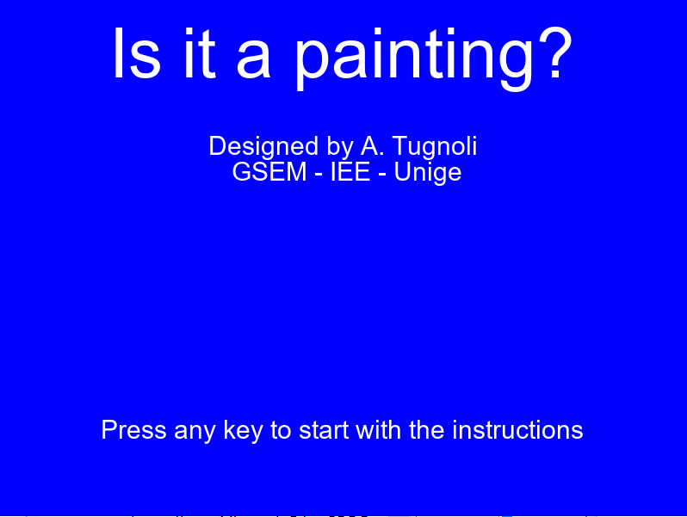

Slide 2
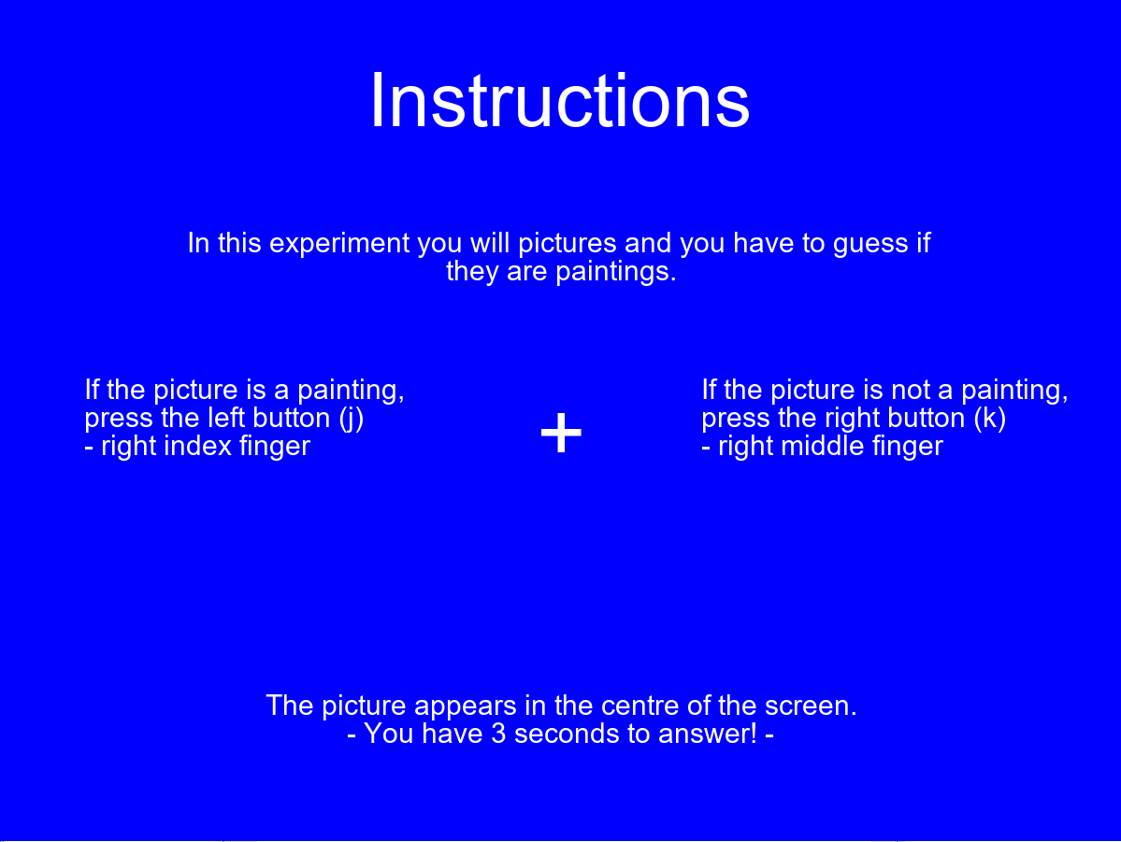

Slide 3
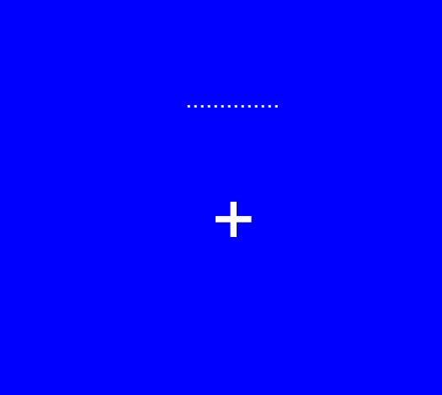

Slide 4
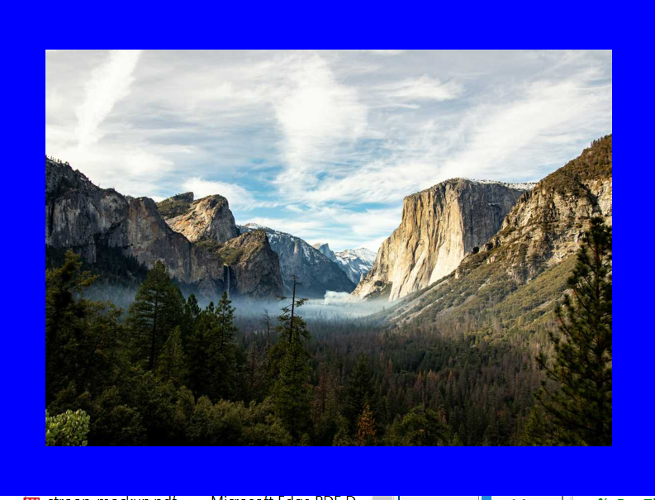

Slide 5
Cues
The database contains 10 paintings:
5 landascapes
5 portraits
For each landscape/portrait is available a color and a black and white version
Consequently the total number of paintings in the database is 20.

Slide 6
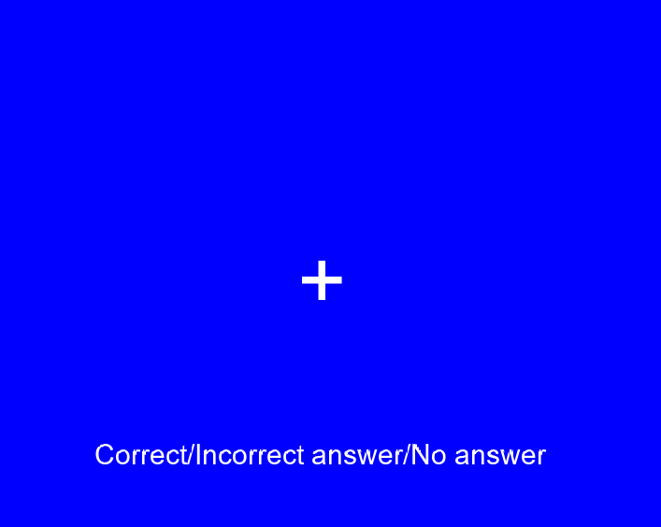

Slide 8
Trials
In this mockup, we show only one trial of the experiment. However, the experiment contains 10 trials.
The experiment has a structure 2x2 (landscape/potrait, color/black and white)

Slide 9
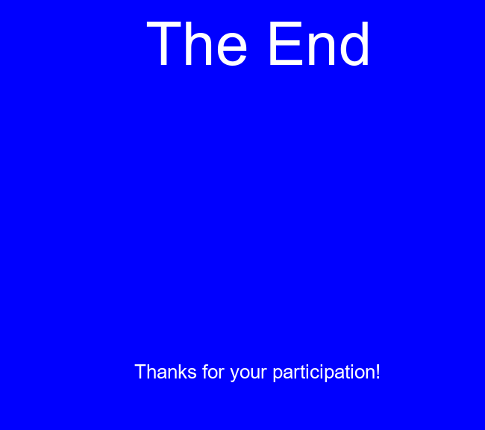

Slide 10
Experiment stages
Event Next
Time
Start
Keypress
inf
Intro
Keypress
inf
wait
Timer, trigger, Keypress
1’’
Task x10
Keypress, time
2’ 00’’
Wait 2
Timer, trigger, Keypress
1’’
end
Keypress
2’’

Slide 11
Trial stages
Time
Fixation
1’’
Total time per trial is 12’’
Cue
3’’
Fixation 2
1’’
Task
3’’
Response
3’’
Buffer
1’’

