Slide 1

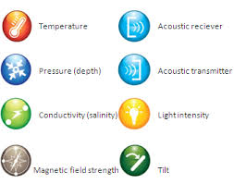
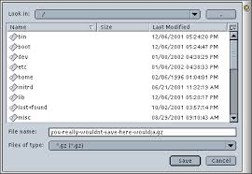

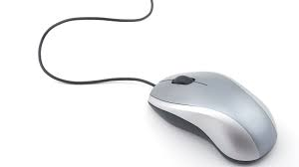
Load Model
Associate Sensors
to the model
Get data streams
from sensors
Real time
visualization
of data streams
on the model

