Slide 1
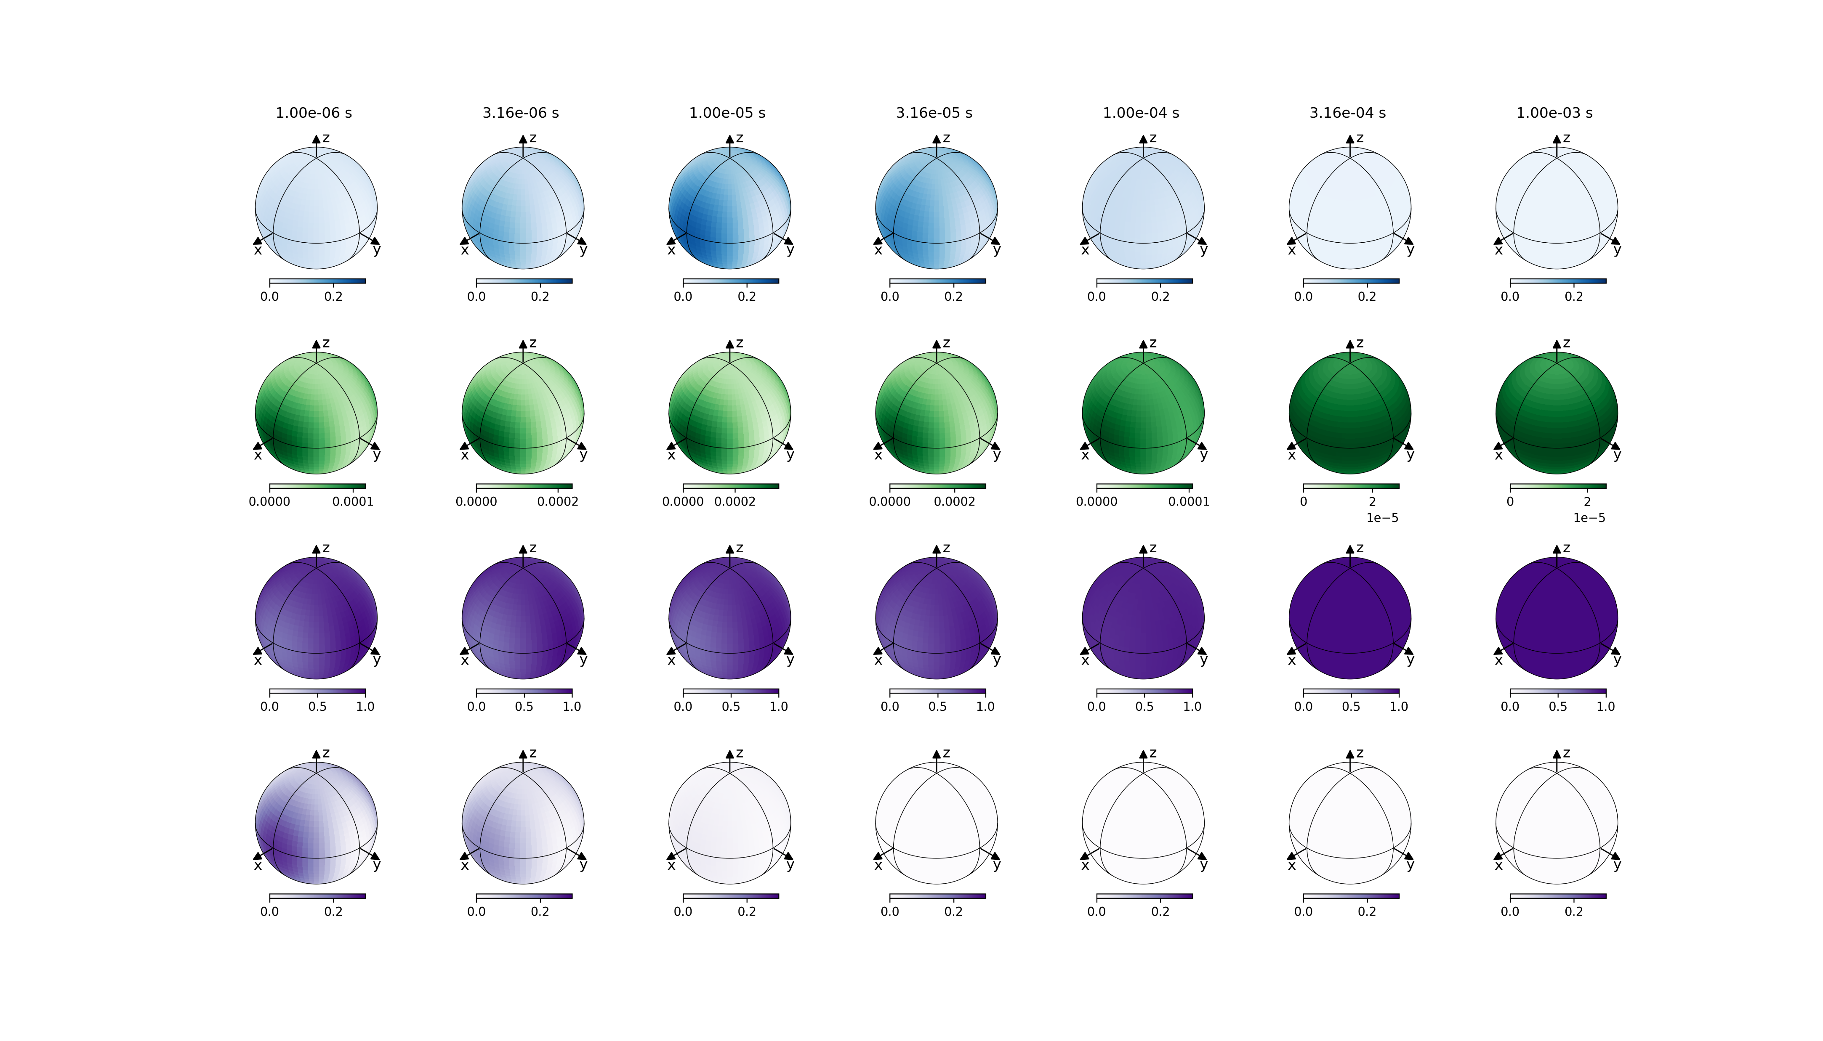
STARSS modality 1
Evolution of populations
tau_R = 100us, rsEGFP2_8states, 488pw 5KW/cm2, 405pw 50KW/cm2 250ns
Ground
on-state
Excited
on-state
Ground
off-state
Ground
off-state-cis

Slide 2
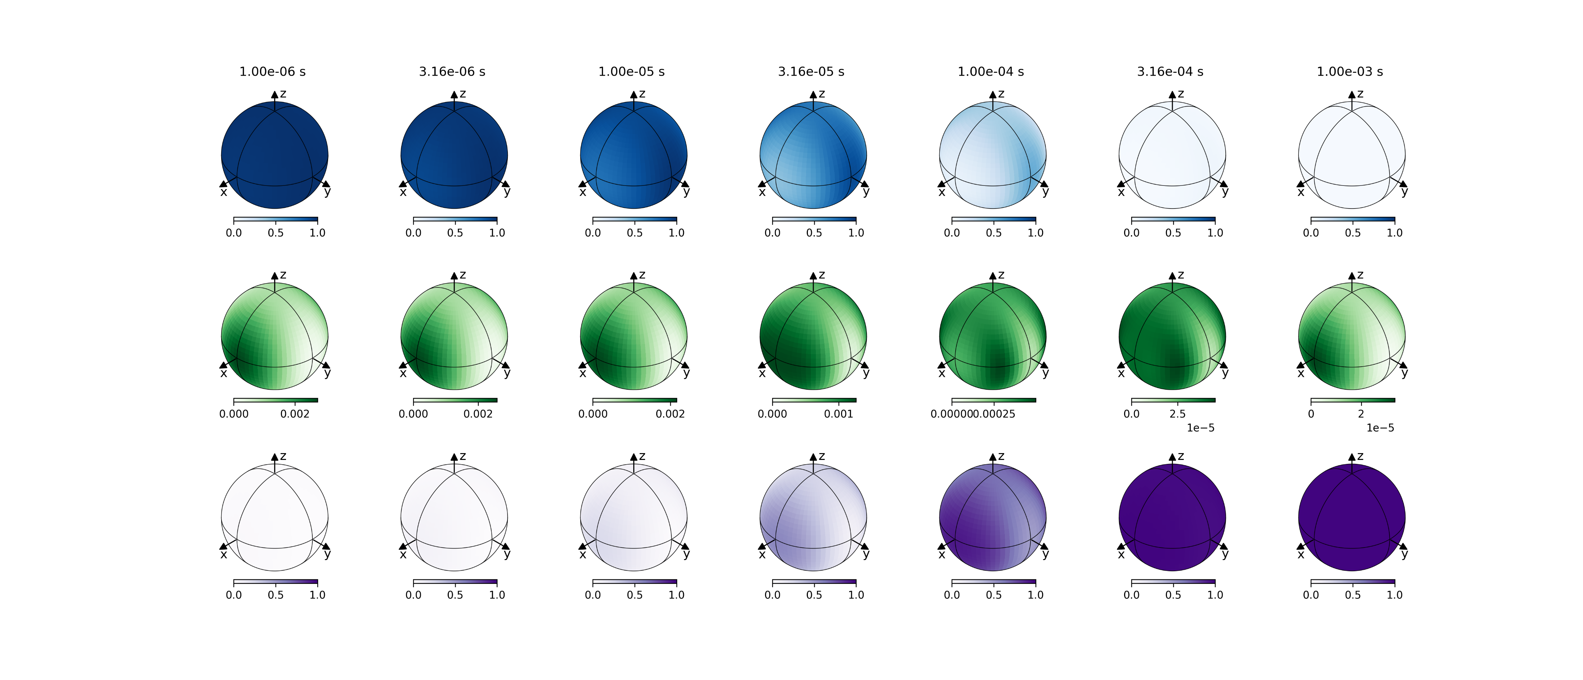
STARSS modality 2
Evolution of orientational populations
tau_R = 100us, rsEGFP2_4states, 488pw 5KW/cm2
Ground
on-state
Excited
on-state
Ground
off-state

