Slide 1
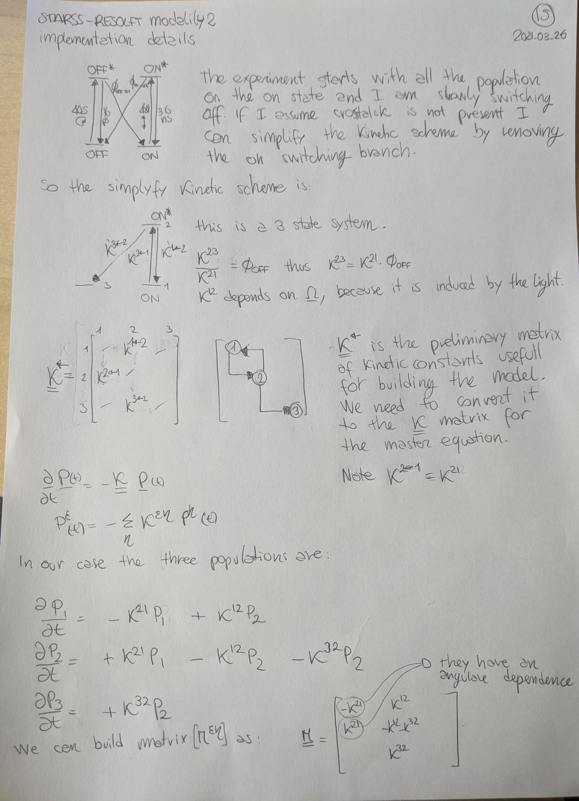

Slide 3
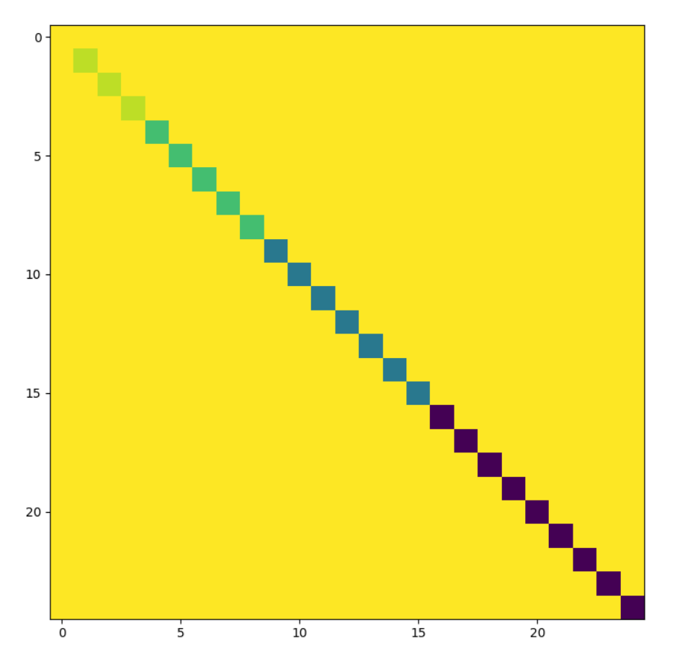
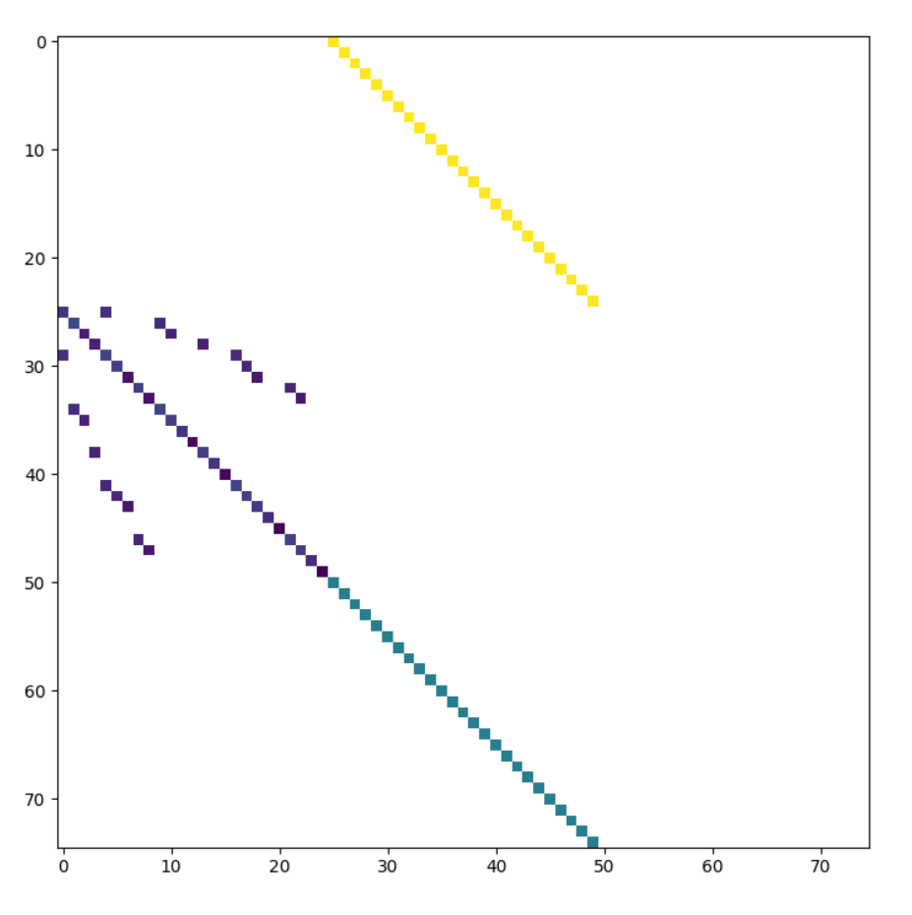
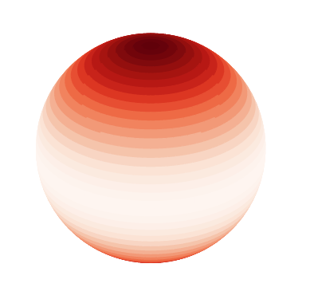
Diffusion rates
Kinetic rates
D=
K_12
K=
K_21
K_32

Slide 4
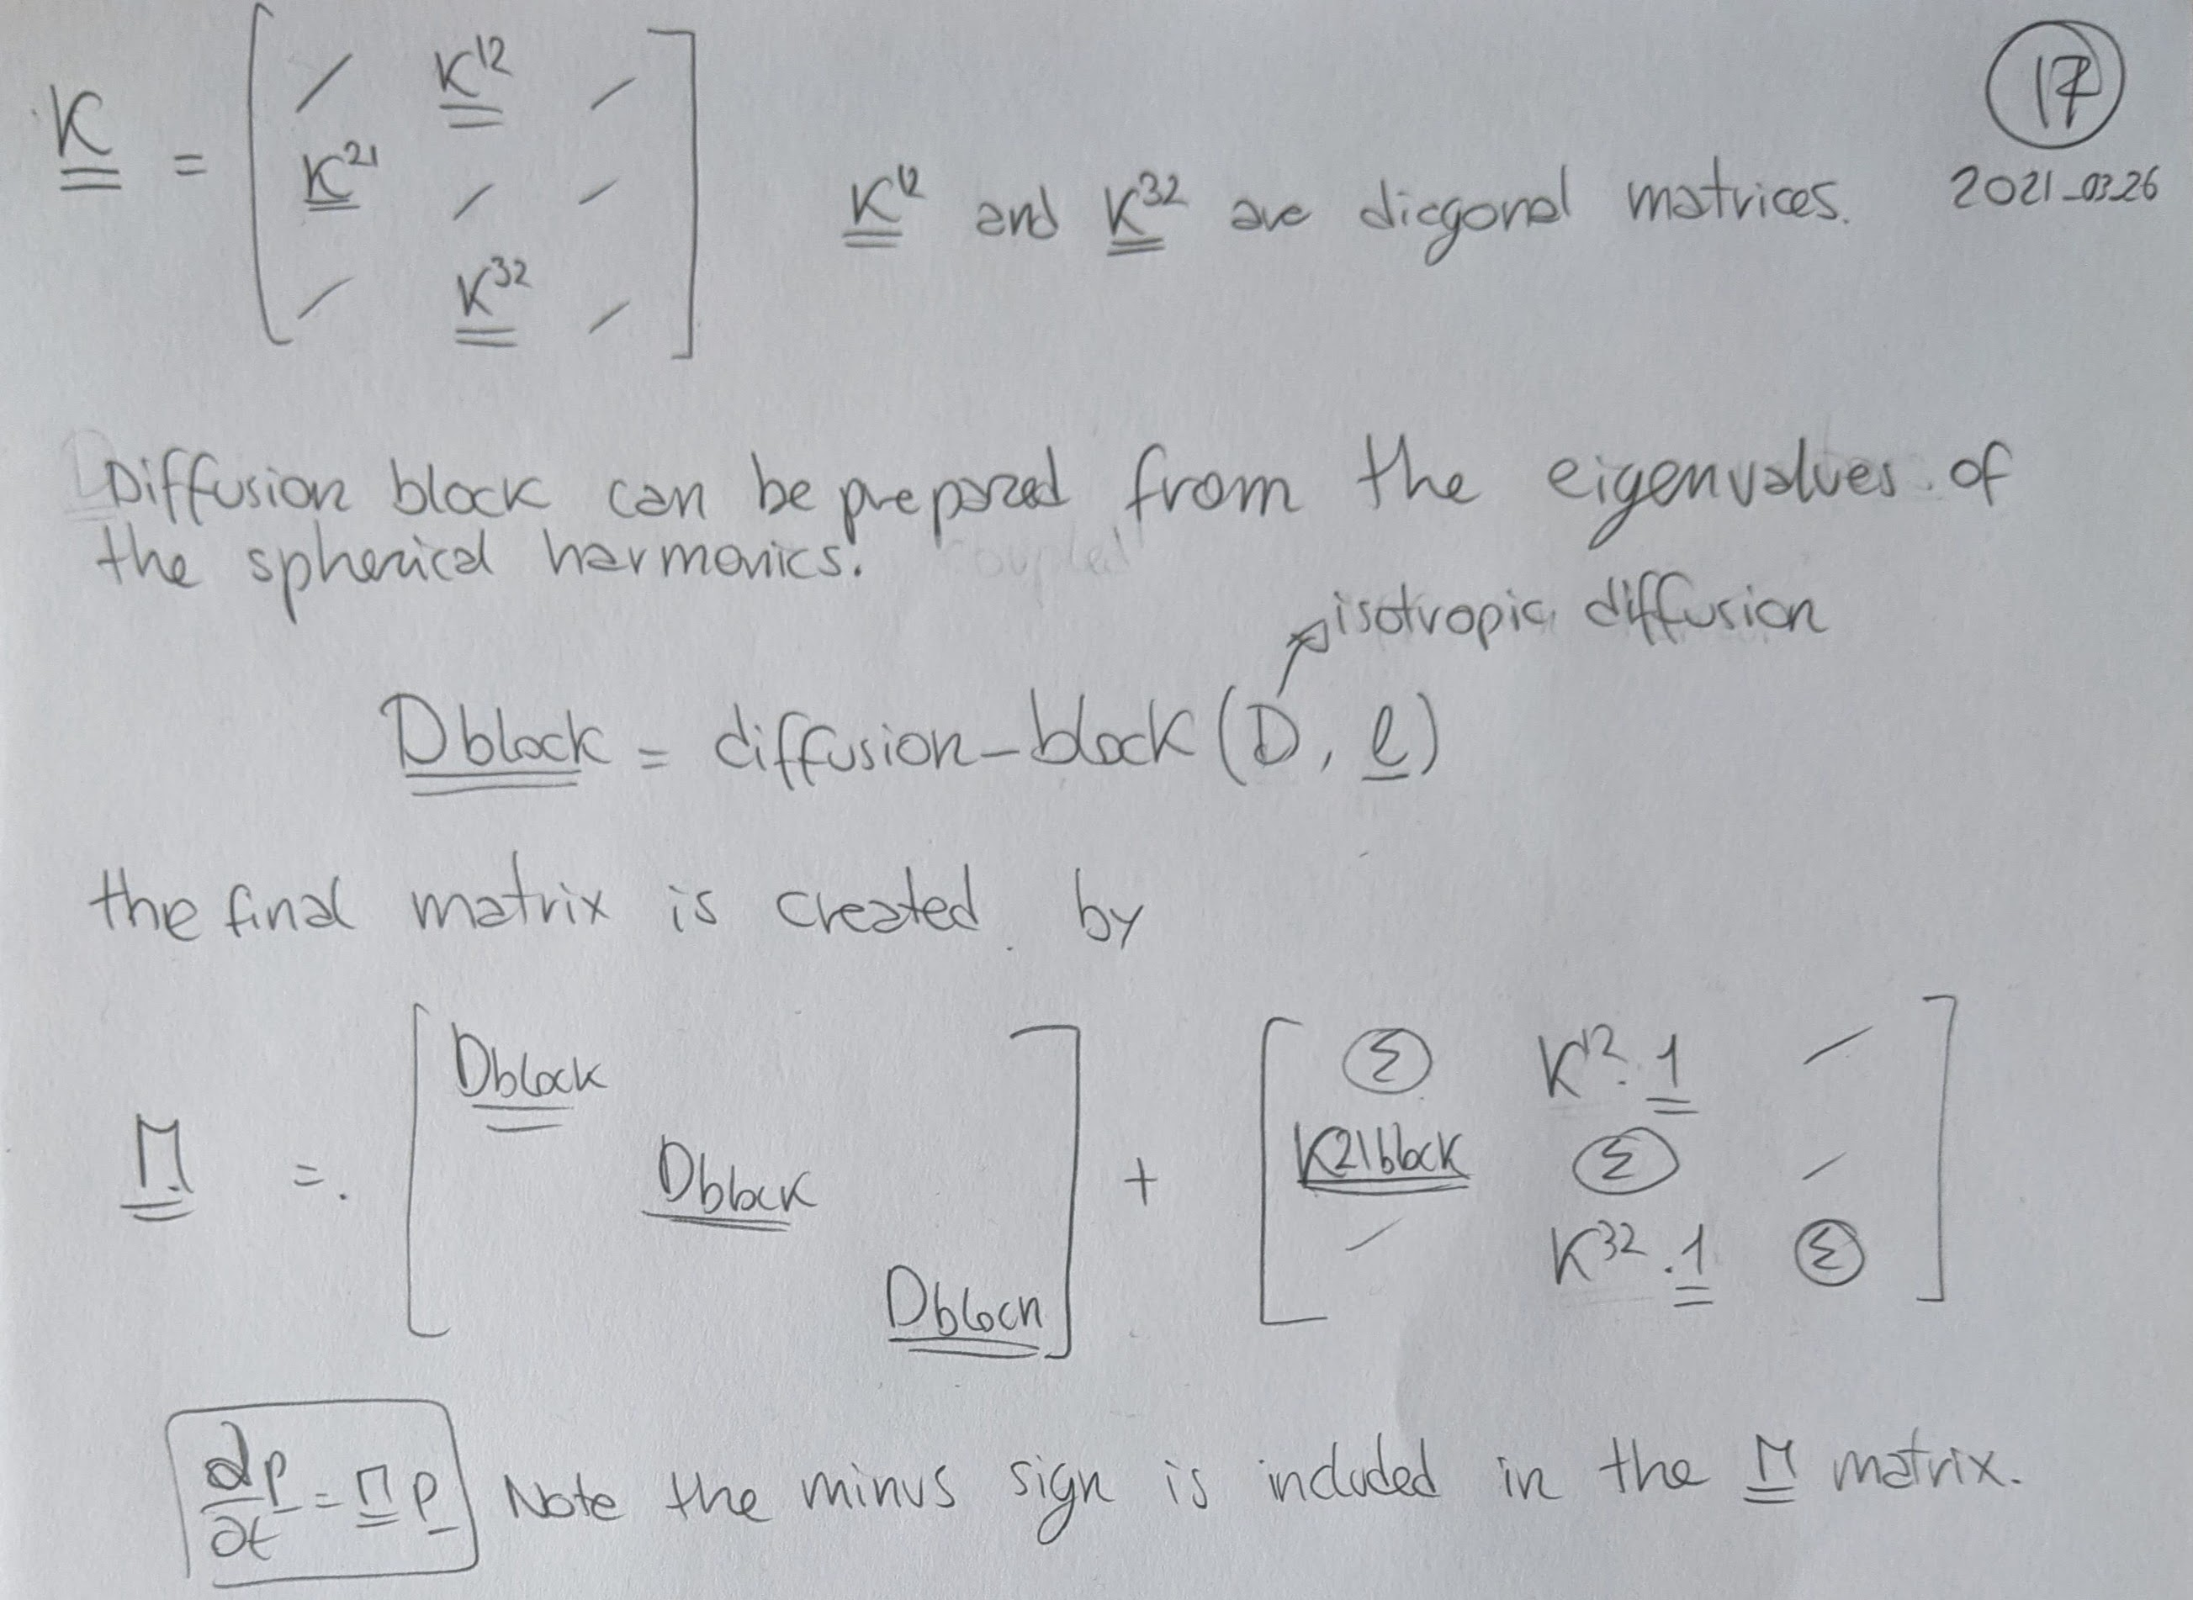

Slide 5
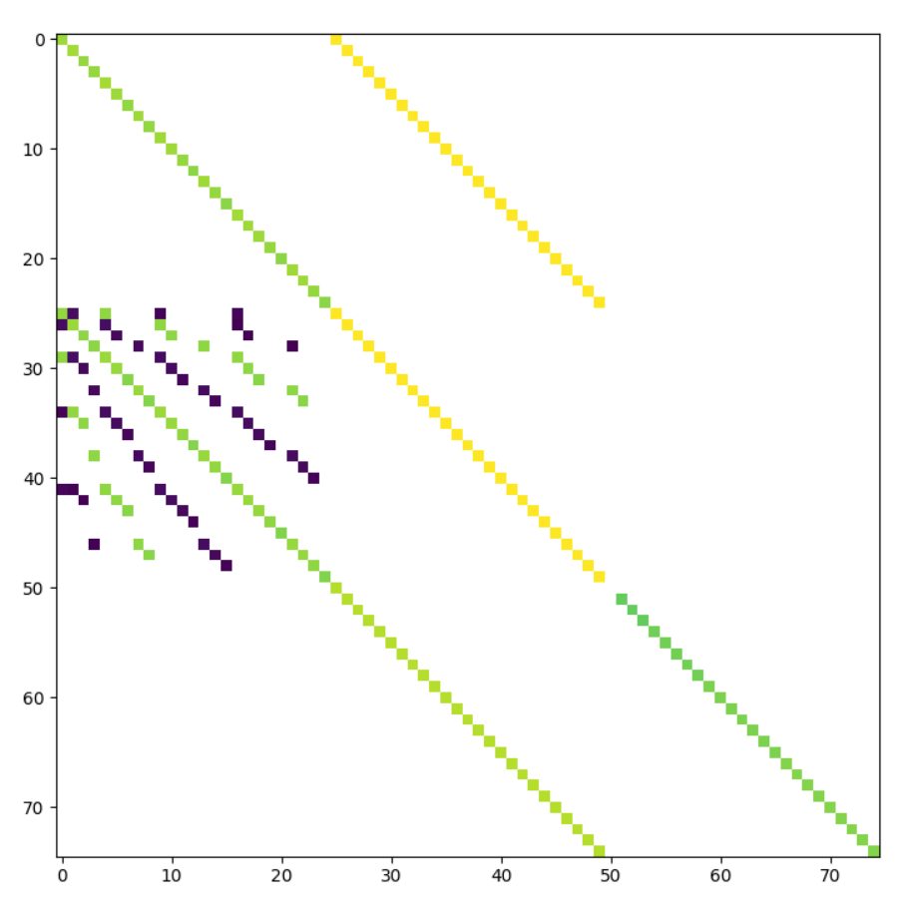
Full kinetic and diffusion matrix
D_1
K_12
M=
D_2
K_21
K_32
D_3

Slide 6
