Slide 1
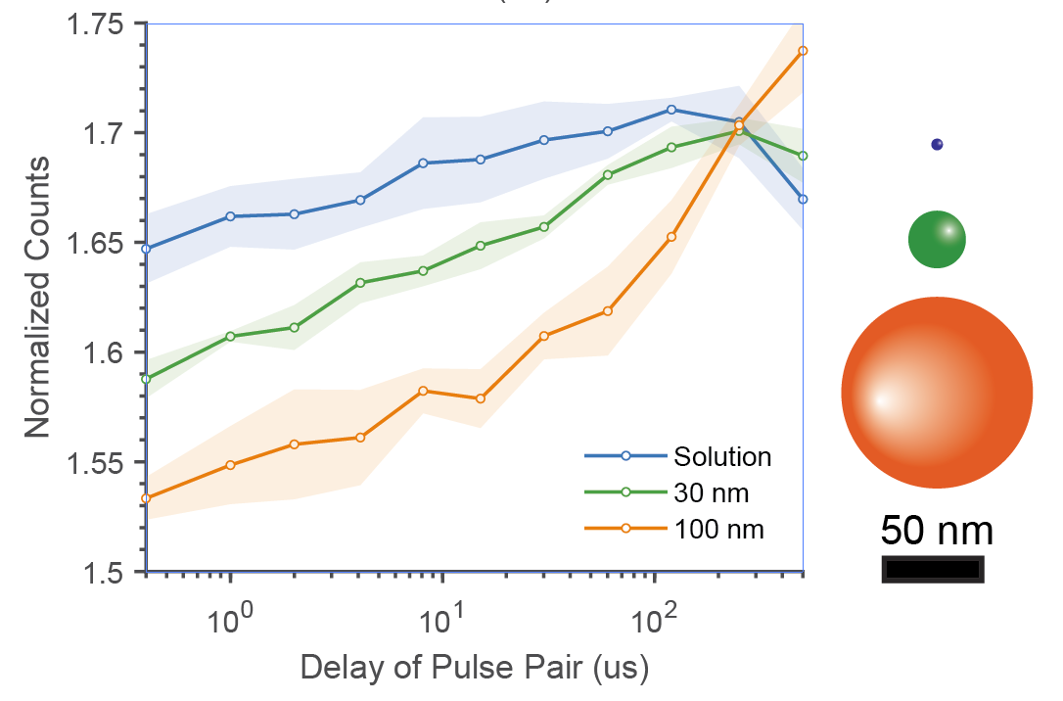
Experimental data

Slide 2
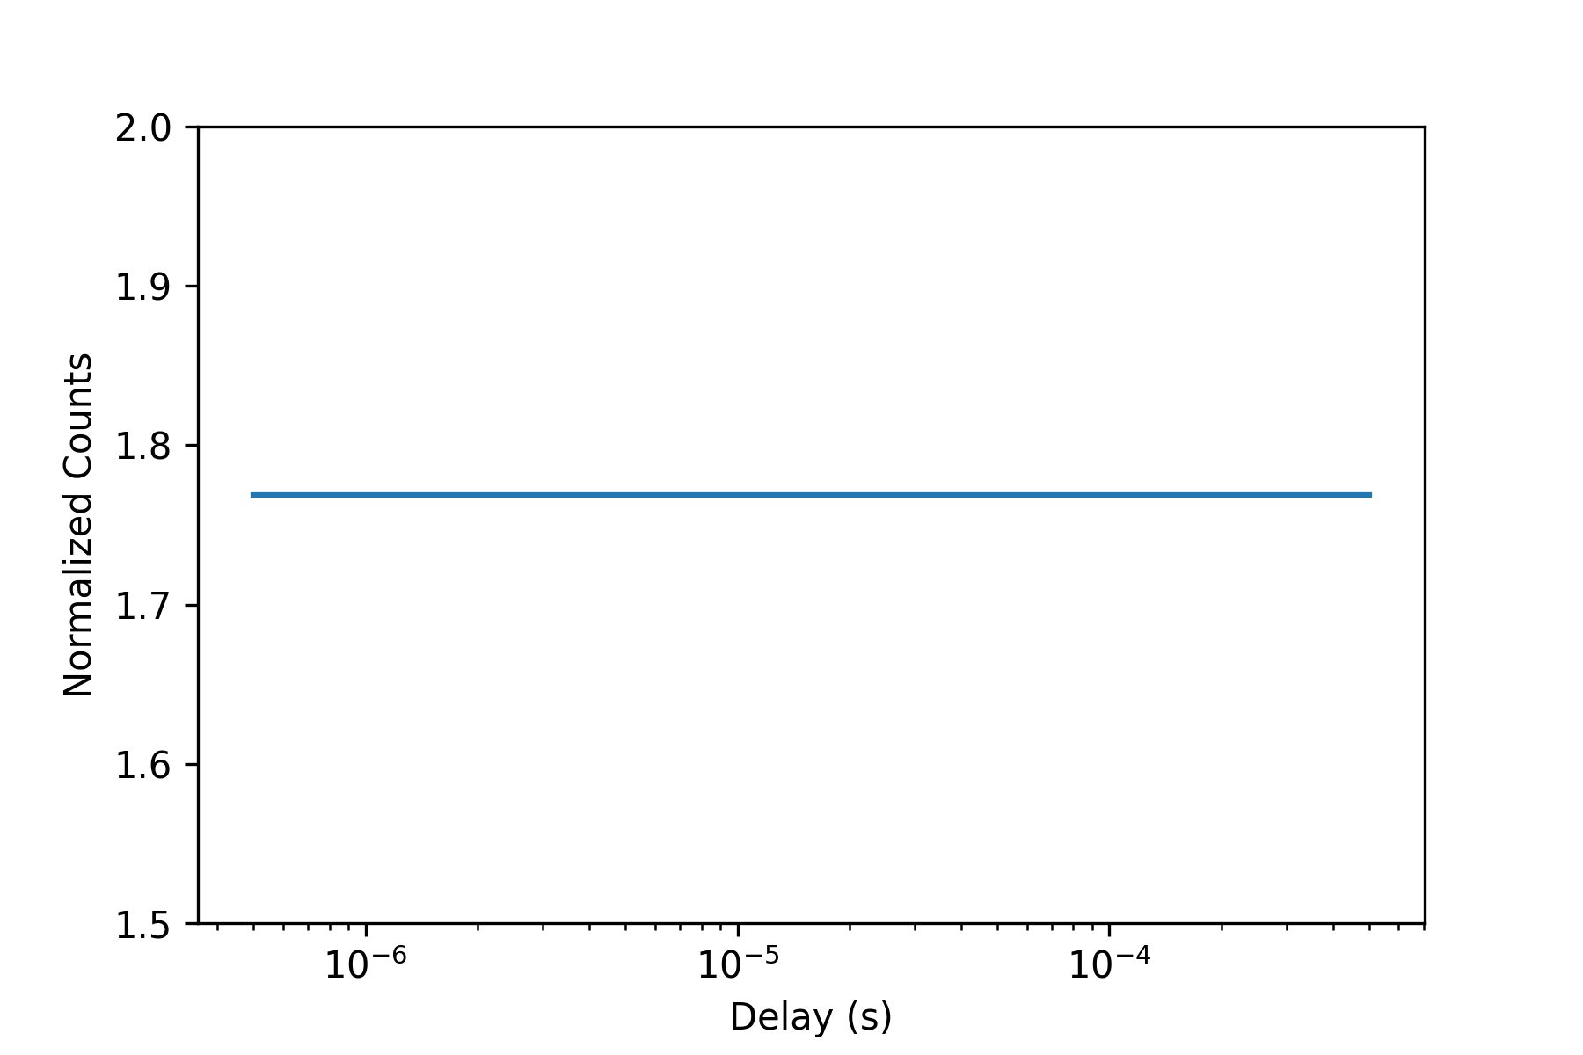
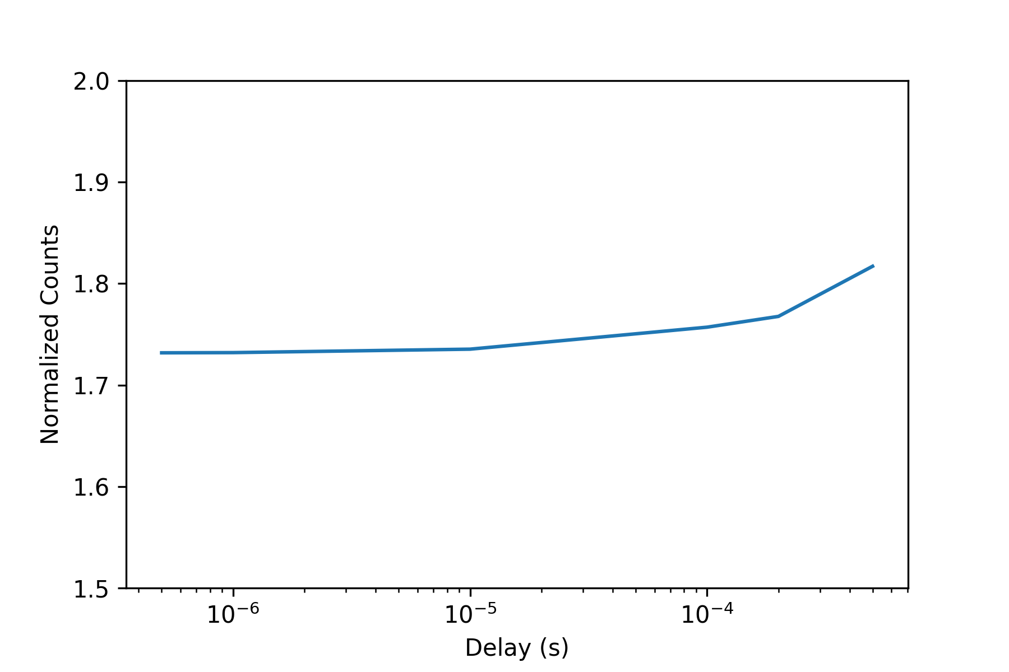
NA 0.1
405nm @ 550 kW/cm2
rsEGFP2 4states
30 ns
(GFP)
100 us
(100nm beads)

Slide 3
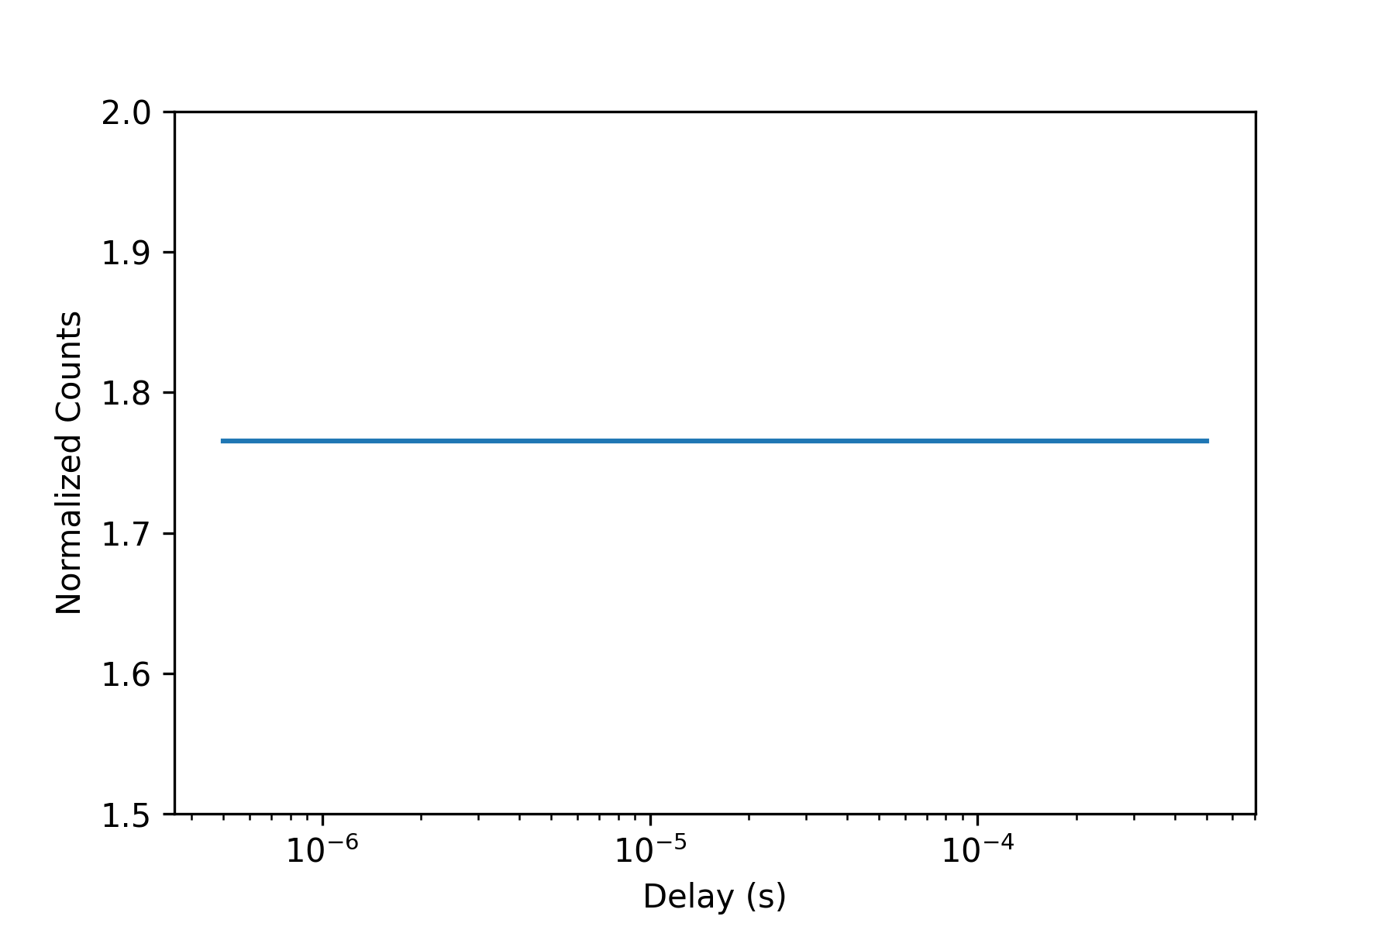
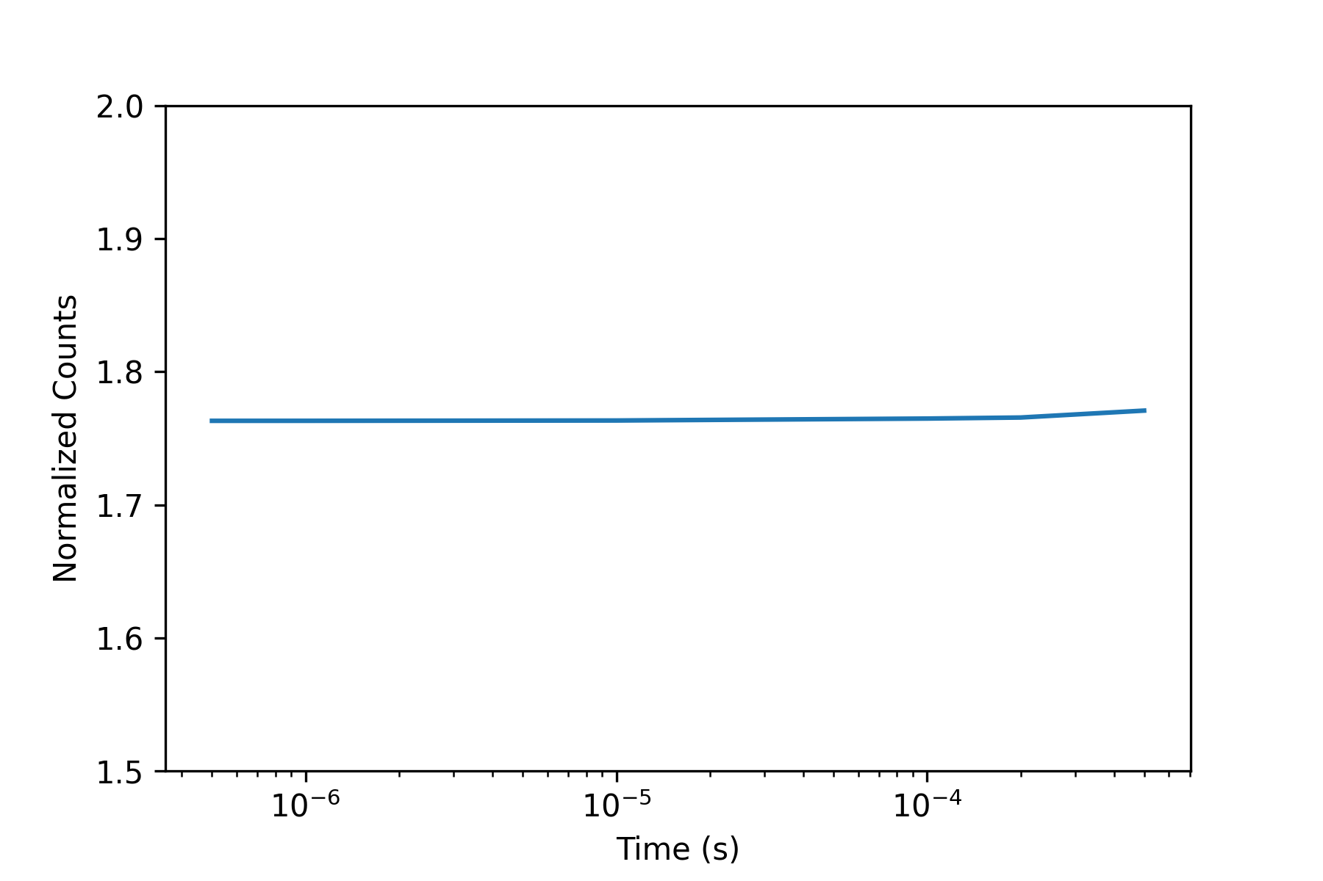
NA 1.4
405nm @ 550 kW/cm2
rsEGFP2 4states
30 ns
(GFP)
100 us
(100nm beads)

Slide 4
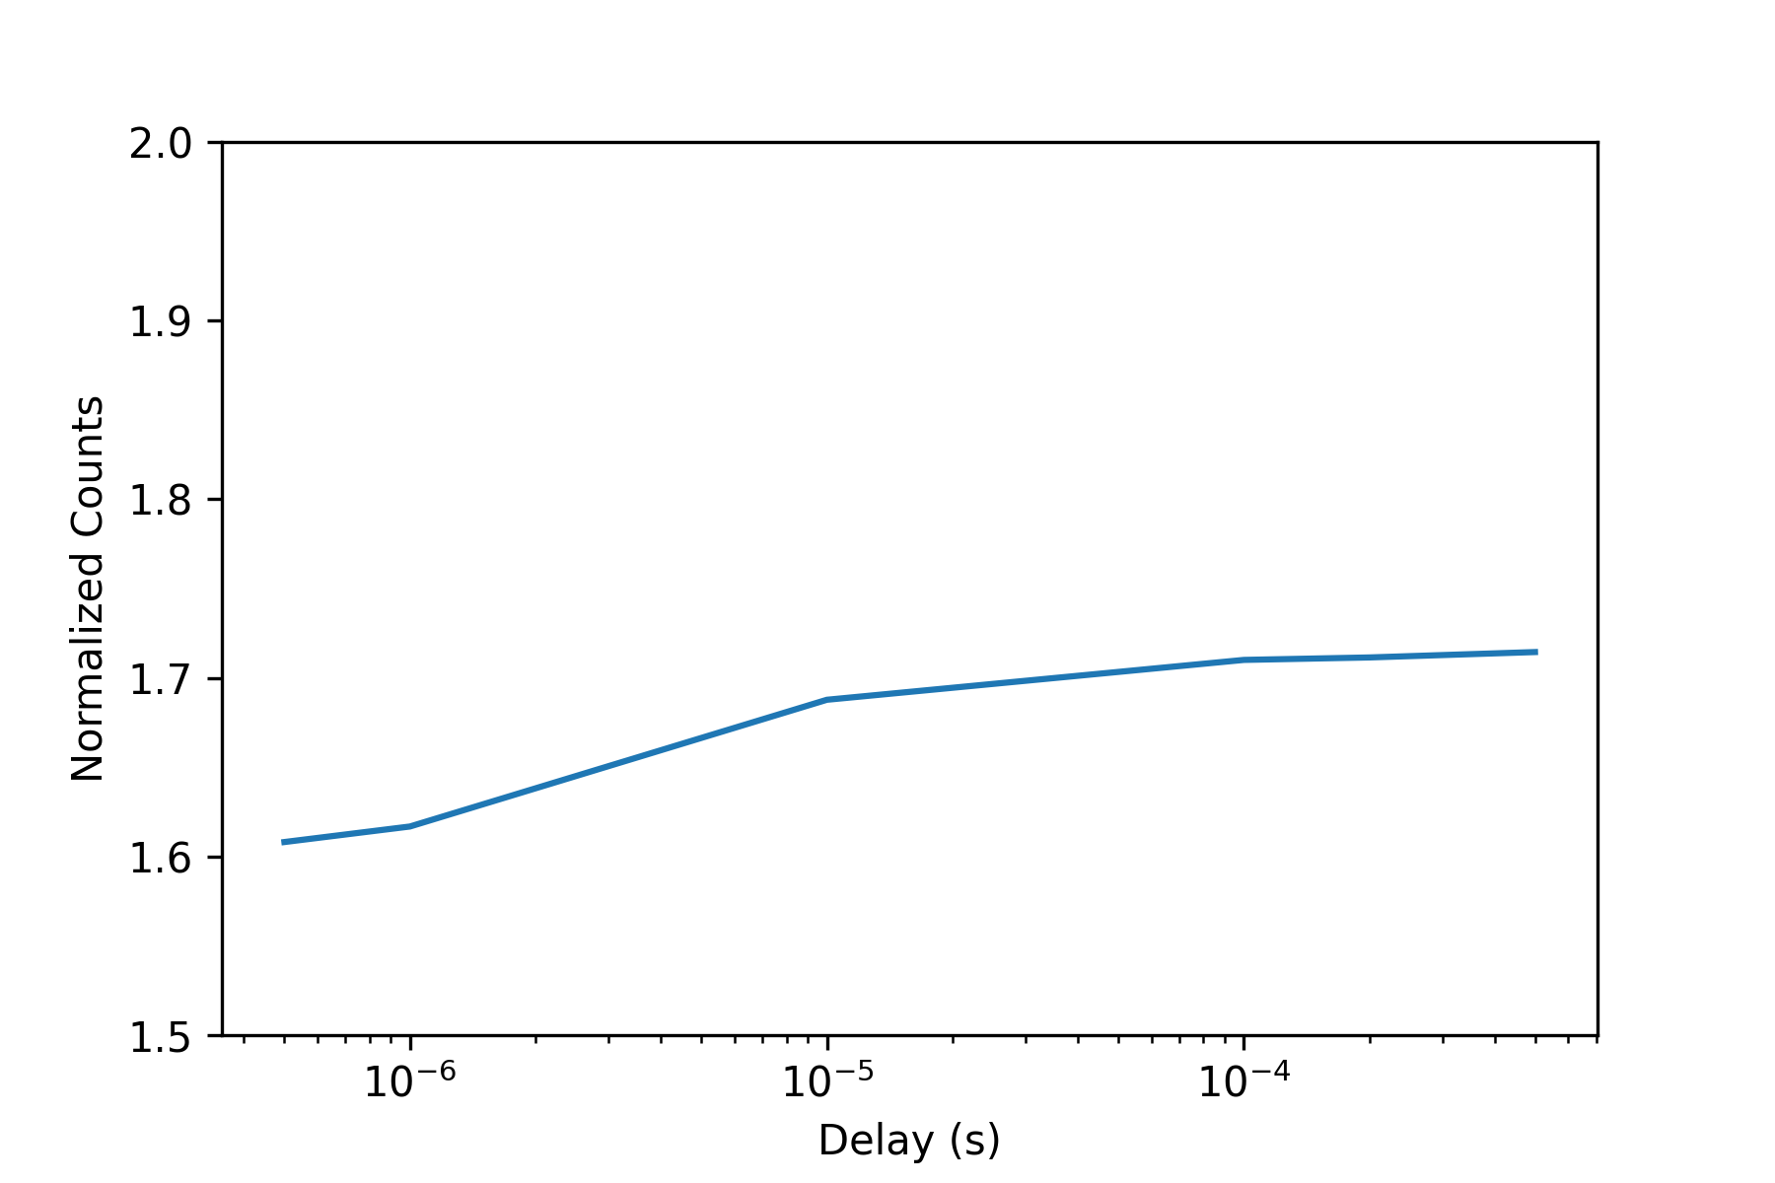
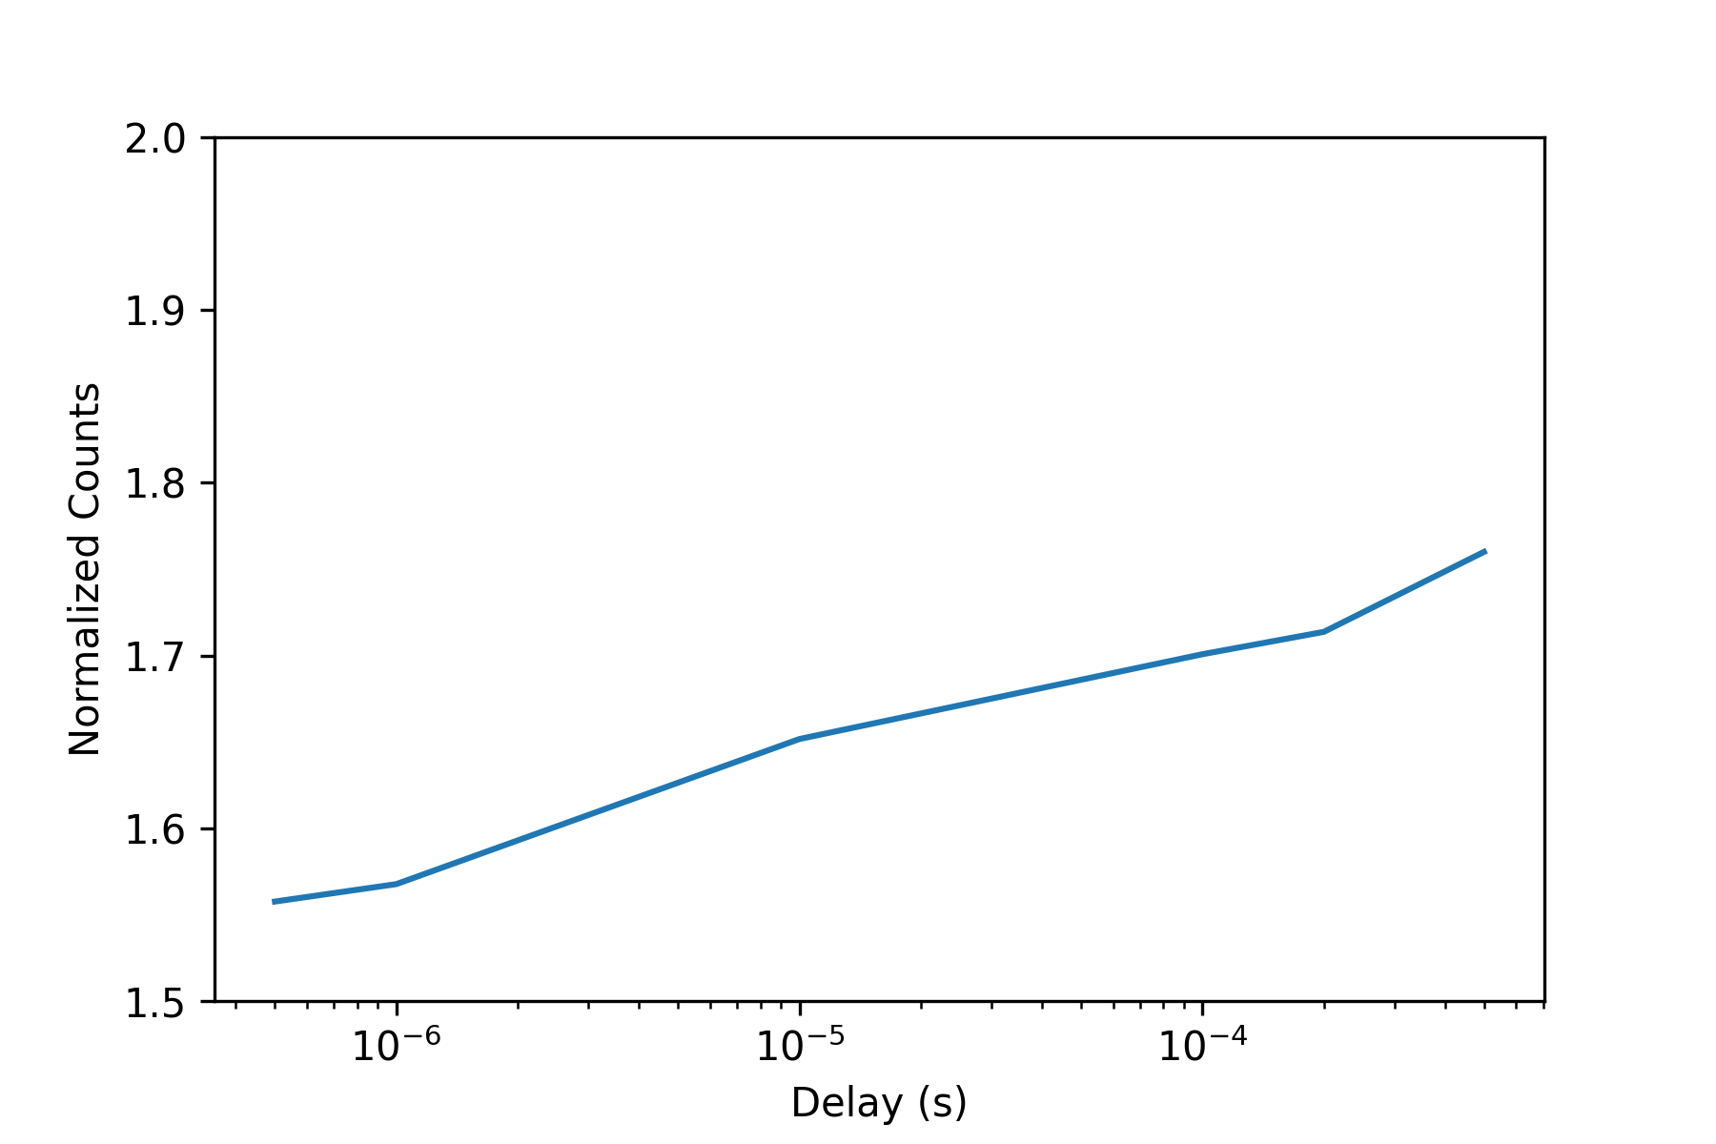
NA 0.1
405nm @ 550 kW/cm2
rsEGFP2 8states
30 ns
(GFP)
100 us
(100nm beads)

Slide 5

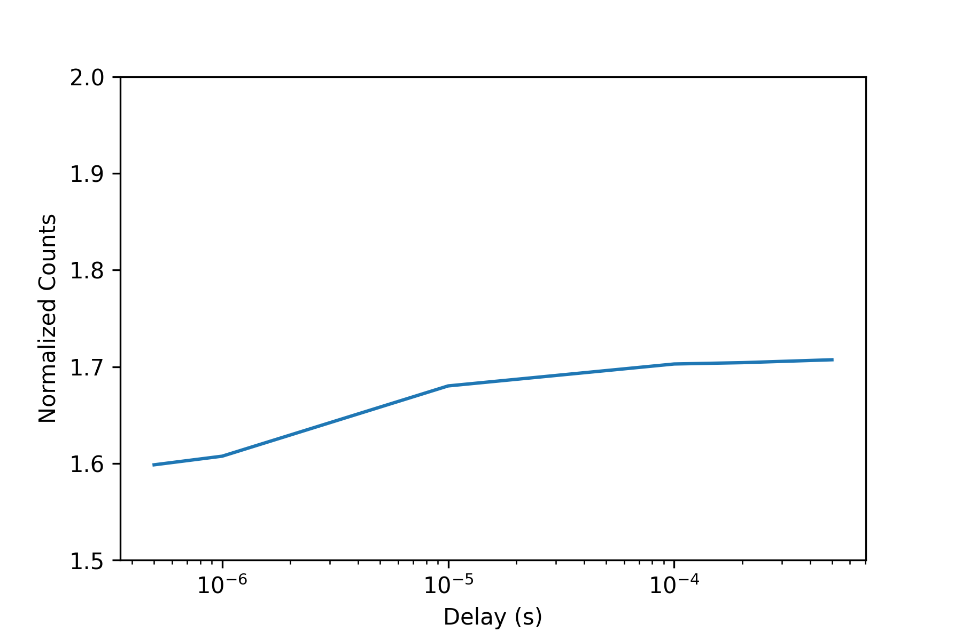
NA 1.4
405nm @ 550 kW/cm2
rsEGFP2 8states
30 ns
(GFP)
100 us
(100nm beads)

Slide 6


NA 1.1
405nm @ 550 kW/cm2
rsEGFP2 8states
30 ns
(GFP)
100 us
(100nm beads)

Slide 7
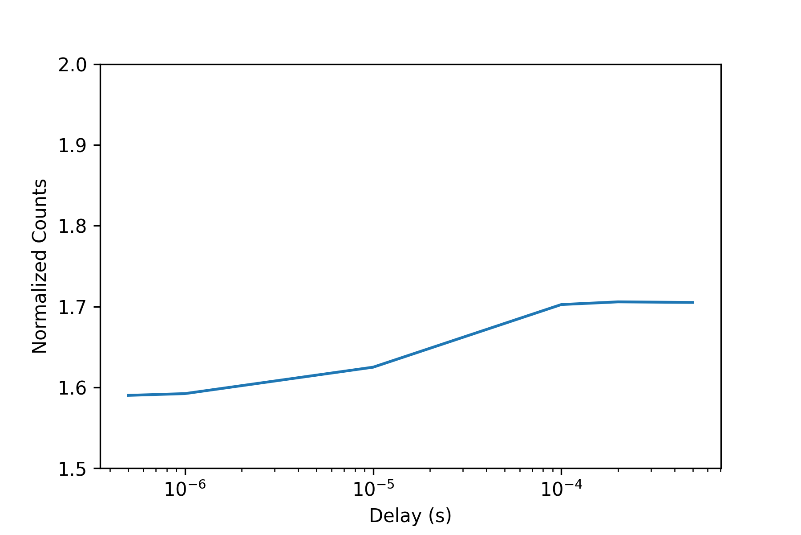
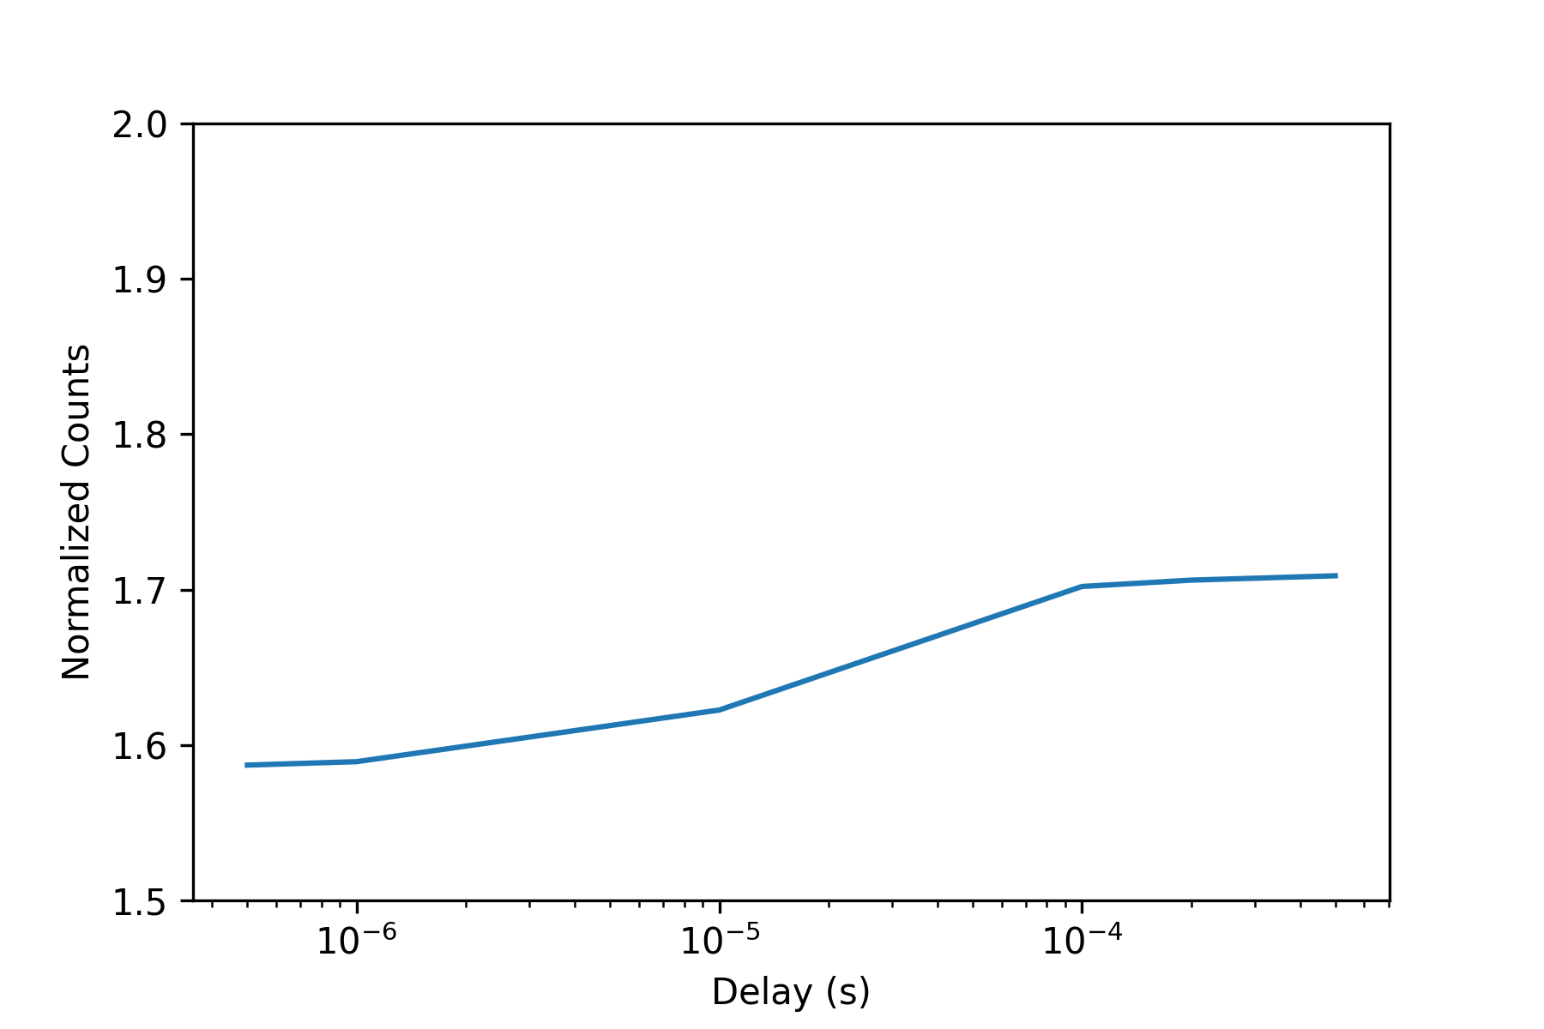
NA 1.4
405nm @ 550 kW/cm2
rsEGFP2 8states – tau_H 25us
30 ns
(GFP)
100 us
(100nm beads)

