Slide 1
Foundation of Data Science
HIT140 Group-28
S371680 ANDREA NICOLE DE LEON
S379408 PRABESH BHUSAL
S371164 AKSHATA BHUSAL
S374583 SHOVANA SHRESTHA

Slide 2



How does digital screen time affect your well-being?

Slide 3
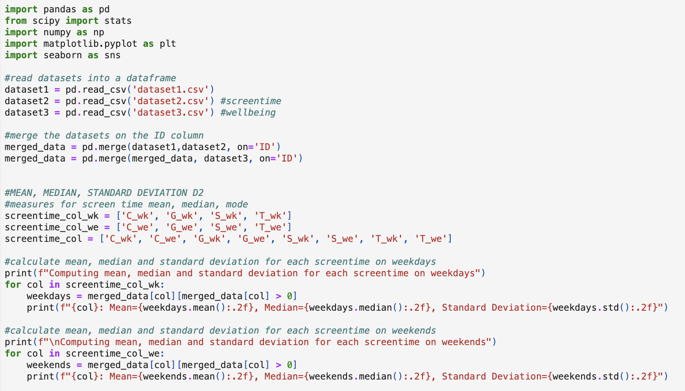
CODING
DESCRIPTIVE STATISTICAL ANALYSIS

Slide 4
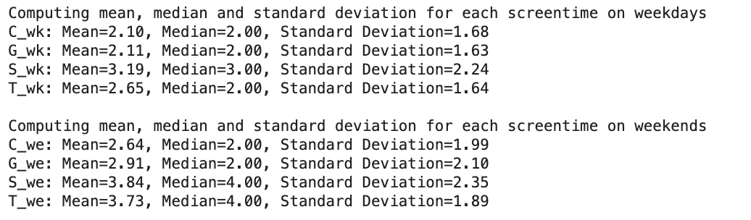
OUTPUT:

Slide 5
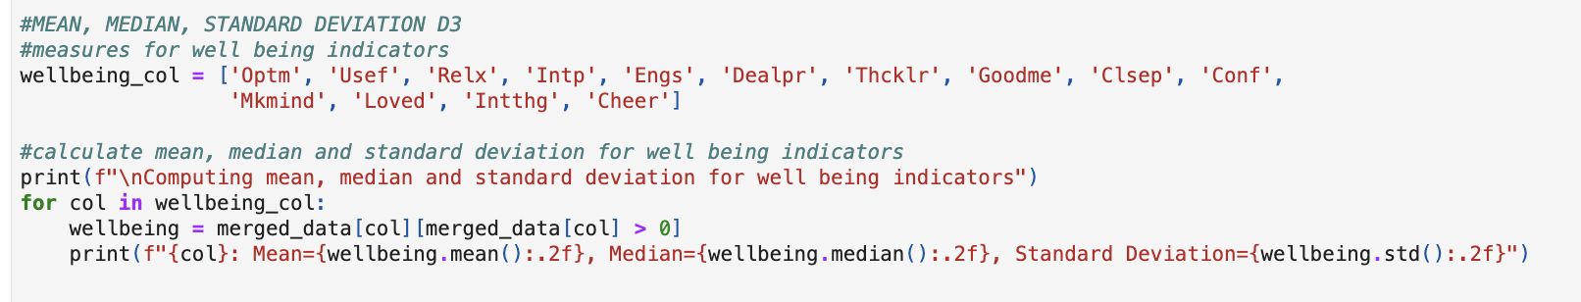
CODING

Slide 6
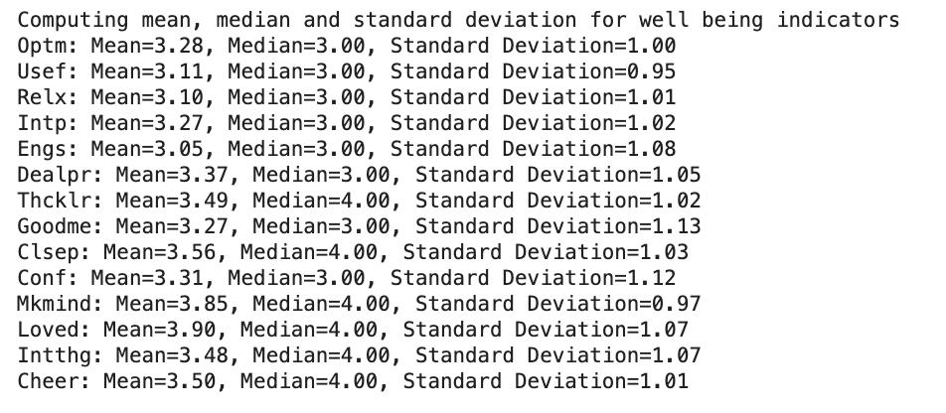
OUTPUT:

Slide 7

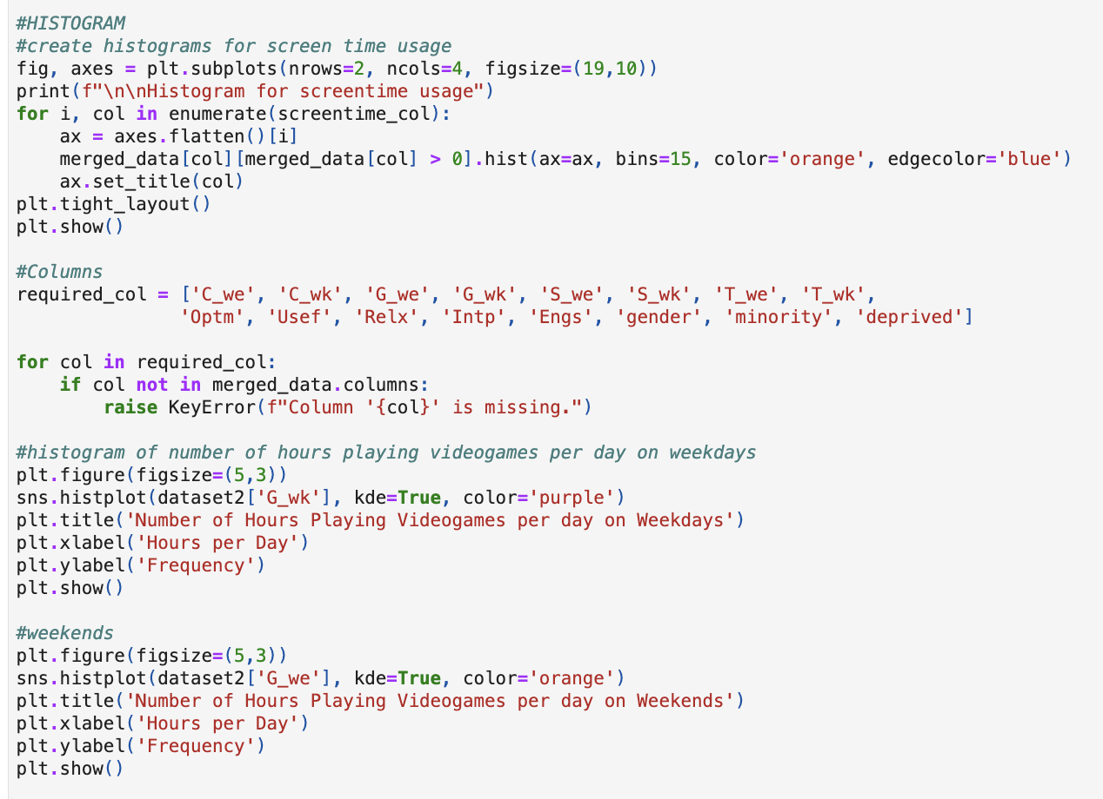
CODING

Slide 8
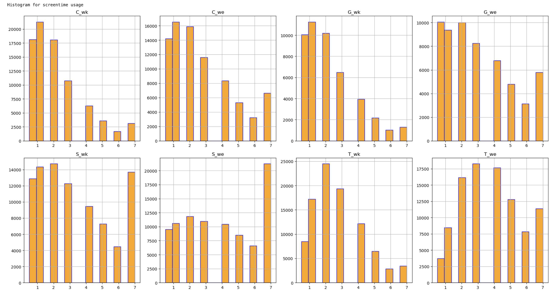
OUTPUT:

Slide 9
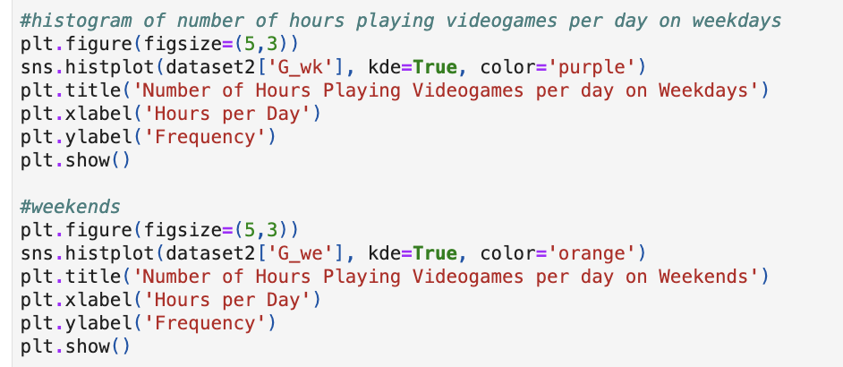
CODING

Slide 10
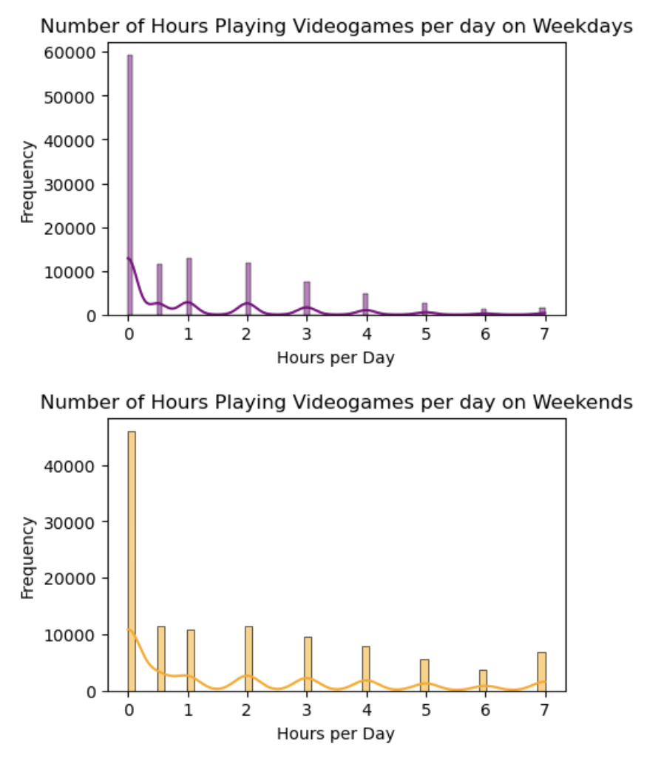
OUTPUT:

Slide 11
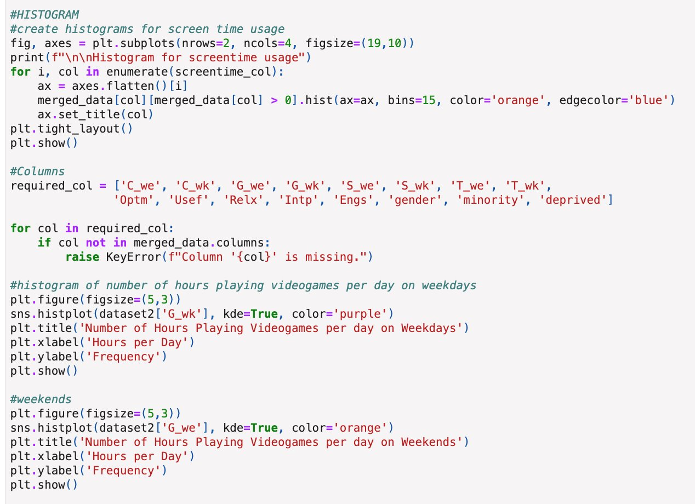
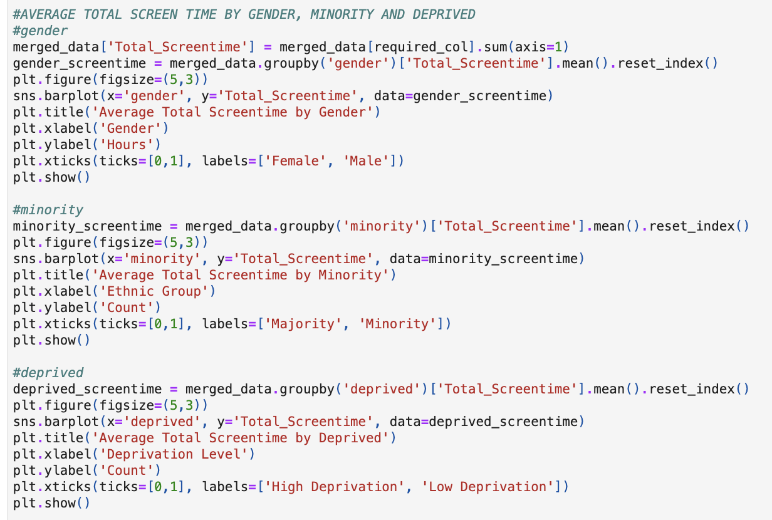
CODING

Slide 12
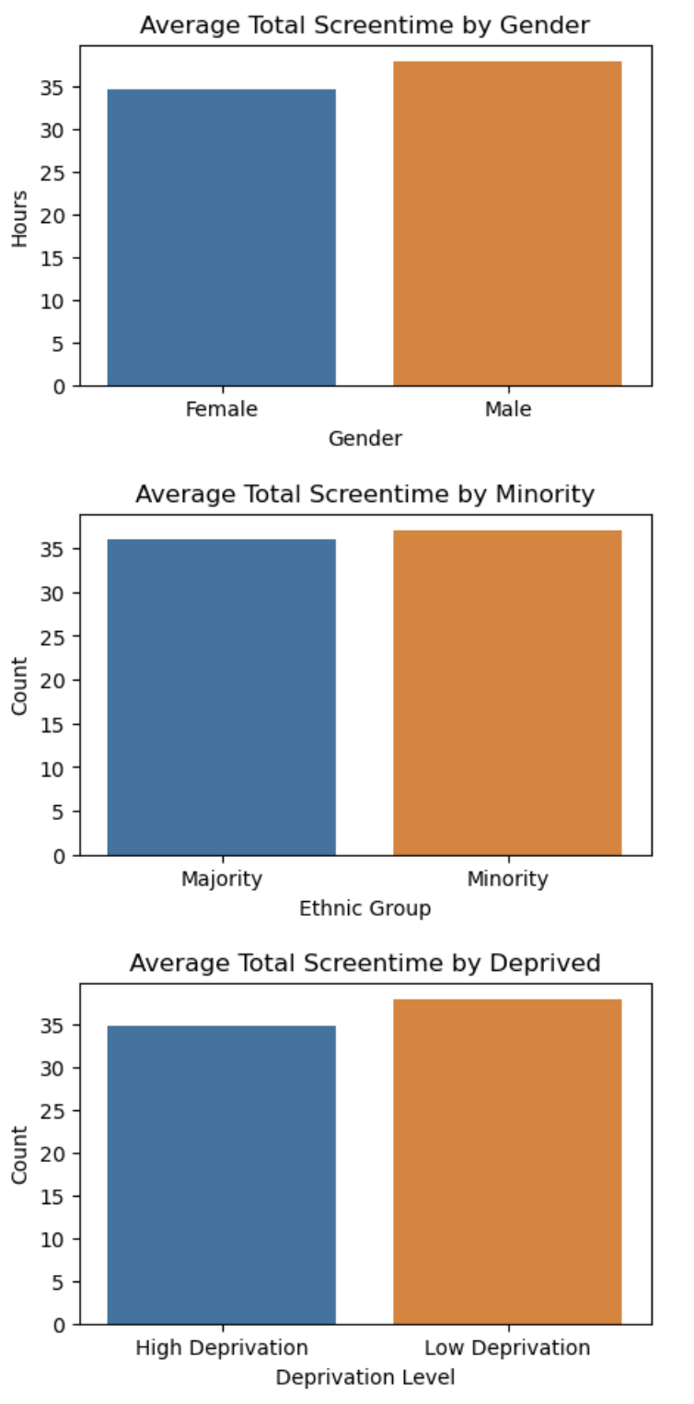
OUTPUT:

Slide 13
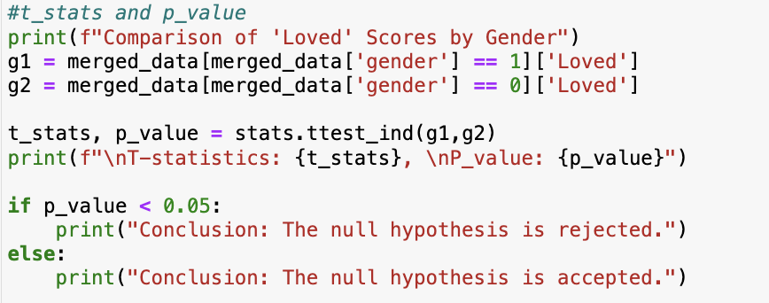
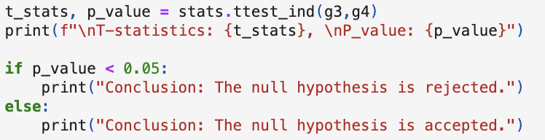
CODING
2 INFERENTIAL STATISTICAL ANALYSIS

Slide 14
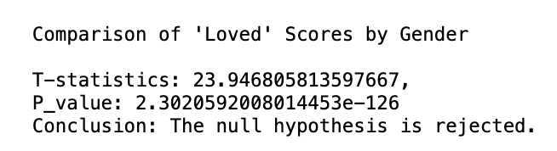
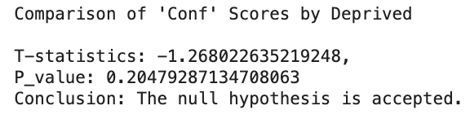
OUTPUT:

Slide 15
Thank you!

