Slide 1
EVENTSAPP
Ivan Montalbano 10503547
Andrea Zanetti 10527115

Slide 2
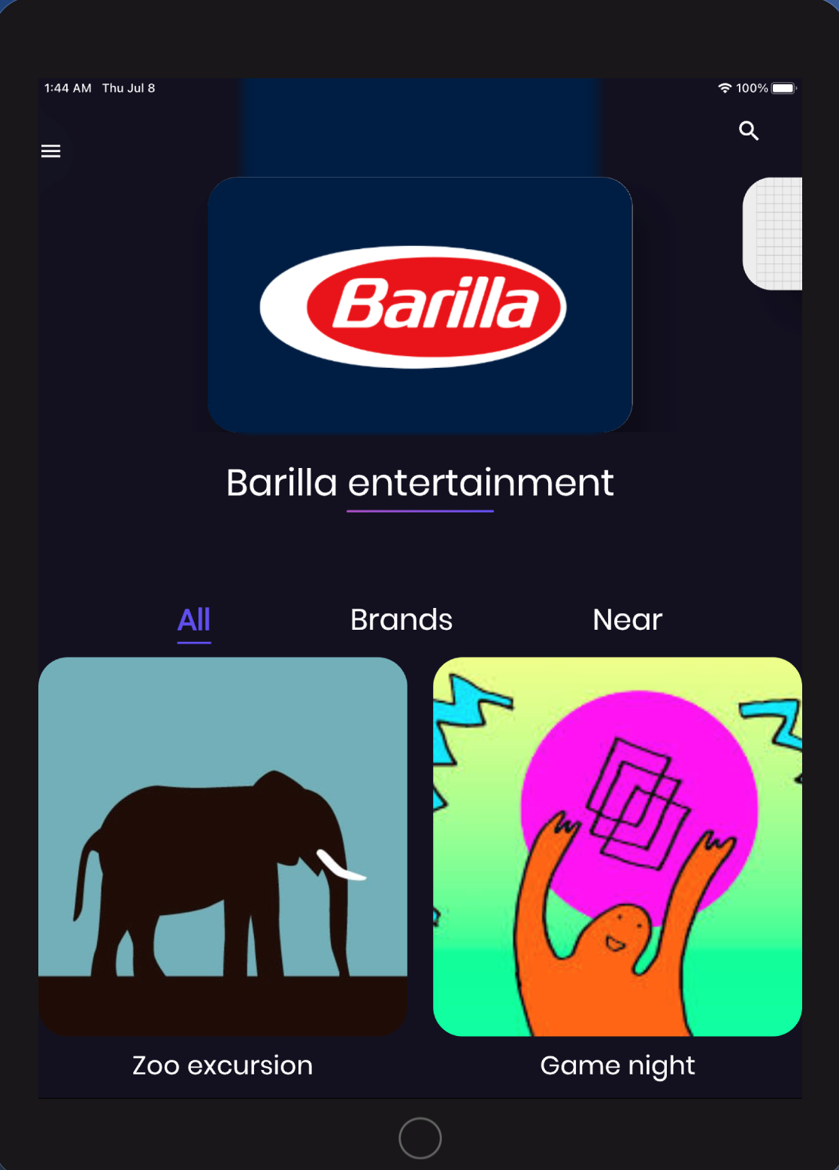
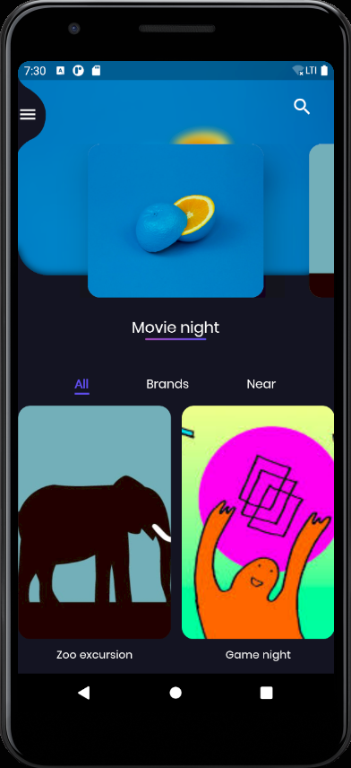
WHAT is it?
Notes:
Eventsapp is an application that allows people and organisation to organise events and share them in the community; we can define it as a social network based on events with the difference with other social networks being in the posts content published by users, which is not something about them but something to do with them

Slide 3
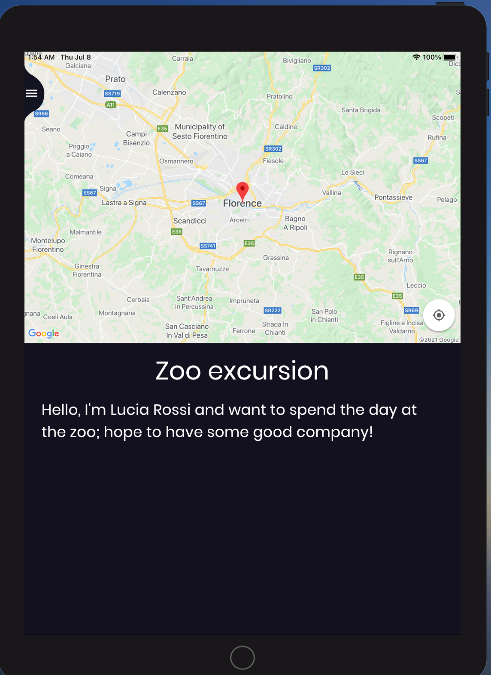
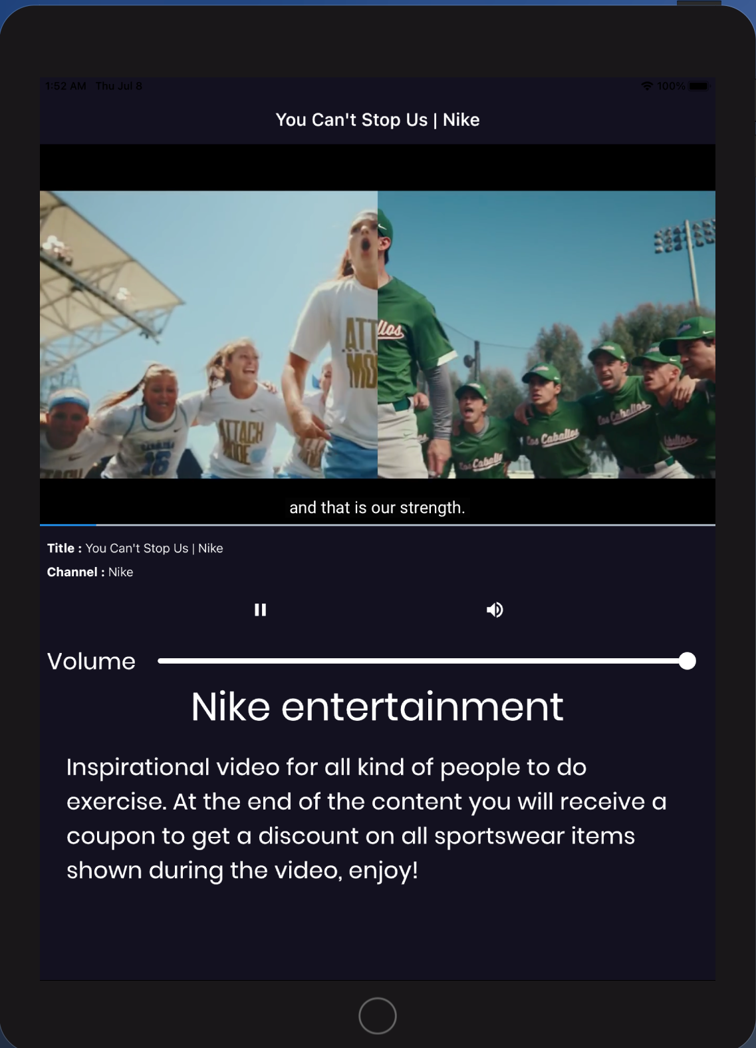
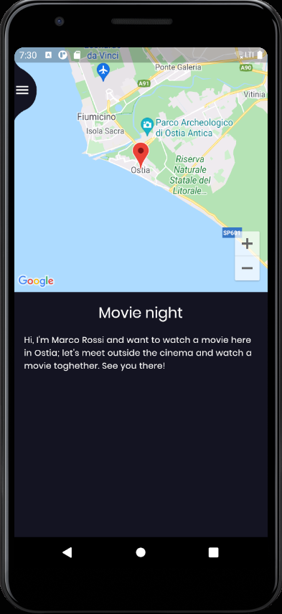
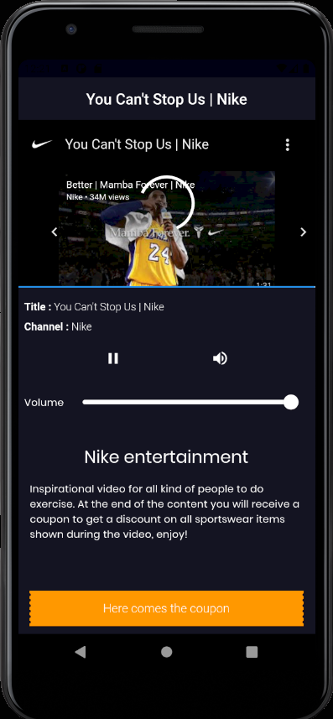
Events differences and technicalities
Notes:
On the left side there is a user event displaying the location of the event, the title and the event description, while on the right side there is another type of event, a branded event, which is part of the branded entertainment ecosystem implemented;
The main difference is that the branded events provide a content to enjoy, at the end of which a coupon will be provided, while the user event is an informational event that instead of a content provides the location where the event will take place on a map.

Slide 4
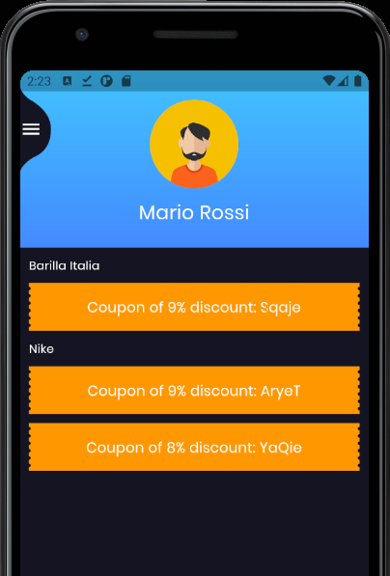
User rewards: coupons
Notes:
In the account page a user can see all the coupons collected grouped by brand; a code to insert before checkout on the brand website is provided and a discount is applied; the entity of the discount is proportional to the length of the entertainment content

Slide 5


Two different kind of users
BRAND
PEOPLE
Notes:
The idea is to have a common place where people can organise and take place to social events or enjoy branded events organised by organisation; nowadays most common social network applications relay on advertisement and data gathering for financial support, while branded entertainment offers a financial support alternative where the advertised content is chosen by the user and the application owners gets financial support directly from the branded organisation that joins the platform.

Slide 6
External services
Google Firebase:
Firebase authentication:
Email and password
Google login
Guest login
Firebase storage
Firebase database
Firebase dynamic links
Google Places API
Location search
Google Maps API
YouTube API
IFrame player
Map and marker display

Slide 7
Performances: KPI
Load speed: depends on the network performances as the majority of assets is stored on the cloud platform Google Firebase
Devices: supports different devices, both smartphones and tablets
Operating systems: supports both Android and iOS operating systems
Permissions: only storage (reading mode) and geolocation permissions required
Notes:
Permissions: no camera, contacts, calls, messages… permissions required

Slide 8
Testing: flutter driver
Unit testing:
Login function: email and password, guest and Google login
Logout function
Register function
Forgot password function
Sidebar elements tapping
Event creation function
Others
Widget testing:
Input to text fields
Pressing of buttons
Expecting of elements in mainly-information-displaying widgets
Integration testing:
Navigation through the application
Correctness of screen displayed through sidebar menu item tapping
Correctness of screen displayed through buttons tapping throughout the application
Notes:
Bottom-up approach: started with unit testing, then widget testing and ended with integration testing. We performed 31 different tests between app navigation and widgets filling; we performed a kind of bottom-up approach, meaning we started with widget filling and tested that the widgets with buttons and text fields behave correctly with determined inputs and then we assured that widgets that mainly displayed information were displaying the correct information; finally we tested the overall application functionality focusing mainly on correct display of widgets and correct handling of tapping events

Slide 9
Future developments
Allowing different kind and different sources of entertainment
1
Implementing invite-only and closed-number events
2
Implementing subscription to user accounts
3
Adding a marketplace
4
Notes:
For now an entertainment content is considered to be a youtube video, in the future it can be also a podcast or a game and can be streamed from other streaming platform and even from our own storage
Subscription to user accounts would allow a user to receive feeds about a specific userg
The marketplace would substitute the current discount-code system rewarding the users with Gems for example allowing them to trade the Gems with rewards available on the marketplace, hence having a choice on the reward

