Slide 1
Stability-plasticity in multi-schema learning
Stability-plasticity dilemma: when/why/how does new learning interfere with old knowledge?
Models that split vs. models that do not split representational resources.
Dual role of prediction error: small prediction errors update existing representations; large prediction errors signal change in environment mode.
Our goal: develop a multi-schema sequential prediction learning task for humans and models.
Manipulate curriculum of the learning experience: (i) Do humans split representations? (ii) Evaluate hypothesis about dual role role of prediction errors.

Slide 2
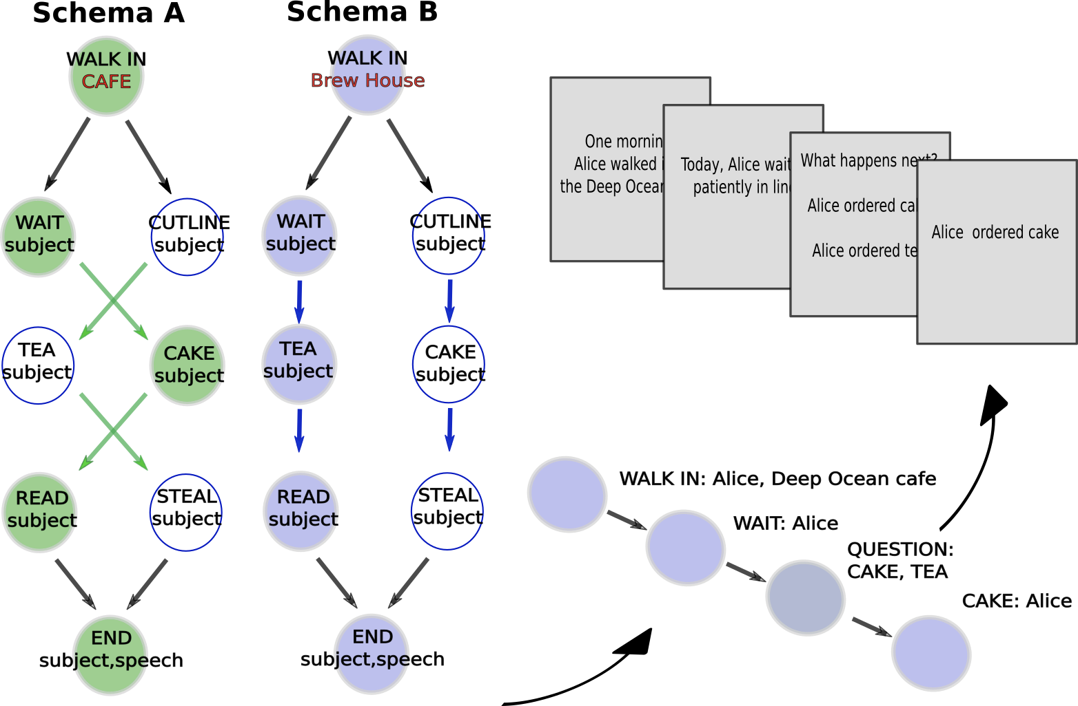
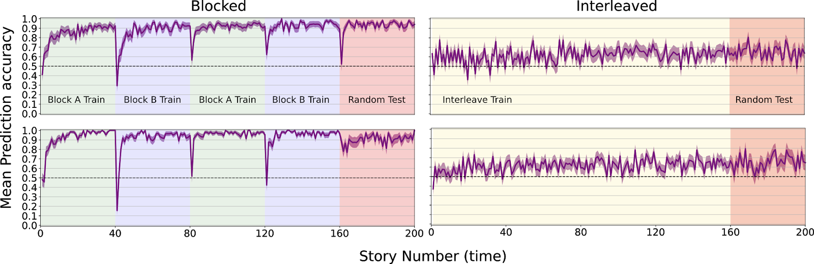
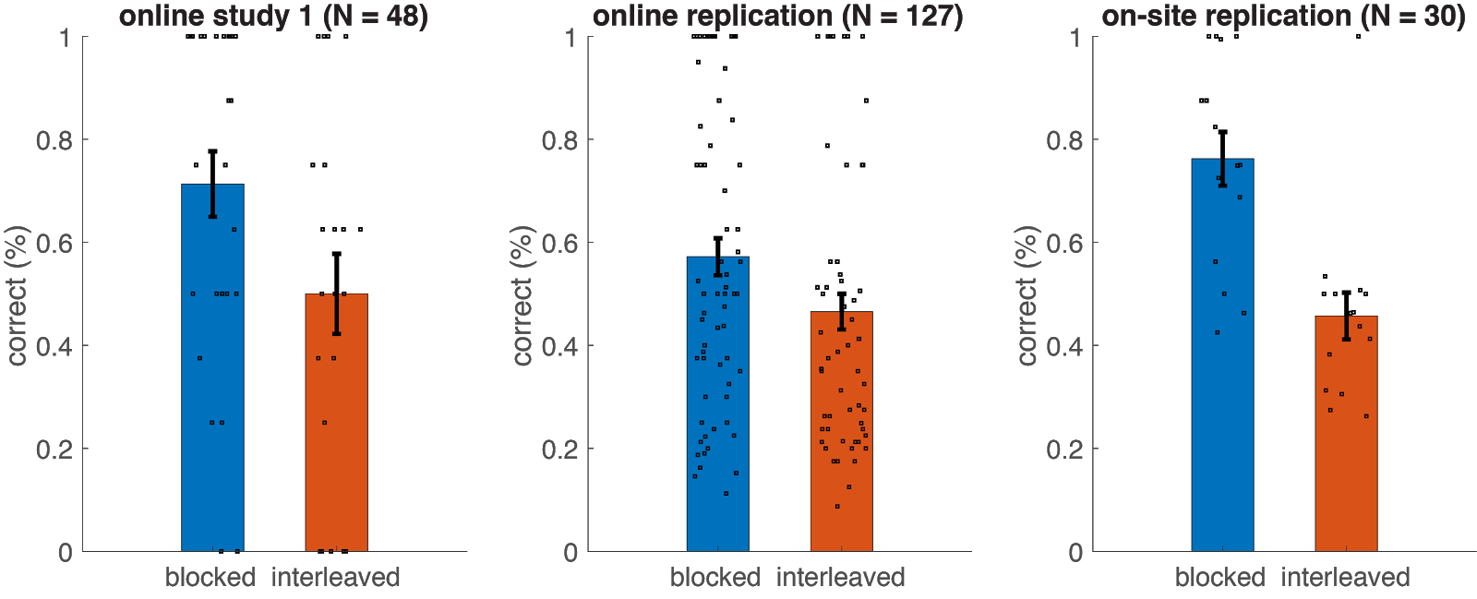
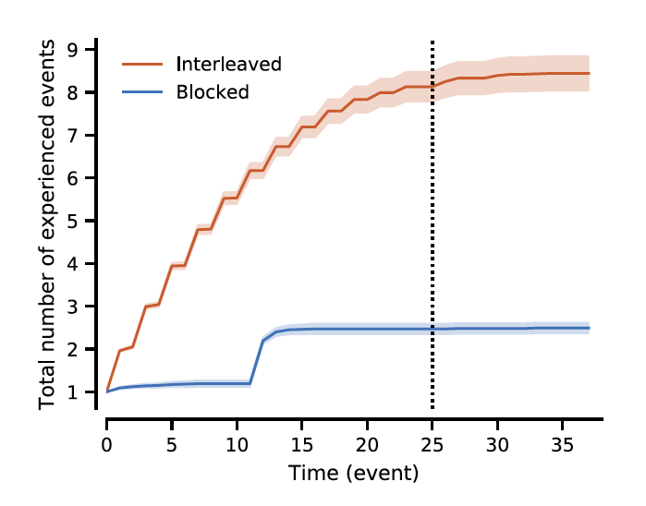
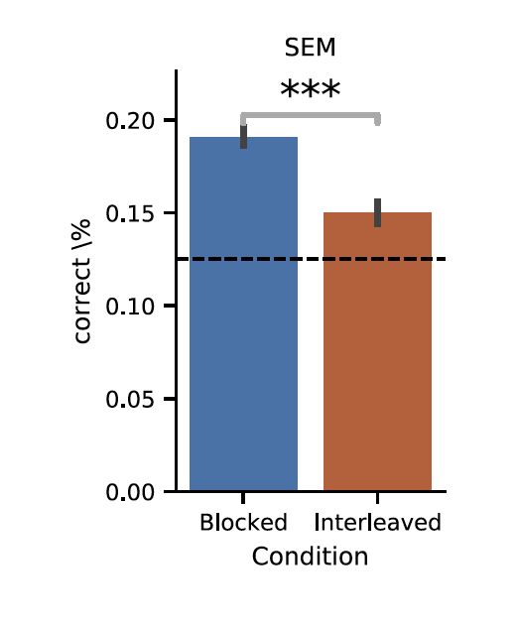
Results
task structure
humans
humans
SEM: splitting model
humans and splitting models: blocked > interleaved
dual-role of prediction error: update or split representations

Slide 3
Next Steps
in prep for submission to nature human behavior
previously presented in:
Curriculum effects in multi-schema learning (2019) Psychonomics Society.
Curriculum effects in multi-schema learning (2019) Context and Episodic Memory Symposium.
Event schemas: learning and use in humans and neural networks (2018) Context and Episodic Memory Symposium.

