Slide 1
Curriculum effects in multi-schema learning
Andre Beukers, Ken Norman

Slide 2
Definitions
Curricula: Structure of the learning experience.
Typically operationalized as blocked-interleaved
Schema: Scaffolding of memory, used for prediction.

Slide 3
Curriculum effects
Benefits of interleaved practicing on learning are well documented (Schmidt & Bjork, 1994)
Benefits of blocking have been observed (Carvalho & Goldstone, 2017)
Previous work focused on category learning classification task
Here we focus on sequential prediction task

Slide 4
Event segmentation theory
EST: how continuous experience is segmented into episodes/events and how these in turn serve to organize memory and prediction (Kurby & Zacks, 2007).
Special emphasis on the role of prediction error learning signal in non-stationary environments (Franklin et al., 2019)

Slide 5
Hypothesis
Blocked learning will set-up stronger expectation; when violated, this will cause participants to infer that a new latent cause is present.
New observations are assigned to the new latent cause, preventing interference with previous learning

Slide 6
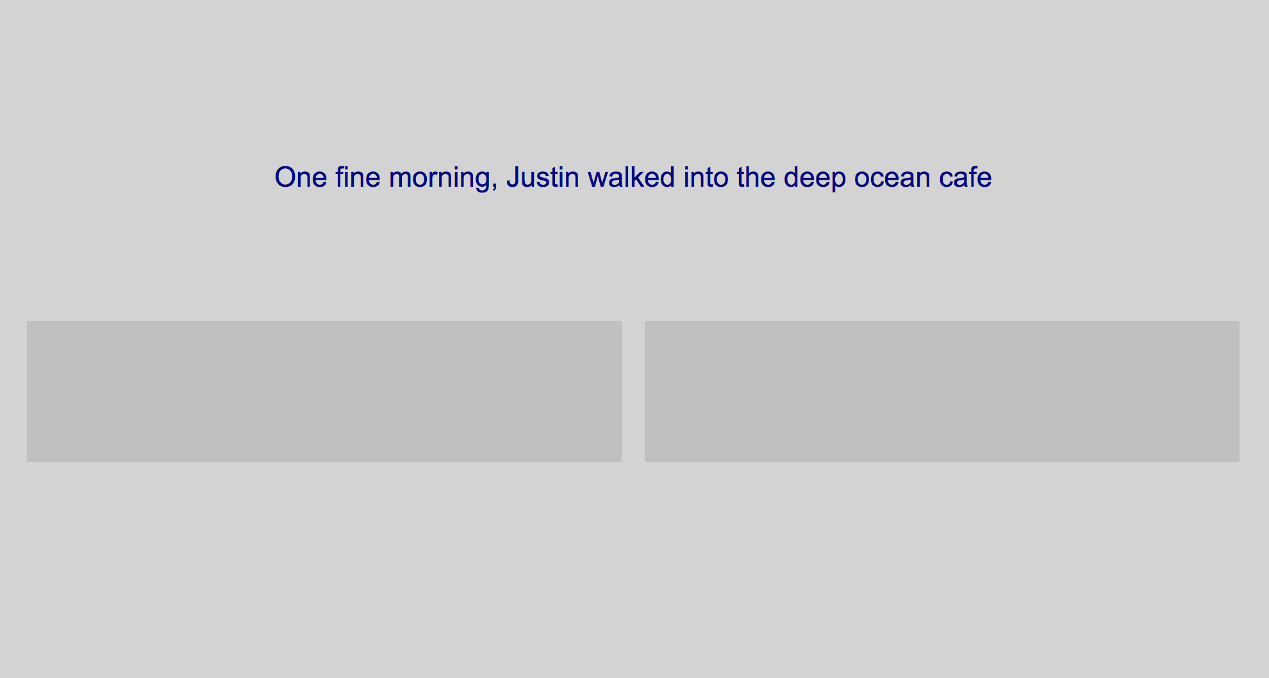
Sequential Prediction Paradigm
Subjects read stories
Sentence at a time

Slide 7

Sequential Prediction Paradigm
Subjects read stories
Sentence at a time
Prediction probe

Slide 8
Sequential Prediction Paradigm
Subjects read stories
Sentence at a time
Prediction probe
2AFC response
Today, Justin cut the line
Today, Justin waited in line patiently

Slide 9
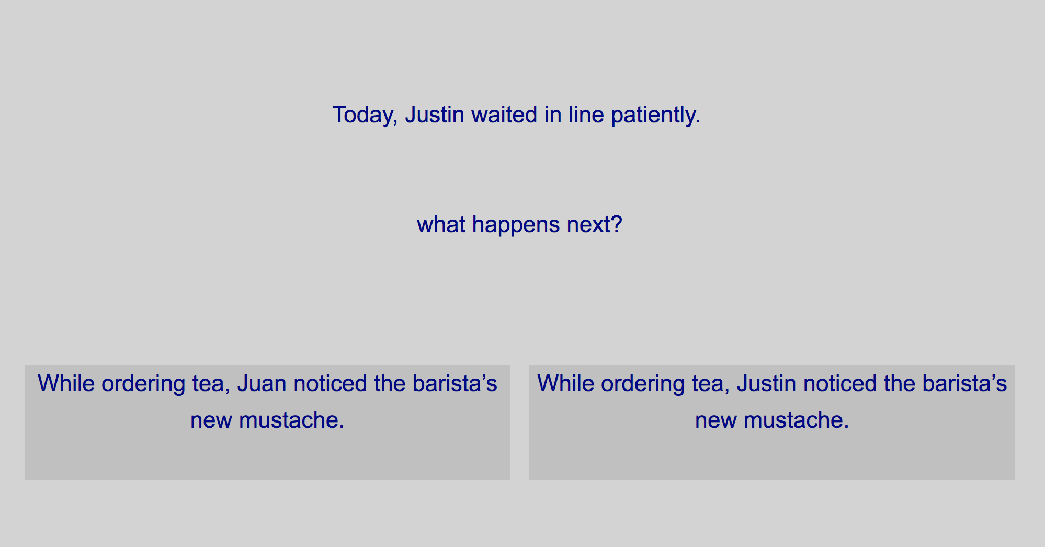


Sequential Prediction Paradigm
Subjects read stories
Sentence at a time
Prediction probe
2AFC response
Next sentence

Slide 10
Where do these stories come from?

Slide 11
Sequential Prediction Paradigm
Stories generated from a probabilistic graph
Each node is an event

Slide 12
Sequential Prediction Paradigm
Walk in cafe
Stories generated from a probabilistic graph
Each node is an event
Order food
Sit down
Read book
Leave

Slide 13
Sequential Prediction Paradigm
Walk in cafe
50%
50%
Notes:
Say the story begins “alice walked into cafe”

Slide 14
Sequential Prediction Paradigm
Walk in cafe
50%
50%
Order food
Order drink
Notes:
Then the next sentence is going to be drawn from either order food or drink

Slide 15
Sequential Prediction Paradigm
Walk in cafe
50%
50%
Stories generated from a probabilistic graph
Each node is an event
Order food

Slide 16
Sequential Prediction Paradigm
Walk in cafe
50%
50%
Stories generated from a probabilistic graph
Each node is an event
Order food
100%
100%
100%

Slide 17
Sequential Prediction Paradigm
Walk in cafe
50%
50%
Stories generated from a probabilistic graph
Each node is an event
Full path defines a story
Order food
100%
Sit down
100%
Read book
100%
Leave
Notes:
For the data I’ll be presenting here we used deterministic paths

Slide 18
Sequential Prediction Paradigm
Walk in cafe
50%
50%
Order food
Order drink
Notes:
Then the next sentence is going to be drawn from either order food or drink

Slide 19
Sequential Prediction Paradigm
Walk in cafe
50%
50%
Order drink

Slide 20
Sequential Prediction Paradigm
Walk in cafe
Walk in cafe
50%
50%
Order food
Order drink
100%
Sit down
Stand by bar
100%
Read book
Steal tip jar
100%
Leave
Leave

Slide 21
Sequential Prediction Paradigm
Walk in cafe
Walk in bar
Notes:
2 differences

Slide 22
Sequential Prediction Paradigm
Walk in cafe
Walk in bar

Slide 23
Sequential Prediction Paradigm
Walk in cafe
Walk in bar
Order drink

Slide 24
Sequential Prediction Paradigm
Walk in cafe
Walk in bar
Order drink
Stand by bar

Slide 25
Notes:
reinstate

Slide 26


Slide 27
Today, Justin cut the line
Today, Justin waited in line patiently

Slide 28
Curricula
Between subject manipulation
200 stories per subject
Blocked: cafe cafe cafe cafe bar bar bar bar
Interleaved: cafe bar cafe bar cafe bar cafe bar
Random test: 50% cafe 50% bar
Same between both conditions

Slide 29
Hypothesis
Blocked learning will set-up stronger expectation; when violated, this will cause participants to infer that a new latent cause is present.
New observations are assigned to the new latent cause, preventing interference with previous learning

Slide 30
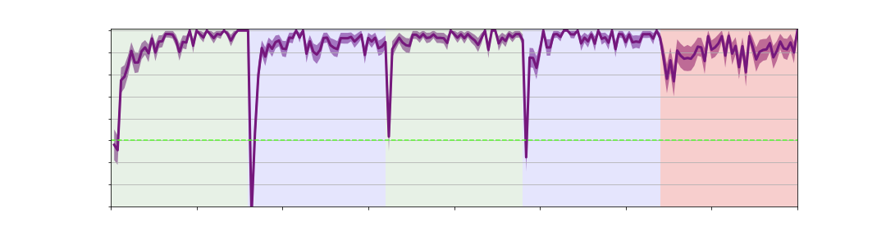
1.0
accuracy
N=33 (50)
0.5
Cafe
Bar
Cafe
Bar
Test
0.2
0
40
Time (stories)
160
200
Notes:
For example

Slide 31
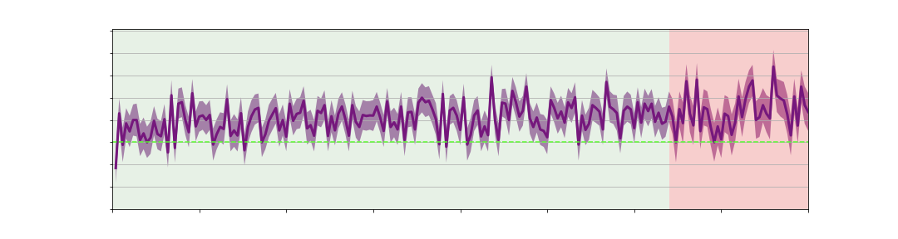
1.0
accuracy
N=33 (50)
0.5
Cafe
Bar
Cafe
Bar
Test
0.2
0
40
Time (stories)
160
200
1.0
accuracy
N=24 (55)
0.5
Interleave cafe/bar
Test
0.2
0
40
Time (stories)
160
200

Slide 32
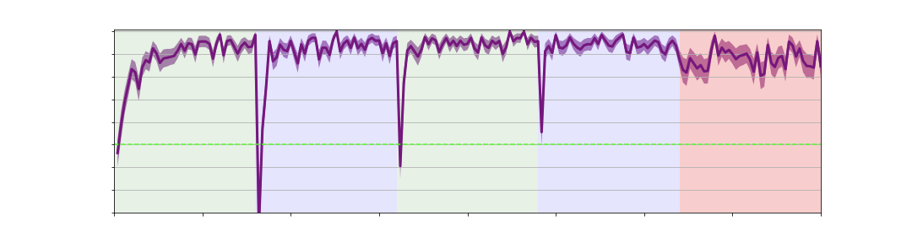
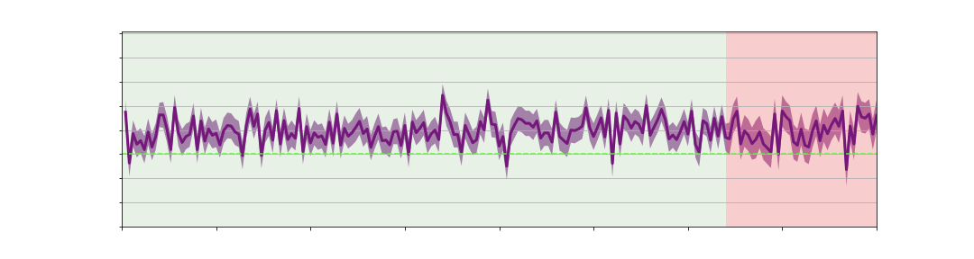
1.0
accuracy
N=26 (55)
0.5
Cafe
Bar
Cafe
Bar
Test
0.2
0
40
Time (stories)
160
200
1.0
accuracy
N=39 (56)
0.5
Interleave cafe/bar
Test
0.2
0
40
160
200
Time (stories)
Notes:
Registered replication

Slide 33
But why?
Unable to detect context marker
Unable to identify that location signals different graph
Unable to keep representations separate
Regardless of context cue identification

Slide 34
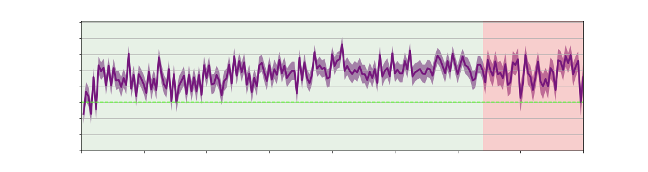
Interleaved explicit
1.0
accuracy
0.5
Interleave cafe/bar
Test
0.2
0
40
160
200
Location (graph) disclosed on every sentence
Location was bold faced
Participants instructed to attend to location

Slide 35
1.0
accuracy
N=26 (55)
0.5
0.2
Cafe
Bar
Cafe
Bar
Test
0
40
Time (stories)
160
200
1.0
accuracy
N=30 (51)
0.5
Interleave cafe/bar
Test
0.2
0
40
Time (stories)
160
200

Slide 36
But why?
Unable to detect context marker
Unable to identify that location signals different graph
Unable to keep representations separate
Regardless of context cue identification
Evidence for both

Slide 37
Future directions
Custom made curricula to test prediction error hypothesis
E.g. single block
Individual subject modeling
Why some subjects learn others don’t

Slide 38

Acknowledgements

Slide 39


Acknowledgements

Slide 40
Acknowledgements
Compmem lab
James Antony
Silvy Collin
Manoj Kumar
Elizabeth McDevitt
Meir Meshulam
Sebastian Michelmann
Monika Schönauer
Paula P. Brooks
Qihong Lu
Rolando Masis
Anne Mennen
Abigail Novick
Victoria J.H. Ritvo
Nina Rouhani
Yeon Soon Shin
Karina Tachihara
Jamal Williams
Asieh Zadbood
Jordan Gunn
Neggin Keshavarzian

Slide 41
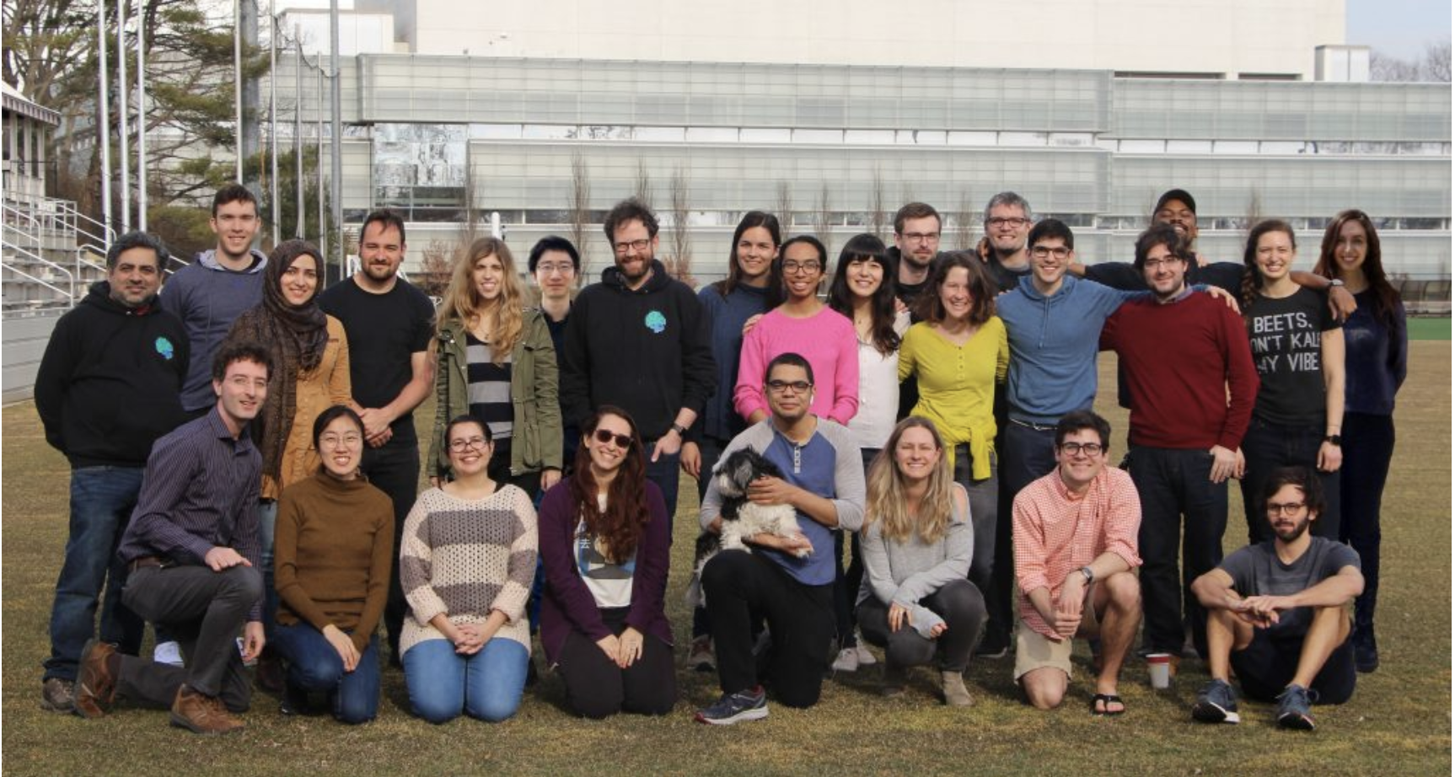
Acknowledgements
Compmem lab

Slide 42
Acknowledgements
Compmem lab
Funding provided by ONR MURI

