Slide 1

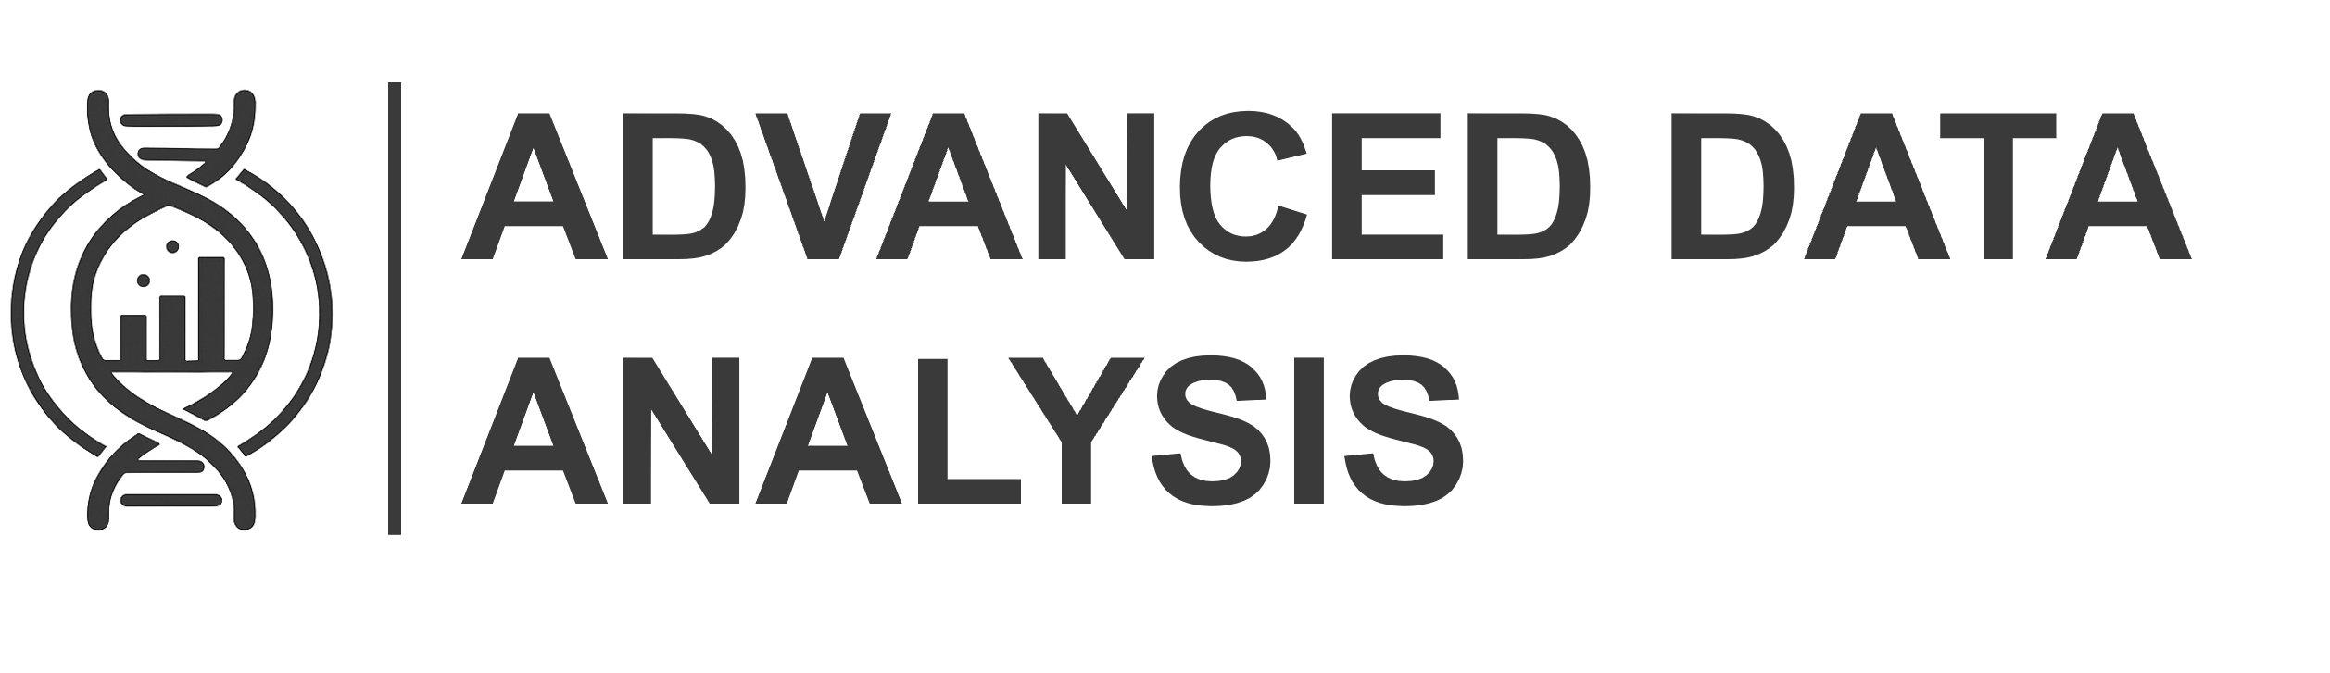
Introduction to R programming language
André Barros
Advanced Data Analysis (ADA) Unit
12th January 2026

Slide 2


Course Outline
Day 1
R Basics – Operations, Packages & Classes
Loops & Conditions
Data Manipulation & Plotting
Functions in R – From use to development
Day 2
Best Practices (Documentation, Reproducibility, …)
AI & Coding
tidyverse Universe
André Barros | Advanced Data Analysis | 12th January 2026
2

Slide 3
Programming & Research
Transparency
Reproducibility
Up-to-date methodology
Big Data Era
André Barros | Advanced Data Analysis | 12th January 2026
3

Slide 4
Programming & Researcher
Documentation
Citations!
Job market!
Capability & Flexibility
Understanding Data Analysis
André Barros | Advanced Data Analysis | 12th January 2026
4

Slide 5

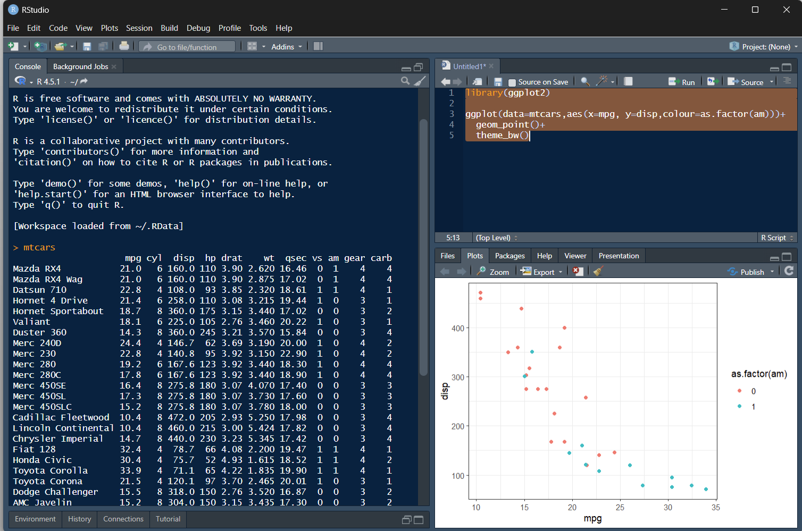



Why R
Statistical Analysis & Data Visualization
Free-to-use, Open Source
Thousands of curated & up-to-date packages
Integrated Development Environment (IDE)
André Barros | Advanced Data Analysis | 12th January 2026
5

Slide 6
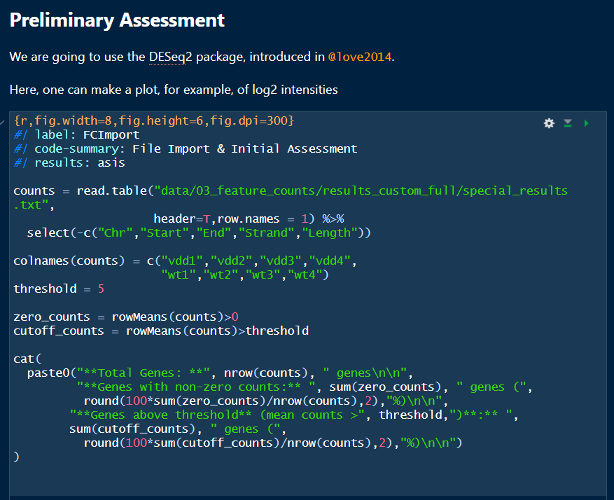
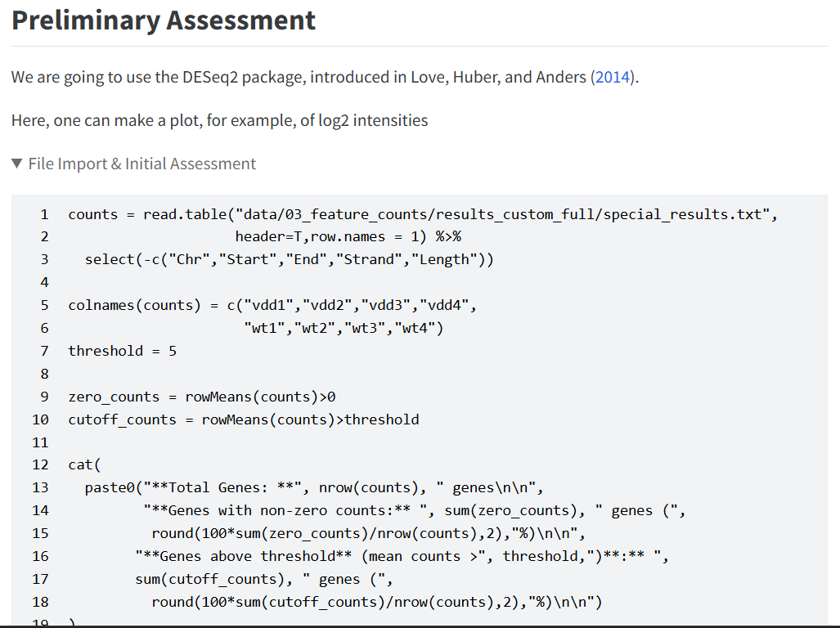

Why R
Statistical Analysis & Data Visualization
Free-to-use, Open Source
Thousands of curated & up-to-date packages
Literate Programming
André Barros | Advanced Data Analysis | 12th January 2026
6

Slide 7
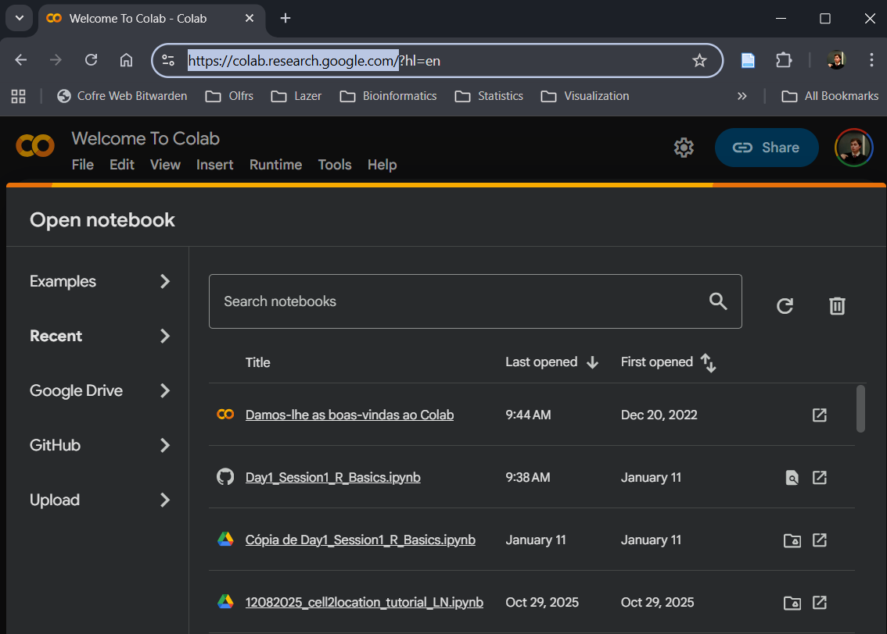
Course Material
https://github.com/andrebolerbarros/Intro_R
Google Colab – colab.research.google.com
André Barros | Advanced Data Analysis | 12th January 2026
7

Slide 8
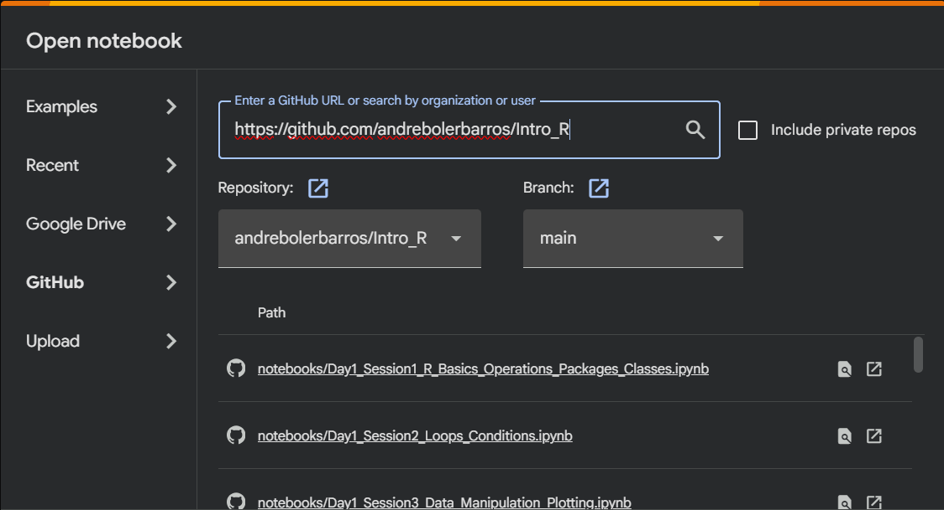
Course Material
https://github.com/andrebolerbarros/Intro_R
Google Colab – colab.research.google.com
André Barros | Advanced Data Analysis | 12th January 2026
8

Slide 9
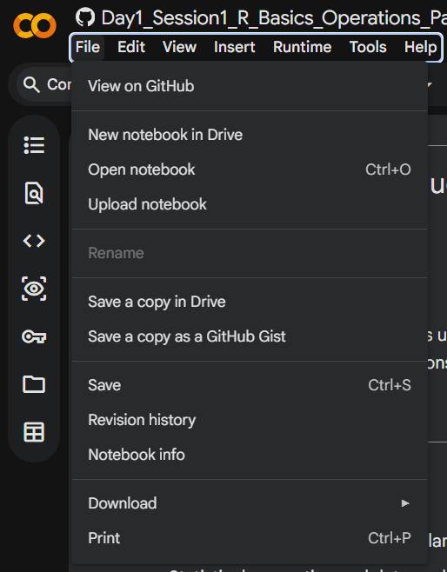
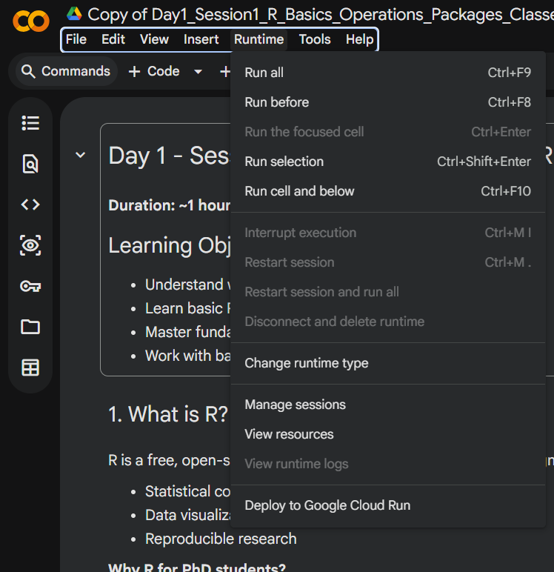
Course Material
https://github.com/andrebolerbarros/Intro_R
2. Save your own copy
André Barros | Advanced Data Analysis | 12th January 2026
9

Slide 10
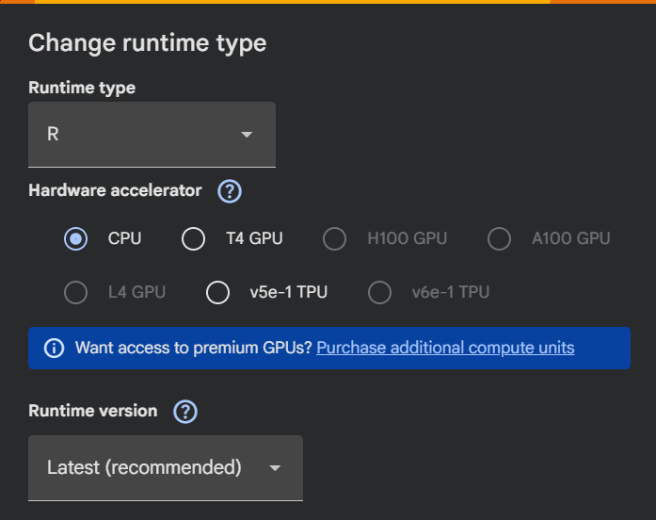
Course Material
https://github.com/andrebolerbarros/Intro_R
3. Change kernel (language)
André Barros | Advanced Data Analysis | 12th January 2026
10

