Slide 1

UAmobile
IHC – Assignment 1
2022/2023
André Silva, 98651
Luís Oliveira, 98543
Leonardo Freitas, 89131

Slide 2

Index
1. Introduction
2. Heuristic Evaluation
3. Results
4. Cognitive walkthrough
5. Appreciation

Slide 3

Introduction
Wath is uamobile:
Aplicação móvel da Universidade de Aveiro. Permite o acesso integrado e em tempo real a conteúdos existentes no PACO, e-learning e no portal da ua.
Target users:
The plataform is aimed for all employees and students of universidade de aveiro

Slide 4
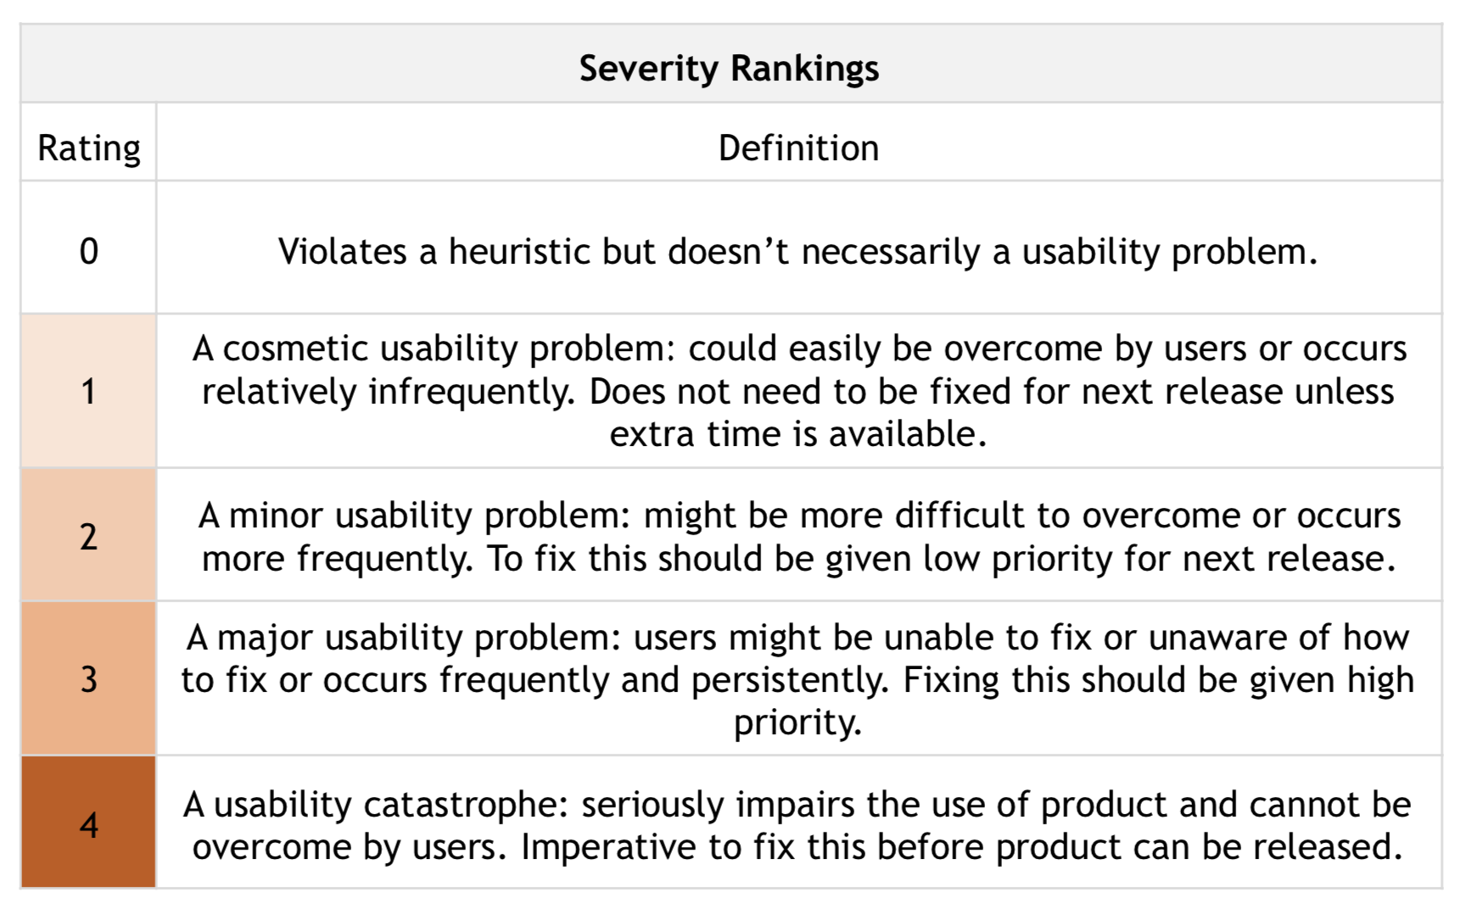
Evaluation
To evaluate Uamobile we are using Jakob Nielsen’s general principles for interaction design.
Visibility of system status
Match between system and the real world
User control and freedom
Consistency and standards
Error prevention
Flexibility and efficiency of use
Aesthetic and minimalist design
Help and documentation

Slide 5

Heuristic Evaluation

Slide 6
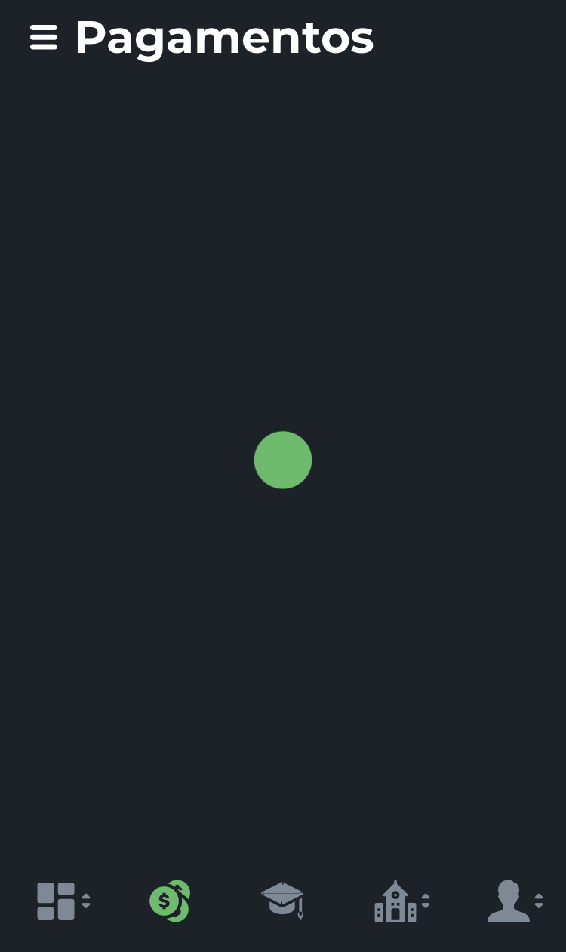

Heuristic evaluation
Issue 1: access a menu without internet.
Heuristic: Visibility of system status.
Severity: 2
Description: when we try to access a menu without internet, there is no connection failure warning and it stays in a loop.
Issue 2: “Administrativos” logo
Heuristic: match between system and the real world
Severity: 1
Description: The “administrativos” logo looks like a church and it’s not clear what the menu means.

Slide 7
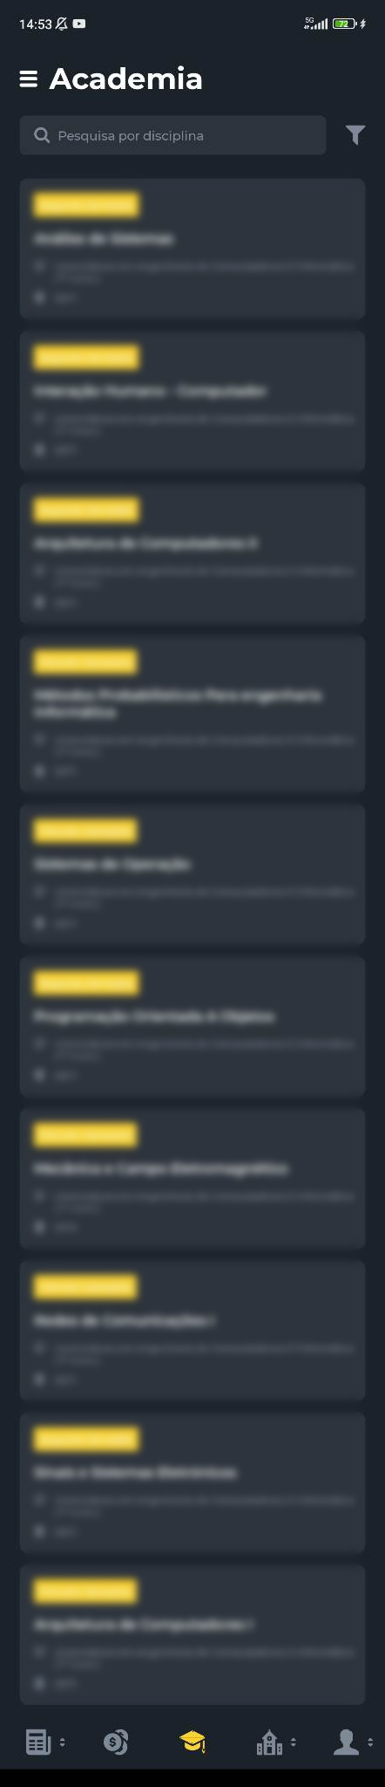
Heuristic evaluation
Issue 3: Schedule not available.
Heuristic: match between system and the real world
Severity: 3
Description: the full schedule is nowhere to be found. The most logical position for a schedule would be an accessible location.

Slide 8
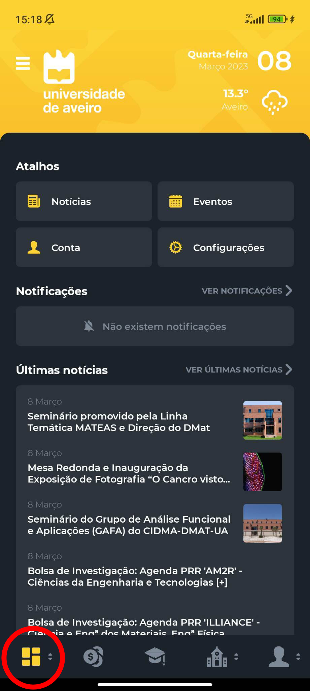
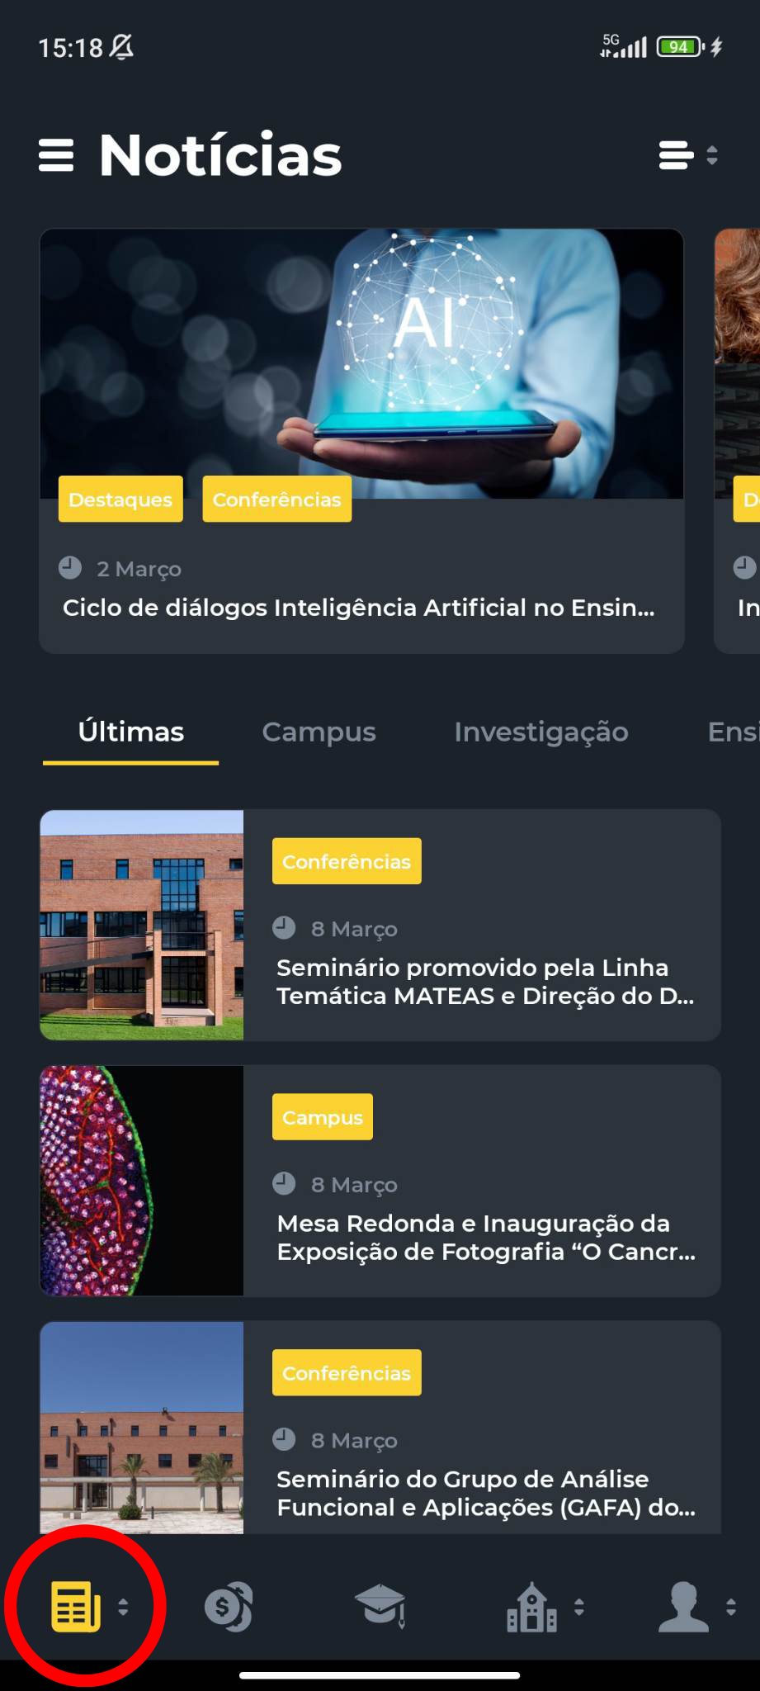
Heuristic evaluation
Issue 4: very confusing and unintuitive app.
Heuristic: aesthetic and minimalist design.
Severity: 2
Description: some menu tabs are not constant and can be changed without the user noticing.

Slide 9
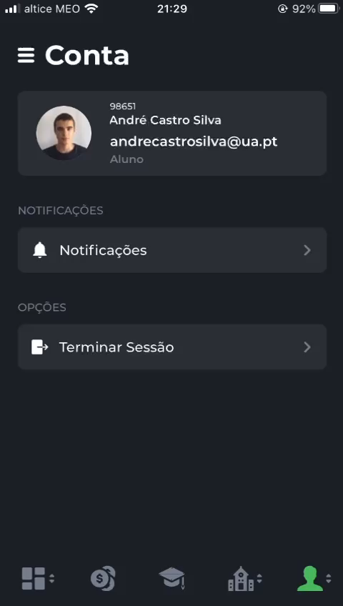
Heuristic evaluation
Issue 5: no logging out prompt
Heuristic: error prevention
Severity: 1
Description: logging out should give some type of prompt to confirm.

Slide 10
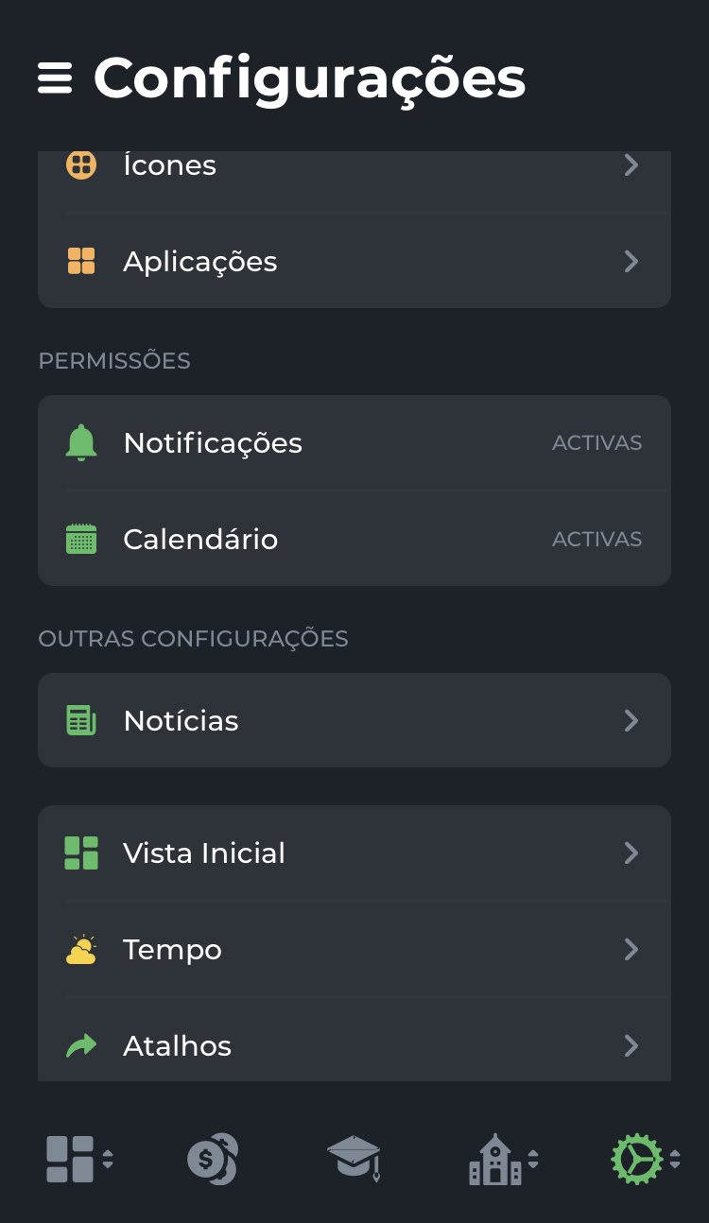
Heuristic evaluation
Issue 6: no help menu
Heuristic: Help and documentation
Severity: 2
Description: IF you have a question about how to go and see my schedule, there is no place to help me get there. The app does not have any kind of documentation or help.

Slide 11
Results

Slide 12
Results
André
Leonardo
Luís
Access a menu without internet
“administrativos” logo
Full Shcedule not available
Very confuse and unintuitive app
No logging out prompt
Help menu
2
2
2
2
1
1
3
2
3
2
2
2
1
2
1
2
2
2

Slide 13

Cognitive walkthrough

Slide 14
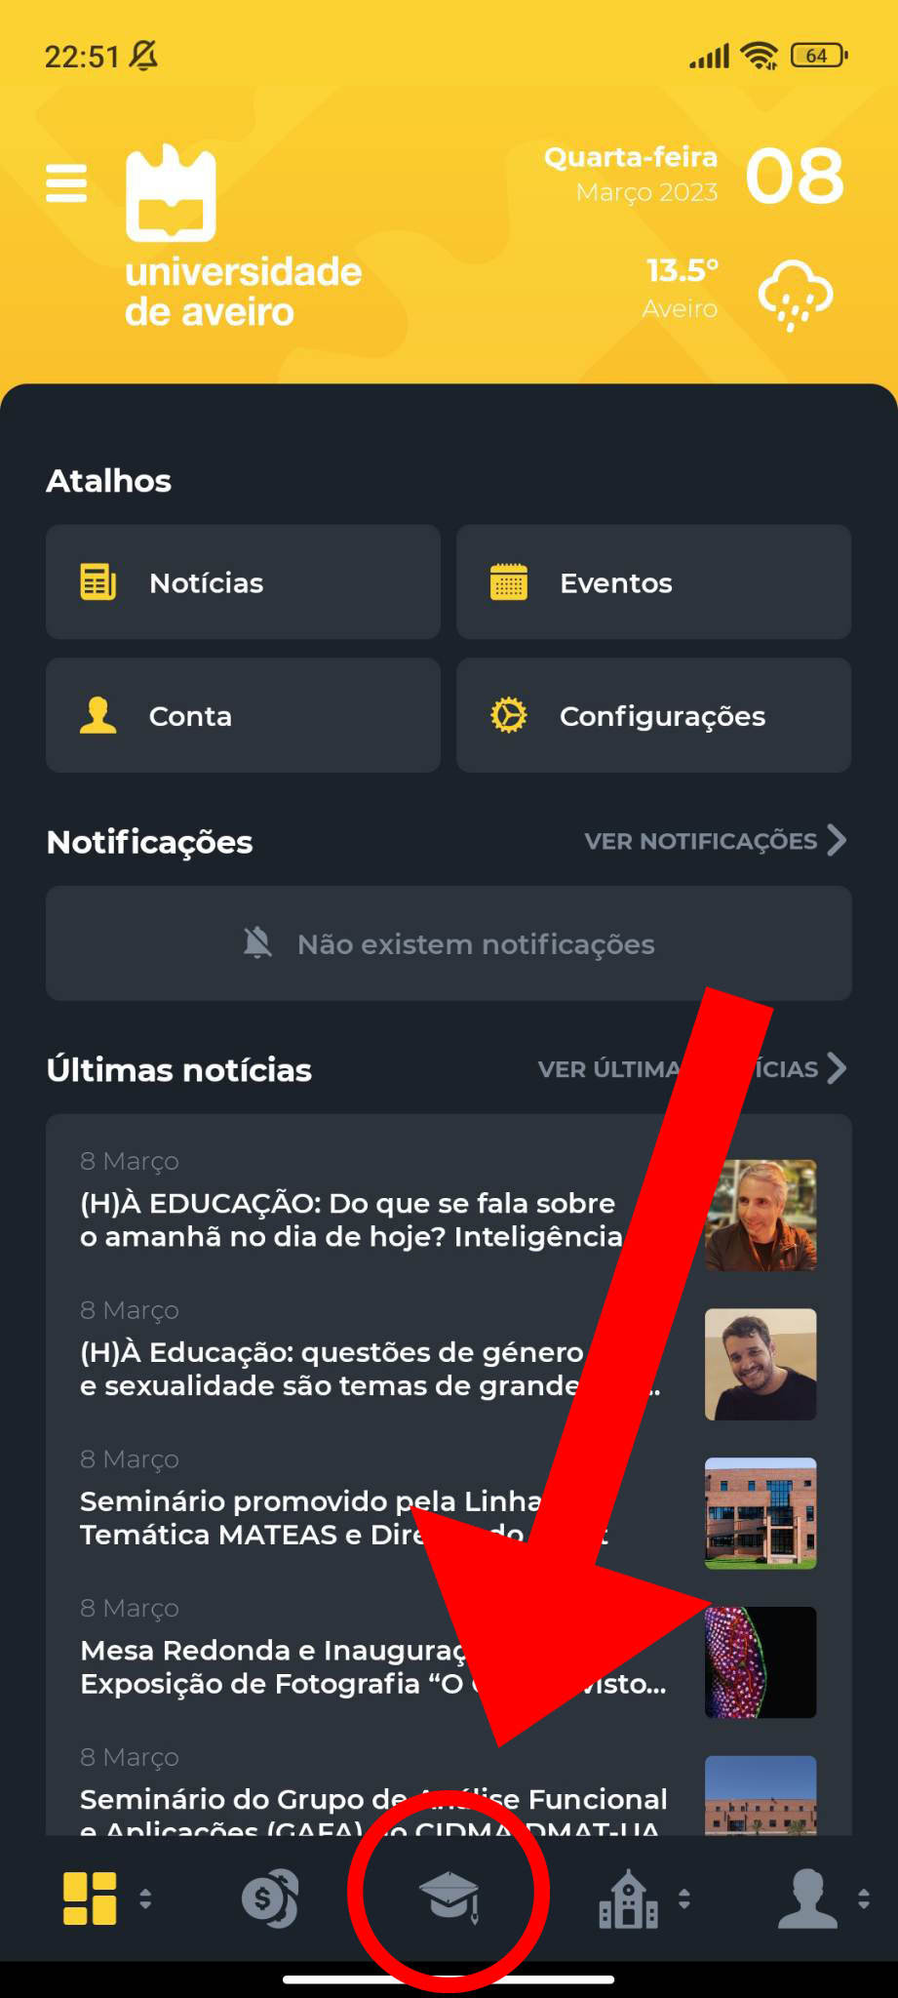
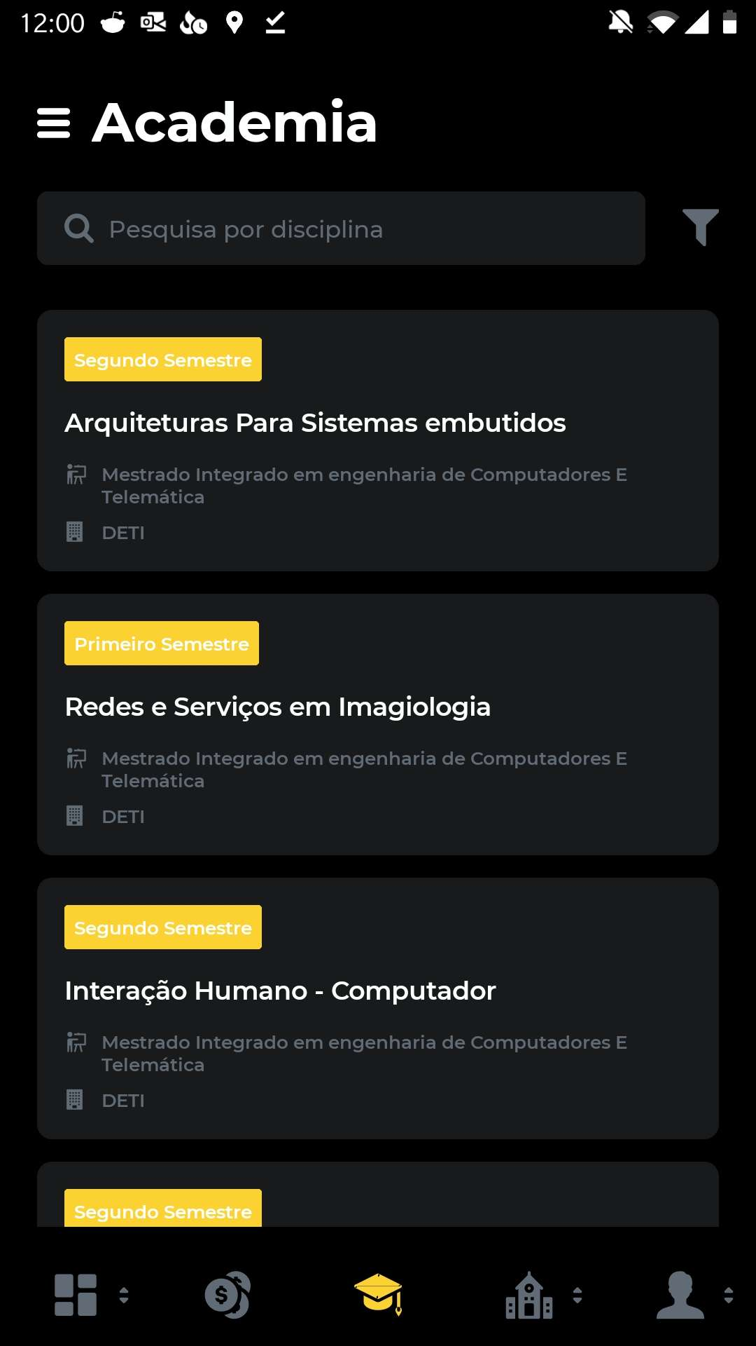
Cognitive walkthrough
Task: Check the schedule of an enroled class
Action #1: Find and open the "Academia" icon
Action #2: Choose the desired class
Action #3: Choose the top right corner option
Action #4: Select “Schedule”
User: UA student
Question #1: Will the user know how to reach the class that he desires?
Question #2: Will the user notice the top right corner button?

Slide 15
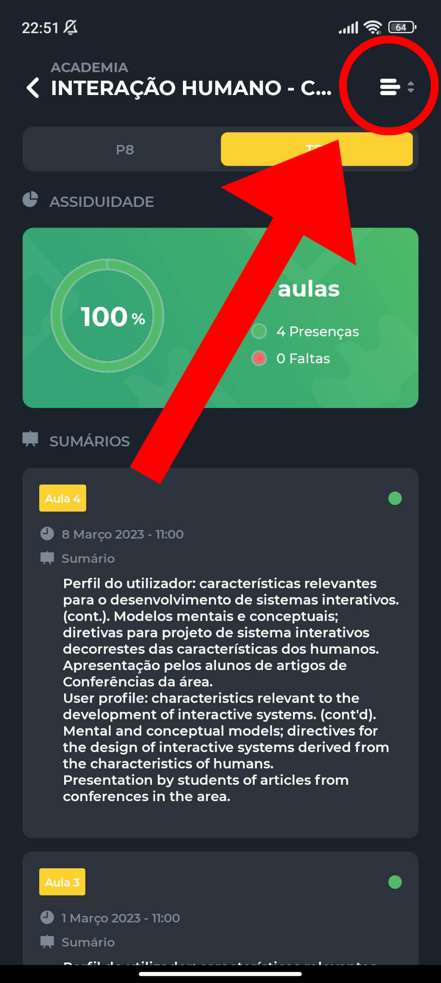
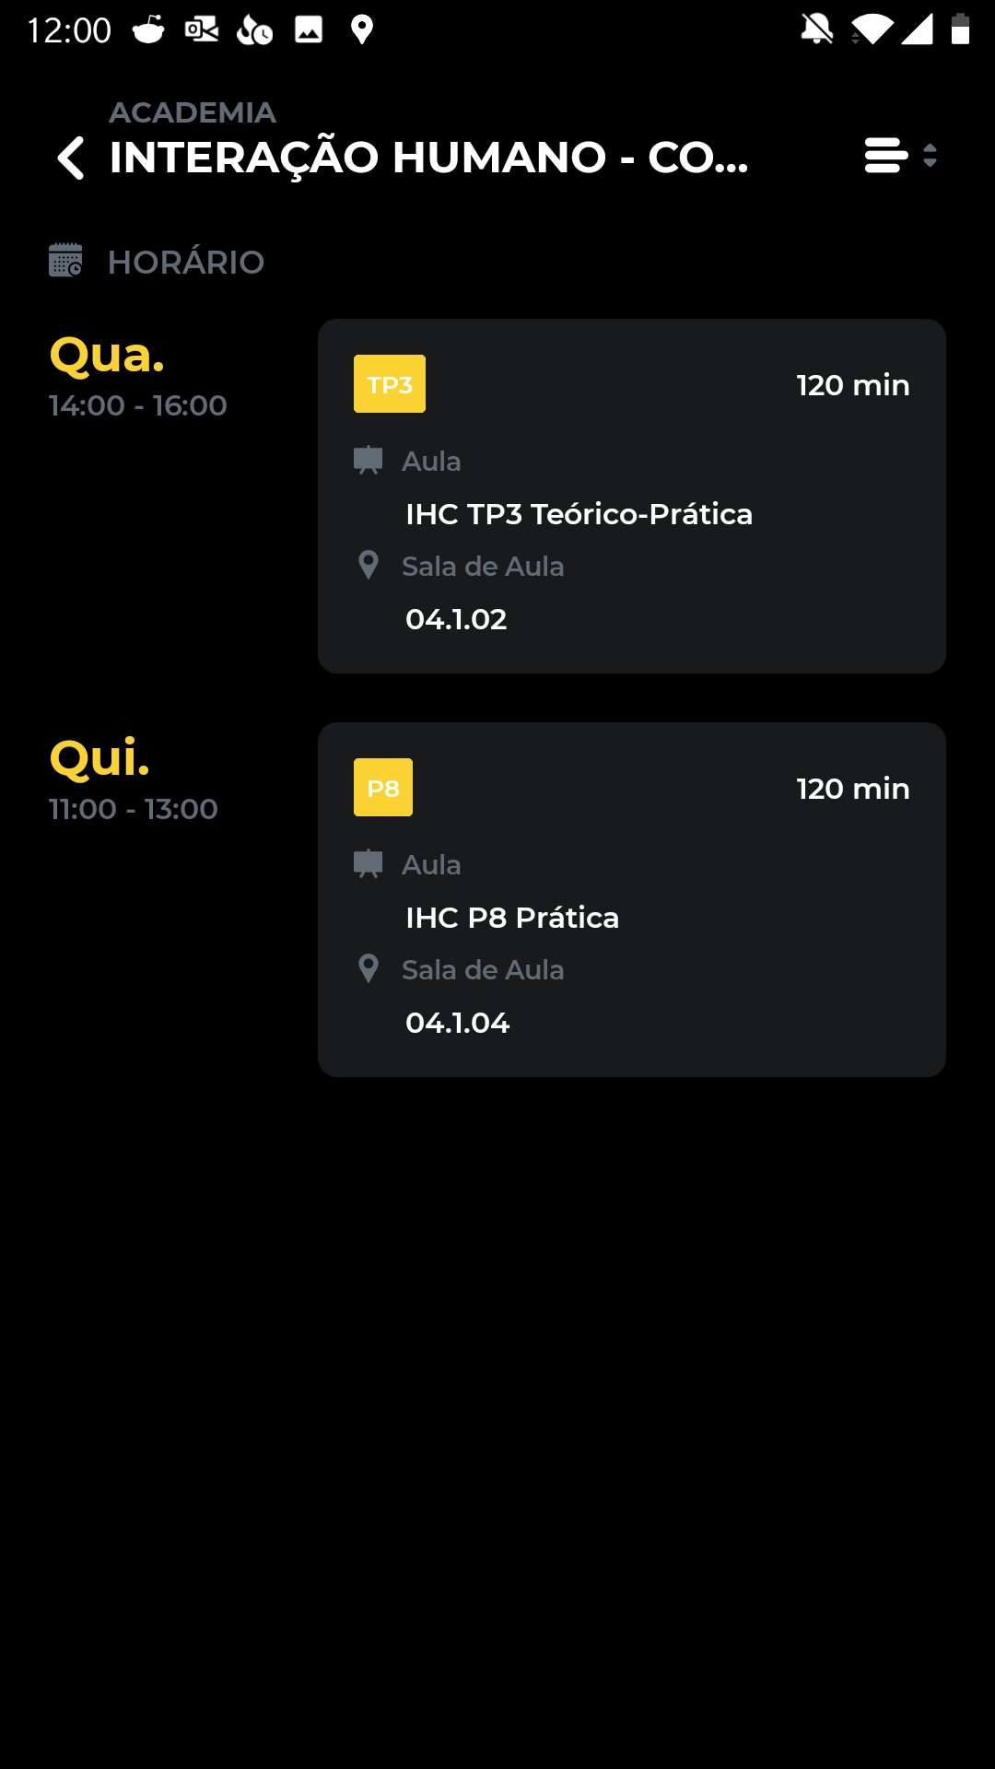
Cognitive walkthrough
Task: Check the schedule of an enroled class
Action #1: Find and open the "Academia" icon
Action #2: Choose the desired class
Action #3: Choose the top right corner option
Action #4: Select “Schedule”
User: UA student
Question #1: Will the user know how to reach the class that he desires?
Question #2: Will the user notice the top right corner button?

Slide 16

Appreciation

