Slide 1
ALMA MATER STUDIORUM — UNIVERSITY of BOLOGNA
PMAO PROJECT · FINAL REPORT · ACADEMIC YEAR 2025/2026
A Decision Support System
for an automotive manufacturing facility
AUTHORS
Marco Buonfantino
Andrea Cevenini

Slide 2
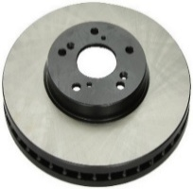
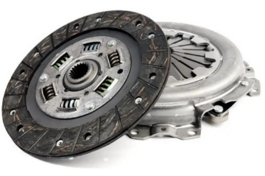
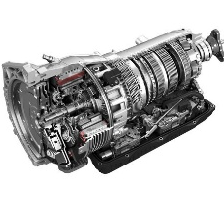
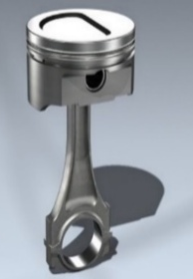

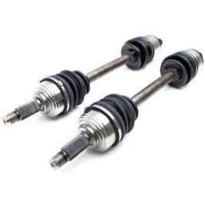



INTRODUCTION
The Manufacturing Environment and DSS Architecture
A flexible Factory producing six automotive families Brakes, Clutches, Pistons, Shafts, Shifts, Wheels. Each product has multi-stage cycles and complex BoM routed across distinct work centers.
P01
P02
P03
P04
DSS PIPELINE
Brake
Clutch
Shift
Piston
MS Access Database
machines · suppliers · calendar etc.
↓
P05
9
Shaft
AMPL Models
mathematical formulation
machine types (M01 → M21)
↓
13
P06
Gurobi Solver
Wheel
manual assembly benches
cost-minimal, constraint and feasible decisions
PMAO · BUONFANTINO · CEVENINI 03

Slide 3



METHODOLOGICAL FRAMEWORK
Four decoupled layers, one coherent plan
Hierarchical Production Planning: each layer's output becomes the next layer's rigid input.
LAYER 1
LAYER 2
LAYER 3
LAYER 4
RRP
MPS
Green MRP
Job Shop
Resource Requirement Planning
Master Production Schedule
Material Requirements Planning
Operational Scheduling
Annual
12 monthly buckets
BOM explosion · CO2 Tax
Continuous : minute level
Sizes the machine park, hires the workforce, accepts/rejects orders to maximize profit.
Balancing inventory holding vs. setup costs to fix monthly production volumes X[p,t].
Couples raw-material demand with discrete supplier batches and penalizes carbon emissions.
Respects sequences of batches, allocates parallel machine copies, solves disjunctive non-overlap constraints.
PMAO · BUONFANTINO · CEVENINI 04

Slide 4



RRP
ANNUAL CAPACITY PLANNING
Maximise profit, size the factory from scratch
DECISION VARIABLES
OBJECTIVE & CONSTRAINTS
Accepted[p,t]
max Production_Profit
binary -> accept or reject each order
Revenue - Production Cost − Machine depreciation − Labor cost (sw · wc)
MachQuantity[m]
integer -> CNC machines to purchase
Machine Capacity
Labor Capacity
monthly bucket · setup ∙ DemandProfile counted
assembly + handling + setup absorbed by wt + sw
sw
integer -> seasonal workers to hire (wt = 0)
FOCUS
SetupTime hits both constraints: machine stopped and operator engaged.
PMAO · BUONFANTINO · CEVENINI 05

Slide 5
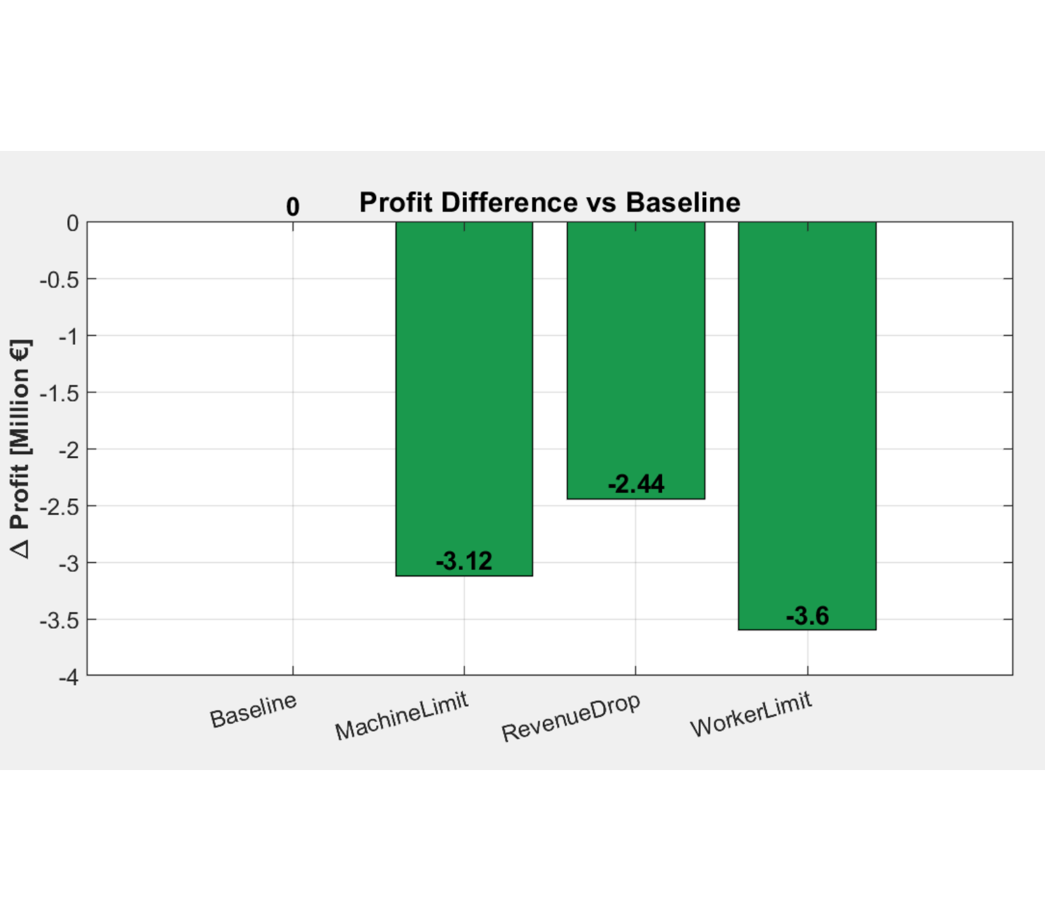
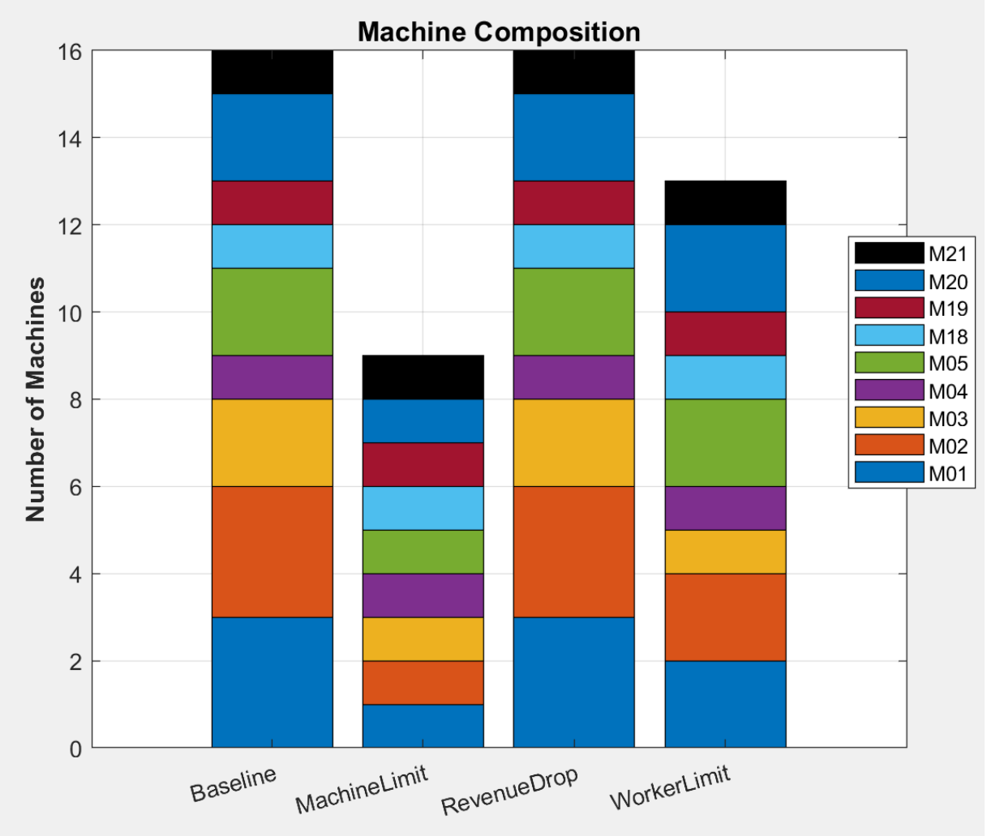
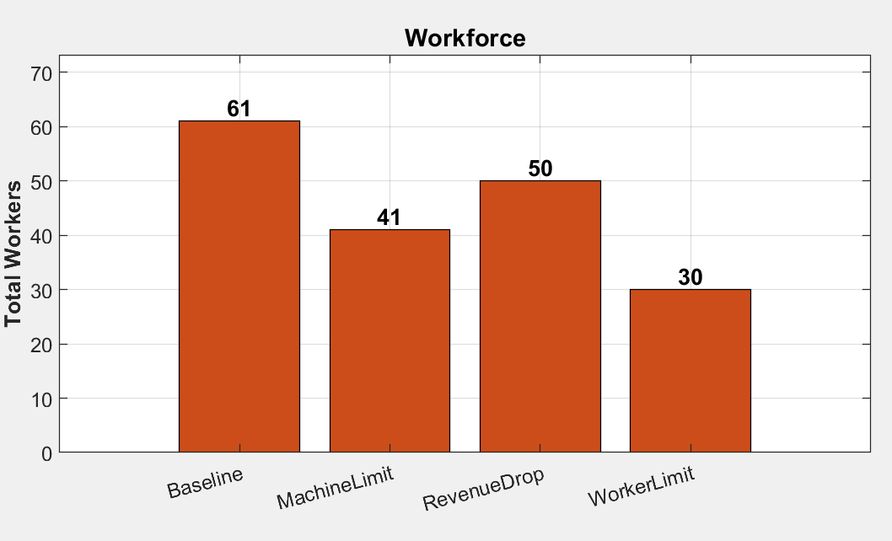
RRP SOLUTIONS
Optimal capacity sizing
NET PROFIT
Σ MACHQUANTITY[M]
WORKFORCE (WT + SW)
€11,307,600
16 units
0 + 61 = 61
261 working days
all seasonal hires
MACHINE COMPOSITION ACROSS RRP SCENARIOS
MACHINELIMIT
Σ MachQuantity ≤ 9
REVENUEDROP
Revenue[Brake] · 0.10
WORKERLIMIT
sw ≤ 30
PMAO · BUONFANTINO · CEVENINI 06

Slide 6

MPS
From annual volume to monthly batches
The MPS inherits the RRP machine park and the accepted demand, then decides when and how much to launch, minimising the trade-off between inventory holding and setup costs.
DECISION VARIABLES:
X[p,t]
S[p,t]
units completed at t
end-of-period stock
RO[p,t]
SPO[p,t]
CORE CONSTRAINTS:
production orders (batches) released at time t
orders completed (exit) at time t
Inv_Balance S[t−1] + X[t] = Demand + S[t]
OBJECTIVE FUNCTION
LeadTime_Link SPO[p,t] = RO[p, t−LTPP]
minimize Total_MPS_Cost:
UnitProdCost ·X + HoldingCostComp ·S + SetupCost · RO + BatchCost · SPO
Batch Sizing MinBatchProd ≤ X ≤ MaxBatchCap
Prod_Capacity ProcTime·X + SetupTime·RO ≤ AvailCap
PMAO · BUONFANTINO · CEVENINI 08

Slide 7
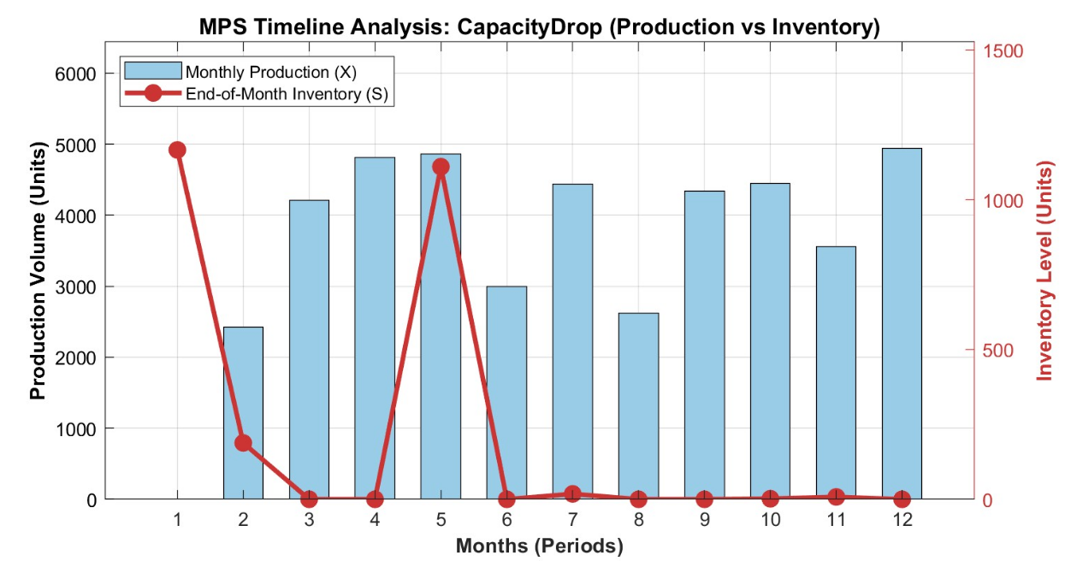
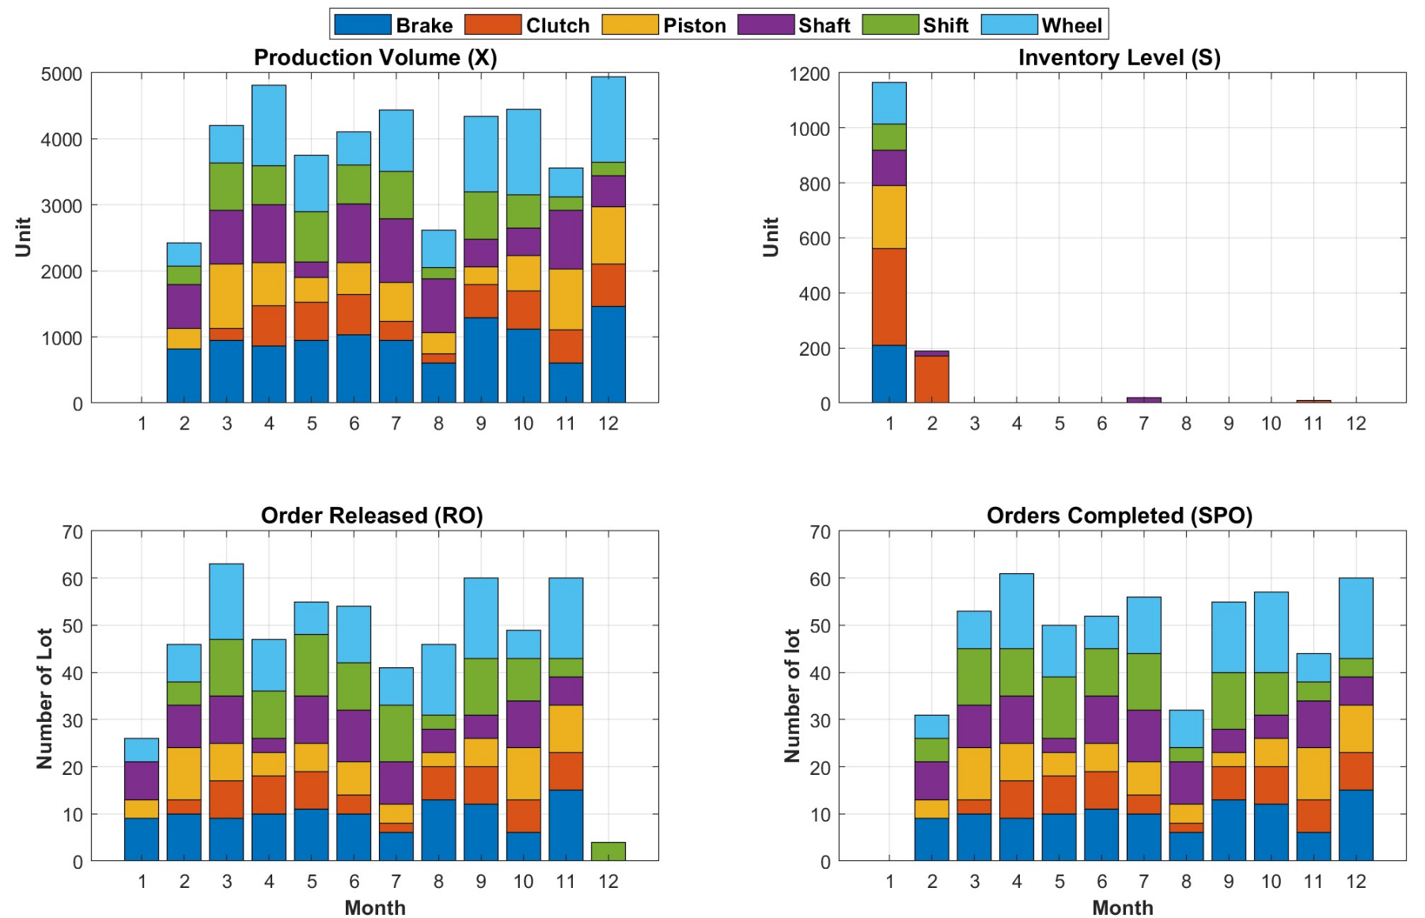
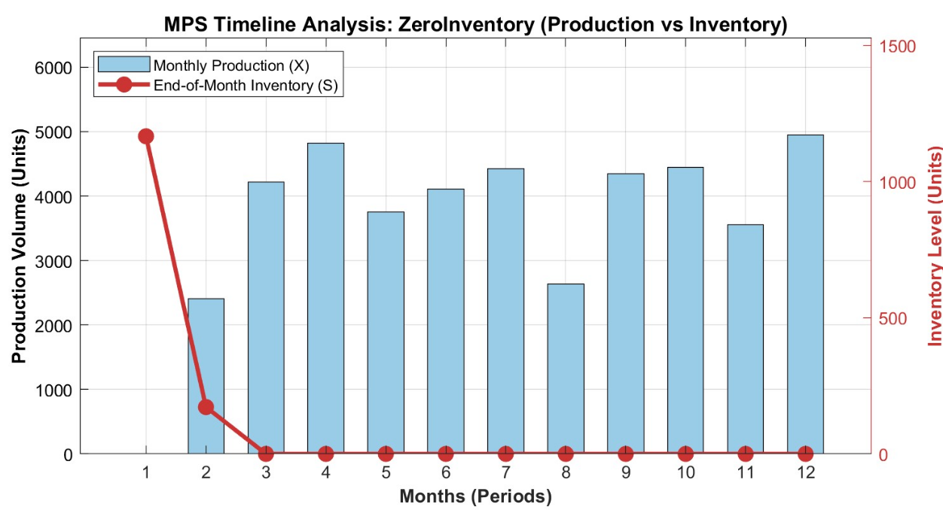
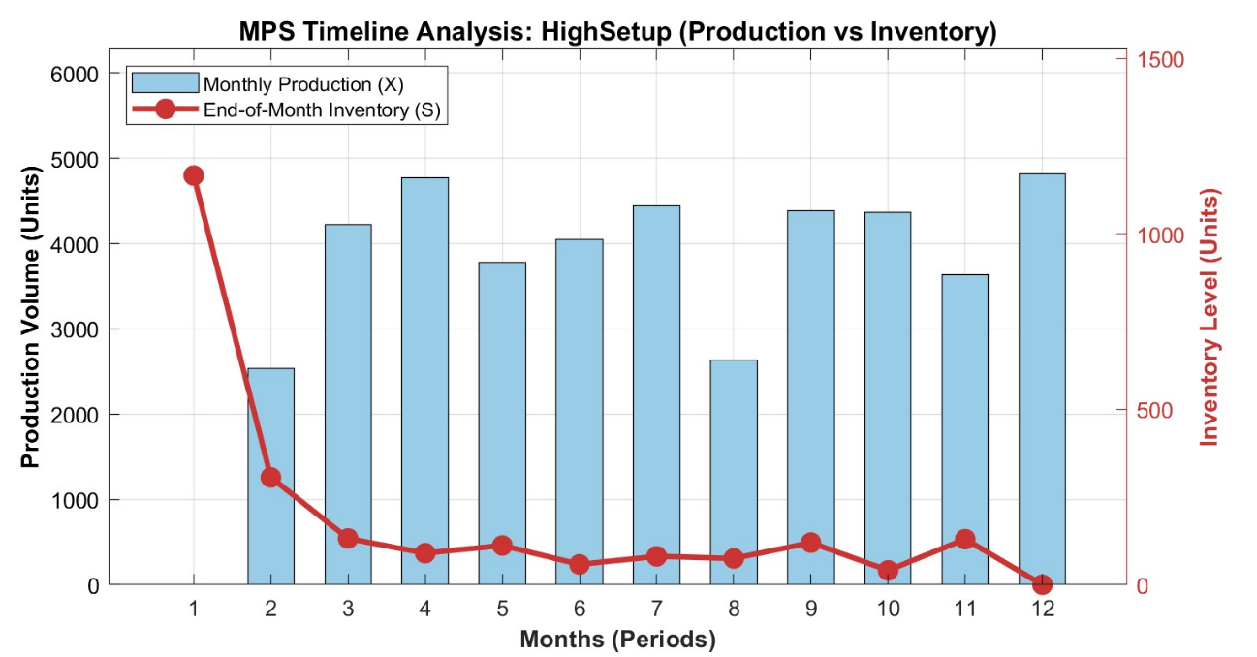
MPS SOLUTIONS
CAPACITYDROP (CAP HALVED AT T = 6)
12 Months Plan
TOTAL COST
Σ X[P,T]
Σ SPO[P,T]
ORDER COMPLETED
€273,711
43,664 units
551 batches
100% from RRP
BASELINE
ZEROINVENTORY
HIGHSETUP
PMAO · BUONFANTINO · CEVENINI 09

Slide 8
GREEN MRP
SUSTAINABLE MATERIAL SOURCING
Internalizing Carbon Costs in Supply Chain Operations
A deliberate design choice: CO2 emissions are an integral, structural part of the transportation logic. The solver minimises cost while penalising the supplier-network footprint.
OBJECTIVE FUNCTION
KEY MECHANISMS
Min Total_MRP_Cost
Leadtime
Assumption: monthly plan Lt_Supp=0
Holding · Inv + (CostOfBox/PcsPerBox) · ArrivalQty + SetupOrderCost · Y
BOM Explosion
GrossReq generated at t with LTPP offset
SetupOrderCost = Distance ·(CostPerKm + CO2EmissionPerKm · CO2Tax)
Rigid Packaging
RO_Comp = NumBoxes · PcsPerBox
Green Big-M Switch
NumBoxes > 0 → Y[c,s,t] = 1 (truck dispatched)
Dual-Zone Warehouse
Inbound (Inv, MagInit) Outbound (S, InitInv)
PMAO DSS · BUONFANTINO · CEVENINI 11

Slide 9
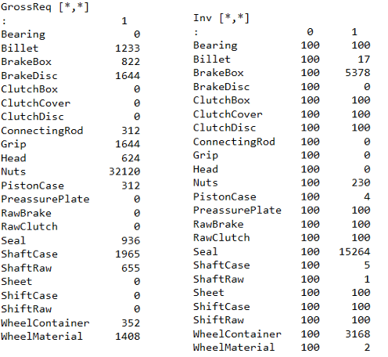
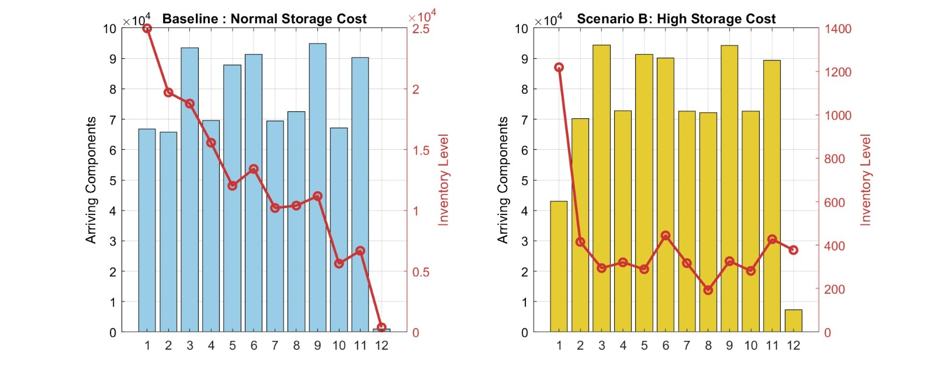
GREEN MRP
Mass-balance verification and inventory profile
TOTAL SUPPLY-CHAIN COST
NUMBOXES[BRAKEBOX, S30, 1]
CO2PENALTY (S30)
€9,752,840
122 boxes
€896.10
MASS-BALANCE at t=1 for Brakebox
MagInit (t = 0) 100 + 122 · PcsPerBox(50)= 6,200
6200 - GrossReq[BrakeBox,1] (822) = 5378
END-OF-HORIZON
Inv[BrakeBox,t]: 1486 → 24 from t = 10 → 12. The Y[c,s,t] switch correctly drops to 0 when NumBoxes = 0 — no phantom CO2 emissions.
Inv[BrakeBox, 1]= 5378 units
COMPONENT ARRIVALS VS. INVENTORY LEVEL — BASELINE (LEFT) AND HIGH STORAGE COST (RIGHT)
PMAO · BUONFANTINO · CEVENINI 14

Slide 10
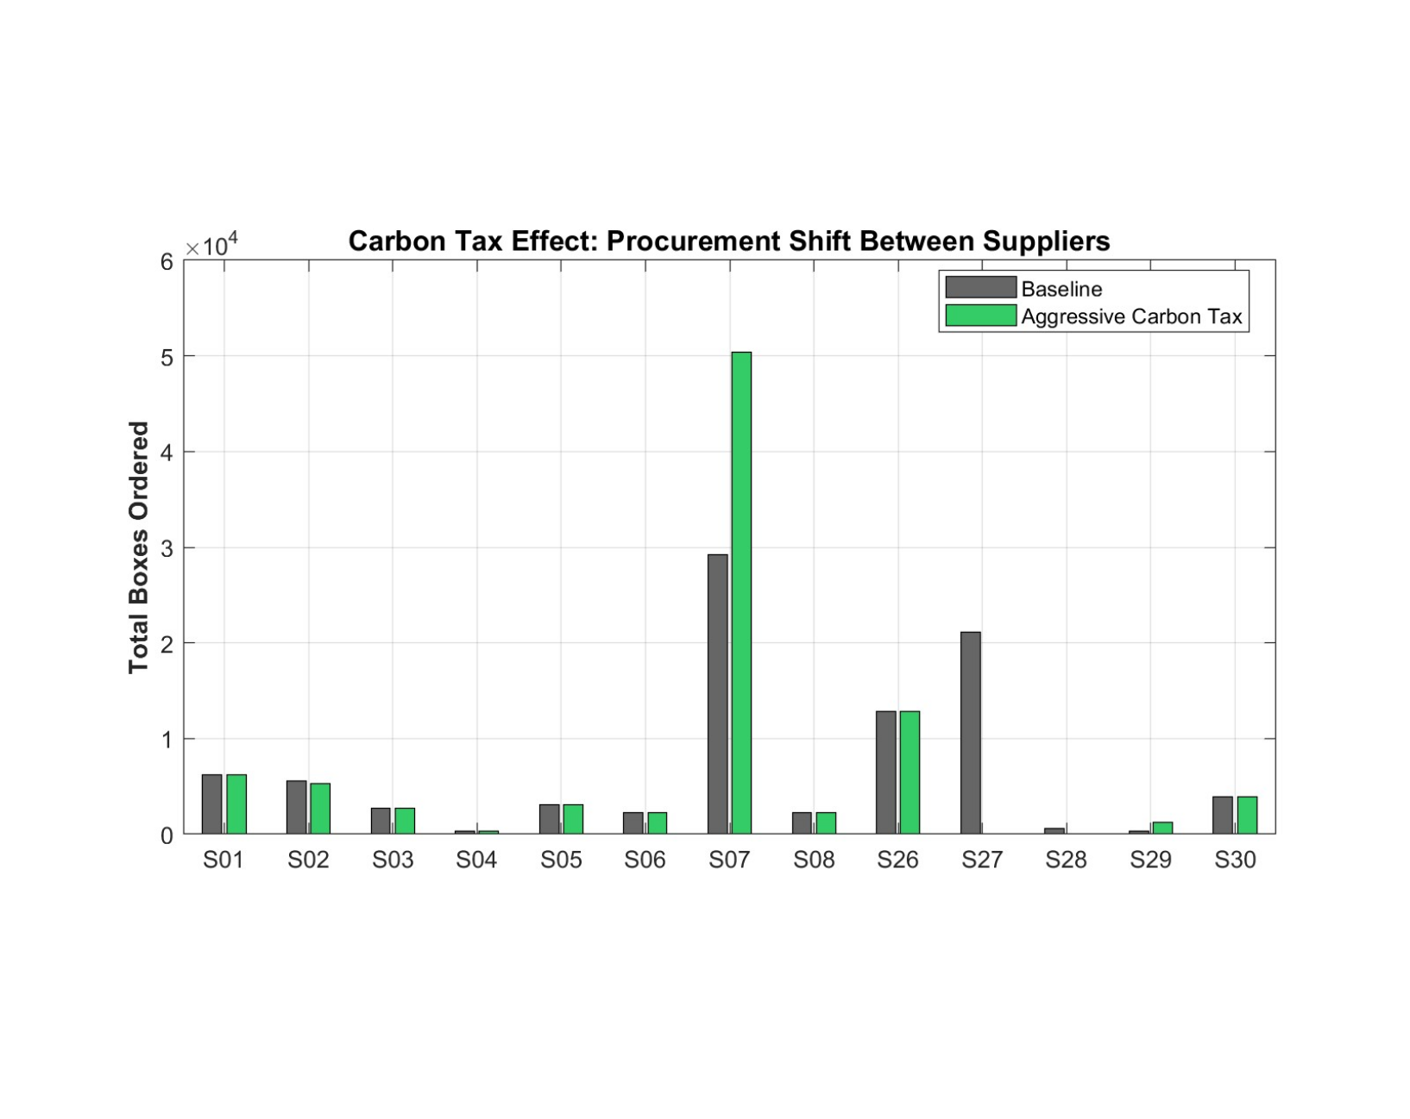
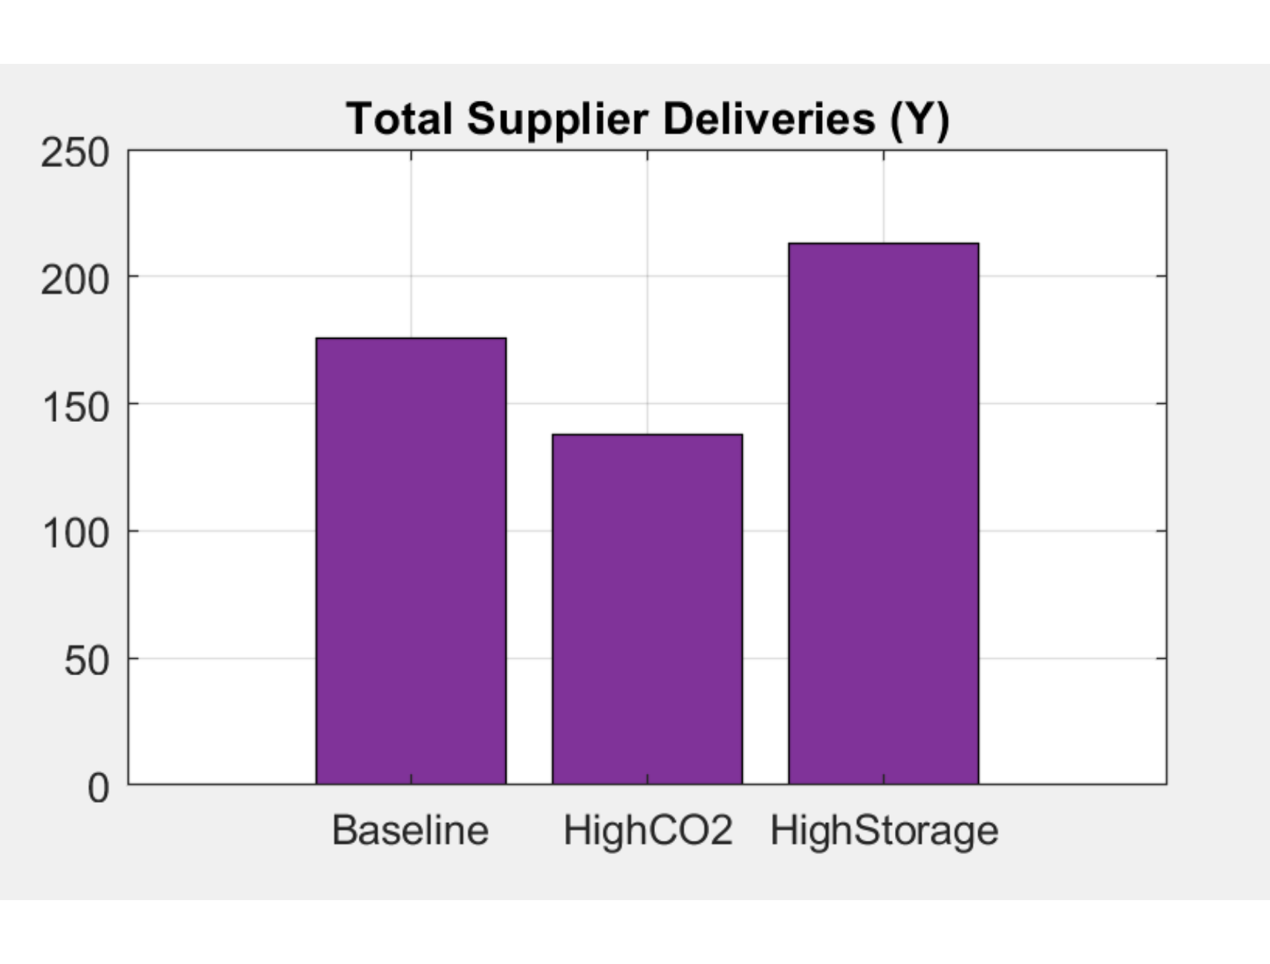
GREEN MRP STRESS TESTS
Carbon-tax procurement shift and High storage cost
AGGRESSIVE CARBON TAX: TOTAL BOXES ORDERED PER SUPPLIER IN ONE YEAR
VOLUMETRIC STORAGE SURGE: TOTAL SUPPLIER DELIVERIES Y[C,S,T] IN ONE YEAR
S27 (710 km) collapses from 21,000 to 0 boxes delivered in one year that are fully reallocated to S07 (54 km), which jumps from 29k to 50k ordered boxes.
Storage shock pushes from Y=176 (baseline) to Y=213 dispatches to keep Inv → 0.
Conversely, highCO2 consolidates loads to 138 dispatches.
PMAO· BUONFANTINO · CEVENINI 15

Slide 11
JOB SHOP SCHEDULING
OPERATIONAL SCHEDULING
From monthly buckets to minute-level sequencing
A continuous-time model that answers when each batch starts, which physical copy of the machine runs it and how long the entire workload takes.
13 pre-existing Assembly Tables in our company
Assumptions
Number of batches (lot) and quantity of products per batch decided on the Access Database
WORKFORCE ARCHITECTURE
DECISION VARIABLES
Makespan
Asymmetric labour allocation
universal shop-floor clock (min)
22
39
StartTime[p,i,m]
exact start minute of lot i on machine type m
CNC team · 1 operator / machine
Assembly · 3 operators / bench
Alloc[p,i,m,k]
binary — assigns lot i of product p to physical copy k of machine m
ACCELERATION TRICK
Z[p1,i1,p2,i2,m]
ProcTime[AssemblyTable] ÷ WorkersPerBench (3) simulates simultaneous manual throughput.
ProcTime [AssemblyTable] = ManualAssembly
SetupTime[AssemblyTable] = 0
disjunctive sequence switch (Big-M)
PMAO · BUONFANTINO · CEVENINI 14

Slide 12
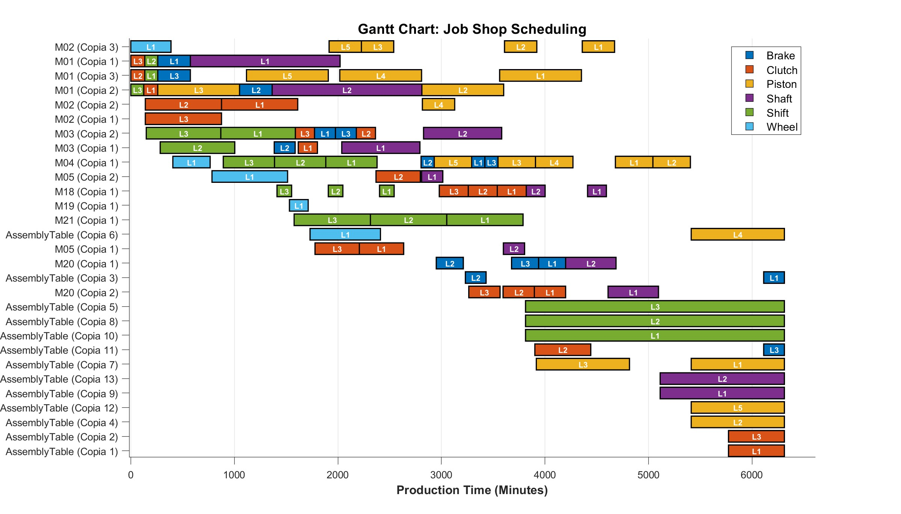
JOB SHOP FULL WORKLOAD · MAKESPAN
Makespan = 6,312 min — workload fits inside one monthly bucket (21 working days)
MAKESPAN
HOURS
8H SHIFTS
WORKFORCE
6,312 min (purely experimental)
105.2 h
13.15 working days (conservative assumption)
22 + 39
CNC · Assembly (3/bench)
FULL GANTT: ALL 6 FAMILIES ON 16 CNC COPIES + 13 ASSEMBLYTABLE COPIES
PMAO · BUONFANTINO · CEVENINI 14

Slide 13





CONCLUSION & SYNTHESIS
Unified Production Framework: From Strategy to Execution
RRP
MPS
MRP
JOB SHOP
€11.3M
€273K
€9.75M
6,312min
annual profit · 16 machines · 61 workers
operational cost · 43,664 units · 100% Service Level from RRP
supply chain · CO₂ tax embedded
makespan · zero overlap · fits one bucket
Hierarchical decoupling works
Validated and elastic
Each layer's output is the next layer's rigid input — strategic stability above, operational precision below, no conflicts in between.
Across nine stress-test scenarios (financial, operational, environmental) the DSS adapts without infeasibility and preserves service level.
PMAO · BUONFANTINO · CEVENINI 16

Slide 14
THANK YOU
Questions & Discussion
TEAM
PROJECT
Marco Buonfantino
Decision Support System for an automotive manufacturing facility
Andrea Cevenini

