Slide 1


SOLANA · COLOSSEUM 2026 · SUPERTEAM BRASIL
Crypto with
a real purpose,
in its owner’s
hands.
Buy with Pix. Pay with a tap. Keep the keys.
Notes:
Open strong, ~10s: "This is SimPay."
One line: crypto you can actually spend at the counter, and that stays in your own wallet.
Name the event: Colosseum, Superteam Brasil track.

Slide 2
01 — THE PROBLEM
Brazil pays instantly.
It still doesn’t own
its money.
01
02
03
Middlemen in every sale
Crypto with no real use
Keys held by someone else
Card machines take a cut of each payment and hold the merchant’s money for days.
Most tokens sit idle on exchanges. You can’t buy a coffee with them.
Buying crypto usually means leaving your keys, and your money, with an exchange.
SIMPAY · COLOSSEUM 2026
02
Notes:
Brazil already has instant money: Pix.
But merchants still pay card machines, and crypto sits idle on exchanges.
Land it: instant is solved; ownership and utility are not.

Slide 3

02 — OUR PURPOSE
Make crypto simple,
useful for everything,
and truly owned by
the people who hold it.
No bank. No middleman. Just you and your wallet.
Notes:
Our purpose, in one breath: simple, useful for everything, truly owned.
No bank, no middleman. This is the original promise of crypto; we make it usable.

Slide 4
03 — HOW IT WORKS
From Pix to the counter
in four steps.
1
2
3
4
Buy with Pix
Own it
Tap to pay
Merchant settles
Pay a Pix and receive SIMPAY in your own Solana wallet in seconds.
Non-custodial wallet. Your keys, with six-digit PIN recovery.
Scan the QR, tap the NFC tag at the till, or pay a Blink from Phantom.
Confirmed in about a second. 0% to receive. Cash out to Pix anytime.
SIMPAY · COLOSSEUM 2026
04
Notes:
Walk the flow left to right, 5s per step.
Emphasise step 2: the customer holds the keys.
Step 4: merchant is paid in about a second, 0% to receive.

Slide 5
04 — THE PRODUCT
One network.
Four products.
All live.
APP
PDV
SimPay Wallet
Merchant point of sale
iOS and Android. Self-custody, QR and NFC tap to pay, cashback, referrals and push when money arrives.
Charge in reais, show the QR, sell through NFC tags per till, cash out to Pix. Wallet restores with a PIN.
Built and shipped end to end: consumer, merchant, web and operations.
WEB
OPS
simpay.tech + Blinks
Admin console
Buy SIMPAY with Pix to any wallet. Every till link is a Solana Blink payable from Phantom.
Partner approval, cashback review, Pix webhooks, treasury costs on Solana, push campaigns, full audit log.
SIMPAY · COLOSSEUM 2026
05
Notes:
Everything on the right is live on devnet today.
If recording, cut to screen captures of each product here.

Slide 6

05 — WHAT’S NEW
Crypto that behaves
like a payment app.
01
Tap to pay on Solana
NFC tags at each till open the live charge. No card machine, no app required on the merchant side.
02
Every till is a Blink
The same link becomes a Solana Action: pay from Phantom or anywhere Blinks render.
03
Recover with a PIN
Merchant wallets restore on a new device with only the PIN (Argon2id + server share). Keys never leave the device.
04
Rewards with a human in the loop
Cashback and referrals are scheduled, reviewable by an admin, then paid automatically on-chain.
06
Notes:
These are the parts judges have not seen elsewhere.
Demo cue: tap phone on the NFC tag, then open the same till as a Blink in Phantom.

Slide 7
06 — BUILT ON SOLANA
~1s
<$0.001
to confirm a payment
at the counter
network fee per transaction,
so micro-payments make sense
Built on Solana devnet.
SPL Token
Solana Pay references
Solana Actions / Blinks
Metaplex metadata
Pix via Delfinance (mTLS)
HashiCorp Vault
OneSignal push
Non-custodial keys
SIMPAY · COLOSSEUM 2026
07
Notes:
Why Solana: speed and cost make counter payments possible.
The pills show we built on real rails: Solana Pay, Actions, Pix over mTLS, Vault.

Slide 8
07 — WHO IT’S FOR
Built for the counter,
not the trading desk.
PRIMARY
GROWTH
EARLY
Small merchants
Pix-native consumers
Crypto holders
Cafés, restaurants and local services in Brazil that lose margin to card fees and wait days for their money.
People 18–35 who already pay everything by phone and are curious about crypto but want it simple.
Solana users who want to actually spend: pay a Blink from Phantom, earn cashback on real purchases.
SIMPAY · COLOSSEUM 2026
08
Notes:
Start with merchants: they feel the card-fee pain every day.
Consumers come through Pix familiarity; crypto users through Blinks.

Slide 9
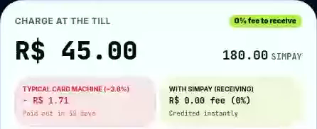
08 — BUSINESS MODEL
Cheaper for the
merchant. Sustainable
for the network.
0%
to receive a payment
Merchants keep the full sale. No machine rental, no waiting days.
WEBSITE SIMULATOR · 5s
5%
only when cashing out to Pix
Merchants choose when to convert. Many keep SIMPAY to spend in the network.
+
service fee on Pix purchases
Consumers buy SIMPAY with Pix; a small fee funds operations.
Cashback and referrals: funded by the 20% rewards allocation.
SIMPAY · COLOSSEUM 2026
09
Notes:
Narration cue: merchant receives the full amount in SIMPAY; a 5% fee applies only when converting to Pix. The screenshot is an illustrative R$25 sale from https://simpay.tech/comerciante, not an actual customer transaction. Click the simulator in slideshow mode to play the embedded five-second clip. The same video is supplied separately. In PDF the video is shown as a static poster frame.

Slide 10
09 — TRACTION PLAN
A growth loop built
into the product.
1
2
3
4
→
→
→
Pilot merchants
Merchant → merchant
Customer → customer
Blinks everywhere
Hand-onboard cafés and local shops with NFC tags and a 5-minute setup.
Each merchant gets a code. Both earn SIMPAY after the new shop’s first sales.
Cashback on every purchase plus invite codes. Rewards unlock on the first real payment.
Till links shared on X, WhatsApp and Phantom bring crypto users to the counter.
NEXT: PILOT MERCHANTS → FIRST PAYMENTS → NETWORK GROWTH
Notes:
Growth is built into the product: every merchant and every customer can refer.
Rewards unlock only on real use, which keeps fake accounts out.
Fill in the 90-day targets before recording.

Slide 11
10 — BEYOND THE COUNTER
The same rails, for
every payment that hurts.
EXPANSION VISION
THEN
Cross-border remittances
NEXT
Business-to-business
NOW
Money sent from abroad lands in a Brazilian wallet and cashes out to Pix, without correspondent banks.
Counter payments
Companies pay suppliers and each other: large amounts, settled in seconds, any day, any hour.
Consumers pay local merchants by QR, NFC and Blinks.
SIMPAY · COLOSSEUM 2026
11
Notes:
This is where SimPay grows beyond retail.
Same rails: the wallet, the token and Pix cash-out we already built.
Next: companies paying companies. Then: money coming from abroad.

Slide 12
11 — NEW FRONTS
Less friction, fewer fees,
fewer intermediaries.
EXPANSION VISION
B2B
REMIT
Payments between companies
International remittances
TODAY
Bank transfers with cut-off times, weekend delays and fees on every large payment.
TODAY
Several banks in the middle, high fees and days until the money arrives.
WITH SIMPAY
Pay suppliers in seconds, 24/7, with an on-chain receipt ready for reconciliation.
WITH SIMPAY
Sent on Solana in seconds; the family cashes out to Pix or spends at partners.
LOOP
Merchants already paid in SIMPAY pay their own suppliers without cashing out.
COMPLIANCE
Operated with licensed exchange partners, following Brazil’s crypto-asset rules.
SIMPAY · COLOSSEUM 2026
12
Notes:
B2B: large payments without bank cut-off times or weekend delays, with a receipt on-chain.
The loop matters: merchants paid in SIMPAY can pay suppliers without converting.
Remittances: fewer intermediaries, cash-out to Pix. Say clearly we will operate with licensed partners.

Slide 13
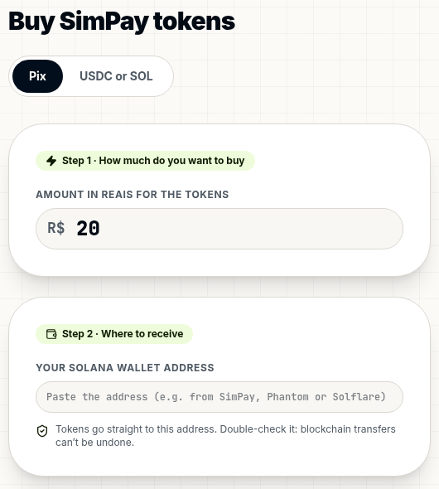
12 — WHERE WE ARE
Not a mockup.
A working network on devnet.
PIX → YOUR WALLET
Wallet app for iOS and Android
Merchant PDV with QR and NFC tags
Buy with Pix, delivered on-chain
Solana Blinks for every till
Cashback and referral programs
Admin console with full audit log
Push notifications when money arrives
Token metadata, whitepaper v2.0
WEB CHECKOUT · ENTRY FLOW
SIMPAY · COLOSSEUM 2026
13
Notes:
Source: https://simpay.tech/comprar. Real public purchase-entry form, wallet address empty and amount entered only locally. No Pix charge, token delivery or payment completion was executed. Empty metrics placeholders were removed because the user has not defined traction figures and is presenting the product first.

Slide 14
13 — TOKEN
FIXED SUPPLY · SPL TOKEN · SYMBOL SPY
5,000,000,000
Minted once. Mint authority is revoked at mainnet launch, so no new tokens can ever be created.
50%
20%
12.5%
Marketing & expansion
Market liquidity
Airdrop & rewards
10%
Private sale
Powers Pix purchases, merchant cash-out and future listings
Cashback, referrals and community campaigns
7.5%
Founding team
SIMPAY · COLOSSEUM 2026
14
Notes:
Fixed supply of 5 billion, minted once.
Half goes to market liquidity so purchases and cash-outs always work.
20% returns to the community as cashback and referral rewards.

Slide 15
14 — ROADMAP
Devnet today.
Mainnet next.
PHASE 1 · NOW
PHASE 2 · NEXT
PHASE 3
Devnet
Mainnet launch
Scale the network
Token live on Solana devnet
Independent security audit
Referral and cashback programs at scale
Full product shipped
Mint on mainnet, revoke mint authority
Liquidity and listings
Pilots and hackathon
Distribution per tokenomics
Open integrations for any app
SIMPAY · COLOSSEUM 2026
15
Notes:
We are in Phase 1 on devnet, on purpose: prove the product first.
Next: audit, mainnet, and revoking the mint authority.

Slide 16
15 — WHY TRUST US
Built like
financial
infrastructure.
BUILT FOR EVERYDAY USE
Your keys.
Your money.
Security first
Pix entry.
QR and NFC payments.
Secrets in HashiCorp Vault, bank API over mTLS, keys never leave the user’s device.
Every action audited
Admin changes, reward adjustments and blocks are logged with before and after.
One connected experience.
Tested end to end
300+ automated tests across API, merchant app and wallet.
SIMPAY · COLOSSEUM 2026
16
Notes:
Team placeholders were replaced with product pillars because the user has not yet defined the team and wants to present the product before developing launch plans. Existing security and test statements are retained from the original user-provided deck, rather than independently verified in this environment.

Slide 17

Pay like Pix.
Own like
crypto.
simpay.tech
EXPLORE SIMPAY · HELLO@SIMPAY.COM
Notes:
Close with the line: "Pay like Pix. Own like crypto."
Invite judges to pay a till Blink on devnet.
Thank you.

