Slide 1
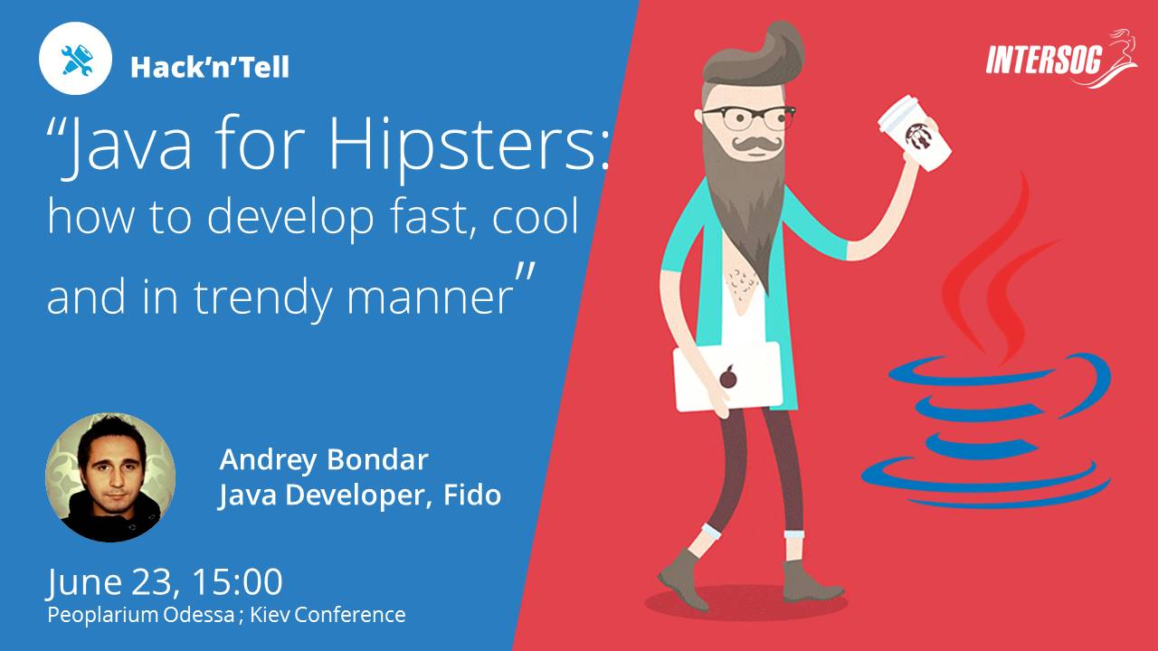


Campaign
proposal
Java for hipsters
How to develop fast, cool and in trendy manner
Hack‘n’Tell

Slide 2


Intro
Generic hipster portrait:
- Like trendy stuff
- Watches TV series from Netflix
- Loves Muffins
- Dislike to work hard
- Uses twitter

Slide 3

Agenda
- how to be fast
- project kickstarters
- code generation
- microservices & tools
- spring components
- microservices tools
- demo

Slide 4

Campaign
proposal
Project & code generation:
Create each time
- mvn folder structure
- pom.xml | gradle.build
- web.xml, myapp-servlet.xml,
- MyAppApplication.class
- etc
IS TOO BORING!
Lets kickstart project with generator!

Slide 5

Project generation
Campaign
proposal
What's Yeoman?
Yeoman helps you to kickstart new projects, prescribing best practices and tools to help you stay productive.
Generators are available for Angular, Java, Backbone, React, Polymer
and over 3900+ other projects.

Slide 6

Project generation
Campaign
proposal
Technology stack on the client side
HTML5 Boilerplate
Twitter Bootstrap
AngularJS
Sass
installation - Bower
Build - Gulp.js
Testing - Karma and PhantomJS
template engine - Thymeleaf
Technology stack on the server side
Spring Boot
Maven or Gradle
"development" and "production" profiles
Spring Security
Spring MVC REST + Jackson
WebSocket support with Spring Websocket
Spring Data JPA + Bean Validation
Database updates with Liquibase
Elasticsearch
MongoDB
Cassandra
Monitoring with Metrics

Slide 7
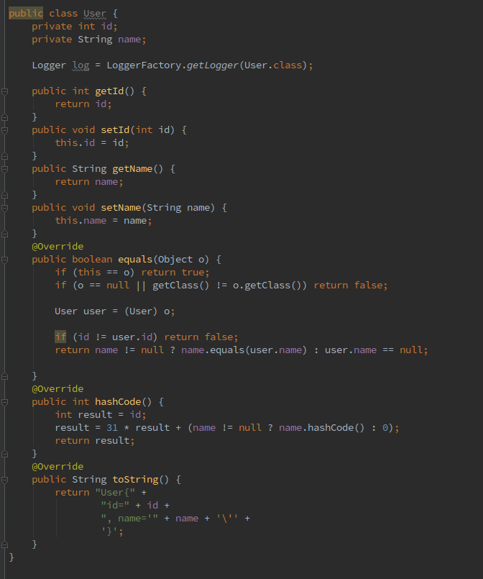
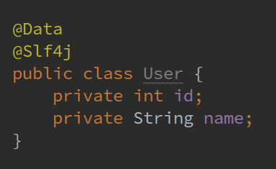
Code generation
Lombok project
Bolerplate code – the biggest evil in Java
@NonNull
@Cleanup
@Getter / @Setter
@ToString
@EqualsAndHashCode
@NoArgsConstructor,
@AllArgsConstructor
@Data
@Value
@Builder
@SneakyThrows
@Synchronized
@Log
@Slf4j
@Log4j
@CommonsLog

Slide 8
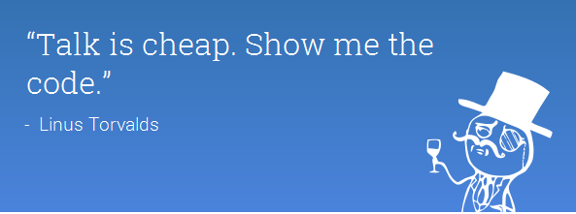
Notes:
<number>

Slide 9


Campaign
proposal
Microservices
with Spring and Netflix OSS

Slide 10
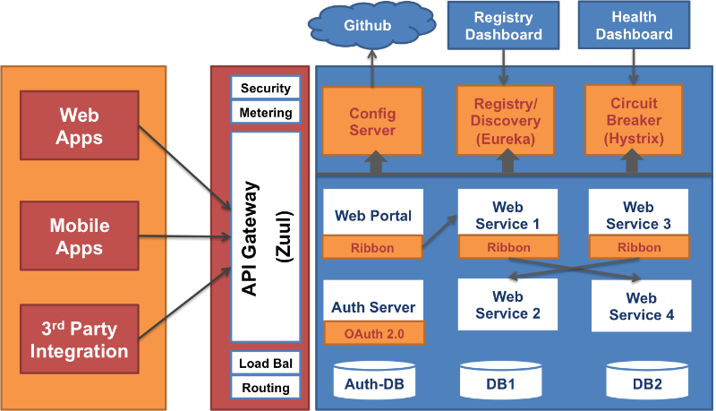
Netflix microservices architecture

Slide 11
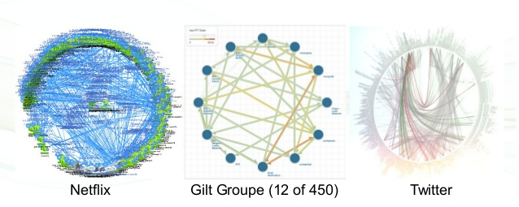
microservice topology or how much services should I have?

Slide 12

Main challenges:
- Service discovery
- Load balancing
- Config management
- Circuit brake
- Health monitoring

Slide 13
Mc'Donalds architecture
storeOrder()
getReport()
Report Service
registerService()
getServiceLocation()
Discovery Service
getMenu()
makeOrder()
Cashbox Service
healthCheck()
Dashboard Service
getPrices()
Price Service
getConfig()
Config Service
H2 DB

Slide 14
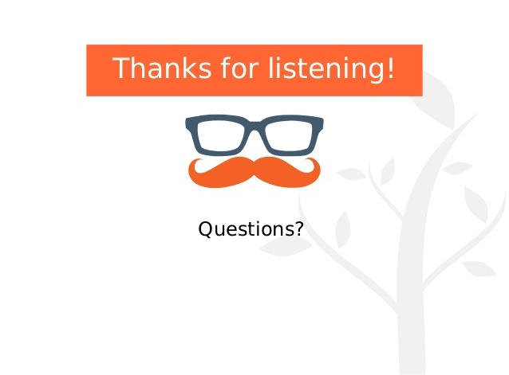
Notes:
Comments about it
<number>

