Slide 1
Reversing Anaglyph Videos Into Stereo Pairs
Matheus Ricardo Uihara Zingarelli – ICMC/USP São Carlos
Leonardo Antônio de Andrade – UFSCar
Rudinei Goularte – ICMC/USP São Carlos
XVII WebMedia – Outubro/2011

Slide 2
Agenda .
Anaglyph Reversal – Why?
Anaglyph Conversion & Reversion
The Color Index Table
Experiments & Results
Conclusion
References

Slide 3
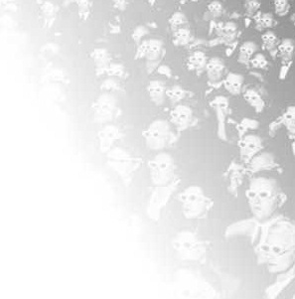
Anaglyph Reversal – Why?

Slide 4
Anaglyph Reversal – Why?
Stereoscopic coding → New strategies to reduce data volume
Incompatibility [4][5]
Lossy compression → depth perception compromised [2][3]
Proposal
Coding method exclusive for stereoscopic video
Compression without compromising depth perception
Generic

Slide 5
Anaglyph Reversal – Why?
Stereoscopic Coding
Compression
Generic

Slide 6
Anaglyph Reversal – Why?
Stereoscopic Coding
Compression
Generic
Anaglyph Conversion

Slide 7
Anaglyph Reversal – Why?
Stereoscopic Coding
Compression
Generic
Anaglyph Conversion
Simple and easy
Data volume reduced by 50%

Slide 8
Anaglyph Reversal – Why?
Stereoscopic Coding
Compression
Generic
Anaglyph Conversion
Simple and easy
Data volume reduced by 50%
Incompatibility

Slide 9
Anaglyph Reversal – Why?
Stereoscopic Visualization
Need of the stereo pair
Stereo Pair
Splitting
Glasses
Glasses Free
Anaglyph
Autostereoscopic
Polarized Light
Shutter

Slide 10
Anaglyph Reversal – Why?
Stereoscopic Coding
Compression
Generic
Anaglyph Conversion
Anaglyph Reversion

Slide 11

Anaglyph Conversion & Reversion

Slide 12
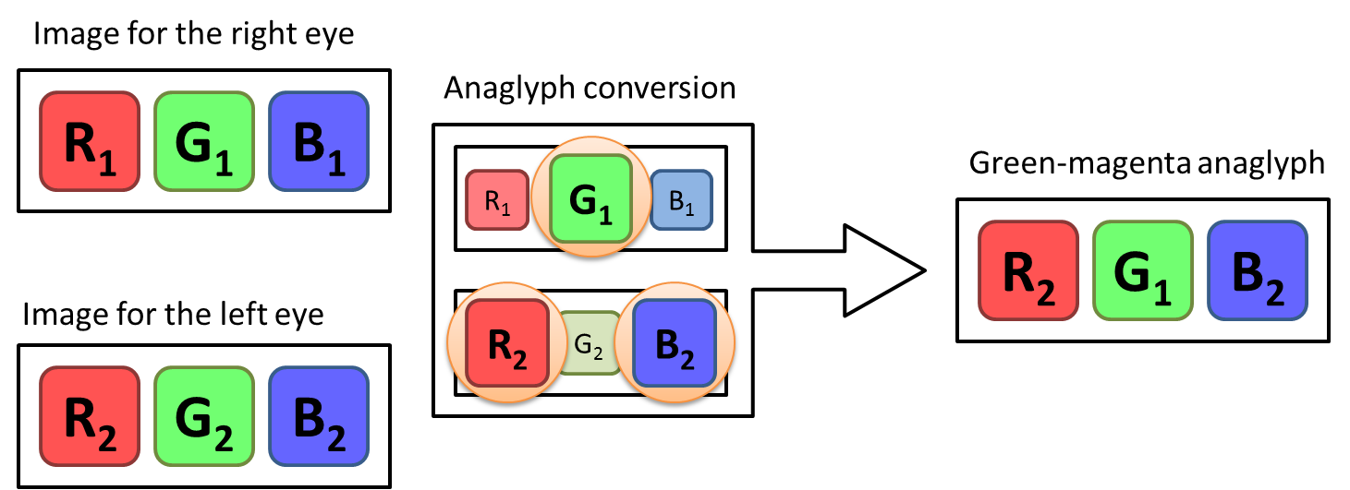
Anaglyph Conversion & Reversion
Retrieve color data removed during anaglyph conversion
Reconstruct the stereo pair
Color Index Table

Slide 13
Anaglyph Conversion & Reversion
Color Index Table
Storage of discarded colors
Complementary anaglyph
RGB → YC_{b}C_{r} (subsampled)
Discard of Y component

Slide 14
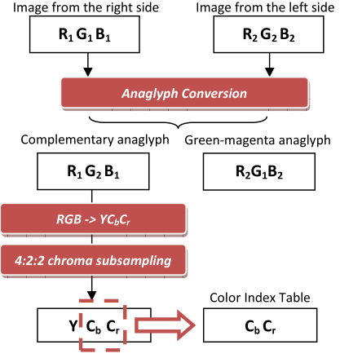
Anaglyph Conversion & Reversion
Based on results obtained in [2] and [3]
Green-magenta anaglyph
4:2:2 subsampling
Lossless compression
Qualificação Mestrado – Matheus Ricardo Uihara Zingarelli

Slide 15
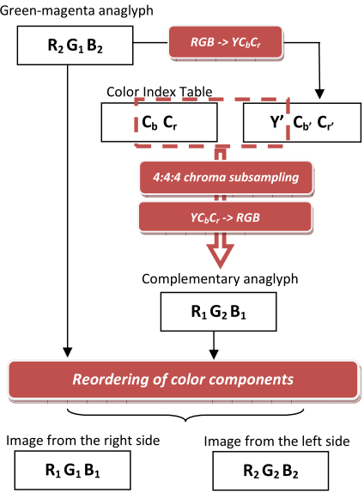
Anaglyph Conversion & Reversion
Using Y’ to reconstruct the complementary anaglyph
Qualificação Mestrado – Matheus Ricardo Uihara Zingarelli

Slide 16
Experiments & Results

Slide 17
Experiments & Results
Stereoscopic videos database [1]
http://200.136.217.194/videostereo/
32 images extracted and grouped by:
Brightness
Saturation
Contrast
PSNR (Peak Signal-to-Noise Ration)
Depth Perception

Slide 18
Experiments & Results
63.09% of overall data compression
Overall PSNR of 34.524 dB
Depth perception not affected
New green-magenta anaglyph created with the reverted stereo pair

Slide 19

Conclusion

Slide 20
Conclusion
Creation of a viable process of anaglyph reversion
Compression and quality
Future Work
Better PSNR results
Pixel displacement

Slide 21
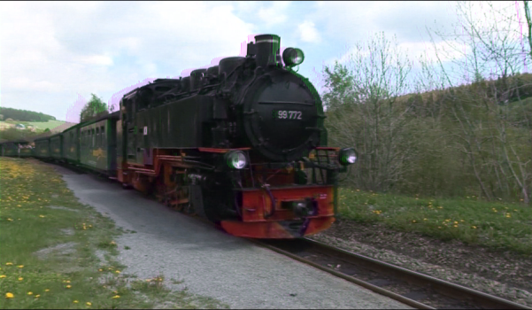
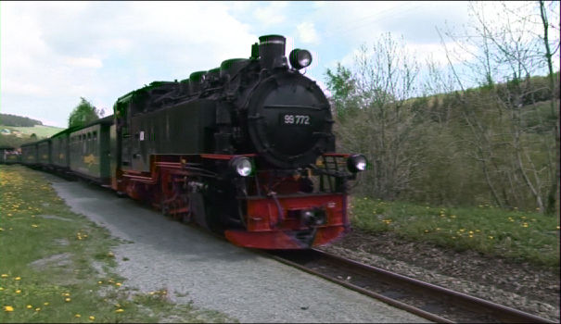
Qualificação Mestrado – Matheus Ricardo Uihara Zingarelli

Slide 22

References

Slide 23
References
[1] Andrade, L., Dolosic, P., Goularte, R. 2010. Construção de uma Base de Vídeos Estereoscópicos. Technical Report. ICMC-University of São Paulo, São Paulo, Brazil. Available at http://www.icmc.usp.br/~biblio/BIBLIOTECA/rel_tec/RT_351.pdf
[2] Andrade, L. A., Goularte, R. 2009. Anaglyphic stereoscopic perception on lossy compressed digital videos. In Proceedings of the XV Brazilian Symposium on Multimedia and the Web (WebMedia '09). Fortaleza, v.1, n.1, 226-233. DOI=http://doi.acm.org/10.1145/1858477.1858506.
[3] Andrade, L. A., Goularte, R. 2010. Uma Análise da Influência da Subamostragem de Crominância em Vídeos Estereoscópicos Anaglíficos. In Proceedings of the XVI Brazilian Symposium on Multimedia and the Web (WebMedia '10).
[4] Smolic, A.; Mueller, K.; Merkle, P.; Kauff, P.; Wiegand, T. 2009. An Overview of Available and Emerging 3D Video Formats and Depth Enhanced Stereo as Efficient Generic Solution. Proceedings of the 27th conference on Picture Coding Symposium, 2009 (May, 2009), 1-4, 6-8. DOI=http://dx.doi.org/10.1109/PCS.2009.5167358.
[5] Vetro, A. 2010. Representation and Coding Formats for Stereo and Multiview Video. In Studies in Computational Intelligence. Springer Berlin / Heidelberg, 51-73. DOI=http://dx.doi.org/10.1007/978-3-642-11686-5_2.

Slide 24

Questions?

Slide 25
New Experiments... New Results
4:2:2 subsampling also applied to the green-magenta anaglyph
79.64% of overall data compression
Test with 4:4:0 subsampling
Superior results
Overall PSNR of 40.905 dB
Fixed rounded values from RGB → YC_{b}C_{r} conversion & reversion
Qualificação Mestrado – Matheus Ricardo Uihara Zingarelli

