Slide 1
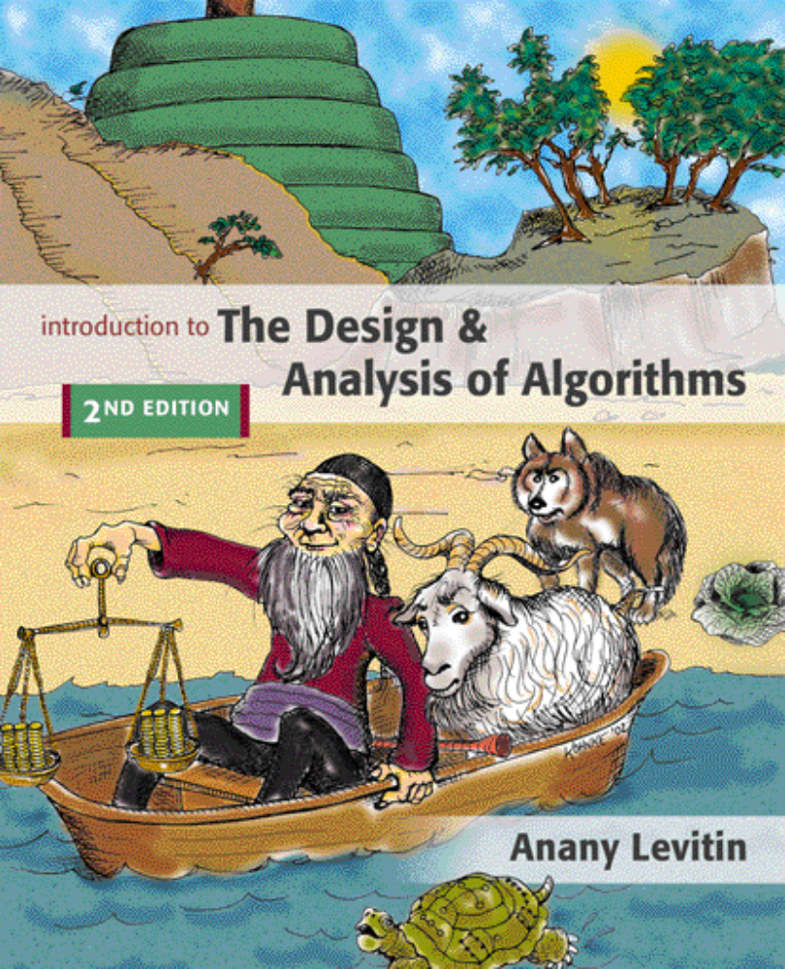

Chapter 3
Brute Force
Copyright © 2007 Pearson Addison-Wesley. All rights reserved.

Slide 2
Brute Force
A straightforward approach, usually based directly on the problem’s statement and definitions of the concepts involved
Examples:
Computing a^{n} (a > 0, n a nonnegative integer)
Computing n!
Multiplying two matrices
Searching for a key of a given value in a list

Slide 3
Brute-Force Sorting Algorithm
Selection Sort Scan the array to find its smallest element and swap it with the first element. Then, starting with the second element, scan the elements to the right of it to find the smallest among them and swap it with the second elements. Generally, on pass i (0 ≤ i ≤ n-2), find the smallest element in A[i..n-1] and swap it with A[i]:
A[0] ≤ . . . ≤ A[i-1] | A[i], . . . , A[min], . . ., A[n-1]
in their final positions
Example: 7 3 2 5

Slide 4
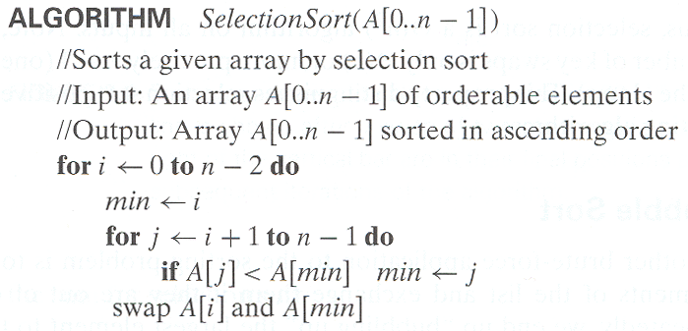
Analysis of Selection Sort
Time efficiency:
Space efficiency:
Stability:

Slide 5
Brute-Force String Matching
pattern: a string of m characters to search for
text: a (longer) string of n characters to search in
problem: find a substring in the text that matches the pattern
Brute-force algorithm
Step 1 Align pattern at beginning of text
Step 2 Moving from left to right, compare each character of
pattern to the corresponding character in text until
    all characters are found to match (successful search); or
    a mismatch is detected
Step 3 While pattern is not found and the text is not yet
exhausted, realign pattern one position to the right and
repeat Step 2

Slide 6
Examples of Brute-Force String Matching
Pattern: 001011 Text: 10010101101001100101111010
Pattern: happy Text: It is never too late to have a happy childhood.

Slide 7
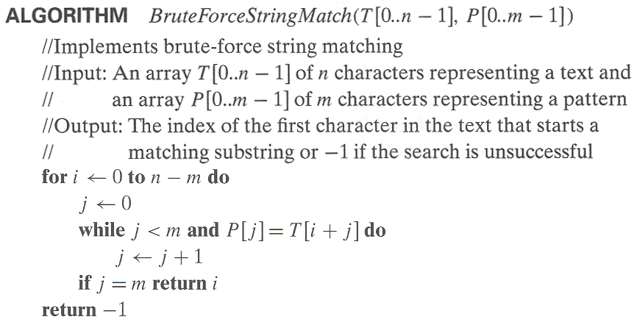
Pseudocode and Efficiency
Efficiency:

Slide 8
Brute-Force Polynomial Evaluation
Problem: Find the value of polynomial
p(x) = a_{n}x^{n} + a_{n-1}x^{n-1} +… + a₁x¹ + a₀
at a point x = x₀
Brute-force algorithm
Efficiency:
p ← 0.0
for i ← n downto 0 do
power ← 1
  for j ← 1 to i do //compute x^{i}
  power ← power ∗ x
  p ← p + a[i] ∗ power
return p

Slide 9
Polynomial Evaluation: Improvement
We can do better by evaluating from right to left:
Better brute-force algorithm
Efficiency:
p ← a[0]
power ← 1
for i ← 1 to n do
    power ← power ∗ x
  p ← p + a[i] ∗ power
  return p

Slide 10
Closest-Pair Problem
Find the two closest points in a set of n points (in the two-dimensional Cartesian plane).
Brute-force algorithm
Compute the distance between every pair of distinct points
and return the indexes of the points for which the distance is the smallest.
Notes:
Draw example.

Slide 11
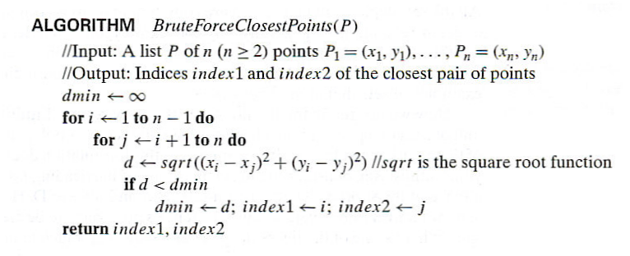
Closest-Pair Brute-Force Algorithm (cont.)
Efficiency:
How to make it faster?
Notes:
The basic operation of the algorithm is computing the Euclidean distance between two points.
The square root is a complex operation who’s result is often irrational, therefore the results
can be found only approximately. Computing such operations are not trivial. One can avoid
computing square roots by comparing distance squares instead.

Slide 12
Brute-Force Strengths and Weaknesses
Strengths
  wide applicability
  simplicity
  yields reasonable algorithms for some important problems
  (e.g., matrix multiplication, sorting, searching, string matching)
Weaknesses
  rarely yields efficient algorithms
  some brute-force algorithms are unacceptably slow
  not as constructive as some other design techniques

Slide 13
Exhaustive Search
A brute force solution to a problem involving search for an element with a special property, usually among combinatorial objects such as permutations, combinations, or subsets of a set.
Method:
  generate a list of all potential solutions to the problem in a systematic manner (see algorithms in Sec. 5.4)
  evaluate potential solutions one by one, disqualifying infeasible ones and, for an optimization problem, keeping track of the best one found so far
  when search ends, announce the solution(s) found

Slide 14
Example 1: Traveling Salesman Problem
Given n cities with known distances between each pair, find the shortest tour that passes through all the cities exactly once before returning to the starting city
Alternatively: Find shortest Hamiltonian circuit in a weighted connected graph
Example:
2
a
b
5
3
8
4
c
d
7

Slide 15
TSP by Exhaustive Search
Tour Cost
a→b→c→d→a 2+3+7+5 = 17
a→b→d→c→a 2+4+7+8 = 21
a→c→b→d→a 8+3+4+5 = 20
a→c→d→b→a 8+7+4+2 = 21
a→d→b→c→a 5+4+3+8 = 20
a→d→c→b→a 5+7+3+2 = 17
More tours?
Less tours?
Efficiency:

Slide 16
Example 2: Knapsack Problem
Given n items:
  weights: w₁ w₂ … w_{n}
  values: v₁ v₂ … v_{n}
  a knapsack of capacity W
Find most valuable subset of the items that fit into the knapsack
Example: Knapsack capacity W=16
item weight value
2 $20
5 $30
10 $50
5 $10

Slide 17
Knapsack Problem by Exhaustive Search
Subset Total weight Total value
{1} 2 $20
{2} 5 $30
{3} 10 $50
{4} 5 $10
{1,2} 7 $50
{1,3} 12 $70
{1,4} 7 $30
{2,3} 15 $80
{2,4} 10 $40
{3,4} 15 $60
{1,2,3} 17 not feasible
{1,2,4} 12 $60
{1,3,4} 17 not feasible
{2,3,4} 20 not feasible
{1,2,3,4} 22 not feasible
Efficiency:

Slide 18
Example 3: The Assignment Problem
There are n people who need to be assigned to n jobs, one person per job. The cost of assigning person i to job j is C[i,j]. Find an assignment that minimizes the total cost.
Job 0 Job 1 Job 2 Job 3
Person 0 9 2 7 8
Person 1 6 4 3 7
Person 2 5 8 1 8
Person 3 7 6 9 4
Algorithmic Plan: Generate all legitimate assignments, compute
their costs, and select the cheapest one.
How many assignments are there?
Pose the problem as the one about a cost matrix:

Slide 19
Assignment Problem by Exhaustive Search
9 2 7 8
6 4 3 7
5 8 1 8
7 6 9 4
Assignment (col.#s) Total Cost
1, 2, 3, 4 9+4+1+4=18
1, 2, 4, 3 9+4+8+9=30
1, 3, 2, 4 9+3+8+4=24
1, 3, 4, 2 9+3+8+6=26
1, 4, 2, 3 9+7+8+9=33
1, 4, 3, 2 9+7+1+6=23
etc.
(For this particular instance, the optimal assignment can be found by exploiting the specific features of the number given. It is: ...)
C =

Slide 20
Final Comments on Exhaustive Search
Exhaustive-search algorithms run in a realistic amount of time only on very small instances
In some cases, there are much better alternatives!
  Euler circuits
  shortest paths
  minimum spanning tree
  assignment problem
In many cases, exhaustive search or its variation is the only known way to get exact solution

