Slide 1
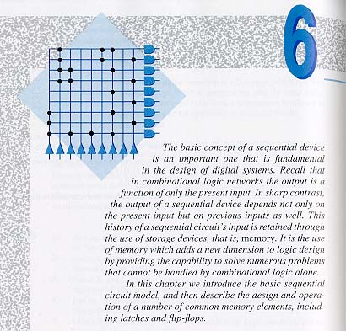
Chapter 6 -- Introduction to Sequential Devices

Slide 2
The Sequential Circuit Model
Figure 6.1

Slide 3
State Tables and State Diagrams
Figure 6.2

Slide 4
Sequential Circuit Example
Figure 6.3

Slide 5
Latch and Flip-flop Timing
Figure 6.4

Slide 6
TTL Memory Elements

Slide 7
Set Latch
Figure 6.5

Slide 8
Reset Latch
Figure 6.6

Slide 9
Set-Reset Latch (SR latch)
Figure 6.7

Slide 10
NAND SR Latch
Figure 6.8

Slide 11
Set-Reset Latch Timing Diagram
Figure 6.9

Slide 12
SR Latch Propagation Delays

Slide 13
SR Latch Characteristics
Figure 6.11
Q* = S + R′Q

Slide 14
SN74279 Latch with Two Set Inputs
Figure 6.12

Slide 15
Gated SR Latch
Figure 6.13

Slide 16
Gated SR Latch Characteristics
Figure 6.14
Q* = SC + R′Q + C′ Q

Slide 17
Delay Latch (D latch)
Figure 6.15

Slide 18
D Latch Characteristics
Figure 6.16
Q* = DC + C′Q

Slide 19
D Latch Timing Diagram
Figure 6.17

Slide 20
D Latch Timing Constraints
Figure 6.18

Slide 21
The SN74LS75 D Latch
Figure 6.19

Slide 22
Propagation Delays and Time Constraints for the SN74LS75

Slide 23
Hazard-Free D Latch, the SN74116
Figure 6.20
Q* = DC + C′Q + DC

Slide 24
Master-Slave SR Flip-flop
Figure 6.20

Slide 25
SR Master-Slave Flip-Flop Characteristics
Figure 6.22
Q* = S + R′Q

Slide 26
Master-Slave D Flip-Flop
Figure 6.23

Slide 27
Master-Slave D Flip-Flop Characteristics
Figure 6.24
Q* = D

Slide 28
Pulse-Triggered JK Flip-Flop Characteristics
Figure 6.25
Q* = K′Q + JQ′

Slide 29
Pulse-Triggered JK Flip Realization
Figure 6.26

Slide 30
The SN7476 Dual Pulse-Triggered JK Flip-Flop
Figure 6.27

Slide 31
SN7474 Dual Positive-Edge-Triggered D Flip-Flop
Figure 6.28

Slide 32
SN7474 Excitation Table
Figure 6.29

Slide 33
SN7474 Flip-Flop Timing Specifications
Figure 6.30

Slide 34
SN74175 Positive-Edge-Triggered D Flip-Flop
Figure 6.31 (a)

Slide 35
SN74273 Positive-Edge-Triggered D Flip-Flop
Figure 6.31 (b)

Slide 36
SN74LS73A Edge-Triggered JK Flip-Flop Logic Diagram
Figure 6.32 (a)

Slide 37
SN74LS73A Logic Symbols
Figure 6.32 (b) and (c)

Slide 38
SN74276 and SN74111 Edge-Triggered JK Flip-Flops
Figure 6.32 (d) and (e)

Slide 39
Negative-Edge-Triggered T Flip-Flop
Figure 6.33

Slide 40
Edge-Triggered T Flip-Flop Characteristics
Figure 6.34
Q* = Q′

Slide 41
Clocked T Flip-Flop
Figure 6.35

Slide 42
Excitation Table for Clocked T Flip-Flops
Figure 6.36
Q* = T′Q + TQ′

Slide 43
The Clocked T Flip-Flop Timing Diagram
Figure 6.37

Slide 44
Summary of Latch and Flip-Flop Characteristics

Slide 45
SE555 Precision Timing Module
Figure 6.38

Slide 46
Astable Operation of The SE555
Figure 6.39

Slide 47
Monostable (One shot) Device Realization
Figure 6.40

Slide 48
PROM-based Sequential Circuits
Figure 6.41

Slide 49
PROM-based Sequential Circuit Example
Figure 6.41

Slide 50
Prime Number Sequencer
Figure 6.43

