Slide 1
Lattice Algebra
Junior Barrera

Slide 2
Relations
Definition: Let A and B be sets. A binary relation from A to B is a subset of A×B.
In other words, for a binary relation R we have R ⊆ A×B. We use the notation aRb to denote that (a, b)∈R and aRb to denote that (a, b)∉R.

Slide 3
Relations
When (a, b) belongs to R, a is said to be related to b by R.
Example: Let P be a set of people, C be a set of cars, and D be the relation describing which person drives which car(s).
P = {Carl, Suzanne, Peter, Carla},
C = {Mercedes, BMW, tricycle}
D = {(Carl, Mercedes), (Suzanne, Mercedes), (Suzanne, BMW), (Peter, tricycle)}
This means that Carl drives a Mercedes, Suzanne drives a Mercedes and a BMW, Peter drives a tricycle, and Carla does not drive any of these vehicles.

Slide 4
Functions as Relations
You might remember that a function f from a set A to a set B assigns a unique element of B to each element of A.
The graph of f is the set of ordered pairs (a, b) such that b = f(a).
Since the graph of f is a subset of A×B, it is a relation from A to B.
Moreover, for each element a of A, there is exactly one ordered pair in the graph that has a as its first element.

Slide 5
Relations on a Set
Definition: A relation on the set A is a relation from A to A.
In other words, a relation on the set A is a subset of A×A.
Example: Let A = {1, 2, 3, 4}. Which ordered pairs are in the relation R = {(a, b) | a < b} ?

Slide 6
Relations on a Set
Solution: R = {
(1, 2),
(1, 3),
(1, 4),
(2, 3),
(2, 4),
(3, 4)}
1
1
R | 1 | 2 | 3 | 4
1
2
3
4
X
X
X
2
2
X
X
3
3
X
4
4

Slide 7
Properties of Relations
We will now look at some useful ways to classify relations.
Definition: A relation R on a set A is called reflexive if (a, a)∈R for every element a∈A.
Are the following relations on {1, 2, 3, 4} reflexive?
R = {(1, 1), (1, 2), (2, 3), (3, 3), (4, 4)}
No.
R = {(1, 1), (2, 2), (2, 3), (3, 3), (4, 4)}
Yes.
R = {(1, 1), (2, 2), (3, 3)}
No.
Definition: A relation on a set A is called irreflexive if (a, a)∉R for every element a∈A.

Slide 8
Properties of Relations
Definitions:
A relation R on a set A is called symmetric if (b, a)∈R whenever (a, b)∈R for all a, b∈A.
A relation R on a set A is called antisymmetric if a = b whenever (a, b)∈R and (b, a)∈R.
A relation R on a set A is called asymmetric if (a, b)∈R implies that (b, a)∉R for all a, b∈A.

Slide 9
Properties of Relations
Are the following relations on {1, 2, 3, 4} symmetric, antisymmetric, or asymmetric?
R = {(1, 1), (1, 2), (2, 1), (3, 3), (4, 4)}
symmetric
R = {(1, 1)}
sym. and antisym.
R = {(1, 3), (3, 2), (2, 1)}
antisym. and asym.
R = {(4, 4), (3, 3), (1, 4)}
antisym.

Slide 10
Properties of Relations
Definition: A relation R on a set A is called transitive if whenever (a, b)∈R and (b, c)∈R, then (a, c)∈R for a, b, c∈A.
Are the following relations on {1, 2, 3, 4} transitive?
R = {(1, 1), (1, 2), (2, 2), (2, 1), (3, 3)}
Yes.
R = {(1, 3), (3, 2), (2, 1)}
No.
R = {(2, 4), (4, 3), (2, 3), (4, 1)}
No.

Slide 11
Combining Relations
Relations are sets, and therefore, we can apply the usual set operations to them.
If we have two relations R₁ and R₂, and both of them are from a set A to a set B, then we can combine them to R₁ ∪ R₂, R₁ ∩ R₂, or R₁ – R₂.
In each case, the result will be another relation from A to B.

Slide 12
Partially Ordered Set
Given a,b,c in A, the following axioms are satisfied
a ≤ a (reflexive);
if a ≤ b and b ≤ a then a = b (antisymmetry);
if a ≤ b and b ≤ c then a ≤ c (transitivity).

Slide 13
Hasse Diagrams
An element a is said to be a minimal member of a poset P if no element b exists such that b < a
An element a is said to be a maximal member of P if no element b exists such that a < b
We can represent a partial order by a directed graph with nodes representing the elements of the poset and with a directed edge from node a to b representing a < b
A Hasse diagram is a digraph representation of a partial order with implied edge directions
If a ≤ b , then b is drawn higher in the graph than a and an edge connects them
Unrelated nodes have no edge between them and can be placed anywhere relative to one another
Edges are not explicitly drawn if they are implied by transitivity
Self-loops are not explicitly drawn

Slide 14
Example Hasse Diagrams
As an example, let P={(1,1),(1,2),(1,3),(2,1),(2,2),(2,3)} and let (x₁,x₂) ≤ (y₁,y₂) whenever x₁ ≤ y₁ and x₂ ≤ y₂. This relation can be represented in the following Hasse diagram :
{a,b,c}
P:
(2,3)
Q:
(1,3)
(2,2)
{a,c}
{a,b}
{b,c}
(1,2)
(2,1)
{a}
{b}
{c}
(1,1)
Ø
Another example, let Q=2^{{a,b,c}} and for x,y ∈ Q let x ≤ y mean that x ⊆ y. Then Q is a poset and we can draw the Hasse diagram for Q.

Slide 15
Meet and Join
Definition: An element m of a poset P is a lower bound of elements a,b ∈ P if m ≤ a and m ≤ b. Further, m is the greatest lower bound or meet of a and b if m’ ≤ m for any other lower bound m’
We write a⋅b = m or a∧b = m to denote that m is the meet of a and b
Definition: An element m of a poset P is a upper bound of elements a,b∈P if m≥a and m≥b. Further, m is the least upper bound or join of a and b if m ≤ m’ for any other upper bound m’
We write a + b = m or a∨b = m to denote that m is the join of a and b
The meet and join of two elements are unique when they exist
Two elements may or may not have a lower (upper) bound and even if they do, they may not have a meet (join) because it can be the case that none of the bounds is greatest (lowest)

Slide 16
Example Hasse Diagrams
As an example, let P={(1,1),(1,2),(1,3),(2,1),(2,2),(2,3)} and let (x₁,x₂) ≤ (y₁,y₂) whenever x₁ ≤ y₁ and x₂ ≤ y₂. This relation can be represented in the following Hasse diagram :
{a,b,c}
P:
(2,3)
Upper bounds
Q:
join
(1,3)
(2,2)
{a,c}
{a,b}
{b,c}
(1,2)
(2,1)
{a}
{b}
{c}
(1,1)
Ø
Another example, let Q=2^{{a,b,c}} and for x,y ∈ Q let x ≤ y mean that x ⊆ y. Then Q is a poset and we can draw the Hasse diagram for Q.

Slide 17
Example Hasse Diagrams
As an example, let P={(1,1),(1,2),(1,3),(2,1),(2,2),(2,3)} and let (x₁,x₂) ≤ (y₁,y₂) whenever x₁ ≤ y₁ and x₂ ≤ y₂. This relation can be represented in the following Hasse diagram :
{a,b,c}
P:
(2,3)
Q:
(1,3)
(2,2)
{a,c}
{a,b}
{b,c}
(1,2)
(2,1)
{a}
{b}
{c}
meet
lower bounds
(1,1)
Ø
Another example, let Q=2^{{a,b,c}} and for x,y ∈ Q let x ≤ y mean that x ⊆ y. Then Q is a poset and we can draw the Hasse diagram for Q.

Slide 18
Lattice ordered set
A lattice (L, ∧, ∨) is a partially ordered set (L, <=) such that every subset X of L has a meet (∧) and a join (∨).
Corolary: every lattice has a least and a greatest element, since:
by dfinition, the join and meet of the empty
set are, respectively, the least and greatest
element of L.

Slide 19
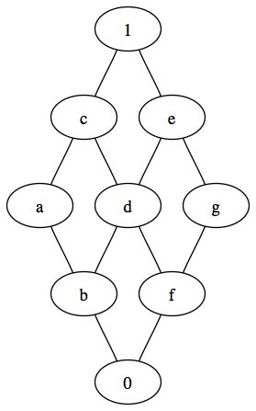
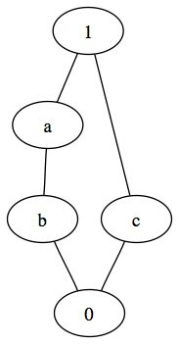

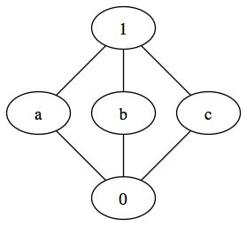
Lattice Examples

Slide 20
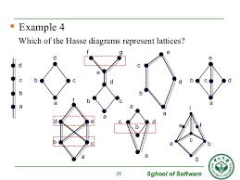
Non Lattice Example ?

Slide 21
Algebra
Algebra – defined by the tuple: ⟨A, o₁, …, o_{k}; R₁, …, R_{m}; c₁, …, c_{k}⟩
Where: A is a non-empty set o_{i} is the function, o_{i}: A^{p}i→ A where p_{i} is a positive integer R_{j} is a relation on A c_{i} is an element of A
EXAMPLE
⟨Z, +, ≤⟩ Z is a set of integers
+ is addition operation
≤ is “less than or equal to” relation

Slide 22
Lattice Algebra
Lattice Algebra – defined by the tuple: ⟨A, •, ∨⟩
Where: A is a non-empty set ∨, • are binary operations
And, the Following Axioms Hold:
a ∨ a = a a • a = a (Idempotence)
a ∨ b = b ∨ a a • b = b • a (Commutativity)
a ∨ (b ∨ c) = (a ∨ b ) ∨ c a • (b • c) = (a • b) • c (Associativity)
a ∨ (a • b) = a a • (a ∨ b) = a (Absorption)
a,b,c ∈ A

Slide 23
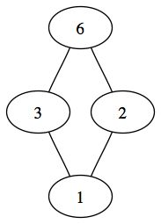
Lattice - Example
Let A={1,2,3,6}.
Let a ∨ b be the least common multiple
Let a ∧ b be the greatest common divisor
Then, the algebraic system ⟨A, ∨, ∧⟩ satisfies the lattice axioms.

Slide 24
Lattice Equivalence
A lattice algebra can be obtained from a lattice-ordered poset (L, ∧, ∨) by defining ∨ as the join ∨ and • as the meet ∧.
Also, from a lattice ⟨L, •, ∨⟩ , one may obtain a lattice ordered set (L, ∧, ∨) by setting
a <= b if and only if a = a•b or, equivalently, b = a∨b.
⟨L, •, ∨⟩

Slide 25
Boolean Algebra
Distributive Lattice Algebra
A Lattice Algebra plus the Following Distributive Laws Hold:
a ∨ (b • c) = (a ∨ b ) • (a ∨ c)
a • (b ∨ c) = (a • b) ∨ (a • c)
Complemented Distributive Lattice Algebra
1) maximal element = 1
2) minimal element = 0
3) For any a ∈ A if ∃ x_{a}∈ A such that a • x_{a} = 0
4) For any a ∈ A if ∃ x_{a} ∈ A such that a ∨ x_{a} = 1
A Complemented Distributive Algebra is a Boolean Algebra

Slide 26
Distributive Lattice Examples
1
1
c is complement of a
c is complement of b
a
c
No complement
b
a
0
0
a • (b ∨ c) = (a • b) ∨ (a • c)?
a • 1 = a
(a • b) ∨ (a • c) = b ∨ 0 = b
No, non-distributive lattice!

Slide 27
Examples
distributive
non-distributive

Slide 28
Boolean Algebra
Let B be a set with at least two elements 0 and 1. Let two binary operations ∨ and ⋅, and an unary operation ‾ be defined on B. The algebraic system
⟨B, ∨, ⋅ ,‾ , 0,1⟩
is a Boolean algebra, if it is a distributive and complemented lattice.

Slide 29
Examples of Boolean Algebras
Boolean Algebra over {0,1}
B={0,1}. ⟨B, ∨, ⋅ ,‾ , 0,1⟩
Boolean Algebra over Boolean Vectors
B^{n} = {(a₁, a₂, … , a_{n}) | a_{i} ∈ {0,1}}
Let a=(a₁, a₂, … , a_{n}) and b = (b₁, b₂, … , b_{n}) ∈ B^{n}
define
a ∨ b = (a₁ ∨ b₁, a₂ ∨ b₂, … , a_{n} ∨ b_{n})
a ⋅ b = (a₁ ⋅ b₁, a₂ ⋅ b₂, … , a_{n} ⋅ b_{n})
‾‾a=(‾a₁, ‾a₂, … , ‾a_{n})
then ⟨B^{n}, ∨, ⋅ ,‾ , 0,1⟩ is a Boolean algebra, where, 0 = (0,0, …, 0) and 1 = (1,1, …, 1)
Boolean Algebra over Power Set

Slide 30
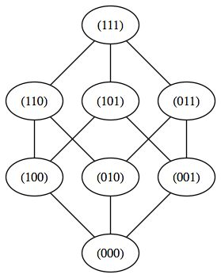
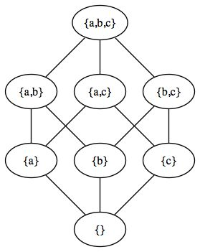
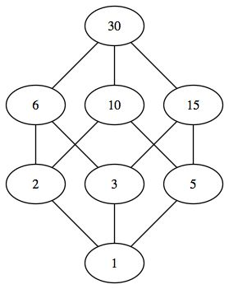
Examples
B³
P({a,b,c})
{n ∈ Ν| n|30}

Slide 31
Atoms Representations
Anti-átomos
X
Átomos
X = Sup{a_{i}: a_{a}<= X}
X = Inf {anti-a_{i}: anti-a_{a}>= X}

Slide 32
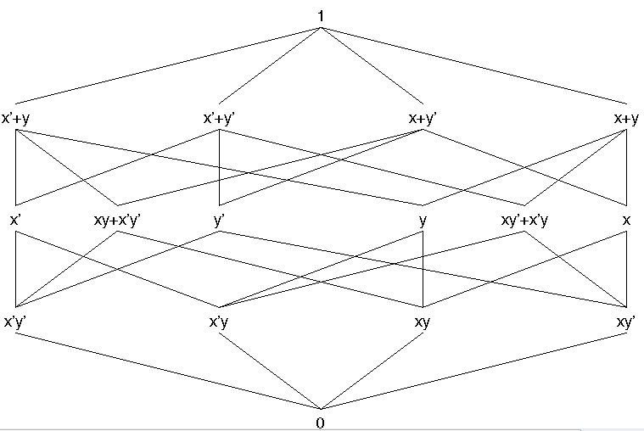
Hasse Diagram of the Boolean Algebra
For example, the Boolean algebra of two variable switching functions has Hasse diagram

Slide 33
Boolean Algebra
⟨B, ∨, •, , 0, 1⟩
0, 1∈ B
is a unary operation over B
∨, • are binary operations over B
0 is the “identity element” wrt ∨ 1 is the “identity element” wrt •
Ordered Set
Lattice
Dist. Lattice
Boolean Algebra

Slide 34
Boolean Algebra Postulates
⟨B, ∨, •, , 0, 1⟩ 0, 1∈ B
For arbitrary elements a,b,c ∈ B the Following Postulates Hold:
Absorption a ∨ (a • b) = a a • (a ∨ b) = a
Associativity a ∨ (b ∨ c) = (a ∨ b ) ∨ c a • (b • c ) = (a • b) • c
Commutativity a ∨ b = b ∨ a a • b = b • a
Idempotence a ∨ a = a a • a = a
Distributivity a ∨ (b • c) = (a ∨ b) • (a ∨ c) a • (b ∨ c) = (a • b) ∨ (a • c)
Involution a = a
Complement a ∨ a = 1 a • a = 0
Identity a ∨ 0 = a a • 1 = a a ∨ 1 = 1 a • 0 = 0
DeMorgan’s a ∨ b = a • b a • b = a ∨ b

Slide 35
Huntington’s Postulates
⟨B, ∨, •, , 0, 1⟩ 0, 1∈ B
All Previous Postulates may be Derived Using:
Commutativity a ∨ b = b ∨ a a • b = b • a
Distributivity a ∨ (b • c) = (a ∨ b) • (a ∨ c) a • (b ∨ c) = (a • b) ∨ (a • c)
Complement a ∨ a = 1 a • a = 0
Identity a ∨ 0 = a a • 1 = a
If Huntington’s Postulates Hold for an Algebra then it is a Boolean Algebra

Slide 36
DeMorgan’s Theorem
⟨B, ∨, •, , 0, 1⟩ 0, 1∈ B
Theorem: Let F(x₁, x₂,…,x_{n}) be a Boolean expression. Then, the complement of the Boolean expression F(x₁, x₂,…, x_{n}) is obtained from F as follows:
1) Add parentheses according to order of operation
2) Interchange all occurrences of ∨ with •
3) Interchange all occurrences of x_{i} with x_{i}
4) Interchange all occurrences of 0 with 1
EXAMPLE F = a ∨ ( b • c ) F = a • ( b ∨ c )
a ∨ (b • c ) = a • ( b ∨ c )
= a • ( b ∨ c )

Slide 37
Principle of Duality
⟨B, ∨, •, , 0, 1⟩ 0, 1∈ B
Interchanging all occurrences of ∨ with • and interchanging all occurrences of 0 with 1 in an identity, results in another identity that holds.
A is a Boolean expression and A^{D} is the Dual of A
0^{D}=1 1^{D}=0
A, B and C are Boolean Expressions
if A = B ∨ C then A^{D} = B^{D} • C^{D}
if A = B • C then A^{D} = B^{D} ∨ C^{D}
if A = B then A^{D} = B^{D}

Slide 38
Logic (Switching) Functions
B ={0, 1}
The set of all mappings B^{n} → B for B ={0,1} can be represented by Boolean expressions and are called “two-valued logic functions” or “switching functions”.
The set B^{n} contains 2^{n} elements
The total number of mappings or functions is
The notation we use is f: B^{n} → B
f can also be described through the use of an expression

Slide 39
Multi-dimensional Logic Functions
f:B^{n}→B^{m} B={0,1}
f is a vector of functions f_{i}: B^{n}→B where I = 1 to m
B^{n} represents the set of all elements in the set formed by n applications of the Cartesian Product B× B × … × B
B^{n} can also be interpreted geometrically as an n-dimensional hypercube
The geometrical representations are referred to as “cubical representations”
Each element in B^{n} is represents a geometric coordinate a discrete hyperspace

Slide 40
Cubical Representation
Consider f:B³→B B={0,1}
The domain of f is a hypercube of dimension n = 3
The range of f is a hypercube of dimension n = 1
(0,1,1)
(1,1,1)
(0,1,0)
(1,1,0)
f
0
1
(0,0,1)
(1,0,1)
(0,0,0)
(1,0,0)
NOTE: These are (sideways) Hasse Diagrams for B³ and B¹ !!!

Slide 41
Some Definitions
variable – A symbol representing an element of B
x_{i} ∈ B
literal – x_{i} or x_{i}
if x_{i}=0 then x_{i} =1
if x_{i} =1 then x_{i} =0
product – a Boolean expression composed of literals and the • operator
(e.g. x₁•x₃•x₄)
NOTE: when two literals appear next to each other, the • operation is “assumed” to be present
(e.g. x₁x₃x₄)
cube – another term for a product
minterm – an element of B^{n} for f:B^{n}→ B such that f = 1
j-cube – a product composed of n-j literals
f(x₁, x₂,…,x_{n}) – a function f: B^{n} → B
f(x₁, x₂,…, x_{n}) – a multi-dimensional function f : B^{n} →B^{m}

Slide 42
Functions and Expressions
⟨B, +, •, , 0, 1⟩ B ={0, 1}
A specific function may be defined by an expression
EXAMPLE: Consider the Boolean algebra defined above. Each operation can be given a name and defined by a personality matrix or table. The table contains the operation result for each element in B×B for a binary operation and for each element in B for a unary operation.
NAME is OR
NAME is AND
NAME is NOT
+ | 0 | 1
0 | 0 | 1
1 | 1 | 1
• | 0 | 1
0 | 0 | 0
1 | 0 | 1
0 | 1
1 | 0
EXAMPLE: A function f: B³→ B can be specified by an expression over some Boolean algebra.
f(x₁, x₂, x₃) = x₁ + x₁ x₂ x₃

Slide 43
Geometric Interpretation of a Function
⟨B, +, •, , 0, 1⟩ B ={0, 1}
f(x₁, x₂, x₃) = x₁ + x₁ x₂ x₃
(0,1,1)
(1,1,1)
(0,1,0)
(1,1,0)
f
x₂
0
1
x₃
(0,0,1)
x₁
(1,0,1)
(0,0,0)
(1,0,0)
f ¹ denotes the “on-set” of the function f
“on-set” is a set of cubes in the domain of f for which f = 1
f ¹={x₁, x₁x₂x₃}

Slide 44
Geometric Description of a Function
⟨ B, +, •, , 0, 1⟩ B ={0, 1}
f(x₁, x₂, x₃) = x₁ + x₁ x₂ x₃
(0,1,1)
(1,1,1)
(0,1,0)
(1,1,0)
x₂
x₃
(0,0,1)
x₁
(1,0,1)
(0,0,0)
(1,0,0)
f = ∑(0,1,2,3,6) where each value represents a 0-cube
Each cube in f₁={x₁, x₁x₂x₃} “covers” 1 or more 0-cubes
x₁ covers {000, 001, 010, 011} x₁ is a 2-cube
x₁x₂x₃ covers {110} x₁x₂x₃ is a 0-cube

Slide 45
Geometric Description (cont)
⟨ B, +, •, , 0, 1⟩ B ={0, 1}
f(x₁, x₂, x₃) = x₁ + x₁ x₂ x₃ = x₁ + x₂ x₃
(0,1,1)
(0,1,1)
(1,1,1)
(1,1,1)
(1,1,0)
(0,1,0)
(1,1,0)
(0,1,0)
x₂
x₃
(0,0,1)
(0,0,1)
(1,0,1)
(1,0,1)
x₁
(0,0,0)
(1,0,0)
(0,0,0)
(1,0,0)
minterm – any 0-cube that is covered by any element in f ¹
“don’t care” is a variable that is not present in a cube in f ¹
don’t care is denoted by “-”
f ¹={x₁--, x₁x₂x₃}={-x₂x₃, x₁-x₃, x₁x₂x₃}
x₂ and x₃ are don’t cares in cube x₁

Slide 46
Cube Sets
f ¹ is a set of all cubes for which f = 1 (on-set)
f ⁰ is a set of all cubes for which f = 0 (off-set)
f ^{DC} is a set of all cubes for which f = don’t care (DC-set)
f is “completely specified” if any two of f ⁰, f ¹ or f ^{DC} are given
f is “incompletely specified” proper subsets are given for f ⁰, f ¹ or f ^{DC}
f ¹ is said to be a “cover” for f

