Slide 1
Distributed Meeting Scheduling
Andrea Damiani
Emanuele Mason

Slide 2

(virtual) Experimental Setting
A corporation and a single working day (08:00-18:00)
Two roles for employees
  Manager
  Can setup a meeting for the team he manages
  May want to participate to other team meetings
  Clerk
  Can only join multiple team meetings
It is less important if a clerk misses a meeting than if a manager does.
Notes:
Emanuele

Slide 3
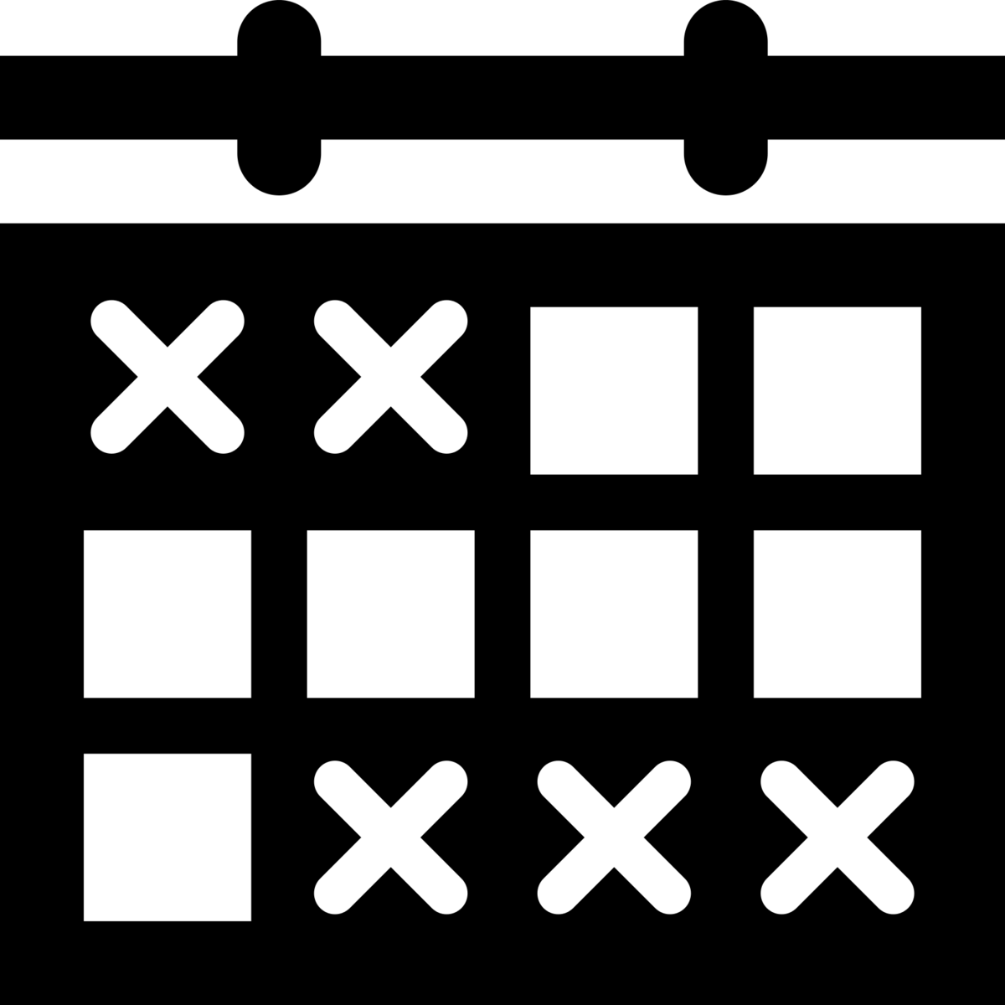

Problem Statement
Setting up a corporate meeting day-schedule
  Allowing intersections
  Trying to minimize overlapping meetings that are in the interests of a single person
  Avoid disclosing everyone’s preferences (PRIVACY) → avoid centralization
Notes:
Emanuele

Slide 4

Solution
ADOPT
Asynchronous Distributed OPTimization
Constraint
For Managers
  Meeting I am interested in
  OVERLAPS
  Meeting I Manage
For All
  Meeting I am interested in
  OVERLAPS
  another Meeting I am interested in
3
Cost
1
Cost
Notes:
Emanuele

Slide 5
Implementation
Step-based JADE Agent Behaviour
  Initialize
  Lookup for available meetings
    JADE Directory Based
  Build Constraint Network
    Multicasting
  Build DFS tree
    Fully distributed root election
    Naive implementation (not focal point)
  ADOPT
Notes:
Andrea

Slide 6
Demo
ADOPT grows exponentially with complexity of Constraint Network
  Small but interesting examples may require more than 15 minutes to terminate
  Live-Demo for naive case
  Screnshoots of interesting case
Notes:
Andrea

Slide 7
SIMULATION
Preferences
Agent | Manages team | Interested in teams | Meeting duration
agA | a | b,c | 3 hours
agB | b | c,d | NO MEETING
agC | c | a,d | 4 hours
agD | d | - | 4 hours
ag1 | - | b,c,d | NOT A MANAGER
Total meeting time = 11 hours
more than available
overlapping required
Both managers and simple employees
Different constrains
Intersecating interests
Intricated Constraint Network
Notes:
Andrea

Slide 8
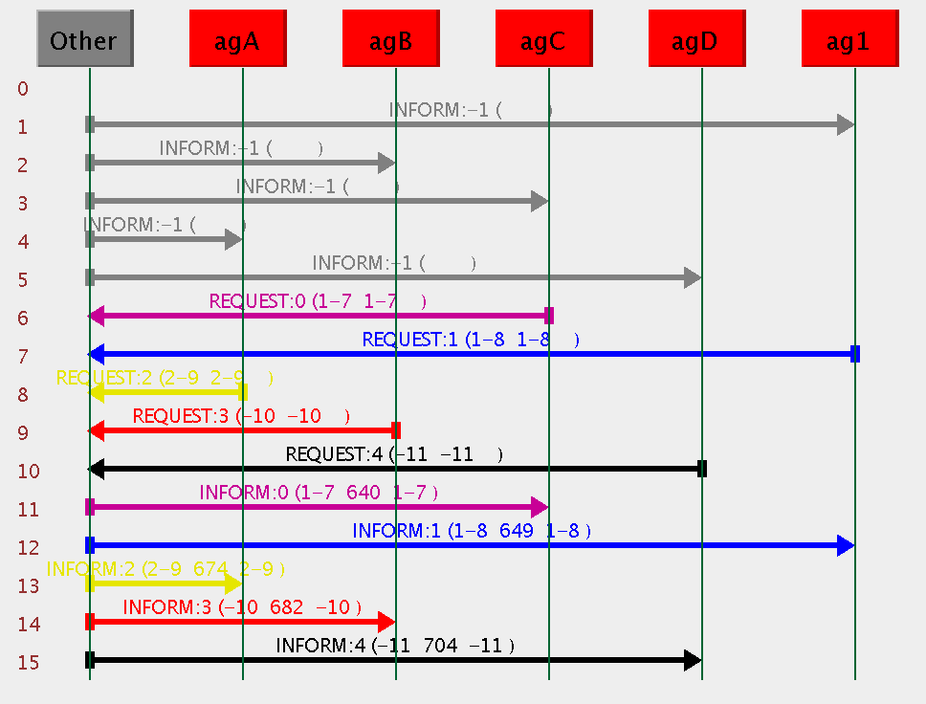
START SIGNAL
DIRECTORY LOOKUP
Notes:
Andrea

Slide 9
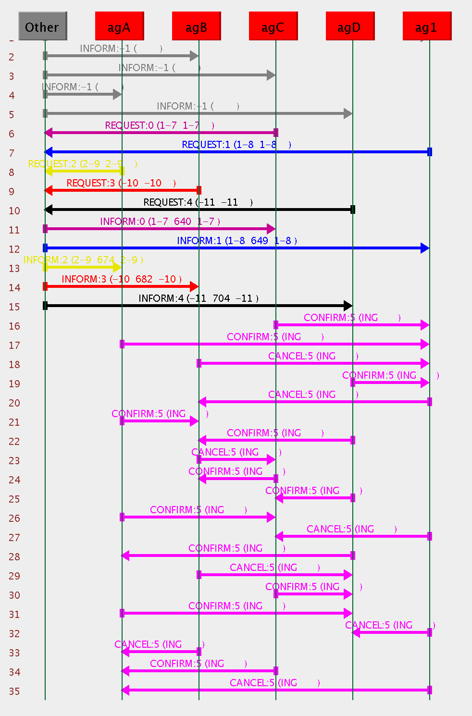
CONFIRMS MEETING
AVAILABILTY
CANCELS MEETING
AVAILABILTY
AVAILABLE MEETINGS
ADVERTISEMENT
Notes:
Andrea

Slide 10
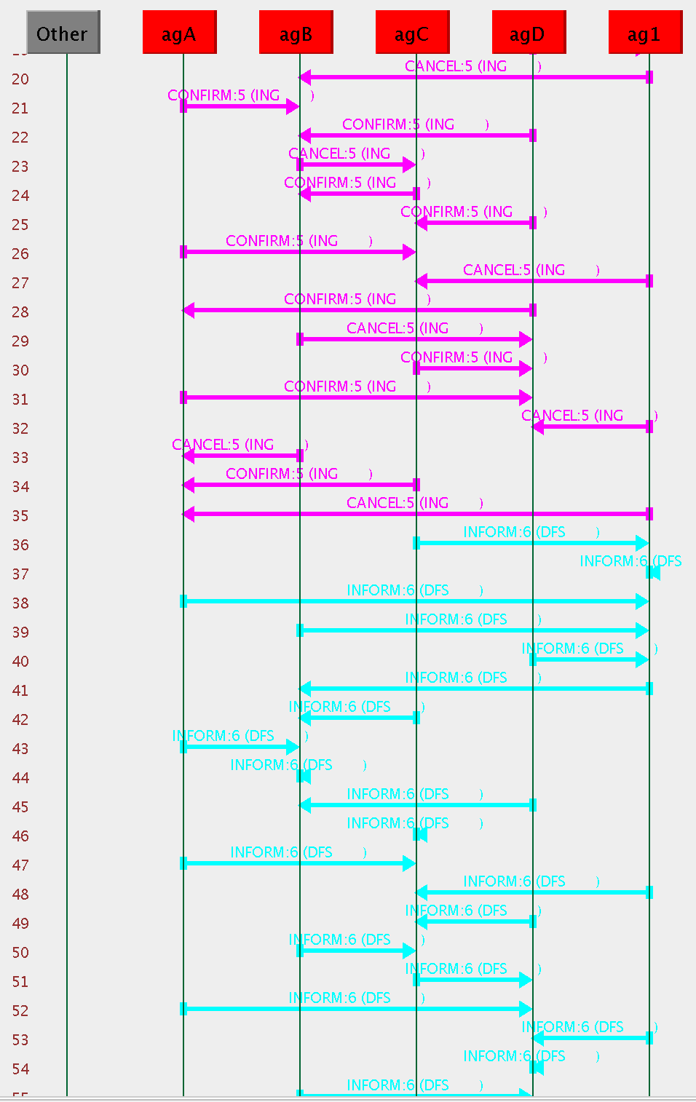
MULTICAST SEND OF
MY RANDOM VALUE
DISTRIBUTED ROOT
ELECTION
(With Random Values)
Notes:
Andrea

Slide 11
… Root Election gets to an end …
Notes:
Andrea

Slide 12
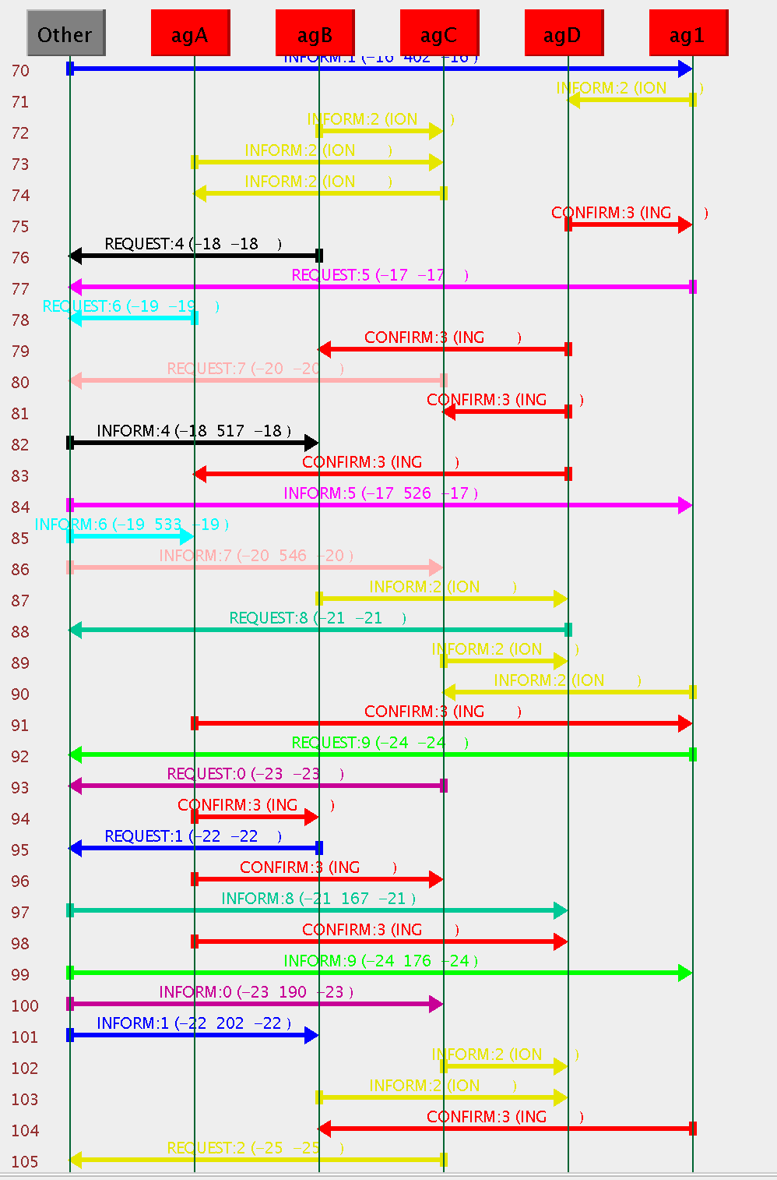
BUILD
CONTRAINT NETWORK
Relevant Messages:
SEND
CONTRAINT COST
TO NEIGHBOR
BROADCAST SIGNAL:
NO MORE CONTRAINT FROM AGENT
Notes:
Andrea

Slide 13
… Constraint Network gets built …
Notes:
Andrea

Slide 14
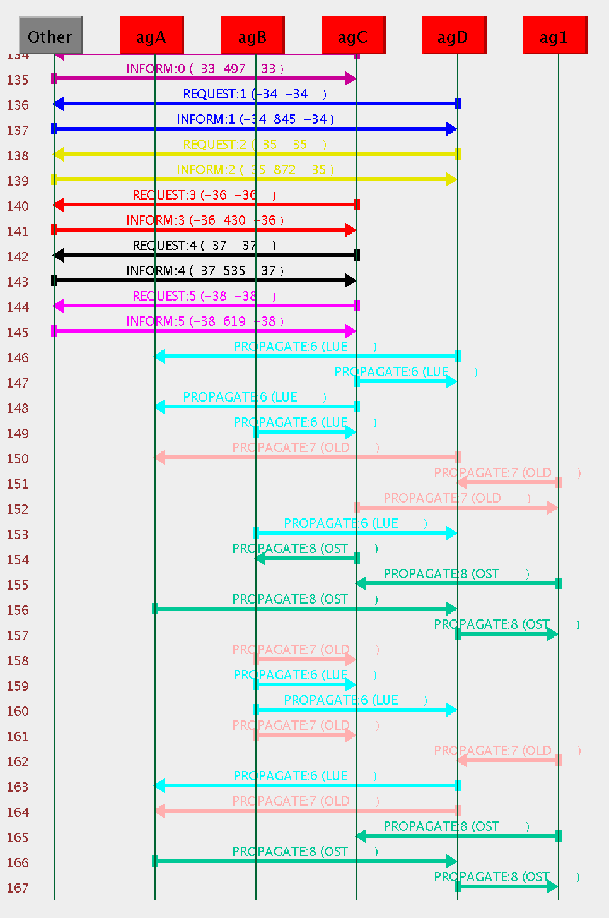
ADOPT
EXECUTION
Messages:
VALUE
Propagates Current
Variable Assignemnts
COST:
Propagates Current
Bounds Extimations
THRESHOLD:
Propagates Current
Minimum Cost Allowance
Notes:
Andrea

Slide 15
… ADOPT goes on …
Notes:
Andrea

Slide 16
… the JADE sniffer “crashes”
more than once under heavy load…
mag 21, 2015 17:41:17 PM jade.core.messaging.OutBox addLast
AVVERTENZA: Message discarded by MessageManager! Queue
size > 100000000, number of pending messages = 860145,
size of last message = 1576
mag 21, 2015 17:53:17 PM jade.core.messaging.OutBox addLast
AVVERTENZA: Message discarded by MessageManager! Queue
size > 100000000, number of pending messages = 88117,
size of last message = 738
mag 21, 2015 17:57:17 PM jade.core.messaging.OutBox addLast
AVVERTENZA: Message discarded by MessageManager! Queue
size > 100000000, number of pending messages = 86124,
size of last message = 1690
Notes:
Andrea

Slide 17
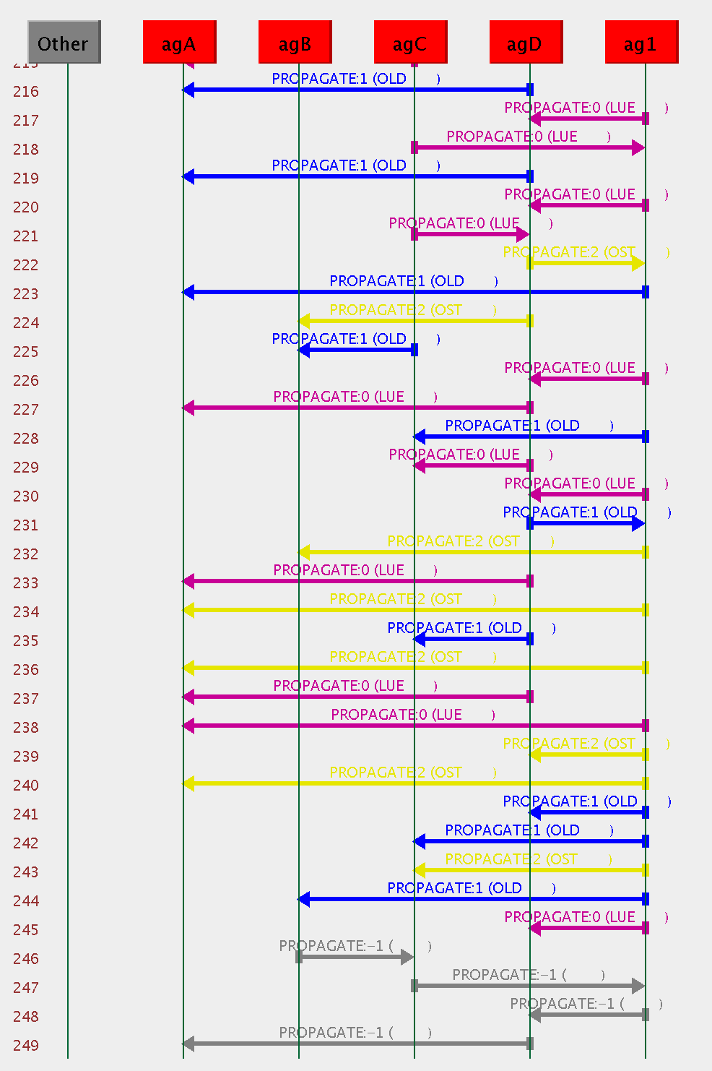
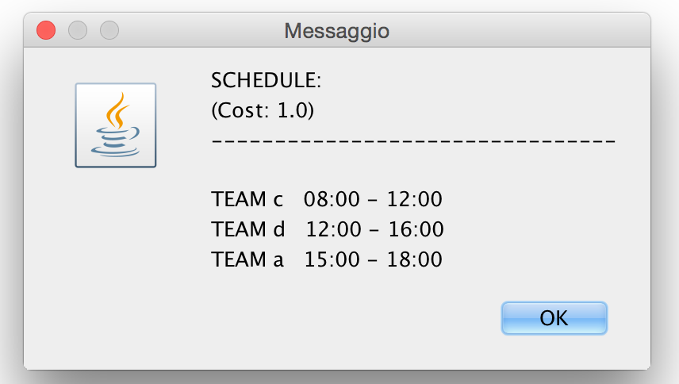
TERMINATION
PROPAGATION
VIOLATES
CONSTRAINT
a<->d
SET BY
AGENT agD
Notes:
Andrea
Obviously Optimal
Overlapping is required
All couples share a praference constraint

Slide 18

Conclusions
As theoretically stated:
ADOPT is not practical even in medium complexity situations
DFS tree deeply impacts on ADOPT performance
Exact solutions are needed only in critical environment and are better addressed in a centralized HPC fashion
Code is here
https://github.com/andredami/ims-scheduling
Notes:
Emanuele
NOTES: We implement the DFS tree as a sequence, since it is not the main point of this project. Smarter DFS tree distributed algorithms exsist.

