Slide 1
Introduction to Intuitionistic Type Theory
(how topoi can help)
Vlad Patryshev

Slide 2
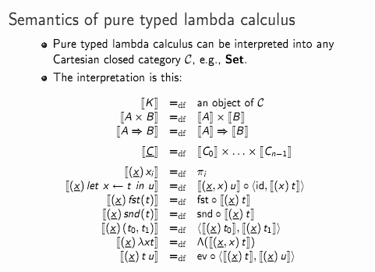
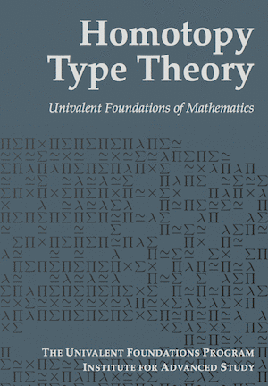
Motivation

Slide 3
Inspiring Example: Naive Refactoring
Have a theory, modify it
Theory₀ - “before”; Theory₁ - “after”
x₀:T₀ ↦ x₁:T₁ (that is, we have a function T₀→T₁)
how about T+U, T×U, T→U? (Theorems For Free may help)
say, U is a subtype of T: U₀⊂T₀, U₁⊂T₁
x₁:T₁ can either be :U₁ or not
x₀:T₀ can either be :U₀ (hence x₁:U₁) or not, then two choices for x₁
This logic is Ternary, not Boolean!

Slide 4
Types in “Before/After”
T₀
T₀
T₁
t₀:T₀
t₁:T₁
x₀:T₀
U₀
x₁:U₁
U₁
u₀:U₀
u₁:U₁
“before”
“after”

Slide 5
Logic in “Before/After”
⊥
⊥
?
⊤
⊤
“before”
“after”

Slide 6
What is Theory, by the way?
A (geometric) theory consists of:
terms (maybe of different sorts)
operations (and relations)
axioms (∀, ∃ quantifiers allowed)
Type theory is a geometric theory

Slide 7
Start from Ground Zero
Have the following:
Types - just abstract names for things.
Functions between types. They are not types; see later.
Think of functions as if they are either in hardware or in libraries

Slide 8
Start from Ground Zero
Have the following:
Types - just abstract names for things.
Functions between types. They are not types; see later.
Functions have equality (which may vary); no “values”.
Functions compose.
Identity function provided for each object.
Yes, we have a category… but wait, there’s more. Much more.

Slide 9
Subtype
Subtype h:A↪B is a function such that:
(for every f,g:C→A) if h∘f = h∘g, then f = g
For typographical reasons I’ll denote this as h:A↣B
Yes, this is a definition of subtype. It is more than a relationship; we need a way to map one type to another, and there can be more than one such way

Slide 10
Terminal Type ⊤
Aka Unit, ⊤ (“top”), 1
For every type there is just one function A→⊤
Functions ⊤→A are called points, or instances of type A
So ⊤ has just one instance

Slide 11
Applying Function to Instance
If x is an instance of A (x:⊤→A, or just x:A),
then,
for f:A→B, f(x)≡f∘x is an instance of B
Note that an instance of A is also its subtype!

Slide 12
Product Type, aka Forming Pairs
Given two types, A and B, another type is defined, A×B
Two projection functions p_{A}:A×B→A, p_{B}:A×B→B
Pairs f:C→A and g:C→B are in one-to-one correspondence with C→A×B

Slide 13
Product Type, aka Forming Pairs
Take C=⊤
Instance p:A×B
is the same as a pair of instances, (x:A,y:B)
You can see that ⊤×A is equivalent to A, so we have some kind of monoid.
“associativity” and “commutativity” are guaranteed by the universality in definition

Slide 14
Diagonal Function
(id_{A},id_{A})
Δ:A→A×A
p₁∘Δ=p₂∘Δ = id_{A}
Diagonal makes A a subtype of A×A

Slide 15
Currying (Exponential Type)
A×B → C
A → C^{B}
where C^{B} is the “type of functions from B to C”
Now every function B→C is an instance of C^{B}:
⊤×B → C
⊤ → C^{B}
Alternatively, we could denote C^{B} as B→C or as B⇒C
but this causes a lot of confusion

Slide 16
Eval Function
Id: B^{A}→B^{A}
ev:A×B^{A}→B
A.k.a. “flip id”
Comes from currying
ev:((A,A=>B)=>B) = identity[A=>B].uncurry

Slide 17
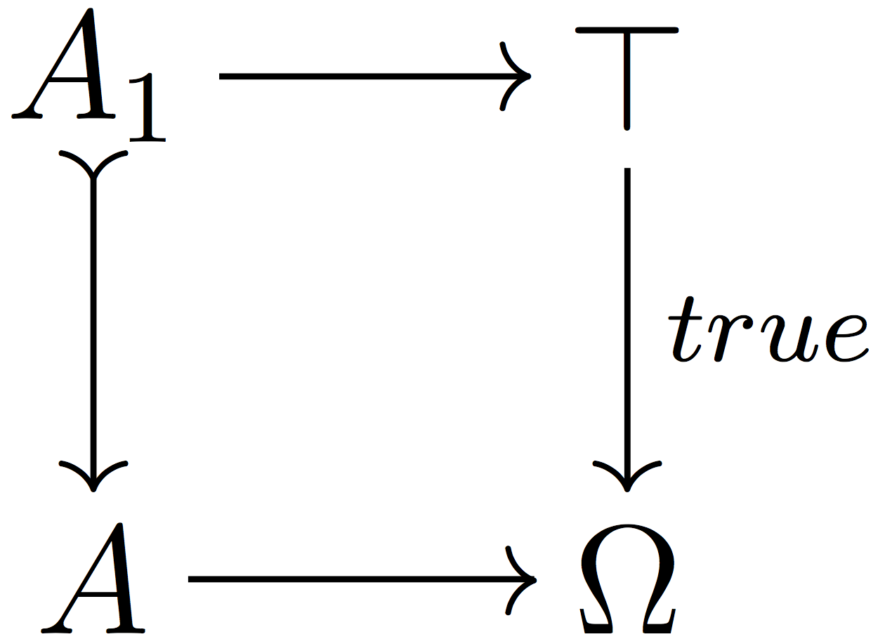
Introduce Logical Type Ω
One special instance of Ω is called true:⊤→Ω
Any function p:A→Ω is called a predicate
Axiom. Subtypes of A are in one-to-one correspondence with predicates on A, as pullbacks:
(in sets, A₁={a∈A | p(a) == true})
(aka comprehension axiom)

Slide 18
Power Type
Type of all subtypes of A is Ω^{A}
p:Ω^{A}
A→Ω
A₁↣A
Each instance of Ω^{A} represents a subtype of A
p: A=>Ω
A_{p}={a | p(a)}

Slide 19
Equality, Singleton, Membership
Δ:A↣A×A
’=’:A×A→Ω
’=’:A×A→Ω
{}:A↣Ω^{A}
Id: Ω^{A}→Ω^{A}
∈:A×Ω^{A}→Ω
singleton = eq.curry
p: A=>Ω
A_{p}={a | p(a)}
eval, flip id

Slide 20
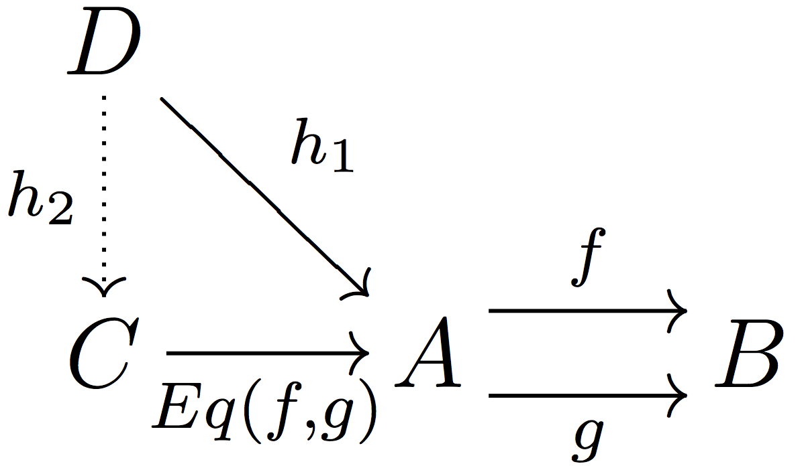
Equalizer Type
Given f,g:A→B, their equalizer is h:C→A such that
f∘h=g∘h
if f∘h₁=g∘h₁, then h₁=h∘h₂ for some h₂

Slide 21
Equalizer Type
Given f,g:A→B, their equalizer is h:C→A such that
f∘h=g∘h
if f∘h₁=g∘h₁, then h₁=h∘h₂ for some h₂
Sql: select * from A where A.f = A.g;
Eq(f,g) is a subtype of A

Slide 22
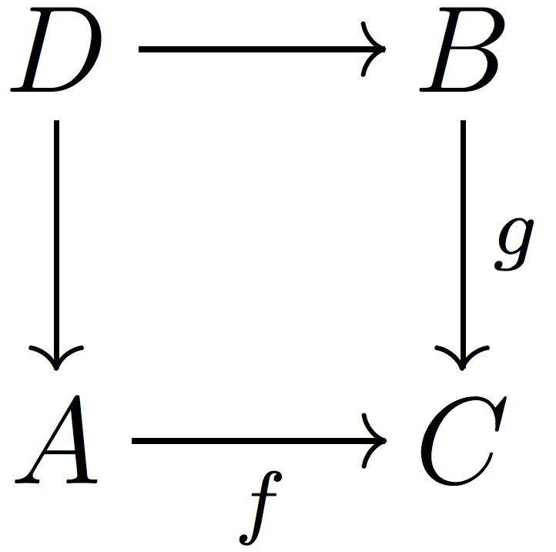
Pullback Type
select * from A,B where A.f = B.g;

Slide 23
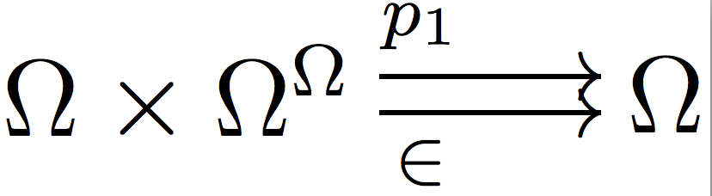
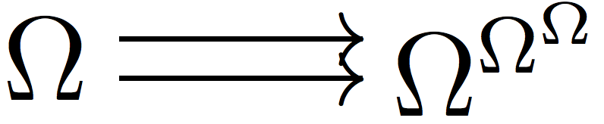
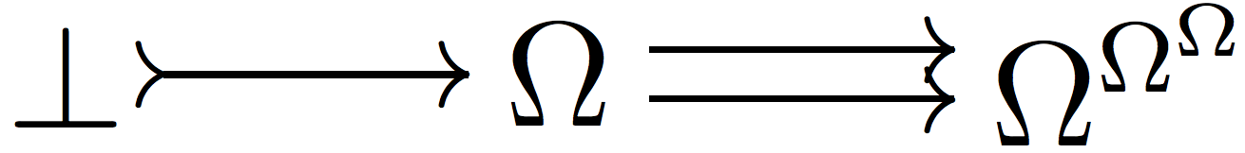
Empty Type
Empty type, aka Nothing, ⊥
Unique ⊥→A for each A
We can build it
take two functions
curry them, getting
take equalizer:
we have a bottom type!
informally it is : {x|∀f f(x) = x})

Slide 24
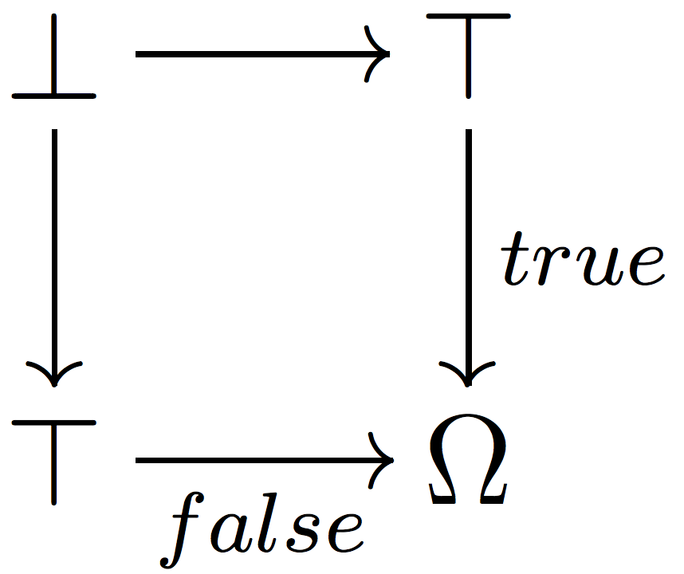
Meet False
It classifies the inclusion of Empty type into Unit type

Slide 25
Union Type
Given types A and B, we can build a disjoint union A+B, the smallest type for which A and B are subtypes
That is,
given f:A→C and g:B→C, we have a unique A+B→C
(proof too sophisticated for this short meeting)

Slide 26
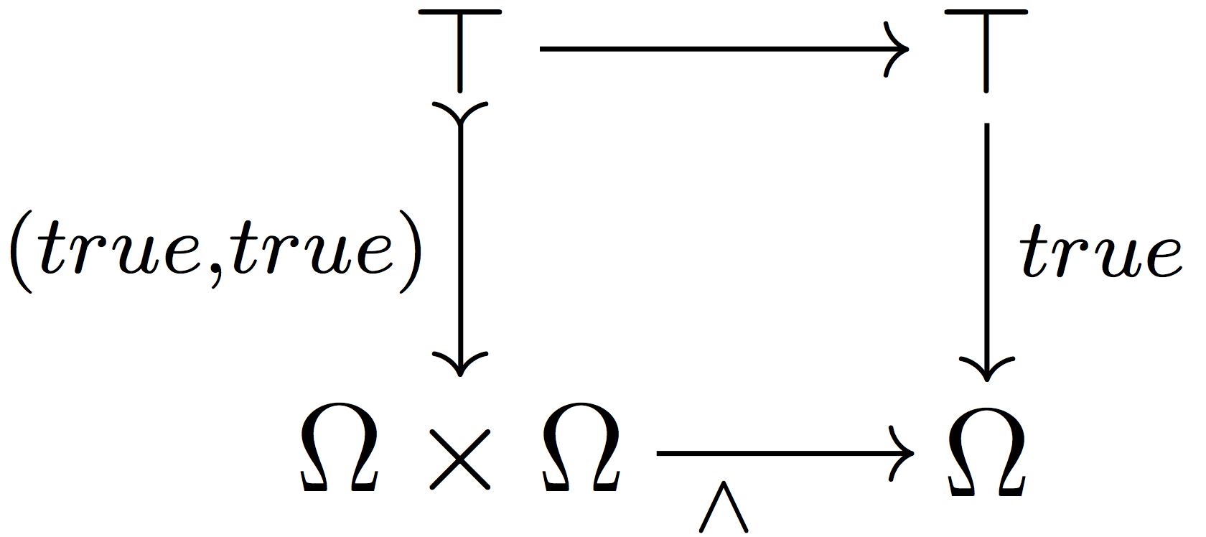
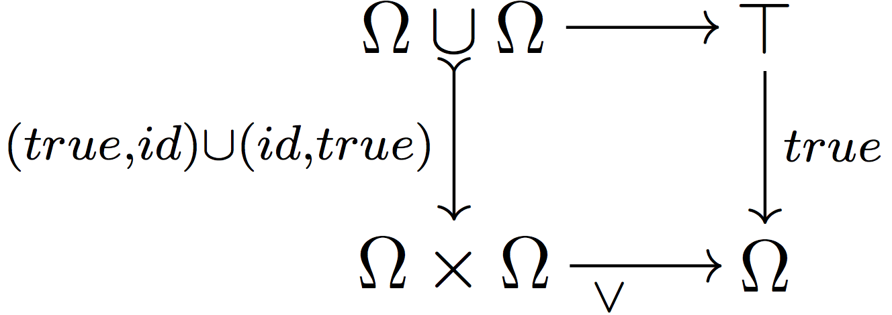
More Logic
Conjunction
Disjunction

Slide 27
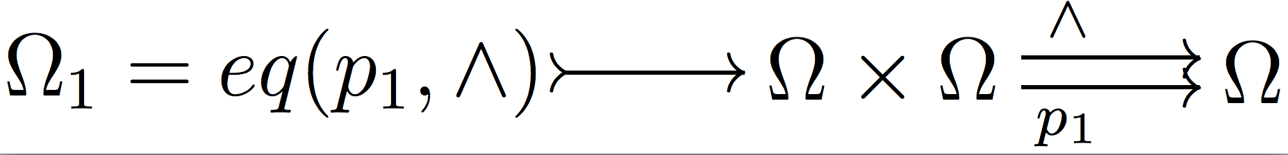
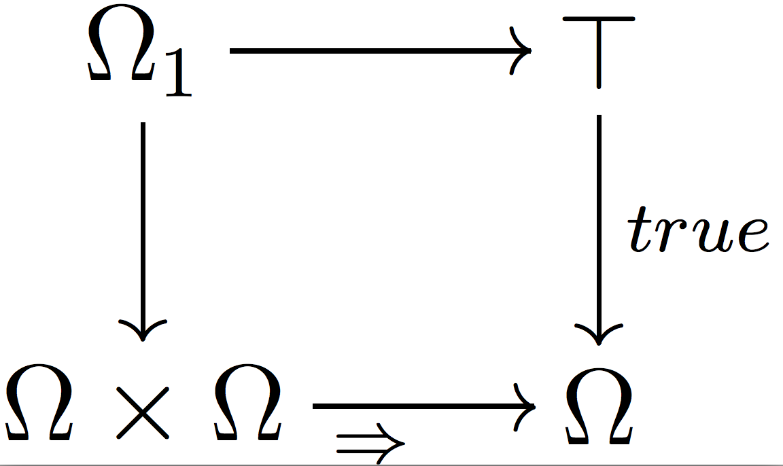
Even More Logic
Partial order on Logical type ({(a,b)|a∧b=a}):
Now implication:

Slide 28
More Logic
Negation
¬x ≡ (x ⇒ false)
can prove ¬¬¬x = ¬x
but not necessarily ¬¬x = x

Slide 29
Quantifiers. ∀
This is a generalization of conjunction.
∀:Ω^{A}→Ω classifies true^{A}:⊤=⊤^{A}→Ω^{A}
Meaning, the extent to which a predicate p:A→Ω
is true everywhere on A.

Slide 30
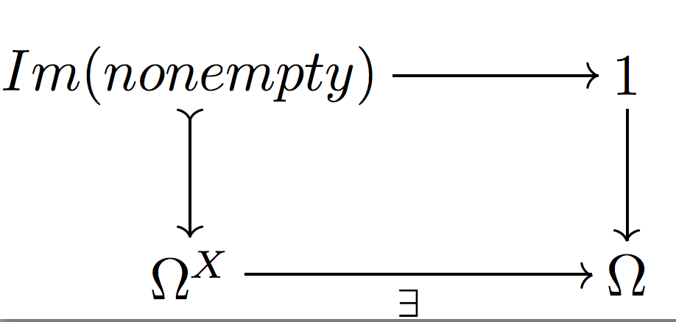
Quantifiers. ∃
For a predicate p:A→Ω, find a 1→Ω that corresponds to “∃a p(a)”. Or, in general settings, ∃:Ω^{A}→Ω.
First, build this function:
Then, the classifier for this function’s image:

Slide 31
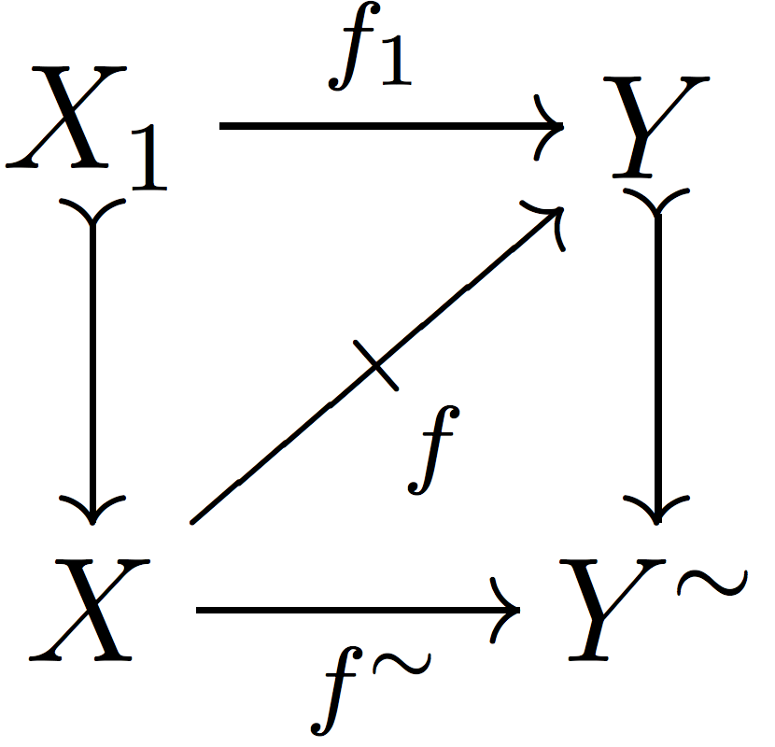
Bonus: Maybe Monad
Given a partial map…
Y~ is not necessarily Y+1

Slide 32
“Before/After” Logic Modeled
Set is trivial (our old Boolean stuff)
Set² A:A₀→A₁, where A₀ and A₁ are sets
Subtype A↣B: A₀↣B₀ and A₁↣B₁ (compatible)
x₀∈B₀, x₁∈B₁; if x₀∈A₀ then x₁∈A₁

Slide 33
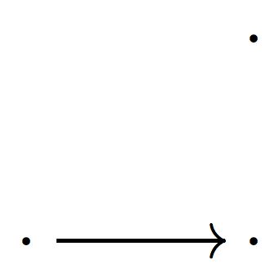
Back to “Before/After” Logic
Unit:
Subtypes of Unit:
Unit
Empty
Half-Unit (empty “before”, point “after”)
Point and a half:

Slide 34
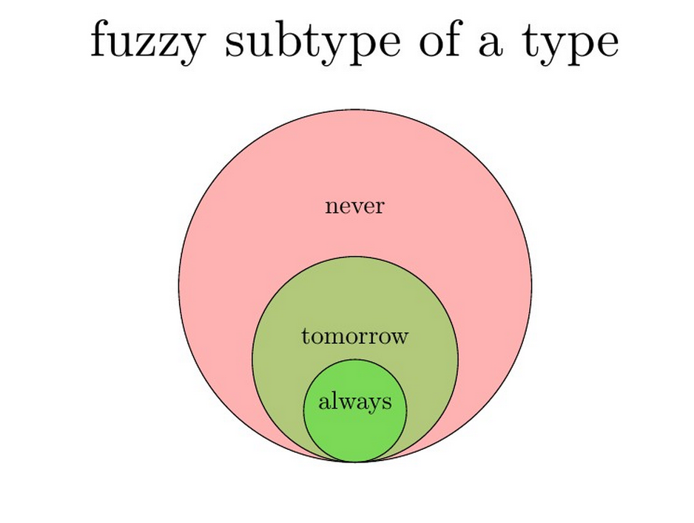
Alternative Representation
E.g.
java.util.HashTable as subtype of
java.util.Map
It was not before v. 1.4

Slide 35
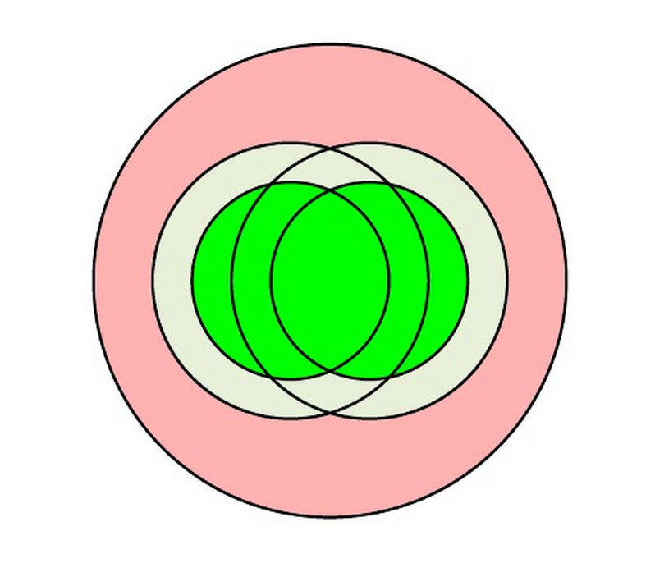
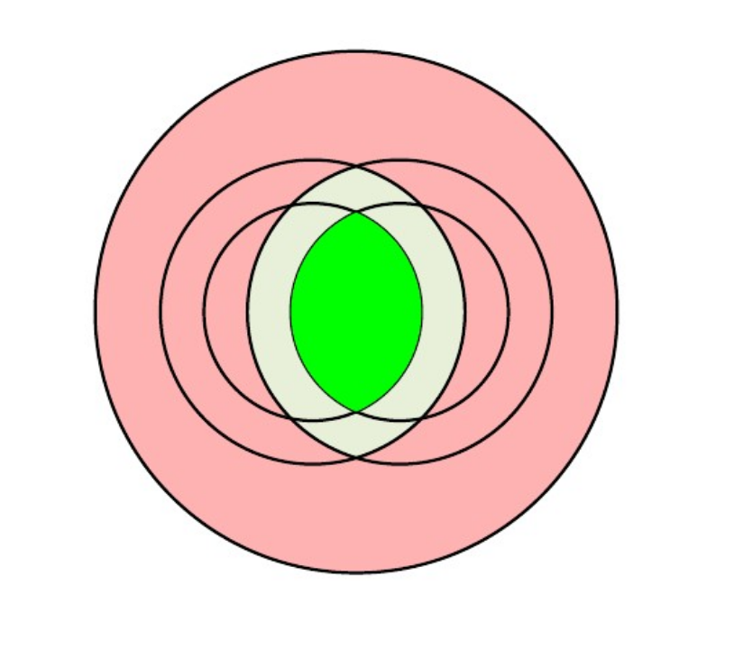
Alternative Representation
Intersection of two subtypes

Slide 36
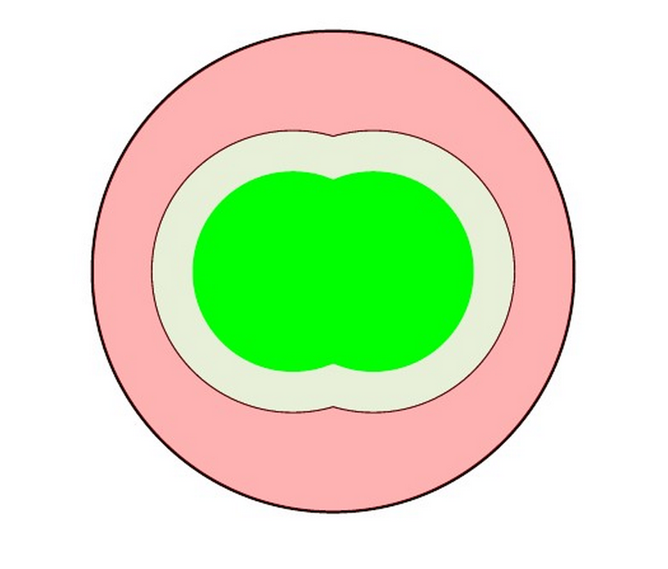
Alternative Representation
Union of two subtypes

Slide 37
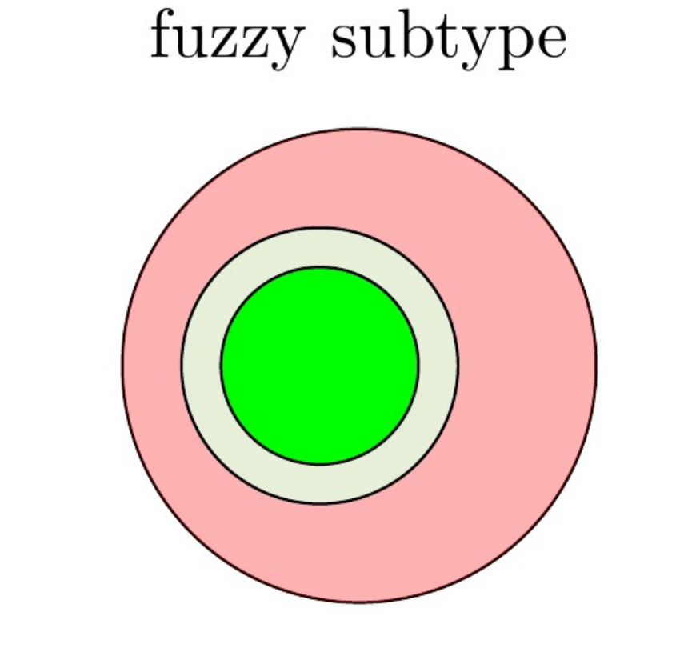
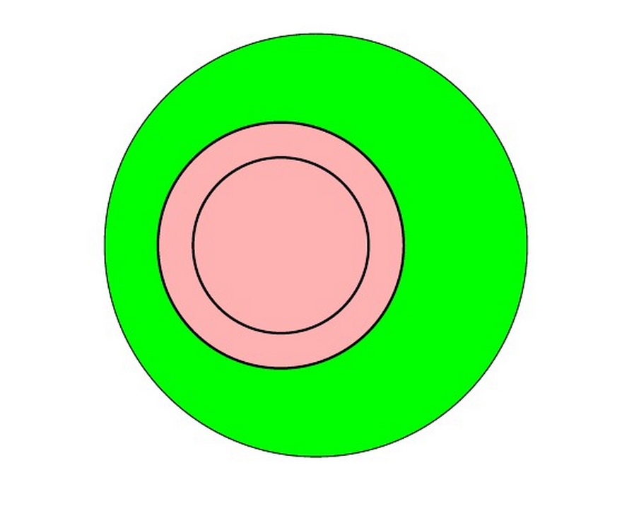
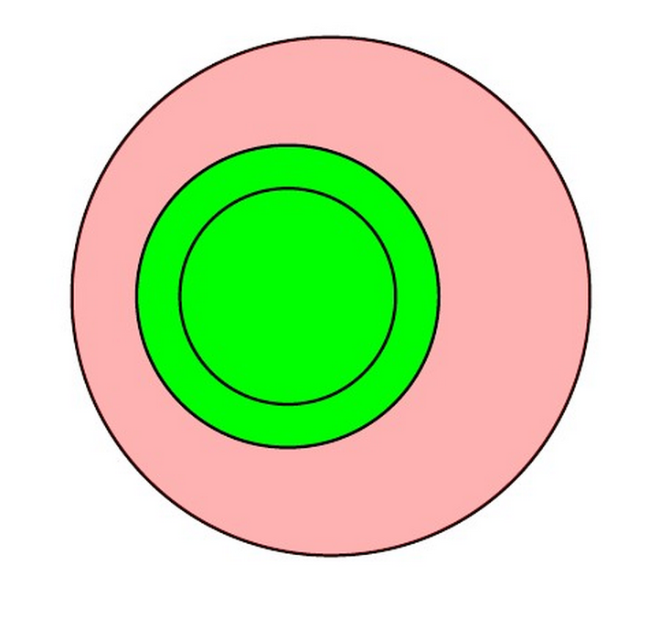
Alternative Representation
Negation of a subtype

Slide 38

References
Pure Subtype Systems
ncatlab, Modal Type Theory
Computational Types from a Logical Perspective
Johnstone, “Topos Theory”
ISO/IEC 13568:2002
Physics, Topology, Logic and Computation: A Rosetta Stone

