Slide 1
SCOTTI
Structured COalescent Transmission Tree Inference

Slide 2
Reconstructing transmission trees
A phylogeny inferred from pathogen genetic sequences does not necessarily corresponds to the true transmission tree.
Possibly : phylogenetic tree ≠ epidemiological tree
Notes:
Non sampled hosts
Within-host diversity (virus mutating while replicating in a given host)

Slide 3
SCOTTI package
Structured COalescent Transmission Tree Inference
Structured coalescent model :
population = host (location)
migration event = new infection

Slide 4
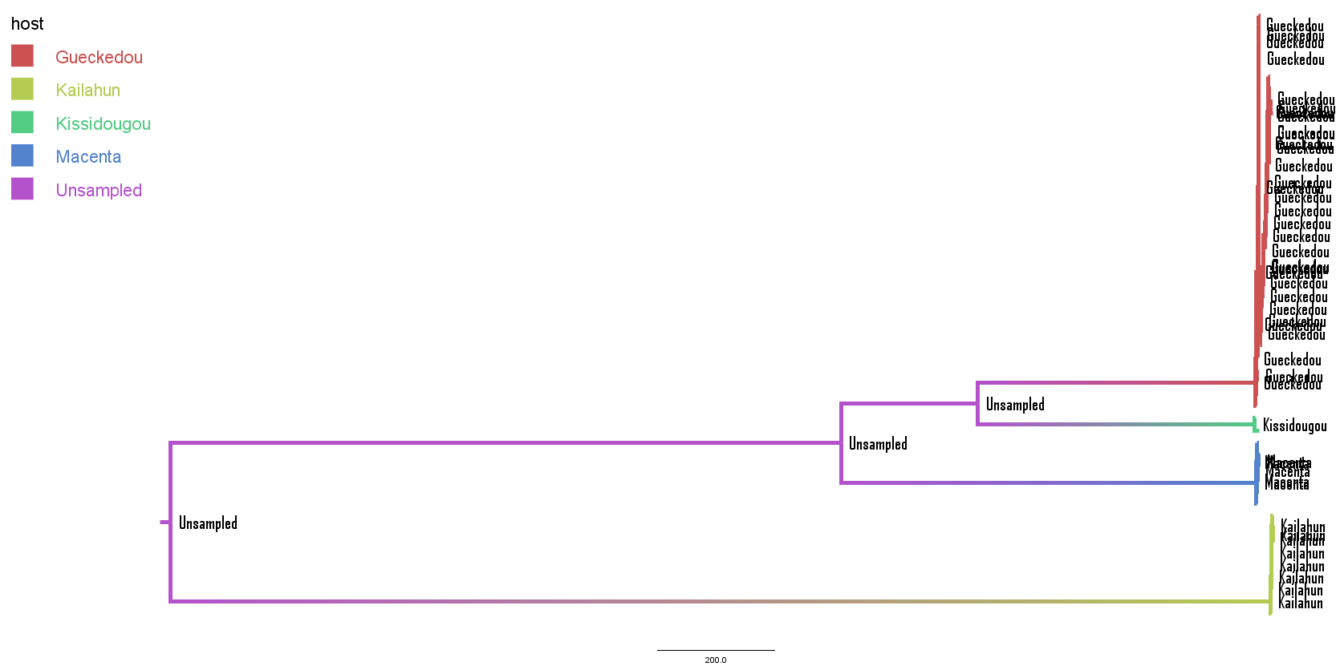
Advantages 1/2
SCOTTI can model non-sampled hosts by increasing the number of populations

Slide 5
Advantages 2/2
SCOTTI uses epidemiological data: hosts are only allowed to transmit the disease while they are infectious (for Ebola, 10 days from the start of the disease, patients aren’t infectious while incubation)
Specify, for each host, the earliest and latest dates at which it can be infectious

Slide 6
Drawbacks 1/2
SCOTTI doesn’t model transmission bottlenecks
depending on the mutation rate of the pathogen, can govern the epidemics dynamics

Slide 7
Drawbacks 2/2
No graphical interface with BEAUti
→ SCOTTI tutorial in Taming the BEAST provides a Python script to create the XML file

Slide 8
Summary
In most structured coalescent models, focus on differences in migration rates and population sizes
Here, inference of migration (=transmission events)

Slide 9
Settings and priors
Infectious time interval for each location
HKY site model
Uniform migration model, 4 to 15 possible demes
Strict clock rate, 10⁻³ substitutions site⁻¹ year⁻¹

Slide 10
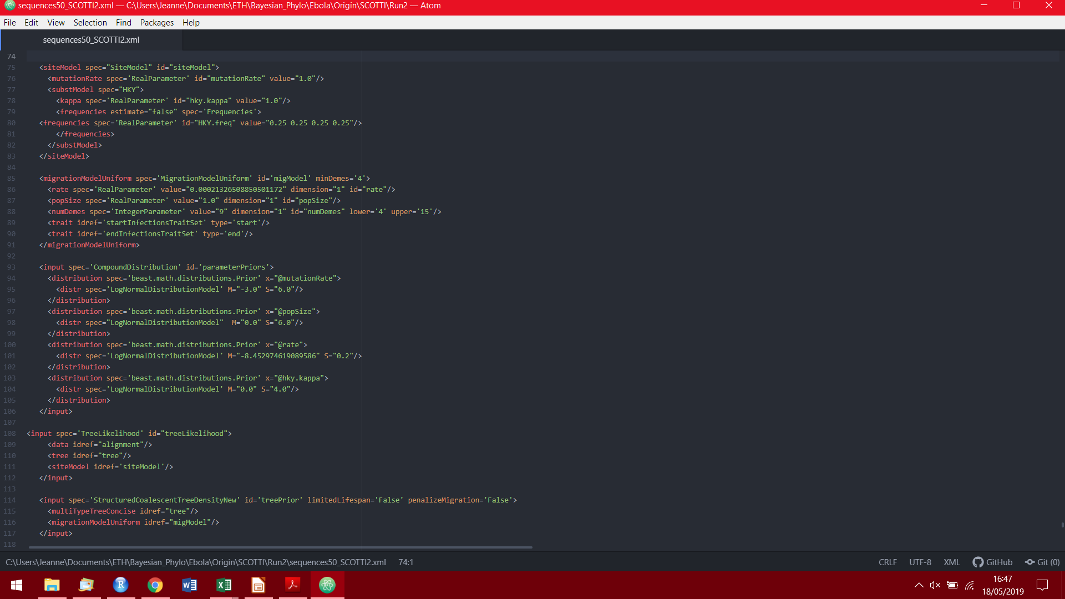

Slide 11
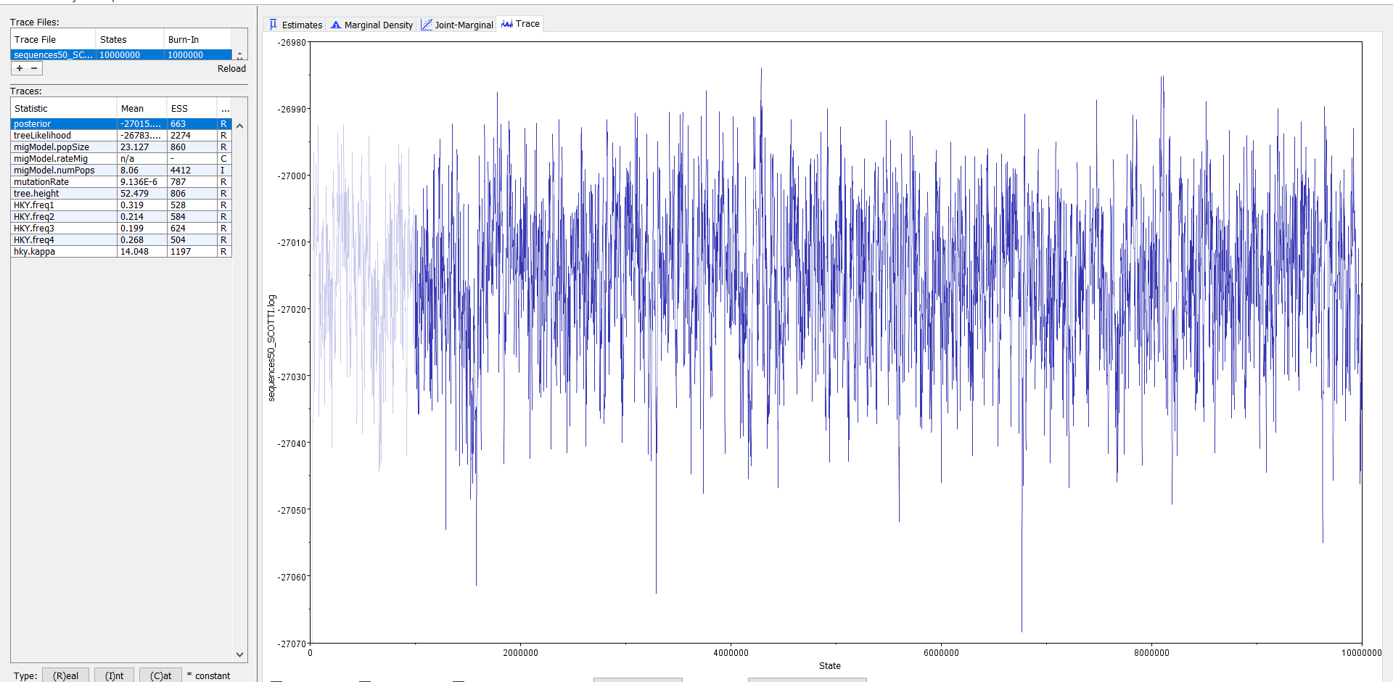
Tracer output

Slide 12
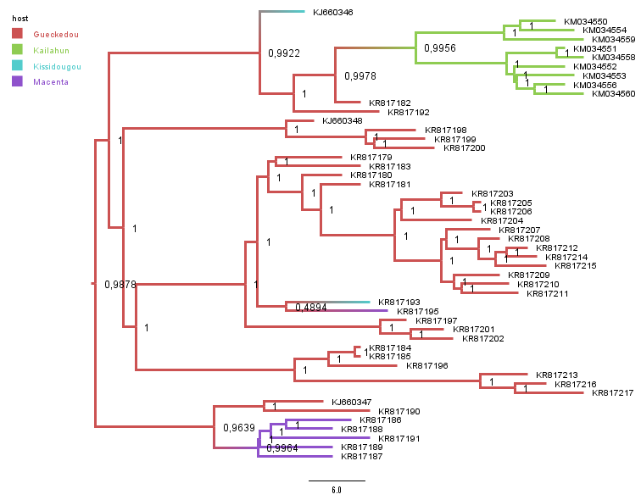
MCC tree and origin

Slide 13
Root location probability

Slide 14
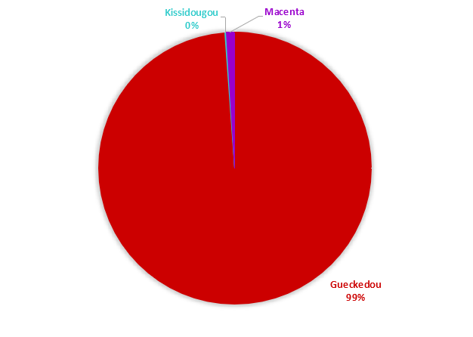
Root location probability

Slide 15
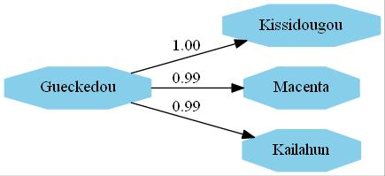
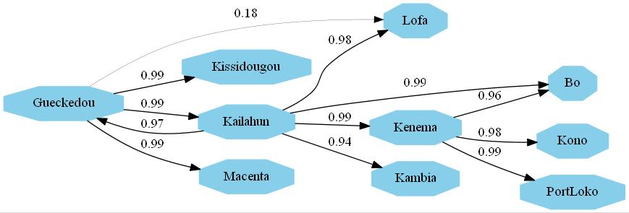
Transmission graphs

Slide 16
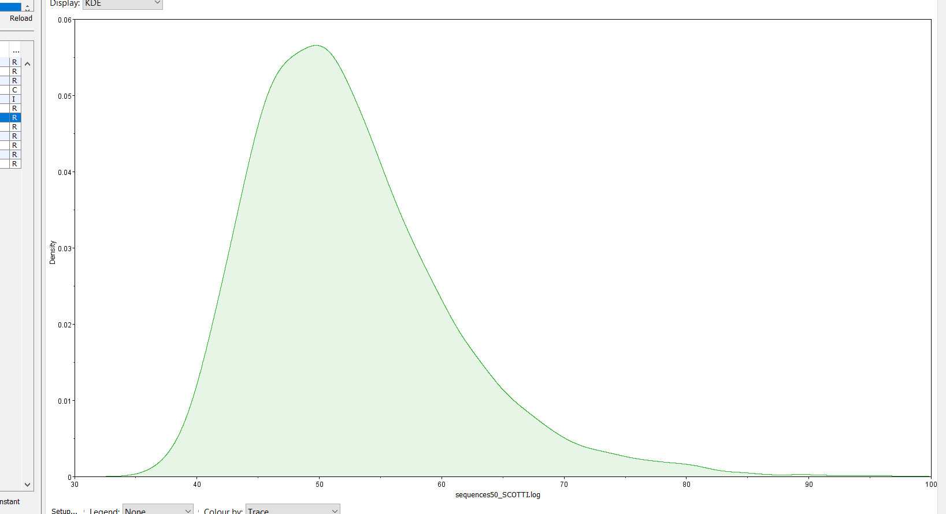
Time origin for 50 sequences
Min 95HPD | Mean date | Max 95HPD
2014-01-07 | 2014-01-24 | 2014-02-05
Time span of 29 days

Slide 17
Bibliography
De Maio N, Wu C-H, Wilson DJ (2016) SCOTTI: Efficient Reconstruction of Transmission within Outbreaks with the Structured Coalescent. PLoS Comput Biol 12(9): e1005130. https://doi.org/10.1371/journal.pcbi.1005130

