Slide 1
Github

Slide 2
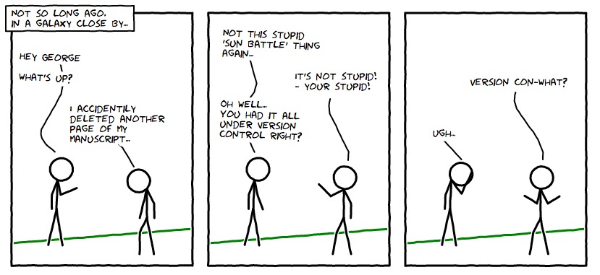
GitHub
Version control
https://git-scm.com/book/en/v2/Getting-Started-About-Version-Control
https://www.perforce.com/blog/vcs/what-is-version-control
https://www.youtube.com/watch?v=ugN-IYV1NTM
Source code management

Slide 3
GitHub
https://guides.github.com/activities/hello-world/
https://guides.github.com/
https://product.hubspot.com/blog/git-and-github-tutorial-for-beginners
https://guides.github.com/introduction/git-handbook/
https://www.edureka.co/blog/how-to-use-github/?ranMID=42536&ranEAID=a1LgFw09t88&ranSiteID=a1LgFw09t88-tiNA8ZyDQnN7ufWJ1BSUSg&LSNSUBSITE=Omitted_a1LgFw09t88
https://www.atlassian.com/git/tutorials

Slide 4
Commands
git clone
git add
git commit
git diff
git status
git rm
git push
http://guides.beanstalkapp.com/version-control/common-git-commands.html

Slide 5
1. install https://www.atlassian.com/git/tutorials/install-git#windows
$ git config --global user.name "Nume Prenume"
$ git config --global user.email email@test.com
2. install github https://desktop.github.com/
set configuration for github
Create a repository and push the project

