Slide 1
Bitonic Sort
Blaga Ana-Maria-Andreea

Slide 2
Agenda
1. Introduction
2. Serial
3. OpenMP
4. Pthreads
5. MPI
6. Hybrid – MPI & OpenMP
7. Conclusions

Slide 3
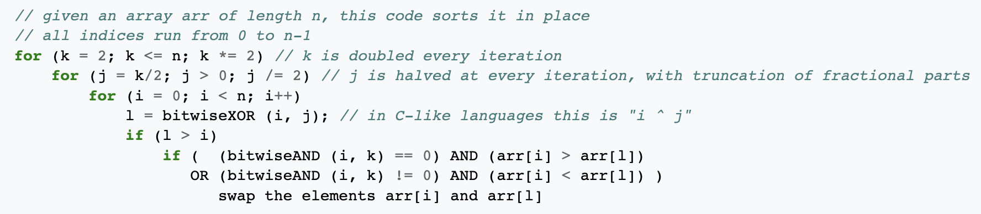
Introduction
Bitonic sort is a comparison-based sorting algorithm that can be run in parallel. It focuses on converting a random sequence of numbers into a bitonic sequence, one that monotonically increases, then decreases.
Bitonic Sort can only be done if the number of elements to sort is 2^{n}.
Time complexity:
Best Case: O(log²n)
Average Case: O(log²n)
Worst Case: O(log²n)

Slide 4
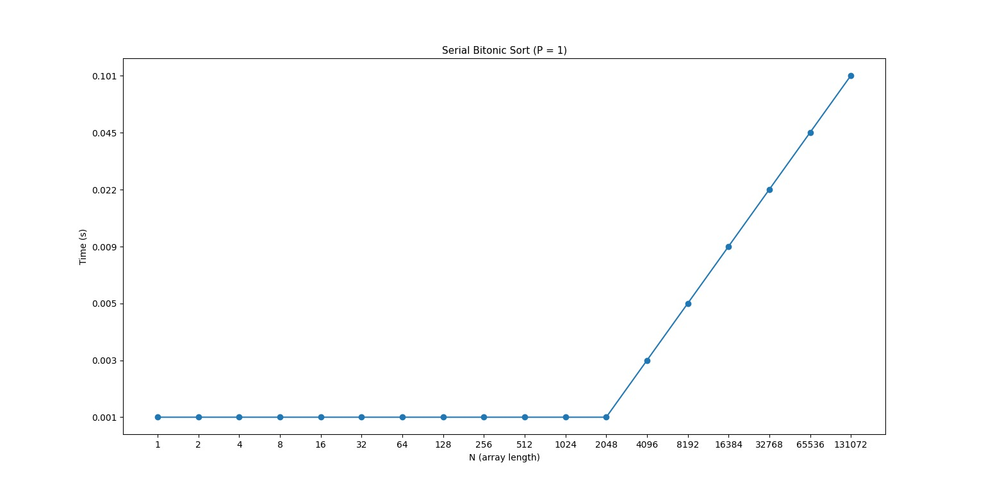
Serial

Slide 5
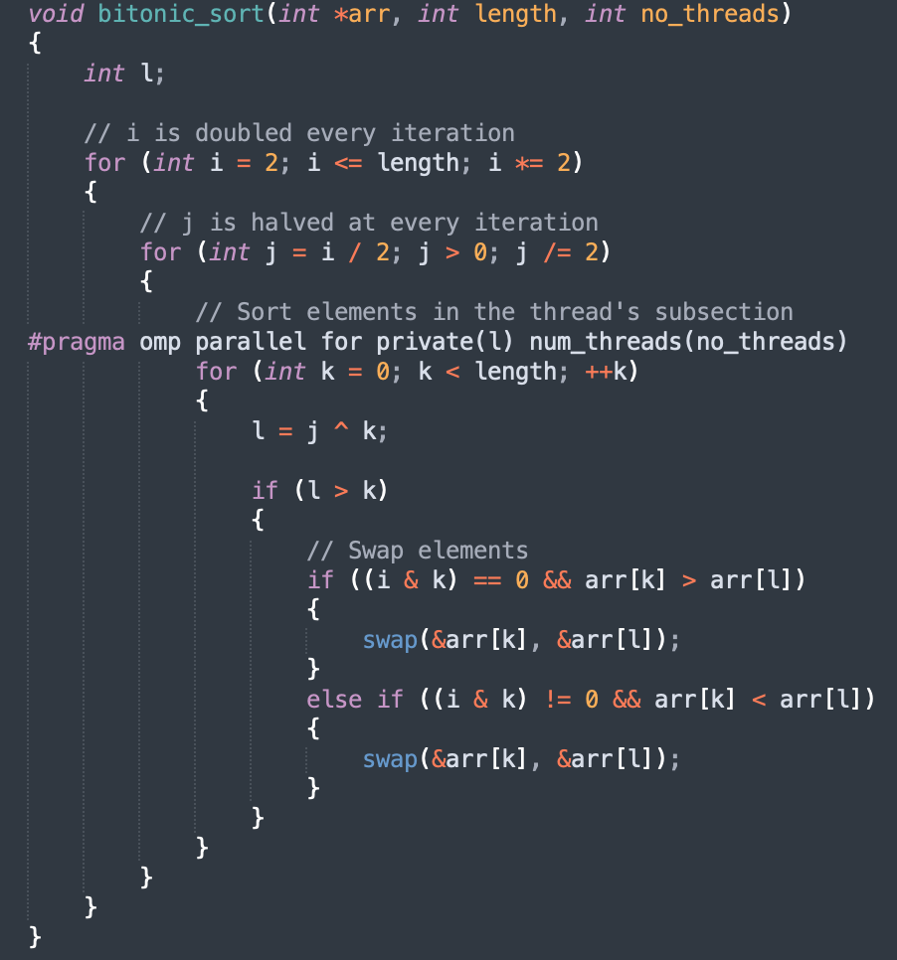
OpenMP
The innermost loop of the algorithm was parallelized using 1, 2, 3 and 4 threads.
It managed to reduce by approximately half the execution time when using at least 2 threads.
Synchronization was not required.

Slide 6
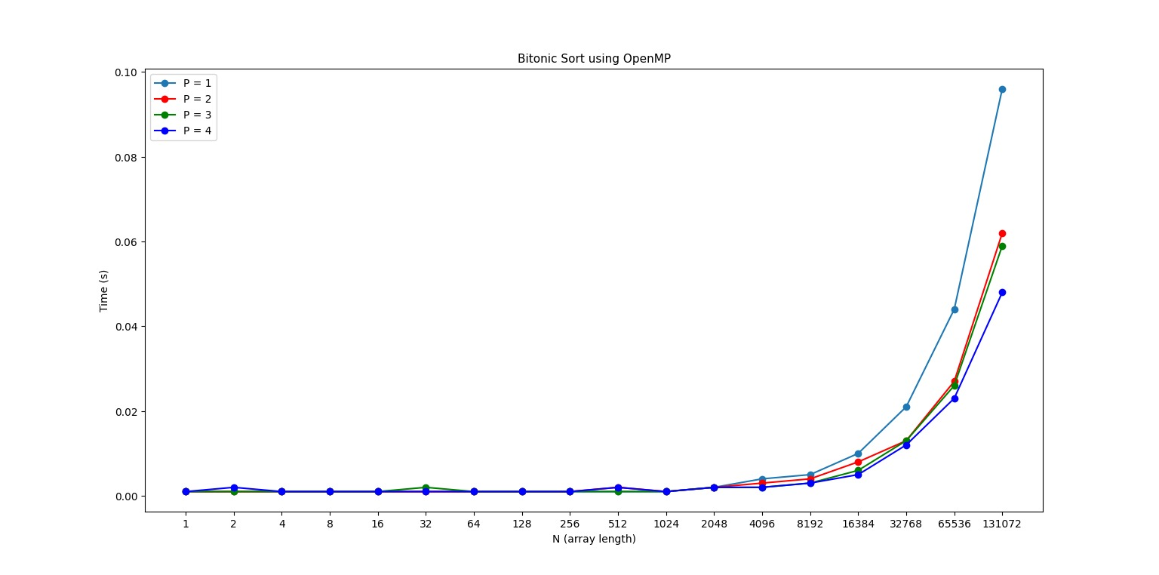
OpenMP

Slide 7
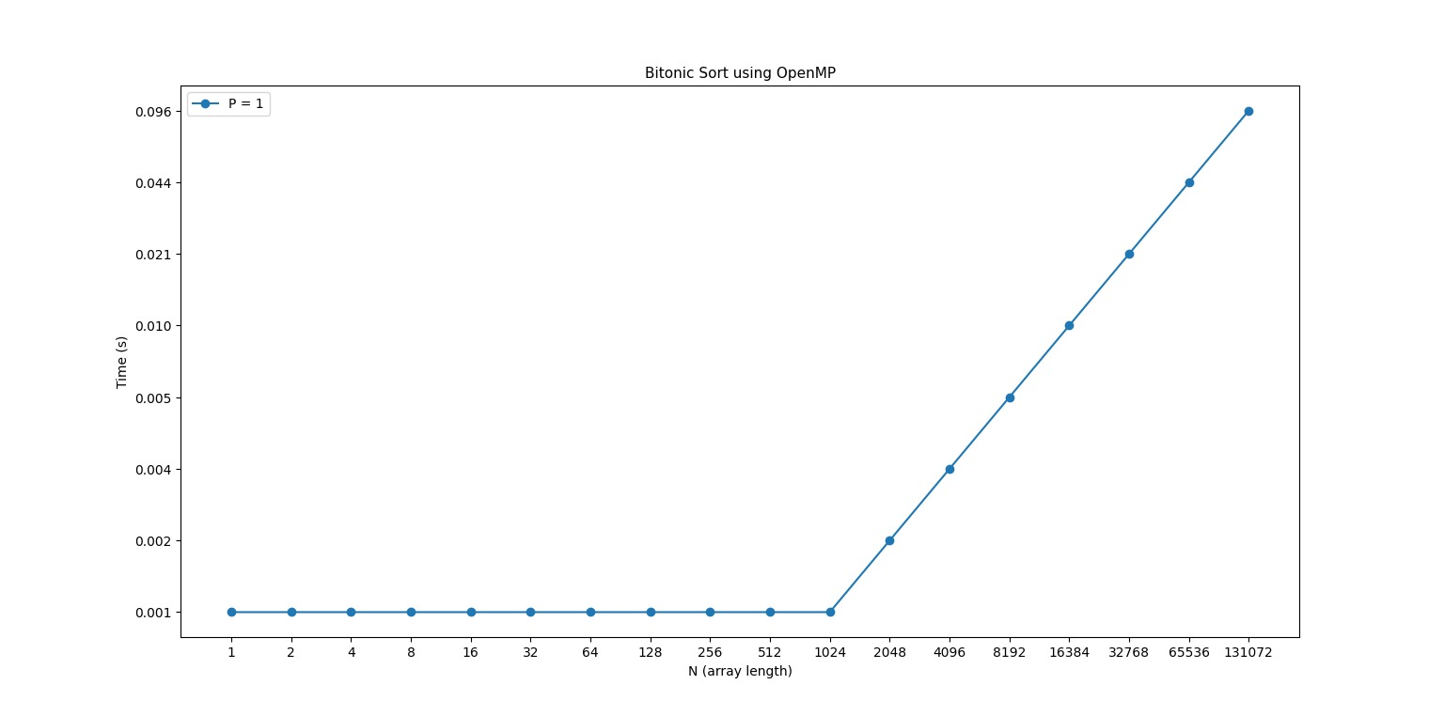
OpenMP – 1 Thread

Slide 8
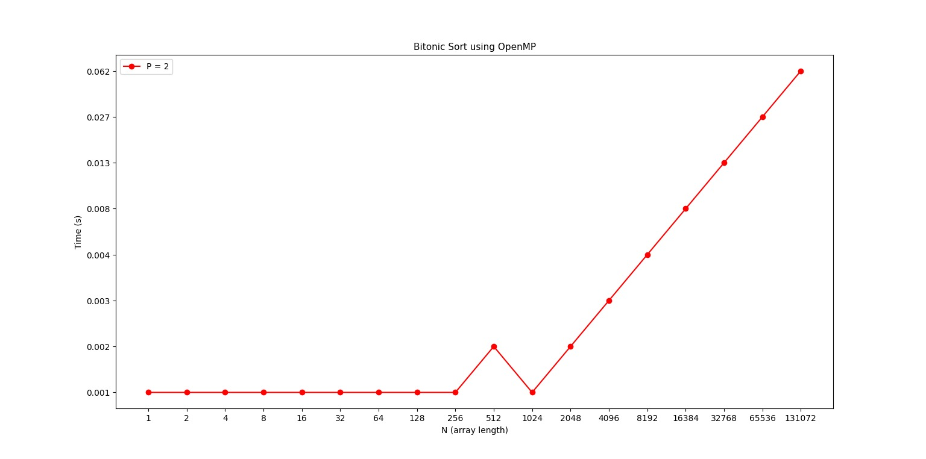
OpenMP – 2 Threads

Slide 9
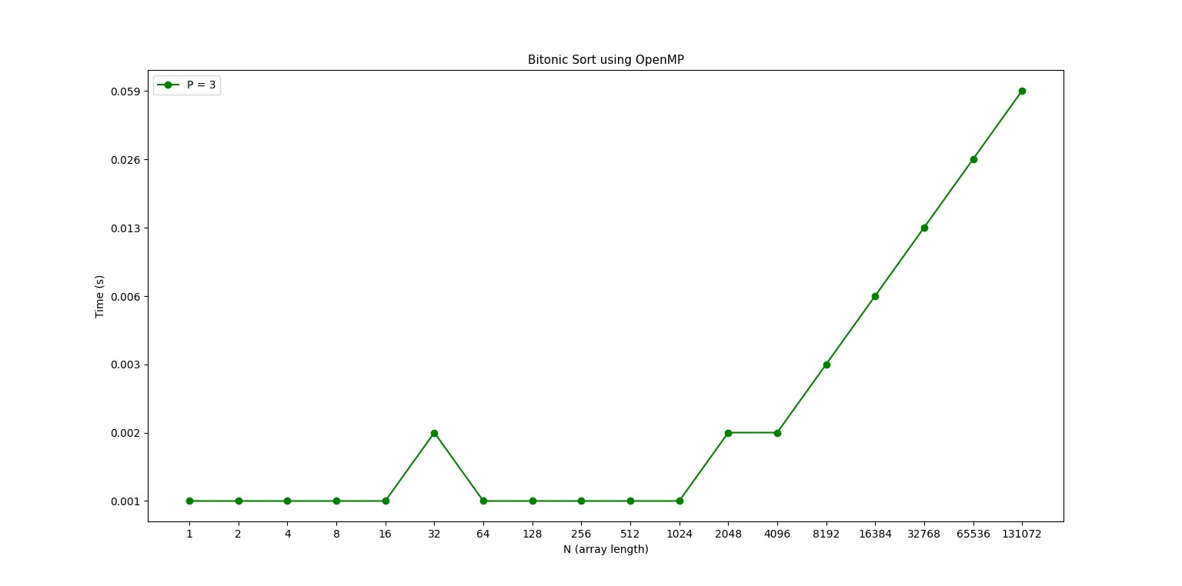
OpenMP – 3 Threads

Slide 10
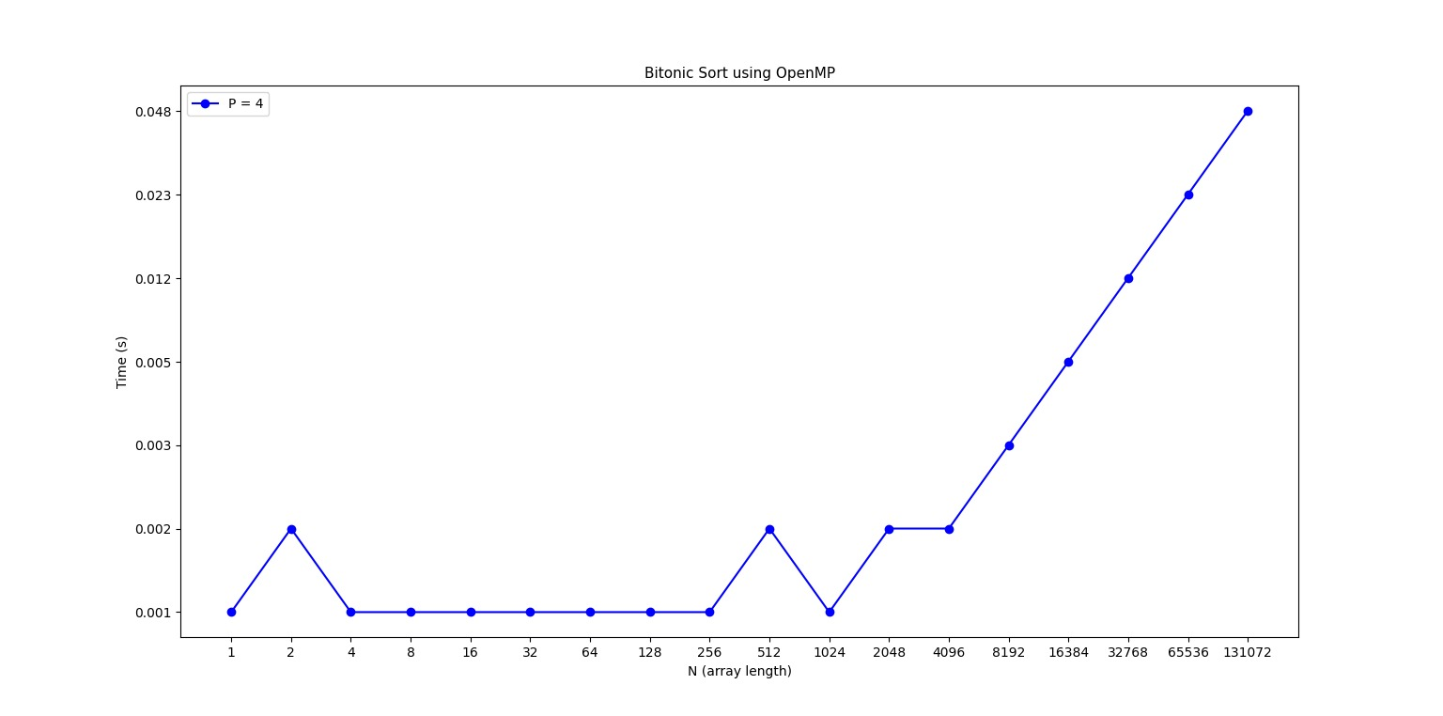
OpenMP – 4 Threads

Slide 11
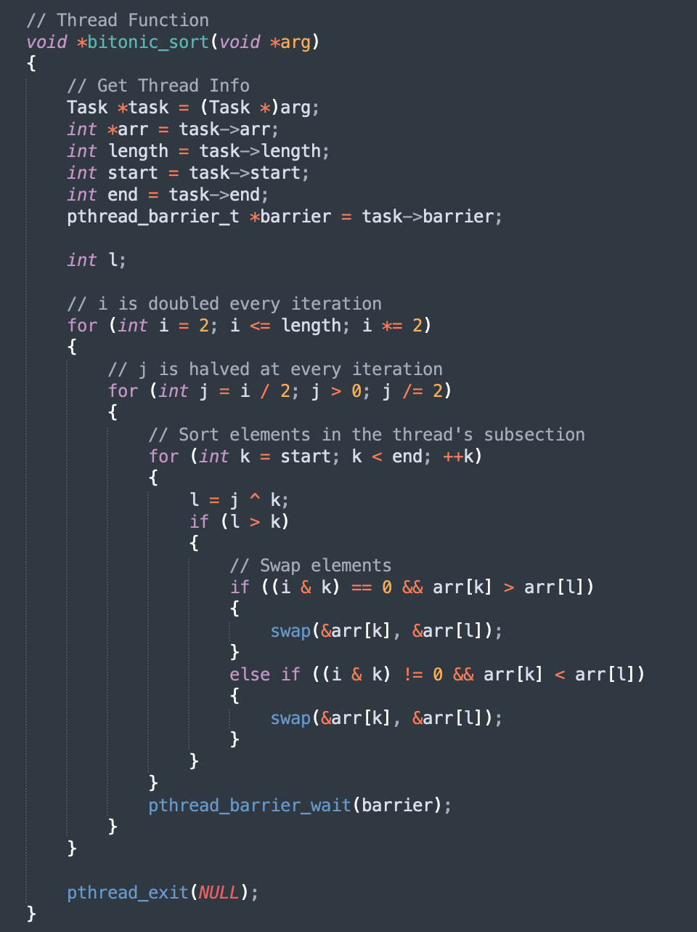
Pthreads
The innermost loop of the algorithm was parallelized using 1, 2, 3 and 4 threads.
It managed to reduce by approximately half the execution time when using at least 2 threads.
Required synchronization after the inner loop with a barrier in order to wait for all the threads to finish the respective loop execution.
Extra memory was required for creating the Thread Structure which hosted the reference to the array, the array’s length, the barrier etc.

Slide 12
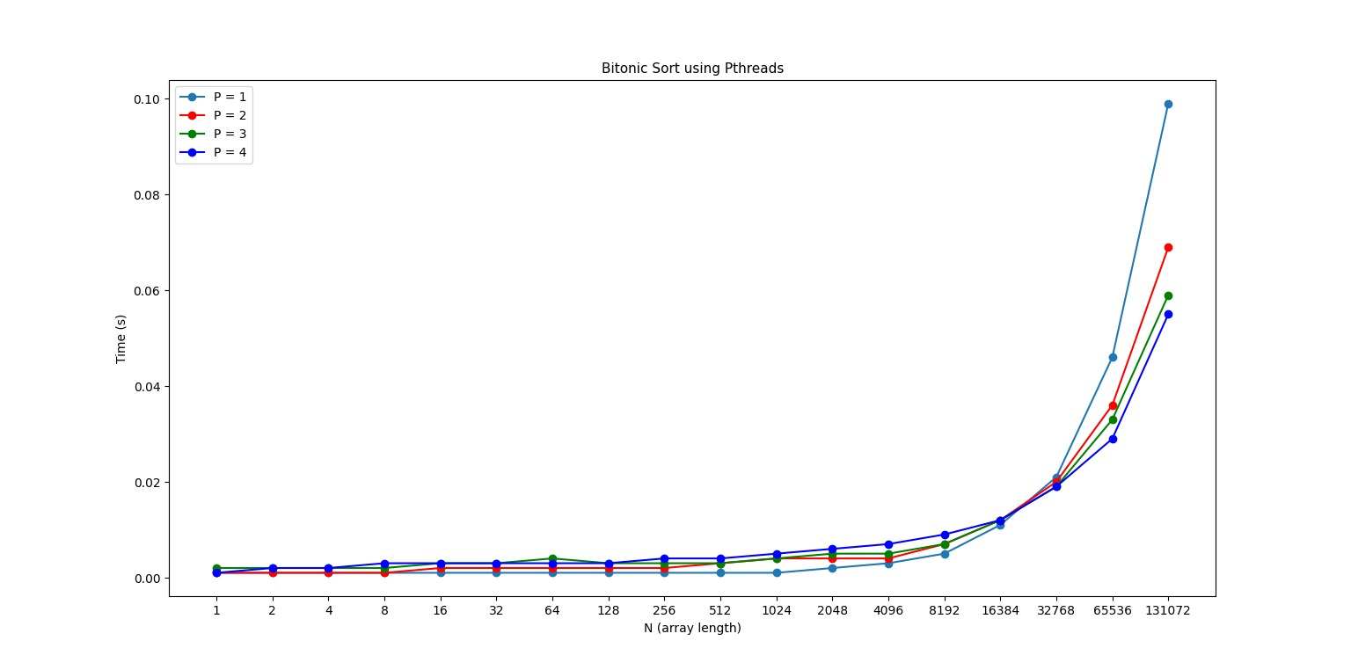
Pthreads

Slide 13

Pthreads – 1 Thread

Slide 14
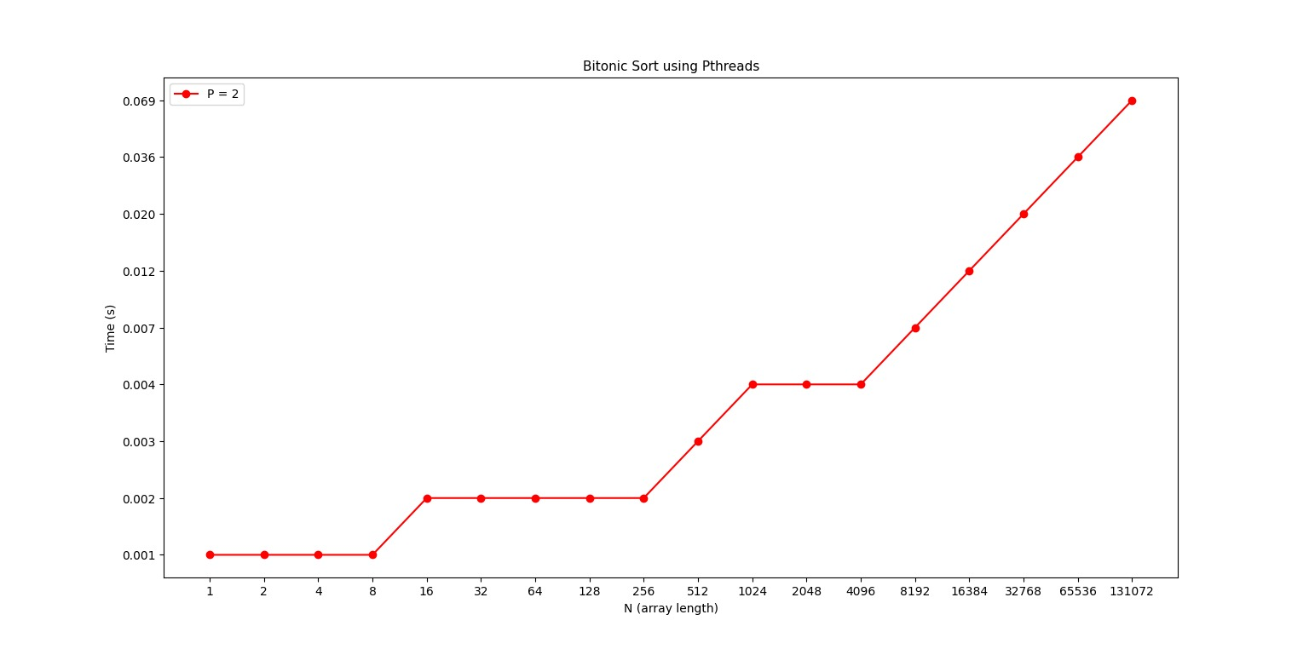
Pthreads – 2 Threads

Slide 15
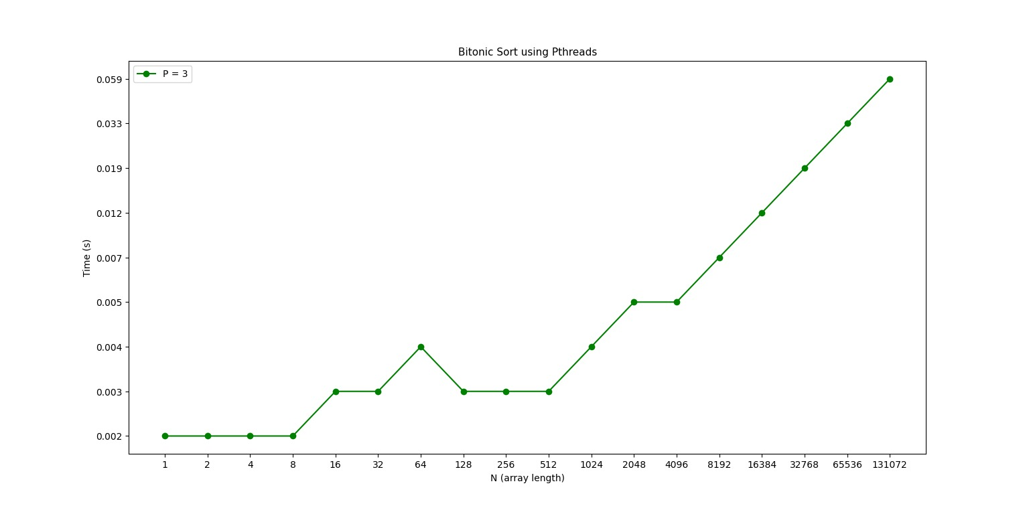
Pthreads – 3 Threads

Slide 16
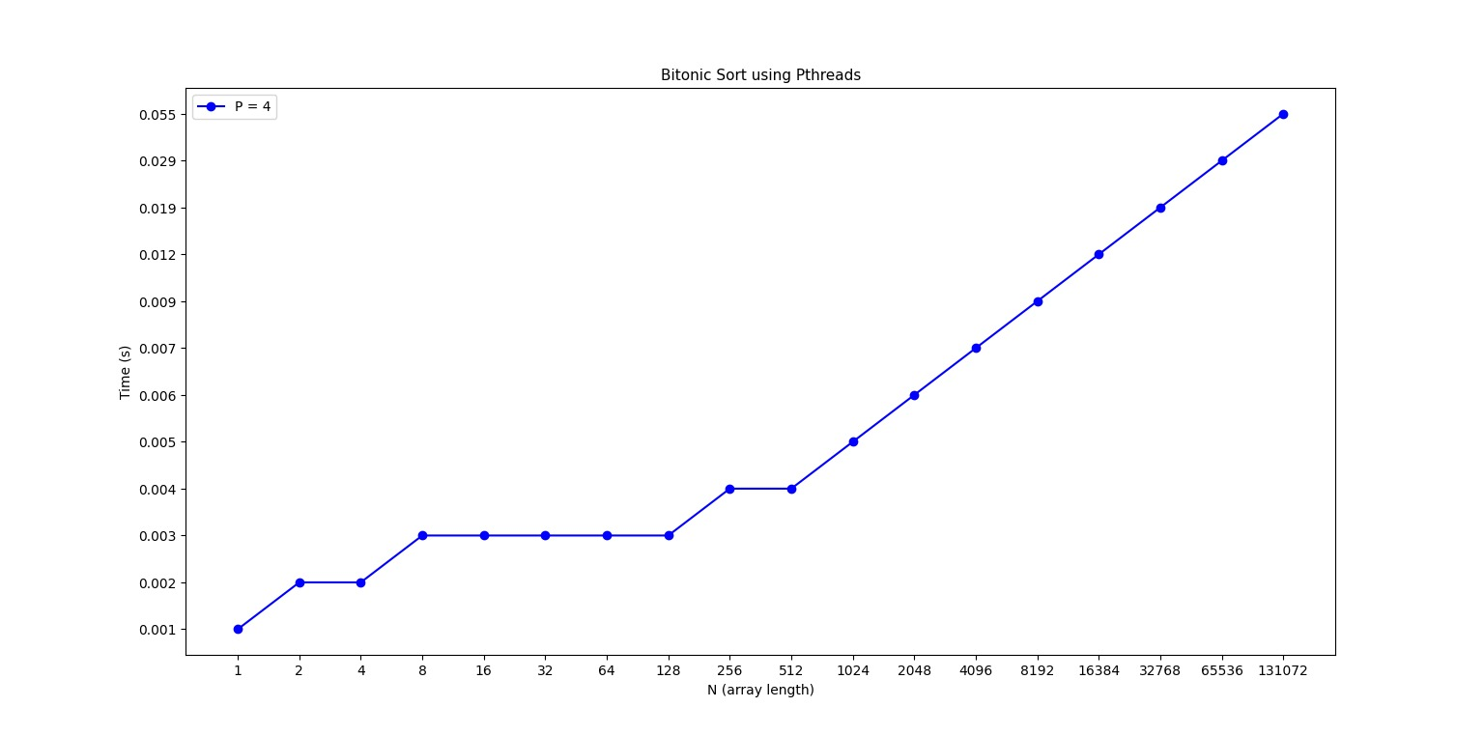
Pthreads – 4 Threads

Slide 17
MPI
The innermost loop of the algorithm was parallelized using 1, 2, 3 and 4 processes.
Didn’t produce satisfying results: the execution time was longer comparing even to the serial version.
Required synchronization after the inner loop with a barrier in order to wait for all the processes to finish the respective loop execution, but also after passing the sections to sort to each process and after finishing the sorting.
Extra memory was required for creating a shared memory window hosting the array which was accessible to all the processes.

Slide 18
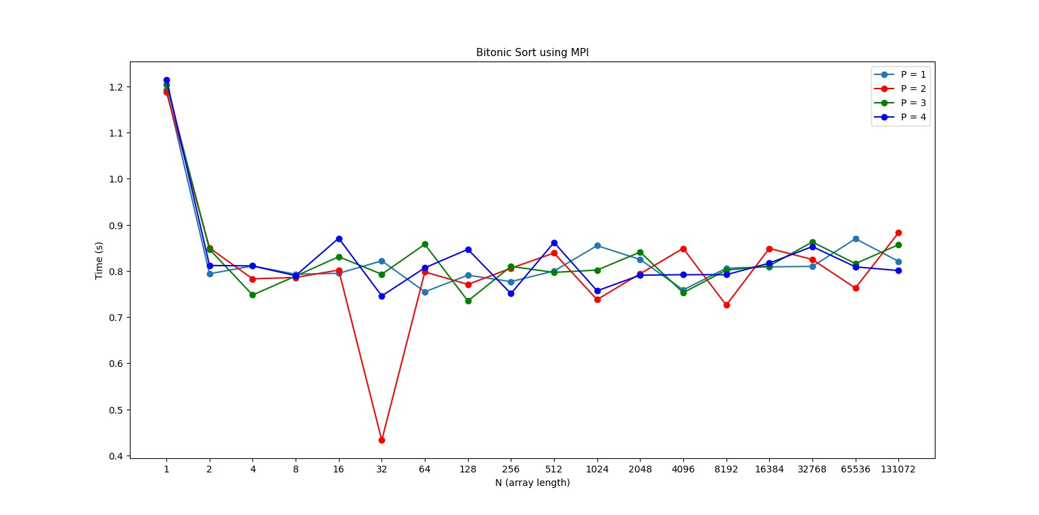
MPI

Slide 19
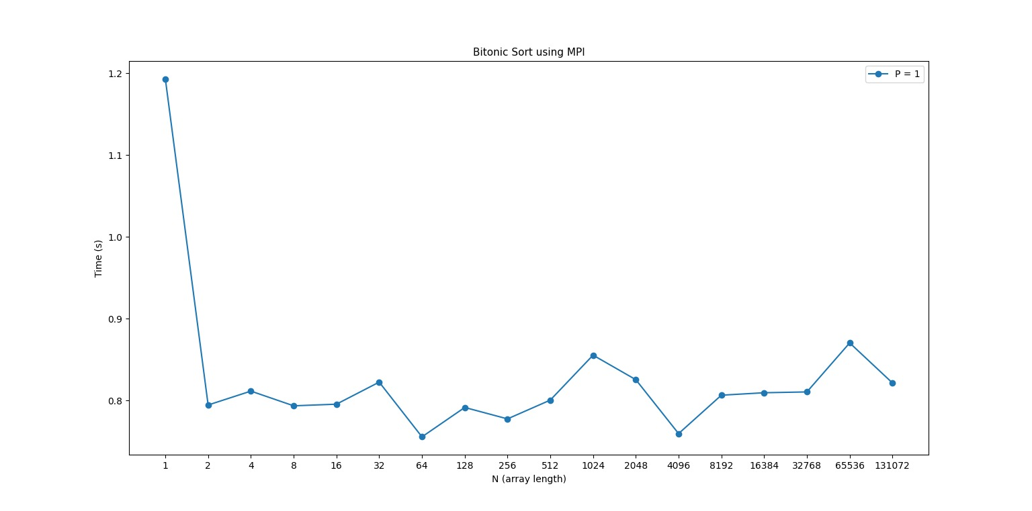
MPI – 1 Process

Slide 20
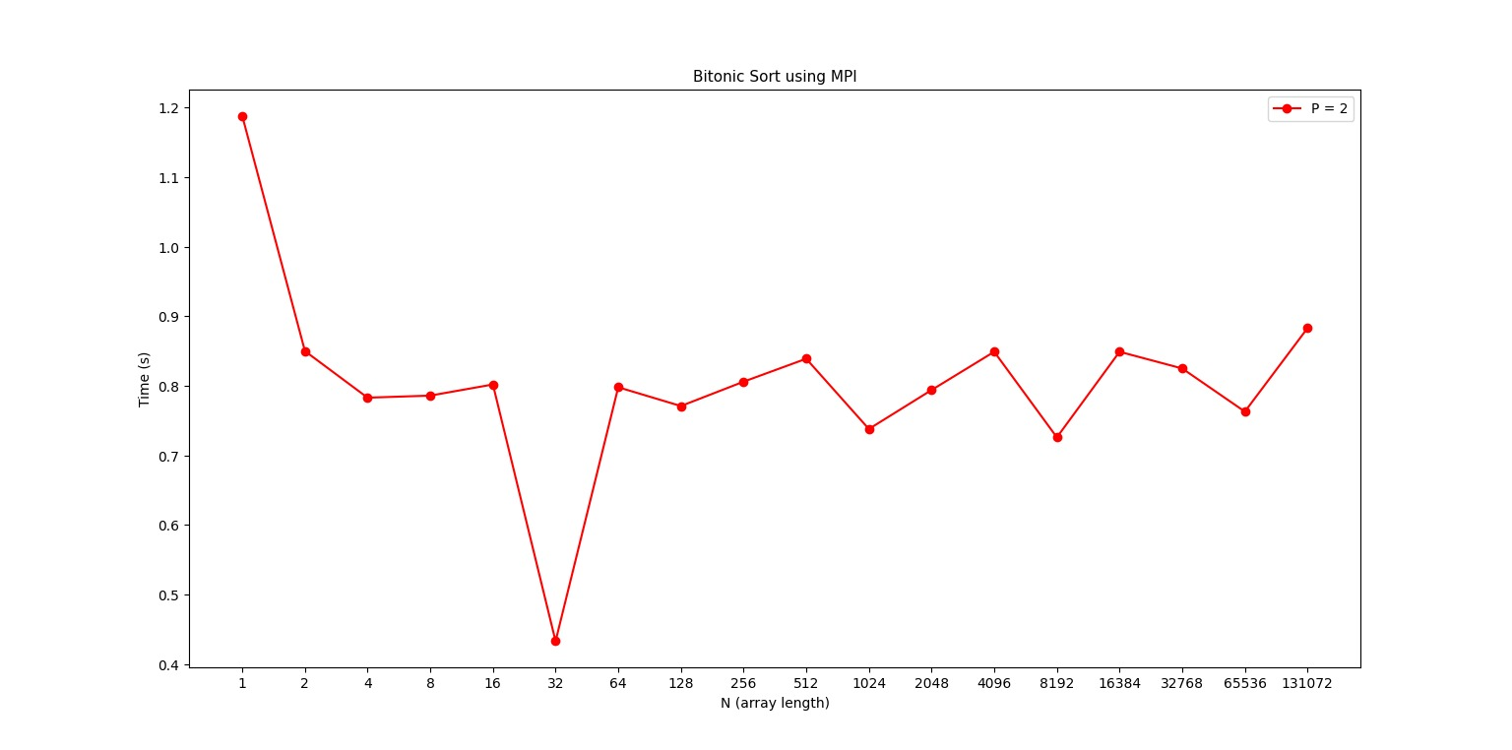
MPI – 2 Processes

Slide 21
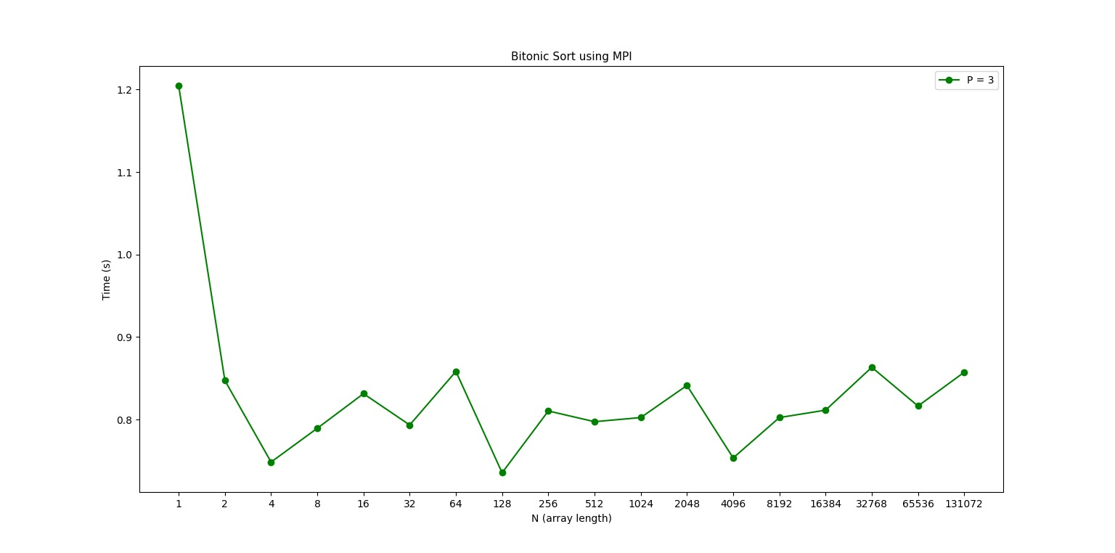
MPI – 3 Processes

Slide 22
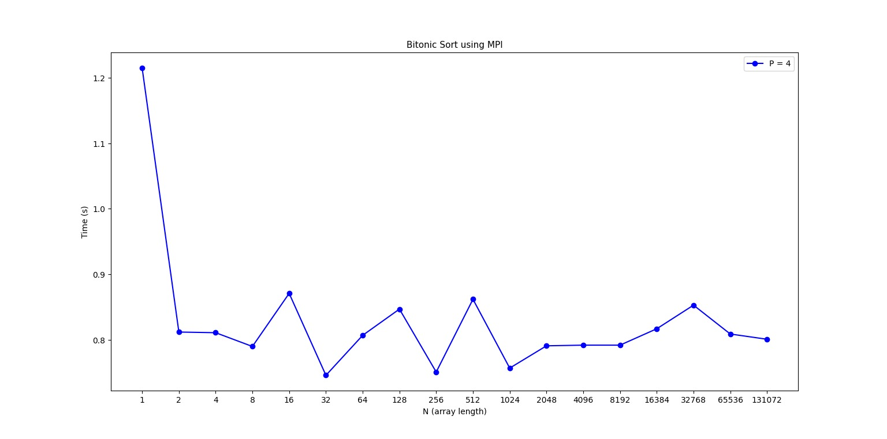
MPI – 4 Processes

Slide 23
Hybrid: MPI & OpenMP
The innermost loop of the algorithm was parallelized twice using 2 and 4 processes/threads: 1 process & 1 thread, respectively 2 processes and 2 threads.
Didn’t produce satisfying results: the execution time was longer comparing even to the serial version and even the MPI version.
Required synchronization like the MPI version: after the inner loop with a barrier in order to wait for all the processes to finish the respective loop execution, but also after passing the sections to sort to each process and after finishing the sorting.
Extra memory was required for creating a shared memory window hosting the array which was accessible to all the processes.

Slide 24
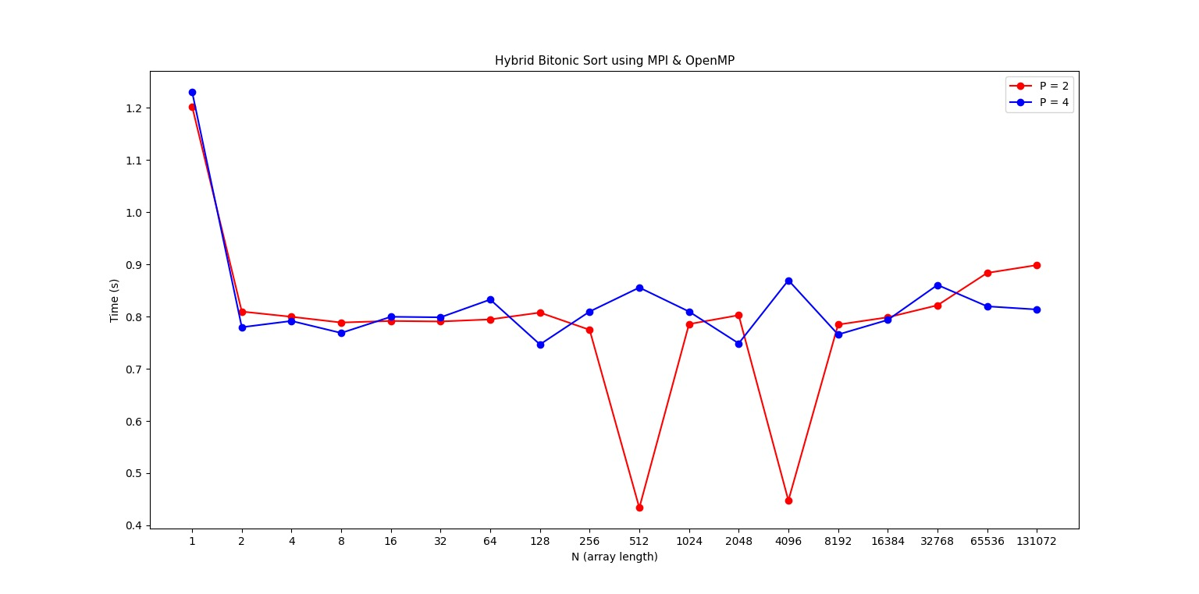
Hybrid: MPI & OpenMP

Slide 25
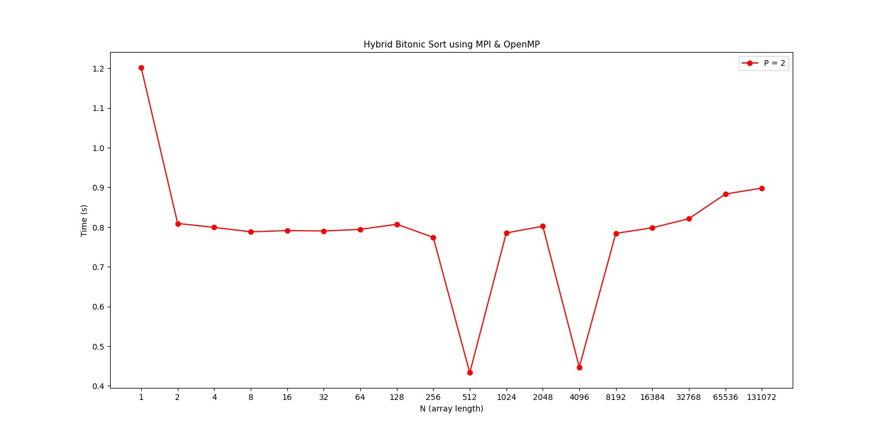
Hybrid: MPI & OpenMP – 2 Processes

Slide 26
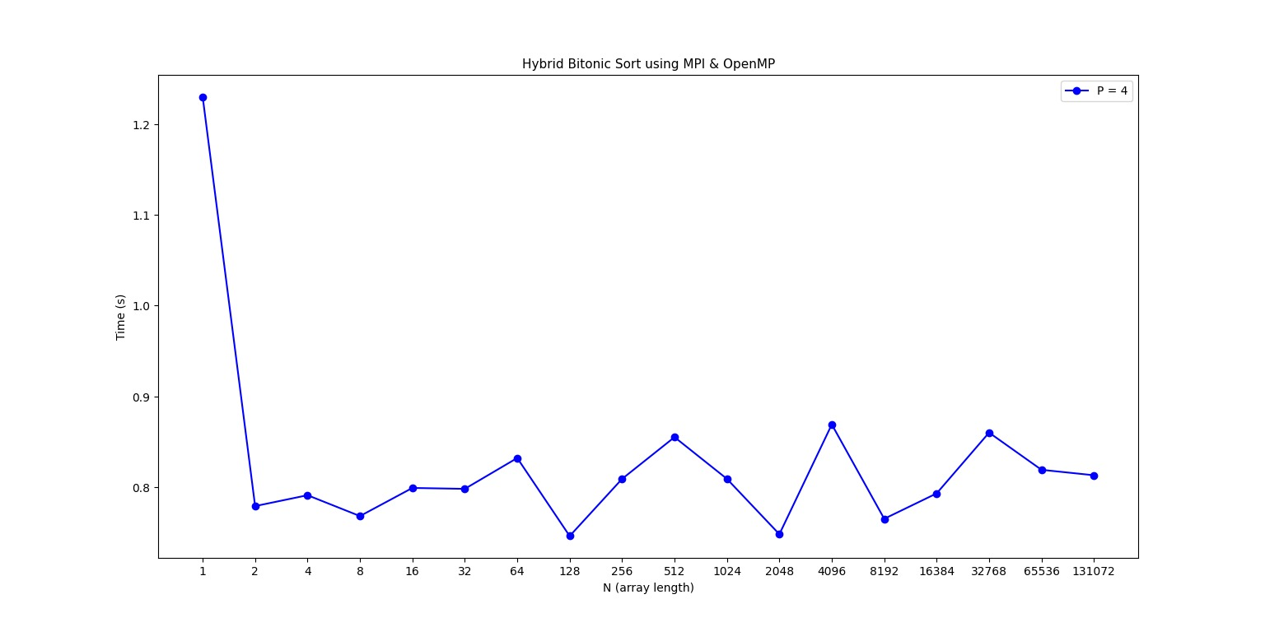
Hybrid: MPI & OpenMP – 4 Processes

Slide 27
Conclusions
With 4 threads the OpenMP & Pthreads versions managed to reduce by half the Serial execution time for the Bitonic Sort algorithm.
The parallel versions of this algorithm obtain better results for arrays of greater length than the serial one. For short arrays the results are equal or better to/for the serial version.
The MPI and Hybrid versions did not manage to surpass the Serial version because of the extra synchornization the processes required after swapping elements.

Slide 28
Thank you!

