Slide 1

Groovy
Script
The Final Frontier

Slide 2


Test your application with Groovy
Why would you use a language called

Slide 3
GROOVY?
Simplicity
OO for JVM
Regular Expression
Fresh Look
Java like syntax
Scripting

Slide 4
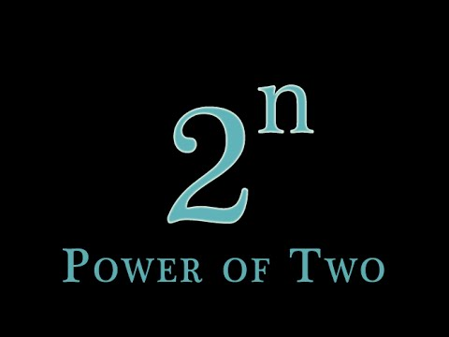
what do I want to do rather then how do I achieve it
JAVA
int n =10
List list = new ArrayList()
for (int i = 0; i<n; i++) {
list.add(Math.pow(2,i))
}
println list
GROOVY
(0..< 10).collect { it-> print ((2 ** it) + " ") } ​
http://www.groovyconsole.appspot.com/

Slide 5
Links
https://groovy-lang.org/
http://groovy-lang.org/groovysh.html
http://groovy-lang.org/groovyc.html
http://groovy-lang.org/groovyconsole.html
http://groovy-lang.org/semantics.html#_power_assertion
http://groovy-lang.org/structure.html#_script_class
http://groovy-lang.org/objectorientation.html#_class

Slide 6
Collections
Range: http://docs.groovy-lang.org/latest/html/gapi/groovy/lang/Range.html
Lists: http://docs.groovy-lang.org/latest/html/groovy-jdk/java/util/List.html
Maps: http://docs.groovy-lang.org/latest/html/groovy-jdk/java/util/Map.html

Slide 7
Closures
http://docs.groovy-lang.org/latest/html/api/groovy/lang/Closure.html

Slide 8
REST Services
@Grab
http://docs.groovy-lang.org/latest/html/documentation/grape.html
Maven repository: https://search.maven.org/
http-builder: https://github.com/jgritman/httpbuilder/

Slide 9

https://medium.com/@webseanhickey/the-evolution-of-a-software-engineer-db854689243#.5zm1hn71e
SPOCK Framework

