Slide 1

Hotel Industry
Sentiment Analysis and topic modeling

Slide 2
Business understanding
1

Slide 3
Hotel Industry
Accommodation booking value worldwide from 2017 to 2023, with a forecast for 2025 and 2027 (in billion U.S. dollars)
Accommodation booking value worldwide 2017-2027
Market size of the hotel and resort industry worldwide in 2022 and 2023 (in trillion U.S. dollars)
Global hotel and resort industry market size worldwide 2022-2023
1,657
1.43
1.5
1,406
978
1,104
1,076
Accommodation booking value in billion U.S. dollars
718
Market size in trillion U.S. dollars
2022
2023
2017
2019
2021
2023
2025
2027
Source: Statista.com

Slide 4
Hotel Industry
Hotel & resort industry
$ 1.5
Trillion
… Airbnb have become extremely popular, hotels are still a huge business globally, and in 2023 the hotel and resort industry market size worldwide reached 1.5 trillion U.S.D.¹
Hotels in construction
6.2
Thousand
The number of hotels in the construction pipeline worldwide that were already under construction was around 6.2 thousand in 2024.¹
¹ Euromonitor

Slide 5
Hotel Industry
Experience
It’s all about the experience.¹
Workations
Optimization
Rise of new types of travel. Travelers on “workations” typically desire a home-like experience.²
The hotels industry is expected to invest further in process optimization tools that help to streamline repetitive and time-consuming tasks.²
¹ https://blog.infraspeak.com/challenges-hospitality/ ² Statista.

Slide 6
Stakeholders’ Needs
2

Slide 7
Stakeholders’ Needs
Need input on how the hotel industry is performing in a specific country or city.
Need to benchmark how their hotel(s) and their competitors are performing in the market.
Hotel investors
Hotel owners

Slide 8
Stakeholders’ Needs
Sentiment analysis by city and hotels
Top topics per city and hotels
Tool to visualize input from hotel clients

Slide 9
Data Collection
2

Slide 10
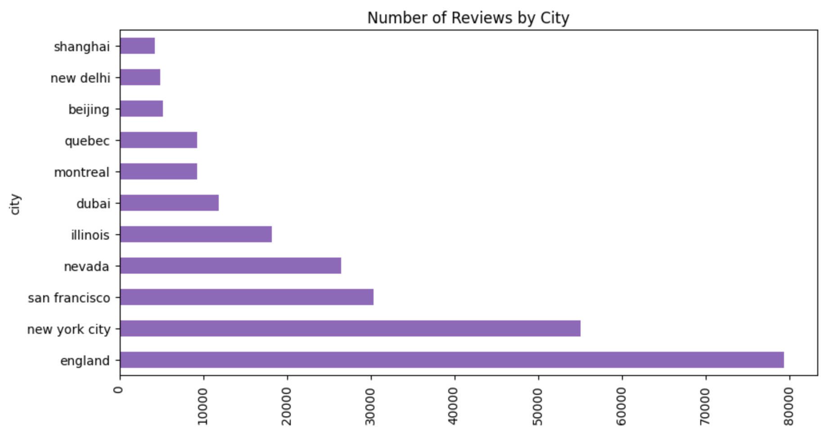
Data
Hotel Reviews
Data from OpinRank Review Dataset collected from Tripadvisor.
Full reviews of hotels in 10 different cities.
There are about 80-700 hotels in each city
Total number of reviews: 254,571

Slide 11
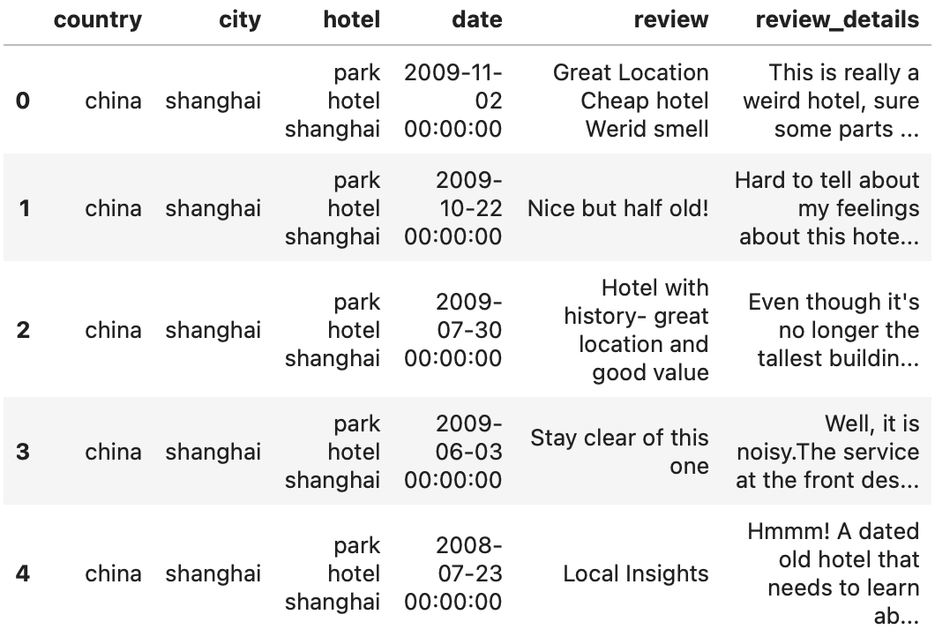
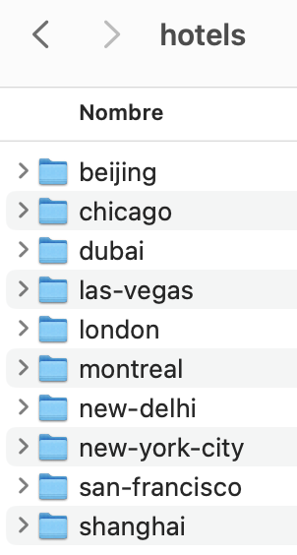
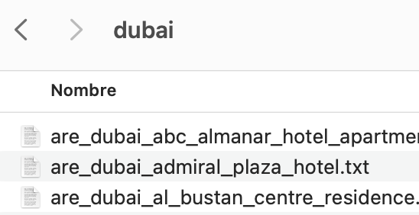
Structure
10 different folders representing the 10 cities mentioned earlier.
Each folders would contain all reviews related to a particular hotel.

Slide 12
AI Models
VADER
Sentiment analysis tool for analyzing text.
Used to detect sentiment in the hotel reviews.
Transformer-based language model designed for natural language.
Used to get emotions from the reviews.
RoBERTa
LDA
Probabilistic topic modeling that identifies hidden topics within collections of documents.
Used to discover the topics in the text reviews.
VADER: Valence Aware Dictionary and sEntiment Reasoner / RoBERTa: Robustly Optimized BERT Pretraining Approach / LDA: Latent Dirichlet Allocation

Slide 13
Demo
5

Slide 14
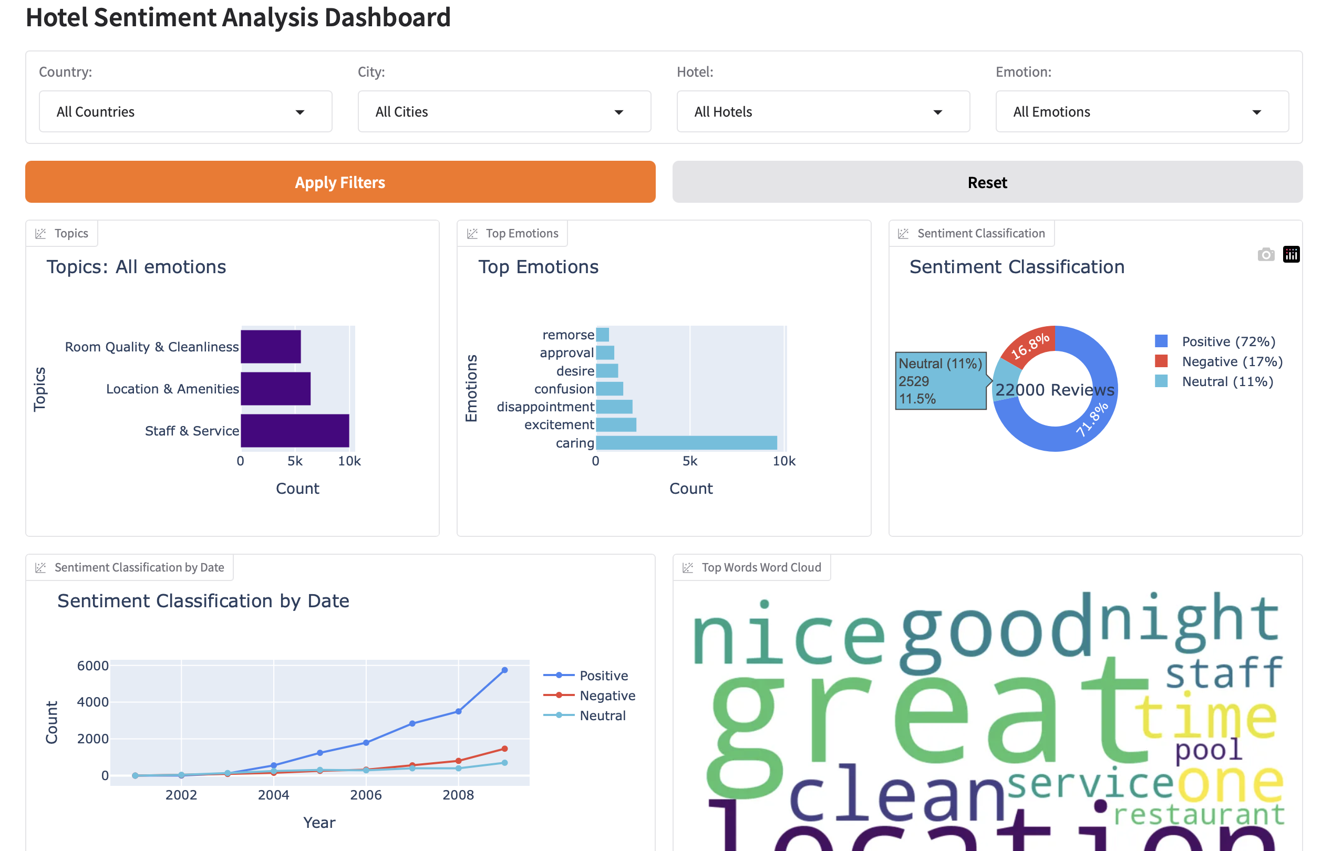
Demo

Slide 15

Thank you

