Slide 1

Movie shop inventory
Andreea Gogoase

Slide 2
Test case
The application containes a unit test for:
each non-absract constructor: Movie constructor and Series constructor;
unit test for four functionalities: Product to JsonObject and Rent a Series.

Slide 3
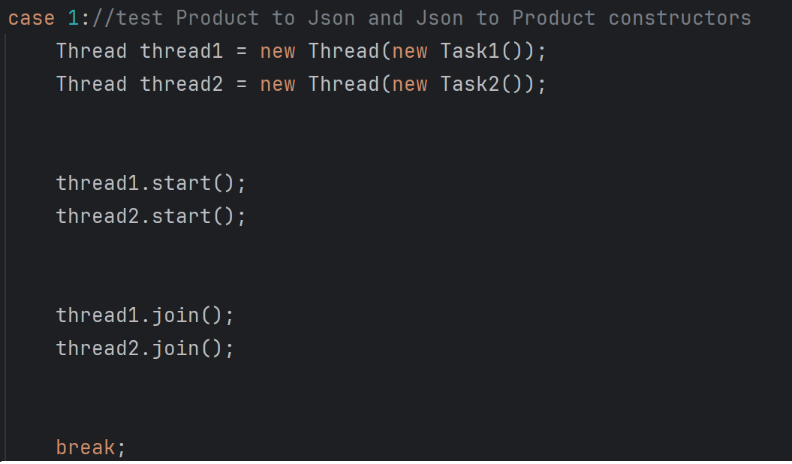
Threads
Threads are used to halve the running time when running the unit tests.

Slide 4
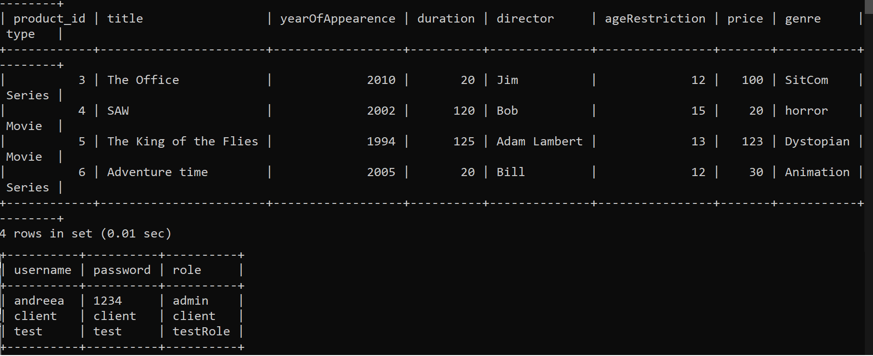
database

Slide 5
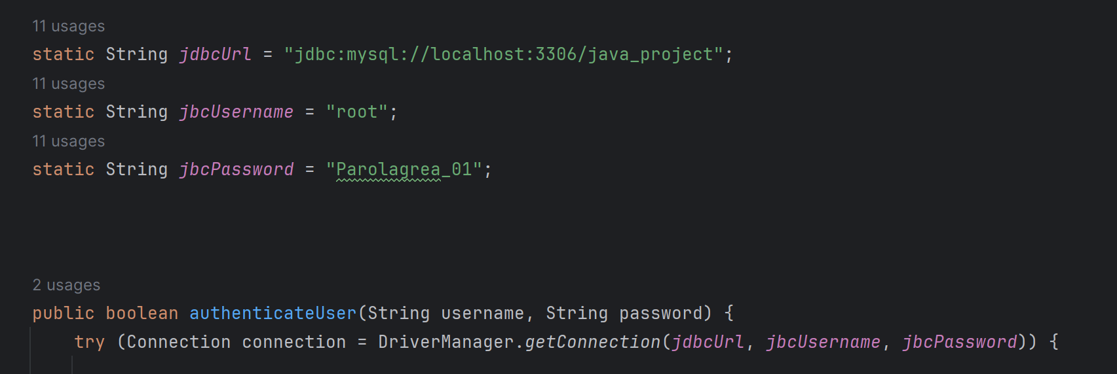
Connection with the database
Every method that works with information from the database connects to the server with the username and password of the sever, through the Connection interface

Slide 6
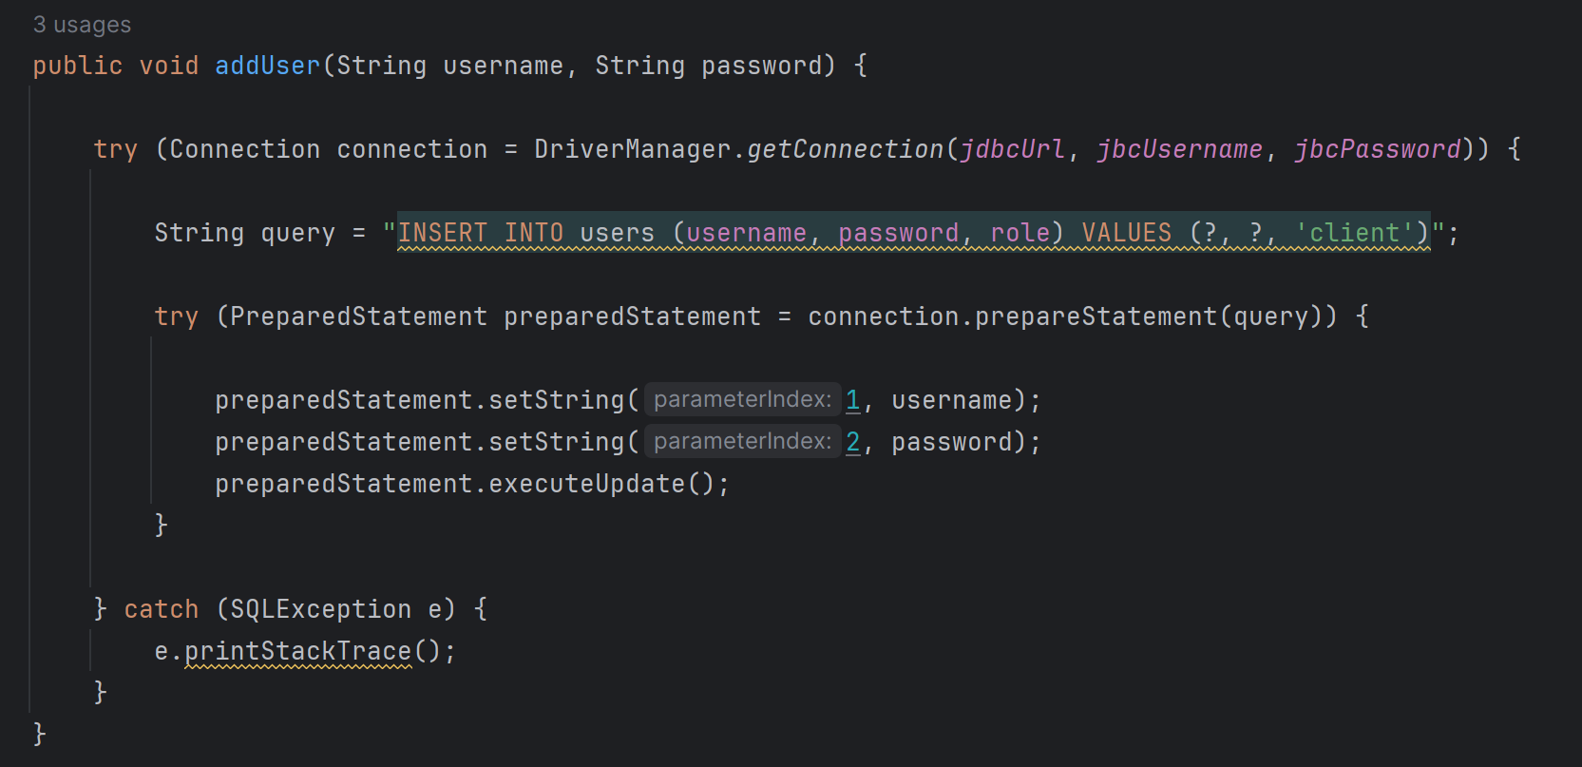
Insert or update the database
The application can add, delete, search and update information from the database;
For example if you want to see all products or all users from the database, the application will provide the title and the type of the product(movie or series) or it will provide the username and the role of the user.

Slide 7
Managing roles
When you start the application you have to log in with an username and a password;
The application will check if that user exists in the database or if the username and the password is correct;
In this version of the application only the admin can add a new user witch will have by default the client role, which can be changed by the admin in the future if necessary.

Slide 8
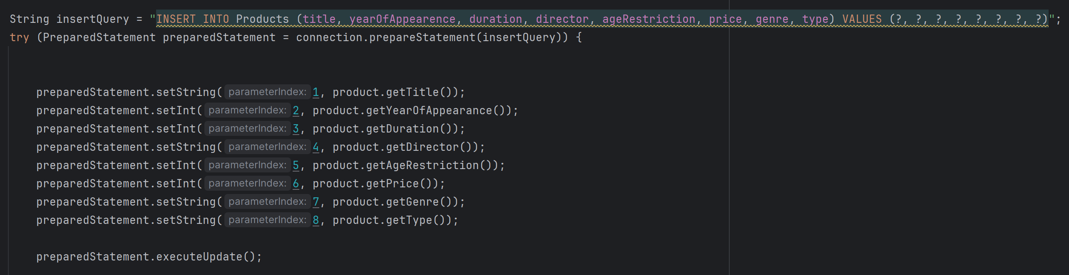
Validate Input data
I used prepared statements to validate the data:

