Slide 1
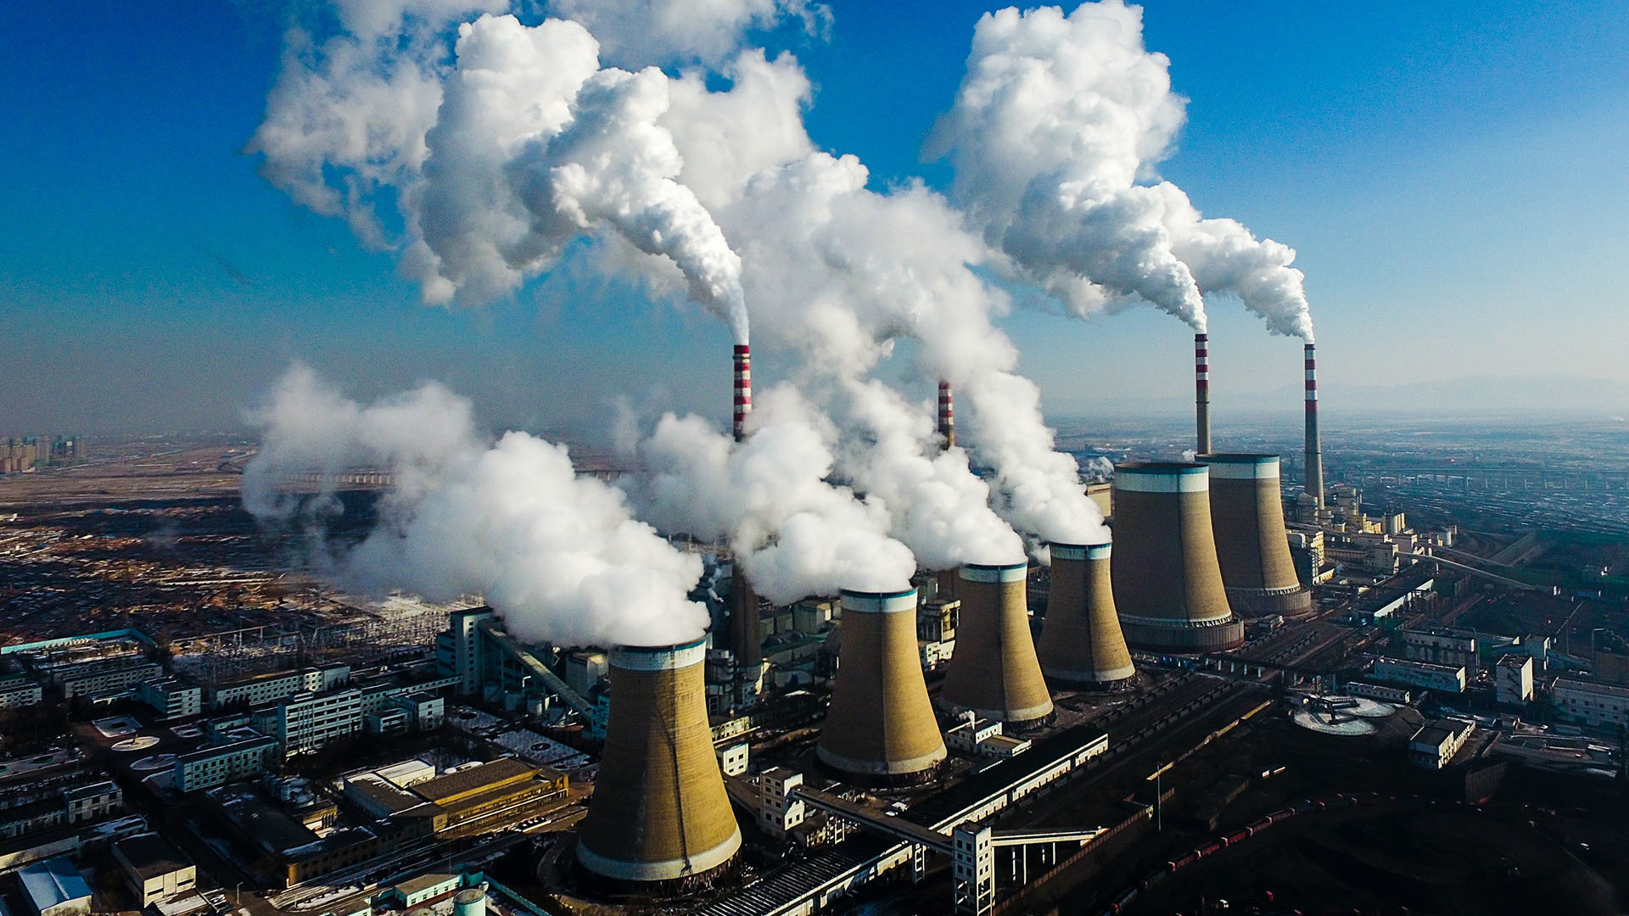
Carbon Dioxide and Greenhouse Gas Emissions
End-to-end Statistical Data Analysis

Slide 2

GOALS:
Find the countries with most emissions and see how much they affect the climate change worldwide.
TARGET:
Increase global awareness for Carbon Dioxide (CO₂) and Greenhouse Gas (GHG) emissions and apply new global policies to impact on slowing the rate and limit the amount of global warming.

Slide 3
WHAT AFFECTS CO₂ AND GHG EMISSIONS?
Human emissions of carbon dioxide and other greenhouse gases – are a primary driver of climate change – and one of the world’s most pressing challenges.
Carbon Dioxide (CO₂) emissions comes from:
coal
oil
cement
gas
flaring
other industries.
Greenhouse Gas (GHG) comes from:
methane
nitrous oxide
primary energy consumption

Slide 4

ABOUT THE DATA
Using two datasets found on Github.com:
https://github.com/owid/co2-data/blob/master/owid-co2-data.csv
https://github.com/hongtaoh/olymvis-data/blob/master/data_sources/continent.csv
Original data is scraped from the database of Our World In Data (OWID), a scientific online publication that focuses on large global problems such as poverty, disease, hunger, climate change, war, existential risks, and inequality:
https://ourworldindata.org/co2-and-other-greenhouse-gas-emissions
The main dataset contains 55 columns with a collection of key metrics about emissions from 1750-2019, with categorical data, but mostly numerical.
Second dataset contains 6 columns with information about countries and continents, with mostly categorical data, and one numerical.

Slide 5
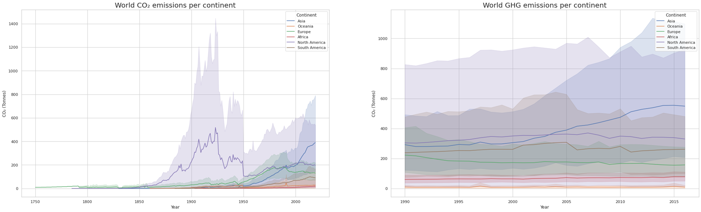
Cumulative CO2 and GHG emissions - per CONTINENT
5

Slide 6
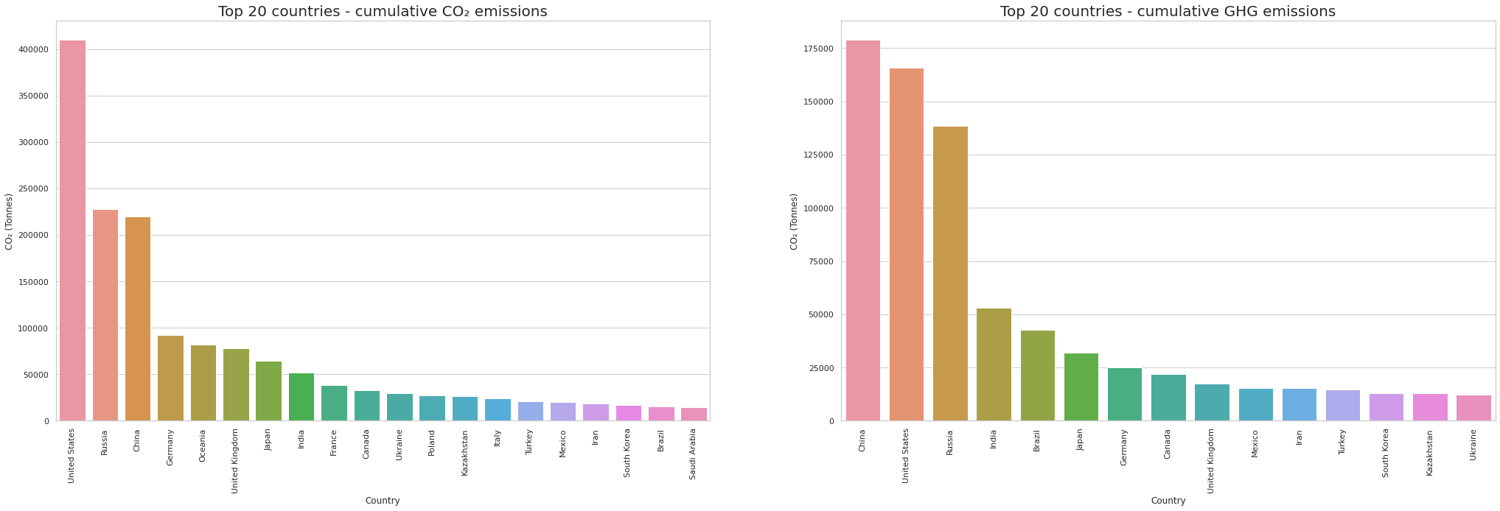
Cumulative CO2 and GHG emissions - by COUNTRY
6

Slide 7
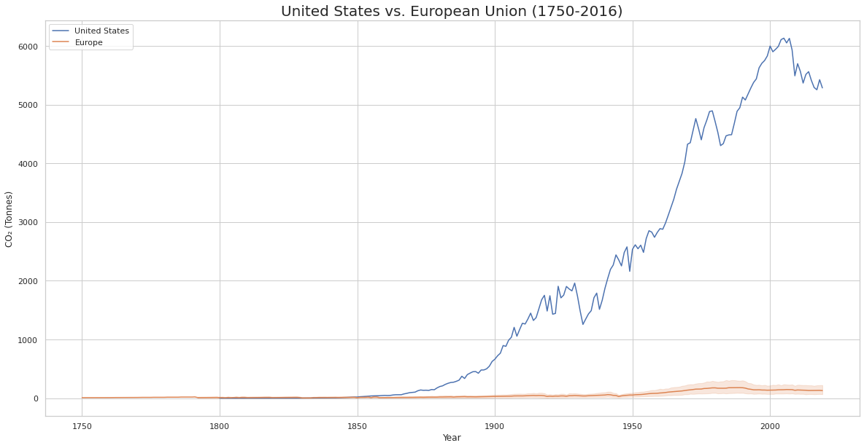
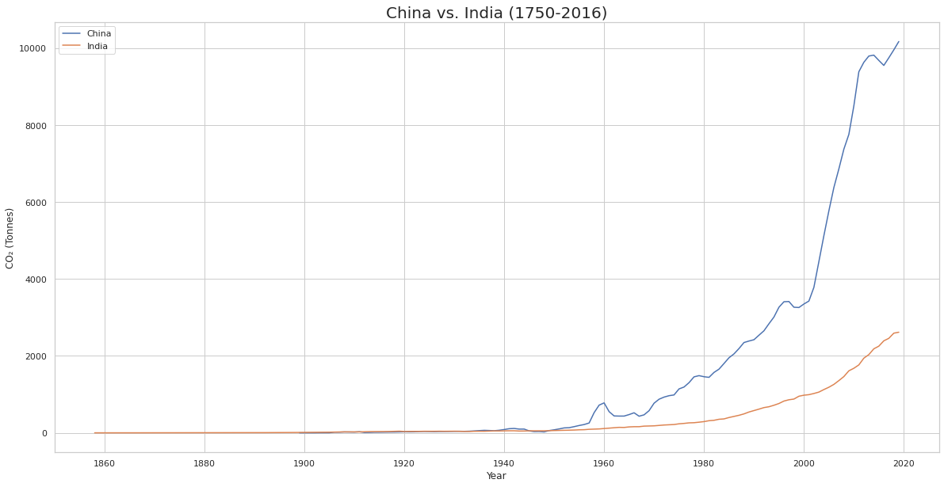
Top 4 countries - CO₂ emissions (1750-2016)
7

Slide 8
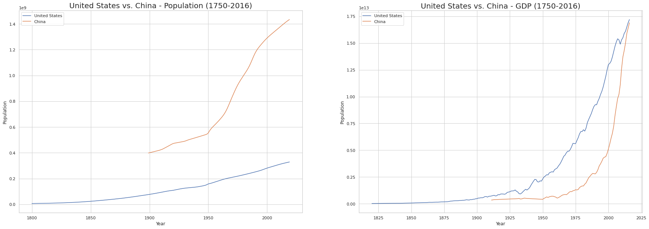
United States vs. China - Population and GDP (1750-2016)
8

Slide 9
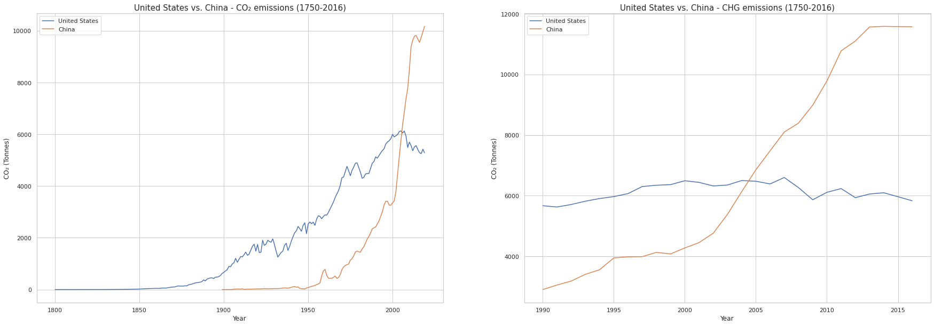
United States vs. China CO₂ and GHG emissions (1750-2016)
9

Slide 10

HYPHOTHESES
H₀: There is no significant difference in the means of the two groups – emissions for United States vs. China between 2012-2016.
Hₐ: There is significant difference in the means of the two groups - emissions for United States vs. China between 2012-2016.

Slide 11
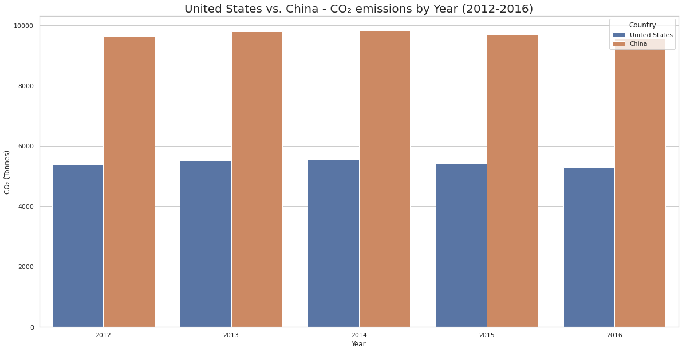
Hypothesis 1: Carbon Dioxide(CO₂) emissions

Slide 12
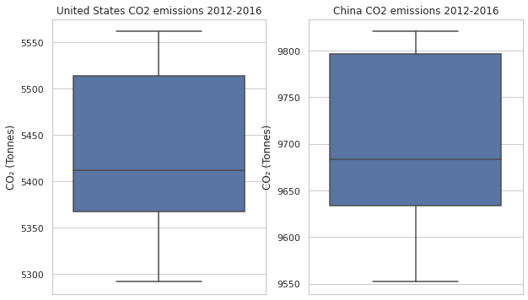
Hypothesis 1: Carbon Dioxide(CO₂) emissions
Hypothesis
United States vs. China between 2012-2016:
H₀: μ₁ - μ₂ = 0; Hₐ: μ₁ - μ₂ ≠ 0
Results
p = 5.76477083016048e-12
The difference is significant at p < .05. With 95% confidence, the difference is between 4130.6 and 4404.7 CO₂(Tonnes).
Cohen's D is -38.6, indicating a large effect size.

Slide 13
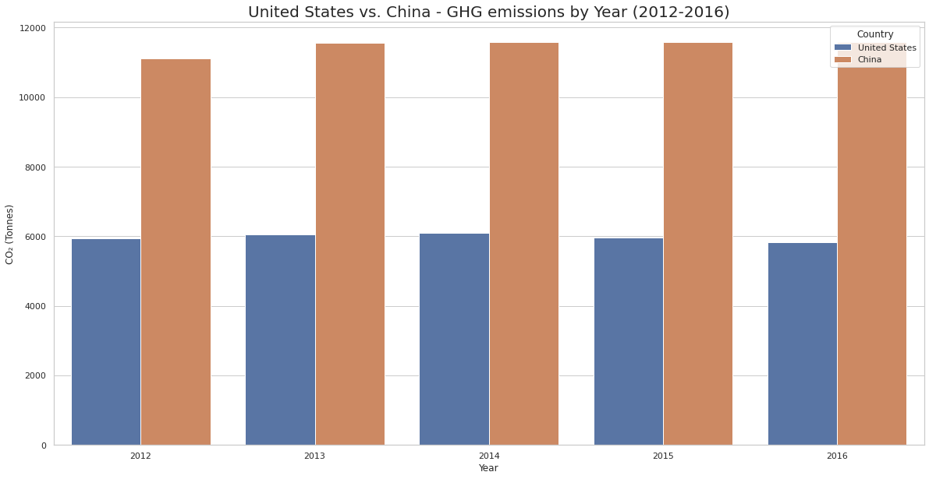
Hypothesis 2: Greenhouse Gas(GHG) emissions

Slide 14
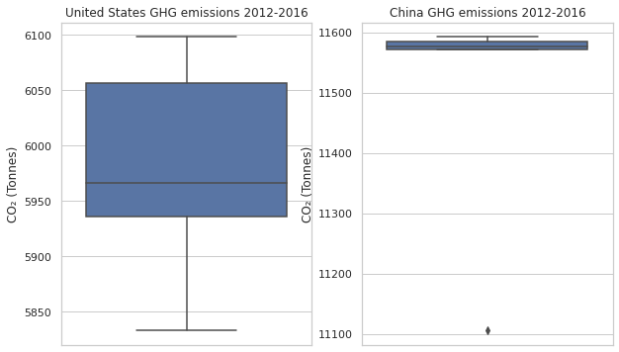
Hypothesis 2: Greenhouse Gas(GHG) emissions
Hypothesis
United States vs. China between 2012-2016:
H₀: μ₁ - μ₂ = 0; Hₐ: μ₁ - μ₂ ≠ 0
Results
p = 2.0474467618870344e-11
The difference is significant at p < .05. With 95% confidence, the difference is between 5300.8 and 5715.3 CO₂(Tonnes).
Cohen's D is -32.9, indicating a large effect size.

Slide 15
CONCLUSION
According to research published by Rhodium Group in 2021, China has been responsible in 2019 for more than 27% of total global emissions. The U.S., the world's second-highest emitter, accounts for 11% of the global total. Followed by India which is responsible for 6.6% of global emissions, edging out the 27 nations in the EU, which account for 6.4%.
I think anyone who's interested in climate change would find valuables insights here. The intended audience can glean insights that help them think about the future of the emissions.
Global CO₂ emissions have seen a sharp increase in recent years, governments are fighting to slowing it down with increasing global awareness for CO₂ emissions and new global policies to combat CO₂ emissions (e.g. Paris 2050 and Kyoto 2020). It is safe to predict that the CO2 emissions will eventually come to a steady-state, but this cannot be achived without proactive efforts from all countries, especially, China, USA, India, and Europe.

Slide 16

Thank you for your attention!
Andreea Ioana Mihai – Data Analytics Flex – Thinkful
Capstone III: End-to-end data analysis project – Module 31

