Slide 1
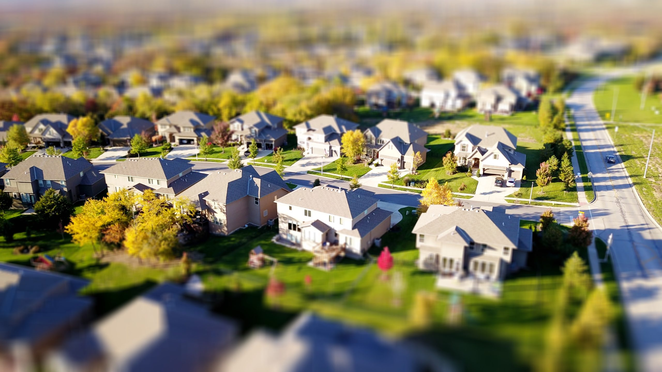
HOME PRICES
Statistical Analysis

Slide 2
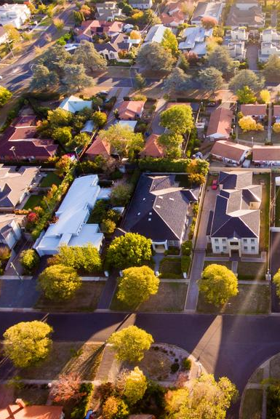
GOALS:
Find factors that drive the home prices the most.
TARGET:
Allocation of dollars earmarked for investment into mortgage-backed securities at an investment bank.

Slide 3
WHAT AFFECTS HOME PRICES?
Home prices are affected by external factors like supply, demand and economic growth.
In addition to that, qualities of the homes and properties have a big impact on the prices.
For this analysis I hypothesized that some of the biggest driving factors would be:
Number of car Garages
House Style
Overall Condition
Foundation
Year built
And I conducted T-tests to test the significance of their effect on the home prices.

Slide 4
HYPOTHESIS
H₀: There is no significant difference in the means of the two groups - houses with the variable value that has the most homes sold and all of the others.
Hₐ: There is significant difference in the means of the two groups - houses with the variable value that has the most homes sold and all of the others.

Slide 5
ABOUT THE DATA
The dataset is a sample of 1460 houses in USA that were sold between 2006-2010.
The distribution between categorical and numerical data is approximately even.
Source: https://www.kaggle.com/c/house-prices-advanced-regression-techniques/data
Descriptive statistics about the dataset

Slide 6
Factor 1: GARAGE CARS
Number of car garages is a very popular factor, but 2-car garages type doesn’t inflate the home prices, despite it’s popularity.

Slide 7
Factor 1: GARAGE CARS
Hypothesis
GarageCars ”2” and Others:
H₀: μ₁ - μ₂ = 0; Hₐ: μ₁ - μ₂ ≠ 0
Results
p = 0.13.
Fail to reject the null that there is no difference between population means of houses with 2-car garage and all others
The difference is not significant at p < .05.

Slide 8
Factor 2: HOUSE STYLE
1 Story homes is a popular factor just like car garages, but it does not increase the home prices.

Slide 9
Factor 2: HOUSE STYLE
Hypothesis
Hypotheses
House Style ”1Story” and Others:
H₀: μ₁ - μ₂ = 0; Hₐ: μ₁ - μ₂ ≠ 0
Results
Results
p = 0.01.
The difference is significant at p < .05. With 95% confidence, the difference is between $1,676 and $17,959.
Cohen's D is 0.12, indicating a small effect size.

Slide 10
Factor 3: OVERALL CONDITION
The most Overall Condition sold is ”5” and increases the home prices by $20,000.

Slide 11
Factor 3: OVERALL CONDITION
Hypothesis
Hypotheses
Overall Cond ”5” and Others:
H₀: μ₁ - μ₂ = 0; Hₐ: μ₁ - μ₂ ≠ 0
Results
Results
p = 3.39512E-38
The difference is significant at p < .05. With 95% confidence, the difference is between $43,295 and $58,268.
Cohen's D is .69, indicating a large effect size.

Slide 12
Factor 4: FOUNDATION
Concrete is a very popular material used for sold homes, and plain concrete foundation increases the home prices by $45,000.

Slide 13
Factor 4: FOUNDATION
Hypothesis
Hypotheses
Foundation ”Pconc” and Others:
H₀: μ₁ - μ₂ = 0; Hₐ: μ₁ - μ₂ ≠ 0
Results
Results
p = 2.74971E-79
The difference is significant at p < .05. With 95% confidence, the difference is between $72,029 and $87,113.
Cohen's D is 1.12, indicating a large effect size.

Slide 14
Factor 5: YEAR BUILT
Year built of 2006 increases the home prices by almost $80,000.

Slide 15
Factor 5: YEAR BUILT
Hypothesis
Hypotheses
YearBuilt ”2006” and Others:
H₀: μ₁ - μ₂ = 0; Hₐ: μ₁ - μ₂ ≠ 0
Results
Results
p = 2.17264E-10
The difference is significant at p < .05. With 95% confidence, the difference is between $54,208 and $94,317.
Cohen's D is .94, which indicates a large effect size.

Slide 16
Results: AVERAGE PRICES BY FACTORS

Slide 17
RECOMMENDATIONS
I identified 3 factors out of 5 that can really raise the average prices of home prices:
1. Foundation
2. Year Built
3. Overall Condition
4. Garage Cars
5. House Style.
My recommendation for the allocation of dollars earmarked for investment into mortgage-backed securities is to use any of these driving factors in order of significance from the conducted analysis or combine all of them.

Slide 18
Results: AVERAGE PRICES BY MULTIPLE FACTORS

Slide 19
Thank you for your attention!
Andreea Ioana Mihai – Data Analytics Flex – Thinkful
Capstone II: Case study – Module 23

