Slide 1
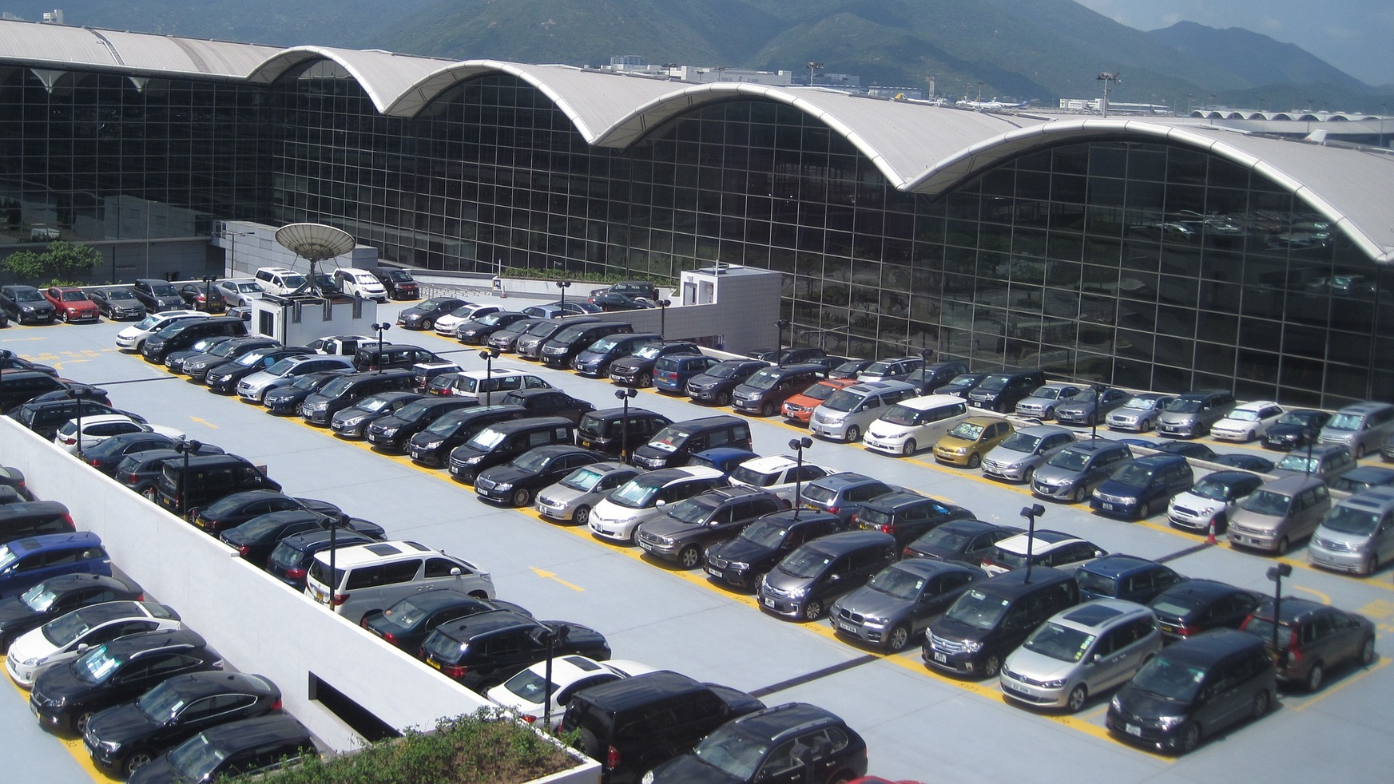

LARIAT RENTAL REVENUE ANALYSIS

Slide 2
GOALS
Minimizing COSTS.
TARGET
Increase REVENUE for the year of 2019.

Slide 3



50
STORES
4000
VEHICLES
$52,830,207
TOTAL REVENUE 2018

Slide 4
LARIAT RENTAL 2018 FINANCIAL ANALYSIS
Total Revenue | $ 52,830,207
Total Costs | $ 33,076,689
Total Profit | $ 19,753,518

Slide 5
2018 BRANCH ANNUAL REVENUE

Slide 6
2019 FY LARIAT RECOMMENDATIONS
Strategy 1: Increase the base cost of the cars in the top 10 states by 10%.
Strategy 2: Increase fleet in the top 10 states by 5%.
Strategy 3: Combine Strategy 1 & Strategy 2.

Slide 7
Strategy 1: Increase base cost in top 10 states by 10%.
Strategy
Same number of cars.
Constant amount of clients.
Assuming company increases base costs by 10%.
Results
Total revenue:
$4,060,083 (7.68% vs. 2018).

Slide 8
Strategy 2: Increase fleet in the top 10 states by 5%.
Strategy
Same base costs.
Constant amount of clients.
Assuming company increases fleet by 5%.
Results
Total revenue:
$1,216,430 (2.30% vs. 2018).

Slide 9
Strategy 3: Combine Strategy 1 & Strategy 2.
Strategy
Constant amount of clients.
Assuming company increases base costs by 3% and fleet by 7%.
Results
Total revenue:
$3,340,242 (6.32% vs. 2018).

Slide 10
2018 vs. 2019 STRATEGIES – Total Revenue

Slide 11
2018 vs. 2019 STRATEGIES – Total Profit

Slide 12
WHAT DO WE DO FROM HERE?
Test these strategies in the top 10 states for the next 3 months.
Analyze data monthly to see the cost of expanding the fleet and increasing the revenue.
Expand strategies to the other states.

Slide 13
OTHER STRATEGIES
Increase fleet with most commonly rented cars and decrease fleet with the least rented cars.
Increase rental charges for car classes with higher end.
Close down low earning branches.

Slide 14
Thank you for your attention!
Andreea Ioana Mihai – Data Analytics Flex – Thinkful
Capstone I: Case study – Module 11

