Slide 1

Preliminary design of a High Pressure Steam Turbine
Rossi Andrea
Politecnico di Milano

Slide 2
The design specifications
The project consist in the preliminary design of the high pressure part of a steam turbine. The design process requires some initial data other than many other assumptions.
Inlet flow characteristics, in terms of total quantities, are:
p_{T} = 150 bar
T_{T} = 700◦C
The stages must provide a pressure ratio β of 2.5.
Since the first stage of the design is the first stage of the whole machine, the inlet direction is assumed to be purely axial.
10 of 62

Slide 3
The model of the fluid
The text leave the choice of the model of the fluid to our responsibility. The two main alternatives are:
perfect gas with γ = 1.33 and constant c_{p}
steam tables
Since steam tables are available as an additional library in Matlab, to guarantee a better precision they are used. In particular the library XSteam is applied in any calculation of steam properties.
10 of 62

Slide 4
The design process
Most of the choices related to the machine are taken based not only on common techniques like loading criteria, but also on the comparison of the result from the implementation of the model in computer code.
The machine will be implemented in a power plant, so the first goal of the design is
highest efficiency as possible
10 of 62

Slide 5
The model of the machine - The inputs
The data available from the costumer are necessary but not sufficient. So as additional and more specific input we take:
the reaction degree in the middle diameter χ,
the rotational speed n in rpm,
the number of stages,
the flow coefficient φ = v_{a}/U,
the minimum value of blade height over the diameter b/D_{mid},
the partial admission coefficient ε,
the blade solidity σ = chord/pitch
the ratio of the chord over the blade height
10 of 62

Slide 6
The model of the machine - The inputs
the blade thickness over the chord
the absolute clearance
the number of seals per rotor
an initial guess of the efficiency (η = 1 could be a guess)
the number of section in which divide the span
other numerical and computational parameters
the maximum number of iterations
the tolerances (1 · 10⁻⁶)
10 of 62

Slide 7
The model of the machine - The inputs
Some of the input are trivial and mandatory, but other are chosen. For example the number of stages is taken as input but it could also be the result of the calculation.
In fact the alternative was to choose the work coefficient λ = l/U², and in that case the number of stages would have been the result.
Since the number of stages is a very significant parameter respect to the work coefficient this choice has been made.
Another parameter is the flow coefficient that can be replaced with
k_{p} = U/v₁
10 of 62

Slide 8
The model of the machine - The main loop
The whole process requires the total efficiency of the machine. The efficiency is also an output of the design: ⇒ iterative loop.
Initial guess of η_{T T}
Perform the design of the machine
no
OLD
yes
Loop again
|η − η | < toll
Convergence reached
T T ^{T T}
10 of 62

Slide 9
The model of the machine - The main loop
h⁰ = h(p⁰ , T⁰ ) (1)
T T T
To compute the isoentropic outlet enthalpy we have simply to consider that the initial final entropy are the same by definition.
s₀ = s⁰ = s(p⁰ , T⁰ ) (2)
T T T
( \
p
0
end
h_{T}
= h ^{T} , s₀ (3)
isoentropic
βT T
Finally we calculate the outlet enthalpy from the efficiency:
end 0 0 end
h = h − η · (h − h )
(4)
T
T
T T
T
^{T}is
10 of 62

Slide 10
The model of the machine - The main loop
Dividing the enthalpy drop by the stages number we find the enthalpy drop of the single stage that is also the Euler work of the stage.
0 end
h − h
l_{e} = u · (v_{1T} − v_{2T} ) =
T T
(5)
Nstages
The main first quantity in which we are interested is the peripheral speed U. We can obtain it from the mass flow rate:
( \
b
1
2
mid
m˙ = ρ · v · S = ρ · v · π
D
(6)
0 A 0 A
^{D}mid
Having defined both φ = v_{A}/U and D_{mid} = 60/(2 π n) U the mass flow rate is only function of the the cube of the peripheral speed.
¹The static density is unknown but since we are iterating we keep the total one
as first guess ad we update it at every cycle
10 of 62

Slide 11
The model of the machine - The velocity triangle
To design the velocity triangle we have to make some hypothesis:
repeated stage, so v₀ = v₂
constant axial velocity v_{1A} = v_{2A} = v_{3A} = v_{A}
the first stator has an axial inlet so it can break the repeated stage rule. In this case its velocity will be v₀ = v_{A}
Now what we need are:
U previously found from equation 6;
v_{A} = φ · U
l
∆v_{T} = − _{U} = v_{1T} − v_{2T}
v_{1T} + v_{2T} = 2 U · (1 − χ_{mid})
10 of 62

Slide 12
The model of the machine - The velocity triangle
As we can see in figure 1 the outlet velocity of the stage is almost but not exactly axial.
The first stage will have a reaction degree at midspan slightly different from the desired.
v₁ → v₂ → ← w₁
← w₂
↑ u
↑ u
Figure: Example of result of a velocity triangle
10 of 62

Slide 13
The model of the machine - The inlet of the machine
After the definition of the velocity triangle the next step is the thermodynamical analysis, and we start from point 0. From the definition of total entropy we can get the static one:
_{v}2 _{v}2
0
1
0 A
h = h +
⇒ h = h −
(7)
T
0
0
T
2 2
To get the static pressure and temperature we have to remember that:
0 0 0
•
the static entropy is equal to the total entropy s = s = s(p , T ).
0
T
T T
But we can obtain the static pressure remembering that the total pressure is obtained stopping the flow in an isoentropic way and measuring the pressure.
p₀ = p(s₀, h₀)
(8)
From the two thermodynamical quantities we can obtain all the others.
10 of 62

Slide 14
The model of the machine - Losses definition
In point 0 we know everything so we can calculate the blade height:
m˙
b =
(9)
0
ρ₀ π D_{mid} v_{A} ε
To perform the thermodynamical analysis of the stator we have to introduce the calculation of the losses. In particular according to the definition of the total pressure loss.
pT 0 − pT 1
=
p_{T 1} − p₁
Y
stator
(10)
rel rel
p − p
Yrotor =
T 1 T 2
(11)
rel
p − p
2
T 1
Where p^{rel} is the total pressure in the relative frame.
T
10 of 62

Slide 15
The model of the machine - Solution of the stator
If we obtain the loss coefficient we are able to find all the thermodynamical quantities at the outlet of the stator (Point 1). The solution is a bit trickier than the previous since it is iterative. Both p_{T 1} and p₁ shares the same entropy that is unknown. In both cases we know enthalpy but as known we miss another quantity.
Substituting p_{T 1} and p₁ into equation 10 leave that equation with just the entropy as unknown.
p_{T 0} − p_{T 1}(h_{T 1}, s)
Y − = 0 (12)
stator
p_{T 1}(h_{T 1}, s) − p₁(h₁, s)
where: h = h
2
2
1 T 1
− v /2 = h
T 0
− v /2.
1 1
Equation 12 is implicit and non-linear and have to be solved numerically since requires the computation of the steam table. We apply the secants method to get a solution in terms of entropy.
10 of 62

Slide 16
The model of the machine - Solution of the rotor
The same procedure can be applied to the rotor with the difference that in this case we use relative quantities.
( \
_{w}2
rel
p_{T} = p h + ₂ , s (13)
_{w}2 _{w}2
rel 2 rel 2
h = h − = h −
(14)
2
T 2 T 1
2 2
Total relative enthalpy conserves along the rotor in an axial machine.
rel rel rel
p − p (h , s)
Yrotor −
T 1 T 2 T 2
= 0 (15)
rel rel
p (h , s) − p (h , s)
T 2 T 2
2 2
We solve equation 15 numerically as the stator case, and from the entropy the solve completely the outlet of the rotor.
16 of 62

Slide 17
The model of the machine - Span evolution
Up to now we have only considered each section uniform along the span. Clearly this is an approximation since the peripheral speed u changes with the radius.
To improve the quality of the result we consider that the velocity triangles evolve along the span with a specific rule.
The approach chosen is the constant angle. It cannot guarantee that the work is constant along the blade height, but since the is only few centimetre height, this approach is good enough.
ADVANTAGE ⇒ Lower manufacturing cost.
We can solve the velocities along the span considering:
the radial equilibrium,
v_{T} /v_{A} = tan(α₁) = constant.

Slide 18
The model of the machine - Span evolution
Applying the previous relation into the radial equilibrium we obtain:
∂v_{A +} v_{T} ∂(r v_{T} ) ₌ ₀ v
T
v and
= tan(α₁) (16)
^{A} ∂r r ∂r
v_{A}
The solution to equation 16 is:

( \ 2
r
sin (α )
mid
mid
r
1
v (r) = v ·

A
A
v (r) = v (r) · tan(α )

T A 1

l(r) = u ∆v = ω r (v (r) − v (r)) /= constant
T T 1 T 2
For the rotor is the same except that we substitute the absolute velocity with the relative one

Slide 19
Figure: Sketch of velocity and angle evolution in a stator.
340
70
320
60
300
280
50
Velocity (m/s)
260
Angle (degrees)
v_{A1}
v_{T1}
U
alpha₀
alpha₁
40
240
220
30
200
20
180
10
160
140
0.24 0.245 0.25
Radius (m)
0
0.225
0.23
0.235
0.255
0.26
0.265

Slide 20
The model of the machine - Section solution
The span velocity is required to compute a better value for the blade height from the mass flow rate.
r
r
tip
m˙ = ρ(r) · 2 π r · v_{A}(r)dr (17)
^{r}hub
Equation 17 cannot be solved analytically to find b = r_{tip} − r_{hub} since the density depends on the steam table.
The solution in to approximate the integral with a summation for some points along the span. The number of point is taken as an input, but their location is chosen smartly.
The solution is in the form:
( \
N points
N points
, ,
m˙ ~ w_{i} · v_{Ai} πD_{mid} ε b = b · πD_{mid} ε · w_{i} · v_{A}(r_{i})
i i
(18)

Slide 21
The model of the machine - Section solution
The radius at which we compute the solution are chosen according to the following rule:
D − b
r =
mid
2
+ x_{i} · b (19)
i
Where the first guess of b is taken from the midspan solution. The coefficients x_{i} and w_{i} are taken form the Legendre-Gauss quadrature technique. For the case of 4 points for example the coefficients result:
x_{i} | w_{i}
0.9306 | 0.1739
0.67 | 0.3261
0.33 | 0.3261
0.0694 | 0.1739

Slide 22
Figure: Influence of the choise of the number of Gauss points
1
0.99998
0.99996
0.99994
0.99992
0.9999
0.99988
0.99986
0.99984
 |  |  |  |  |  |  | Number Number Number Number Number Number Number Number |  | of of of of of of of of | stages stages stages stages stages stages stages stages |  | = = = = = = = = | 1 2 3 4 5 6 7 8
Sum of blade heights of all stages (normalized)
1
2
3
4
5 6
Gauss Points
7
8
9
10
We can notice that the difference is absolutely negligible for a number of Gauss points greater than 2. For safety region we will use 4 points to be sure not to lose precision and to have a better span evolution

Slide 23
The model of the machine - Section solution
So we start a new iterative process to find the correct value of the blade height.
In this process we need the pressure along the span.
⇒ We have to pass from the loss coefficient.
Loss coefficient accounts for 3 contributions:
profile losses ← local property
clearance losses ← global property
secondary losses ← global property
So along the span we compute the specific profile losses that depends on the velocity triangle, but we keep the others from the midspan.
Doing this we have made the strong assumption that the fluid flows along almost parallel streamlines.

Slide 24
So we have two other iterative loops inside the main one.
Initial guess of b from initial point
Solve stator midspan
Solve rotor midspan
Solve stator along the span and calculate a new value for b
Solve rotor along the span and calculate a new value for b
Loop again
no
|bold − b| < toll
yes
b of the stator
no
Loop again
|bold − b| < toll
yes
STAGE SOLVED! Start with the next one.
b of the rotor

Slide 25
The model of the machine - The end of the loop
Repeating the loop sketched in the previous slide for all the stages we completely solve the thermodynamics of all the points of interest.
From all the data we collect we can verify that the total pressure ratio is that desired and we can compute the efficiency of each stage.
Finally we can calculate the most important parameter, the total to total efficiency that we have guess at the beginning.
_{h}isoentropic _{= h(p}end_{, s0)}
(20)
^{T}end
T
h − h
end
T
η_{TT} =
T 0
(21)
h − h
isoentropic
^{T}end
T 0
If convergence is not reached the main loop start again.

Slide 26
The model of the machine - Effective work
Applying constant angle methodology the work is not constant along the span, so per each stage we can compute the effective work and compare to the real one.
If the difference is significant we have to redesign the velocity triangles to guarantee that the expansion work is that desired. We can take a mean along the span weighting on the mass flow or on the Gauss weight.
),
N points
i
w · u · (w − w
) · π D
b · ρ v
l ~
i i 1T 2T
mid i Ai
(22)
i
i
m˙
The difference due to small blade height in high pressure part of the turbine is negligible.

Slide 27
0.14
n = 3000
n = 4500
n = 6000
n = 7500
n = 9000
n = 10500
n = 12000
0.12
Error of the mean work (In percentage)
0.1
8 · 10⁻²
6 · 10⁻²
4 · 10⁻²
2 · 10⁻²
0
1
1.5
2
2.5
3
3.5 4 4.5 5 5.5
Number of stages
6
6.5
7
7.5
8

Slide 28
3
 |  |  |  |  |  |  |  |  |  | b/Dm = 0.025 b/Dm = 0.077778 b/Dm = 0.13056 b/Dm = 0.18333 b/Dm = 0.23611 b/Dm = 0.28889 b/Dm = 0.34167 b/Dm = 0.39444 b/Dm = 0.44722 b/Dm = 0.5
2.9
Effective compression ratio βT T
2.8
2.7
2.6
2.5
2.4
1
1.5
2
2.5
3
3.5 4 4.5 5 5.5
Number of stages
6
6.5
7
7.5
8
In mid or low pressure turbine the assumption could be not true.

Slide 29
The model of the machine - The losses
Up to now we have simply spoken of rotor and stator losses in a generic way without explaining how to evaluate them. The losses are divided in 3 groups:
Profile losses;
Secondary losses;
Clearance losses.
As previously stated the last two are evaluated by the model as mean losses along the section.
The calculation of profile losses is performed according to the
Ainley-Mathieson correlation.
The calculation of others instead is performed according to the
Dunham-Came correlation.

Slide 30
The model of the machine - Profile losses
Profile losses are calculated in a general case with a linear interpolation between:
axial inlet with χ = 0.5 (α₀ = 0)
symmetrical blades (α₀ = −α₁)
Profile losses (axial inlet) Profile losses (symmetric blades)
0.10 0.30
10
15
20
25
30
40
50
α1 = 10
15
20
25
30
40
50
0.08
0.25
Profile losses Yp
Profile losses Yp
0.06
0.20
0.15
0.04
0.10
0.02
0.2
0.4
0.6
0.8
1
1.2
0.05
0.2
0.4
0.6
0.8
1
s 1
s
1
=
=
c solidity
c solidity

Slide 31
The model of the machine - Profile losses
We compute the total pressure losses in both cases and than we apply the following interpolation:
2
Y_{p} = Y + m (Y − Y )
(23)
A B A
reference
α
Where m_{α} = −α₀/α₁. Then we apply further corrections:
(
\mα
t /c
Max thickness: Y_{p} = Y_{pref} ·
max
t
/c|
(
max ref
\
Re
0.2
Reynolds: Y_{p} = Y_{pref} ·
ref
(
Re
( \\
t t
1
Trailing edge: Y = Y · 1 + 7 −
1
p
^{p}ref
s s
ref
Where the Reynolds number is that referred to the chord and values:
ρ₀ v c
Re =
µ₀
(24)

Slide 32
The model of the machine - The solidity
The main parameter that influences profile losses is the solidity Even if it can be chosen arbitrarily it must be subjected to the number of blades that is instead an integer. So the solidity is computed passing through a rounding operation.
( \
π D
mid
N = round
σ (25)
blades
c
And then we recalculate the solidity.
c c
σ = =
s π D
^{N}blades
(26)
mid
Than when we calculate profile losses along the span we keep that number of blades and recalculate the solidity in the same way as equation 26 with the new value of the diameter.

Slide 33
The model of the machine - Secondary losses
Secondary losses are accounted as follow:
cos(α )
Y = 0.0334
1
H
(27)
secondary
cos(α₀)
c
2
cos²(α₁)
H = 4 (tan α₀ − tan α₁) b
(28)
cos(α )
m
tan α₀ + tan α₁
= (29)
tan α
m
2
Every loss equation in the way it is written holds for a stator, for a rotor instead we must replace
α₀ ⇔ β₁
α₁ ⇔ β₂

Slide 34
The model of the machine - Clearance losses
Secondary losses are accounted as follow:
( \
k
0.78
^{Y}clearance ^{= B}
H (30)
c
Where H has been previously defined in equation 28 The term k is the clearance normalized respect to the number of seals.
( \
clearance
0.42
k =
(31)
seals number
The coefficient B distinguish between the stator and the rotor and for the type of casing.


0
stator
shrouded rotor
unshrouded rotor

B = 0.37
0.47

Slide 35
The choice of parameters - Reference condition
When testing many configurations, we keep for parameters which are note analysed the following values:
solidity σ = 1.225
number of stages n_{stages} = 4
rotational speed n = 6000 rpm
reaction degree at midspan χ = 0.5
flow coefficient φ = 0.5
partial admission ε = 1
blade height over mean diameter b/D_{mid} = 0.05
blade height over chord b/D_{mid} = 0.5
seals number = 2
clearance k = 0.0006 m

Slide 36
The choice of parameters - The solidity
0.94
 |  |  |  |  | nStages = 1 nStages = 2 nStages = 3
 |  |  |  |  | nStages = 4 nStages = 5 nStages = 6
 |  |  |  |  |  | nStages = 7
 |  |  |  |  | nStages = 8
0.95
0.93
0.92
0.91
0.9
0.89
0.94
0.93
0.92
0.91
etaTT
etaTT
0.9
0.88
0.87
0.89
0.88
n = 3000
n = 4500
n = 6000
n = 7500
n = 9000
0.86
0.85
0.84
0.83
0.82
0.87
0.86
0.85
n = 10500
n = 12000
1 | 1.1 | 1.2 | 1.3 | 1.4 | 0.84 1 | 1.1 | 1.2 | 1.3 | 1.4
 |  | solidity |  |  |  |  | solidity

Slide 37
The choice of parameters - The solidity
0.96
0.95
0.94
0.93
0.92
0.91
0.9
0.89
0.88
0.87
0.86
0.85
0.84
0.93
etaTT
etaTT
chordsub = 0.25
chordsub = 0.5
chordsub = 0.75
0.92
chiMID = 0.35
chiMID = 0.4
chiMID = 0.45
chiMID = 0.5
chiMID = 0.55
chordsub = 1
chordsub = 1.25
chordsub = 1.5
chordsub = 1.75
chordsub = 2
1
1.1
1.2
solidity
1.3
1.4
0.83
1
1.1
1.2 1.3
solidity
1.4
37 of 62

Slide 38
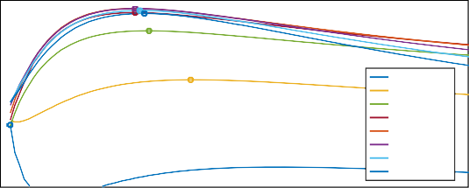
The choice of parameters - The solidity
Even if the solidity is a key parameter for the performances of the machine, keeping into a reasonable range suggested by the theory, it not influences too much the efficiency.
From the analysis of the previous graphs seems reasonable to pick a value of the solidity of 1.225;
Solidity σ = 1.225
0.94
0.93
0.92
0.91
0.9
0.89
0.88
0.87
0.86
0.85
0.84
0.83
etaTT
nStages = 1
nStages = 2
nStages = 3
nStages = 4
nStages = 5
nStages = 6
nStages = 7
nStages = 8
0.6 0.8 1 1.2 1.4 1.6 1.8 2 2.2
solidity
2.4 2.6 2.8 3
38 of 62

Slide 39
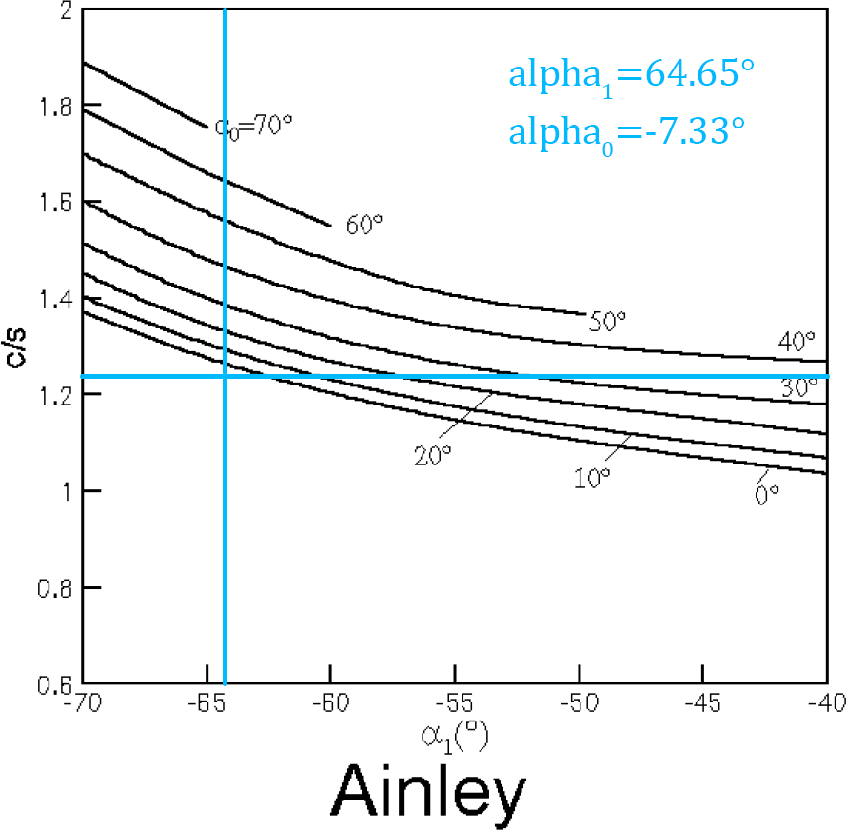
The choice of parameters - The solidity
Comparison of the solidity
with loading criterion of Ainley. As we see in figure 4 the value that we take is very similar
to that predicted by the Ainley loading criterion.
Figure: Ainley criterion

Slide 40
The choice of parameters - The reaction degree
The reaction degree at midspan is also a relevant parameter.
If too low, the stator is too loaded.
If too high the load is mainly on the rotor.
From the theory we know that a mean between this two extreme condition let to have a good result.
So we check what is the reaction degree that gives the better performances around χ = 0.5.

Slide 41
The choice of parameters - The reaction degree
A good value for χ seams to be 0.47, just a bit less than 0.5.
0.94
0.93
0.92
0.94
 |  |  |  |  |  |  |  | n = 3000 n = 4500 n = 6000 n = 7500 n = 9000 n = 10500 n = 12000
0.93
0.91
0.92
0.9
0.91
0.89
0.9
etaTT
0.88
etaTT
nStages = 1
nStages = 2
nStages = 3
nStages = 4
nStages = 5
nStages = 6
nStages = 7
nStages = 8
0.89
0.87
0.86
0.88
0.85
0.87
0.84
0.83
0.86
0.82
0.36 0.38 0.4 0.42 0.44 0.46 0.48 0.5 0.52 0.54
chiMID
0.85
0.36 0.38 0.4 0.42 0.44 0.46 0.48 0.5 0.52 0.54
chiMID

Slide 42
The choice of parameters - The reaction degree
It is also interesting to analyse the graphs in a reverse way, to start to check the best value for the number of stages and the rotational speed.
0.94
0.94
 |  |  | chiMID |  |  | = | 0.35
 |  |  | chiMID |  |  | = | 0.4
 |  |  | chiMID |  |  | = | 0.45
 |  |  | chiMID |  |  | = | 0.55
0.93
0.92
 |  |  | chiMID = 0.35 chiMID = 0.4
 |  |  | chiMID = 0.5 chiMID = 0.55
0.93
0.92
0.91
0.91
0.9
0.89
0.88
etaTT
etaTT
0.9
0.89
0.87
0.86
chiMID = 0.45
0.88
chiMID = 0.5
0.87
0.85
0.3 0.45 0.6 0.75 0.9 1.05 1.2
1
2 3
4
5
6
7
8
nStages
rotational speed(rpm)
·10⁴
42 of 62

Slide 43
The choice of parameters - Clearance and seals
From 1 to 2 seals we have a good increase in efficiency that is decreases so we take 2 seals per rotor.
0.96
0.95
0.94
0.93
0.92
0.91
0.9
0.89
0.88
0.87
0.86
0.85
0.84
0.83
0.82
0.96
0.95
0.94
0.93
0.92
0.91
0.9
0.89
0.88
0.87
0.86
0.85
0.84
0.83
etaTT
etaTT
^{seals}n^{um = 1}
^{seals}n^{um = 2}
^{seals}n^{um = 3}
^{seals}n^{um = 4}
^{seals}n^{um = 5}
^{seals}n^{um = 6}
^{seals}n^{um = 7}
nStages = 1
nStages = 2
nStages = 3
nStages = 4
nStages = 5
nStages = 6
^{seals}n^{um = 8}
nStages = 7
nStages = 8
^{seals}n^{um = 9}
^{seals}n^{um = 10}
5 6 7
2
4
6
8
10
0.82
1
2
3
4
8
^{seals}n^{um}
nStages
43 of 62

Slide 44
The choice of parameters - Clearance and seals
Decreasing the clearance the efficiency increases. We take as clearance k ≈ 0.02 · b ≈ 0.5 mm.
0.96
0.95
0.94
0.95
0.94
0.93
0.92
0.91
0.9
0.89
0.88
0.87
0.86
0.85
0.84
0.83
0.82
0.81
0.8
0.93
0.92
0.91
etaTT
0.9
etaTT
0.89
nStages = 1
nStages = 2
nStages = 3
nStages = 4
nStages = 5
nStages = 6
nStages = 7
nStages = 8
n = 3000
0.88
n = 4500
n = 6000
n = 7500
n = 9000
n = 10500
n = 12000
0.87
0.86
0.85
0.84
0.2
0.4
0.6
0.8
1
0.2
0.4
0.6
0.8
1
clearance
·10⁻³
clearance
·10⁻³
44 of 62

Slide 45
The choice of parameters - Stages and speed
For any number of stages exists a proper value of the rotational speed that let to reach almost the same efficiency. Critical decision:
⇒ at 3000rpm, good efficiency for over 10 stages.
⇒ for 2 stages, good efficiency for n above 10000 rpm.
0.95
0.94
0.93
0.92
0.91
0.9
0.89
0.88
0.87
0.86
0.85
0.84
0.83
0.82
0.81
0.8
0.79
0.78
0.77
0.76
0.75
0.95
0.94
0.93
0.92
0.91
0.9
0.89
0.88
0.87
0.86
0.85
0.84
0.83
0.82
0.81
0.8
0.79
0.78
0.77
0.76
0.75
etaTT
etaTT
nStages = 1
nStages = 2
nStages = 3
nStages = 4
nStages = 5
n = 3000
n = 4500
n = 6000
n = 7500
nStages = 6
n = 9000
nStages = 7
nStages = 8
n = 10500
n = 12000
0.4
0.6
0.8
1
1.2
10⁴
2
4
6
8
nStages
10 12
14
45 of 62
n

Slide 46
The choice of parameters - Stages and speed and phi
For φ = 0.4469 we have the optimal efficiency at:
⇒ 4 stages;
⇒ n = 6000 rpm;
0.94
 |  |  |  | nStages = 3 nStages = 4 nStages = 5
0.94
 |  |  |  |  | n = 4000 n = 4500 n = 5000 n = 5500 n = 6000 n = 6500 n = 7000
0.93
0.93
0.92
0.92
0.91
0.91
etaTT
0.9
etaTT
0.9
0.89
0.88
0.89
0.87
0.88
0.86
0.87
0.85
0.4469 0.6
0.8
1
1.2
1.4
0.86
0.4469 0.6
0.8
1
1.2
1.4
phi
phi

Slide 47
The design of the blades
The blades are designed according two different rules:
NACA 4-digits for the mean line;
A₃K₇ for the thickness.
0.6
0.4
0.2
0
−0.2
0 0.2 0.4 0.6 0.8 1 1.2 1.4 1.6 1.8 2 2.2
Figure: Example of a rotor blade with max thickness over chord of 0.2

Slide 48
The design of the blades - The mean line
Calling m the maximum of the mean line and p the position between 0 and 1 at which the maximum is present, the equation of the mean line are represented by a parabola.

m _{p}2

2

(2 p x − x ) for x < p
B =
m

2

(1 − 2 p + 2 p x − x ) for x ≥ p
(1 − p)
2
The advantage of this approach is that we can easily calculate everything we want of the mean line like the slope or the osculating circle radius.
It is reasonable to take p = 0.4.

Slide 49
The design of the blades - The mean line
We miss the parameter m.
We can obtain it from the camber angle required and from p.
tan α₀ + tan α₁
1 − tan α₀ tan α₁
tan θ = tan(α + α ) =
(32)
0 1
Where tan α₀ = ^{2 m} and tan α₁ = ^{2 m} .
p 1−p
Finally m is the solution of the following equation.
4 tan(θ) m² + 2 m + p (p − 1) · tan θ = 0
(33)

Slide 50
The design of the blades - The thickness
Since the points are quite rough we apply a spline interpolation to get a smoother profile.
To find the top and bottom points of the blade we project the thickness perpendicular to the mean line
x_{up} = x − t · sin(tan⁻¹(y_{c}' ))
y_{up} = x + t · sin(tan⁻¹(y_{c}' ))
x_{down} = x + t · sin(tan⁻¹(y_{c}' )) (34)
y_{down} = x − t · cos(tan⁻¹(y_{c}' )) (35)
x/c(%) | 0 | 1.25 | 2.5 | 5 | 10 | 15 | 20 | 25 | 30 | 35 | 40 45
t/c | 0 | 3.469 | 4.972 | 6.916 | 9.007 | 9.827 | 10 | 9.699 | 9.613 | 9.106 | 8.594 7.913
x/c(%) | 50 | 55 | 60 | 65 | 70 | 75 | 80 | 85 | 90 | 95 | 100
t/c | 7.152 | 6.339 | 5.5 | 4.661 | 3.846 | 3.067 | 2.406 | 1.83 | 1.367 | 1.101 | 0
Table: Thickness along the mean line.

Slide 51
The design of the blades - The deviation
Even if the blades drive the flow, at the trailing edge we have just one side that keep it in the desired direction.
⇒ The flow deviates.
Theroretical 1D approach can provide the result, but the semi-experimental correlations are more reliable.
Ainley and Mathieson provide a correlation for the deviation given:
the geometrical angle;
the curvature of the suction side e²;
the mach number if greater than 0.5.
²We approximate it by computing the radius of the circumference passing
through the last 3 points of the mean line.

Slide 52
The design of the blades - The deviation
We know how to calculate the real flow angle from the geometrical angle but we are interested in the opposite process.
We need a specific flow angle that provides the work required by the compression.
⇒ We want to know the geometric angle of the blade.
s
α_{flow} = f (α_{geom}) − 4 _{e(α} (36)
geom
)
In the case M is greater than 0.5 we must apply a further correction. We solve equation 36 by applying the secants method.
From that solution ⇒ design the blade that provides the required work also accounting for the deviation angle.

Slide 53
The results - Losses
Losses of the four stages for the stators and the rotors.
10
Profile losses Secondary losses Clearance losses
10
Profile losses Secondary losses Clearance losses
8
8
Losses in %
6
Losses in %
6
4
4
2
2
0
1
2
3
4
0
1
2
3
4
Stage
Stage

Slide 54
The results - Profile losses along the span
Losses of the four stages for the stators and the rotors.
2.1
1.6
2
1.58
Profile losses (in %)
Profile losses (in %)
1.9
1.56
1.8
1.54
1.7
Stator 1
1.52
Rotor 1
Stator 2
Stator 3
Stator 4
Rotor 2
Rotor 3
Rotor 4
1.6
0
0.2
0.4 0.6
Span coordinate
0.8
1
1.5
0
0.2
0.4 0.6
Span coordinate
0.8
1
54 of 62

Slide 55
The results - TS transformation
Representation of the stages in the T-S plane and the comparison with the liquid vapour curve.
1,000
960
940
800
920
Temperature T (K)
Temperature T (K)
600
900
880
400
860
840
200
820
0
0
2
4
6
8
10
800
6.96 6.97
6.97 6.98 6.98 6.99
Entropy s
Entropy s
54 of 62

Slide 56
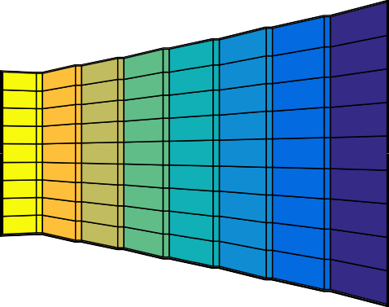
The results - The temperature
0.54
0.53
0.52
0.51
0.5
0.49
960
940
920
900
880
860
840
0.48
0
1
2
3
4
5
6
₁₀−2
56 of 62

Slide 57
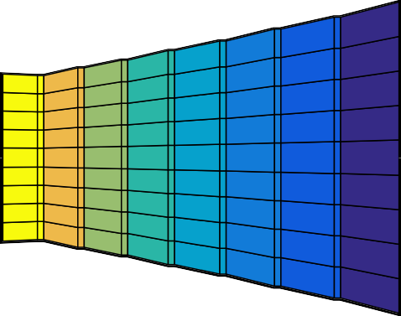
The results - The pressure
0.54
0.53
0.52
0.51
0.5
0.49
140
130
120
110
100
90
80
70
0.48
0
1
2
3
4
5
6
₁₀−2
56 of 62

Slide 58
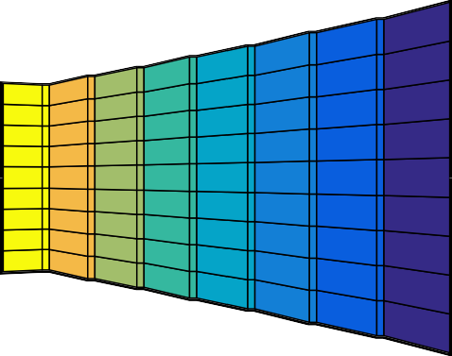
The results - The density
0.54
34
0.53
32
30
0.52
28
0.51
26
24
0.5
22
0.49
20
0.48
0
1
2
3
4
5
6
18
₁₀−2
58 of 62

Slide 59








The results - The cascade
10
8
6
4
2
0
0
2
4
6
8
10
12
14
62 of 62

Slide 60
Table: Stator properties
Stage | Blades | Solidity | β | Blade h.(m) | Inlet M | C_{p}
1 | 156 | 1.219 | 1.121 | 0.025 | 0.194 | 2524.1
2 | 131 | 1.217 | 1.124 | 0.027 | 0.463 | 2480.5
3 | 110 | 1.223 | 1.130 | 0.033 | 0.473 | 2437.8
4 | 91 | 1.220 | 1.136 | 0.039 | 0.484 | 2395.9
Table: Rotor properties
Stage | Blades | Solidity | β | Blade h.(m) | Inlet M_{w} | C_{p}
1 | 143 | 1.223 | 1.110 | 0.025 | 0.198 | 2501.2
2 | 119 | 1.214 | 1.114 | 0.030 | 0.202 | 2458.2
3 | 99 | 1.214 | 1.119 | 0.036 | 0.207 | 2415.8
4 | 82 | 1.218 | 1.125 | 0.043 | 0.212 | 2374.3
Table: Stage properties
Stage | χ | ηT T | β | βT T
1 | 0.461 | 0.927 | 1.244 | 1.240
2 | 0.465 | 0.930 | 1.252 | 1.251
3 | 0.465 | 0.933 | 1.264 | 1.263
4 | 0.465 | 0.936 | 1.278 | 1.276
Total | - | 0.936 | 2.518 | 2.500
62 of 62

Slide 61
Further develops
Compare constant angle with other methodologies;
Iterate to guarantee the required work along the span;
Different solidity for the rotor and the stator;
Variable χ with stages (lower in the first stages);
Off-design performances;
Mechanical analysis
Optimize rotor internal diameter.
Vibration analysis and natural frequencies.
Apply more refined losses correlation.
Clearance design;
Cost/performance comparison between 3000 and 6000 rpm.
62 of 62

Slide 62
62 of 62

