Slide 1
TP2 Overview Trusted PaaS Environment for Containerized Services
SRSC 2017/2018
2nd Semester

Slide 2
Outline for TP2 Specification
TP2 Objectives
System model and architecture
Client / Outsourced Platform as a Service
Platform Software Stack
Adversary Model
Targeted solution: Platform Service Stack Components
Technology
Deployment
Complementary Specifications and experimental evaluation

Slide 3
Outline for TP2 Specification
TP2 Objectives
System model and architecture
Client / Outsourced Platform as a Service
Platform Software Stack
Adversary Model
Targeted solution and Platform for Outsourced Service Stack Components
Technology
Deployment
Complementary Specifications and experimental evaluation

Slide 4
TP2 Objectives
Development of a Trustable REDIS-Enabled Platform “as a service” (PaaS) with Attestation Guarantees, to run a Privacy Enhanced REDIS Key Value Store (KVS) Repository
Clients can use the REDIS KVS with attestation of the Platform: with the trust and privacy required guarantees
Motivation (motto): approach to GDPR compliance conditions in preparing a platform for Cloud-Based Outsourced Computing and Storage

Slide 5
TP2 Motivations (motto background)
GDPR Compliance: https://www.eugdpr.org
TP2 Focus: Enforcement for
Controller and Processor:
Chap. 4, Sect. 1 Art. 25, Sect. 2 Art. 43
Attestation provided to clients / data owner (auditable client-control)
Support “by design and in runtime” for Integrity and Confidentiality

Slide 6
Real example (GDPR conditions)
Text to customers from a real case: “O tratamento de dados pessoais visa que seja garantida a sua segurança, incluindo a proteção contra tratamento não autorizado ou ilícito bem como contra a sua perda, destruição ou danificação acidental”
So, we will address this type of conditions “by design” but adding a client-enabled auditing and control support, client-control on privacy conditions, including independence against possible “vendor lock-in” practices

Slide 7
Outline for TP2 Specification
TP2 Objectives
System model and architecture
Client / Outsourced Platform as a Service
Platform Software Stack
Adversary Model
Targeted solution and Platform for Outsourced Service Stack Components
Technology
Deployment
Complementary Specifications and experimental evaluation

Slide 8
System model: reference deployment environment
Java-Based
Client Application
Remote Micro-Services
(outsourcing computing base)
Micro Service
Remote Operation
Platform:
Software
Stack
Client
PAAs Stack
Attestation
Protocol
Client Machine
Server Machine
PaaS
Trusted Environment
(Client-Side)
Server-Side
Outsourced Software Stack Platform “as a Service”

Slide 9
Reference platform (PaaS): Software Stack
Service
Containers
Docker Enabled
Micro Services
GUEST OS
Execution Environment
Docker Plat.
2nd Level of
Virtualization
DOCKER ENGINE
JRE
OpenJDK 8
THE FULL PaaS STACK
Guest OS
Linux DISTR OS
Virtualization
(Hypervisor)
Virtual Box or
VMWare
1st Level of
Virtualization
DOCKER ENGINE
OpenJDK 8 or
Oracle JDK 8
JRE
Host OS
HOST MACHINE
HW

Slide 10
Outline for TP2 Specification
TP2 Objectives
System model and architecture
Client / Outsourced Platform as a Service
Platform Software Stack
Adversary Model
Targeted solution and Platform for Outsourced Service Stack Components
Technology
Deployment
Complementary Specifications and experimental evaluation

Slide 11
Adversary model conditions
X.800 Attack Types in the Communication Channel between client and platform
Protection: Mutual Authenticated TLS with Adjustable/Parameterizable TLS Ciphersuites for the TLS Session Context
Internal Adversaries (or Intrusders) in the Infrastructure running the Platform:
“Honest but Curious” (HbC) adversaries (internal System Administrators or external Hackers that can cause intrusions (being able to obtain, illicitly, root/sysadmin privileges )
Data-leakage / Confidentiality Threats: KVS data
Integrity compromises of the Platform SW Stack
Protection: Operations (GET/SET/ERASE) in the KVS REDIS service will be supported on “always” encrypted data with keys managed only in the client-side
Users/client SW (and all its computing base) are TRUSTED

Slide 12
Outline for TP2 Specification
TP2 Objectives
System model and architecture
Client / Outsourced Platform as a Service
Platform Software Stack
Adversary Model
Targeted solution and Platform for Outsourced Service Stack Components
Technology
Deployment
Complementary Specifications and experimental evaluation

Slide 13
REDIS as a Platform Micro Service
Service
Containers
Docker Enabled
Micro Services
GUEST OS
Execution Environment
Docker Plat.
2nd Level of
Virtualization
DOCKER ENGINE
JRE
OpenJDK 8
THE FULL PaaS STACK
Guest OS
Linux DISTR OS
Virtualization
(Hypervisor)
Virtual Box or
VMWare
1st Level of
Virtualization
DOCKER ENGINE
OpenJDK 8 or
Oracle JDK 8
JRE
Host OS
HOST MACHINE
HW

Slide 14
TP2: Main Idea for Trustability Assumptions
Trust Platform Modules (used as a remote TCB components for Platform Attestation):
HOS-TPM: Host OS TPM Module
GOS-TPM: Guest OS TPM Module
VMS-TPM: Virtual Micro Services TPM Module
Both provide (at different levels of abstraction):
A Measured (Authenticated) Boot evidence of the remote platform
Attestation protocol for the scrutiny of client applications using the remote platform “as a service”

Slide 15
The Platform “as a Service” (PaaS)
Basically, it will provide a Virtualized Environment to run sandboxes of services, as trusted containerized services
For TP2 purpose we will consider to provide a Key-Value-Store as a Service: REDIS
https://redis.io
REDIS is one of the best and more Popular KVS currently used in industry
See
https://db-engines.com/en/ranking/key-value+store
https://www.g2crowd.com/categories/key-value-stores
https://www.infoworld.com/article/3223728/nosql/nosql-standouts-the-best-key-value-databases-compared.html

Slide 16
Case-Study Implementation Variants
PaaS provided Services:
Application Level: REDIS enabled Micro Services (in containerized docker components)
Two variants (students can choose):
Remote REDIS Repository Service
KVS Database will be proposed/implemenetd by students
Client is a REDIS Benchmark for operations in the Database
Authentication Server alternative (for TP1)
Reimplementation of the Authentication, Access control and Key / Security associations Distribution for TP1 (implemented with a REDIS-enabled repository)

Slide 17
The two TP2 variants for “application-case study”: demo case-study 1
A JAVA client benchmarking on a REDIS-Based KVS repository
A KVS table with 1000 entries
You can design and choose the content of the KVS
Some suggestions:
A Database to store blood tests (as Electronic Medical Records) of different persons
A Database with the salary mass of the players of a football team (or employees of a company)
Balances and movements (payments, withdrawals, credits) in a bank account of a customer of a bank

Slide 18
The two TP2 variants for “application-case study”: demo case-study 2
Improvement of your TP1 context – in this case you will implement the REDIS Key Value Store to manage DATA for the Authentication Service and a Docker-based Java Micro-Service to implement the Authetication and Access Control Service

Slide 19
The required “PaaS” (Platform “as a service”)
For Both Variants
See TP2 information for the initial deployment
and setup components in:
asc.di.fct.unl.pt/~hj/srsc/aulas-praticas

Slide 20
REDIS as a Platform Micro Service
Service
Containers
Docker Enabled
Micro Services
GUEST OS
Execution Environment
Docker Plat.
2nd Level of
Virtualization
DOCKER ENGINE
JRE
OpenJDK 8
THE FULL PaaS STACK
Guest OS
Linux DISTR OS
Virtualization
(Hypervisor)
Virtual Box or
VMWare
1st Level of
Virtualization
DOCKER ENGINE
OpenJDK 8 or
Oracle JDK 8
JRE
Host OS
HOST MACHINE
HW

Slide 21
REDIS KVS as a Platform Micro Service
CLIENT REDIS
(GET/SET/REMOVE)
Operations
REDIS KVS
REDIS KVS
GUEST OS
Execution Environment
Docker Plat.
2nd Level of
Virtualization
DOCKER ENGINE
JRE
OpenJDK 8
Guest OS
Linux DISTROS
Virtualization
(Hypervisor)
Virtual Box or
VMWare
1st Level of
Virtualization
DOCKER ENGINE
OpenJDK 8 or
Oracle JDK 8
JRE
Host OS
HOST MACHINE
HW

Slide 22
TP1 Auth and Access Control as a Platform Micro Service
CLIENT
Auth + Key
Dist. Service
Auth + Access Control Service
REDIS KVS
Auth and Access
Control Service
GUEST OS
Execution Environment
Docker Plat.
2nd Level of
Virtualization
DOCKER ENGINE
JRE
OpenJDK 8
Guest OS
Linux DISTROS
Virtualization
(Hypervisor)
Virtual Box or
VMWare
1st Level of
Virtualization
DOCKER ENGINE
OpenJDK 8 or
Oracle JDK 8
JRE
Host OS
HOST MACHINE
HW

Slide 23
TPM Levels of the PaaS Attestation
Service
Containers
Authentication and
Integrity Attestation
Services Containers
(Docker-Enabled)
GUEST OS
Execution Environment
DOCKER ENGINE
Authentication and
Integrity Attestation
JRE
Guest OS
Guest OS
BOOT Loader
Virtualization
(Hypervisor)
DOCKER ENGINE
Authentication and
Integrity Attestation
JRE
Host OS
Host OS + Base Services
BOOT Loader
(including BIOS)
HW

Slide 24
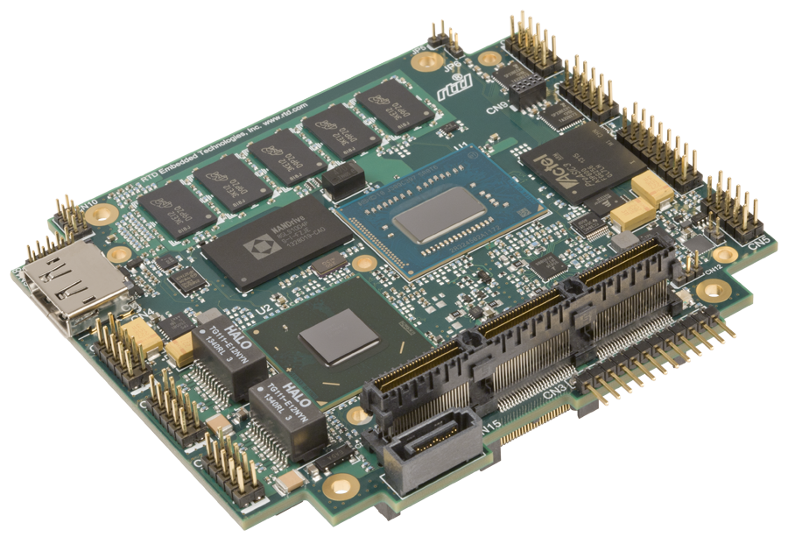
TPMs: GOS-TPM, VMS-TPM and HOS (“HW enabled TPM 2.0)
Service
Containers
Authentication and
Integrity Attestation
VMS
GUEST OS
Execution Environment
DOCKER ENGINE
Authentication and
Integrity Attestation
JRE
JRE
Guest OS
Guest OS
BOOT Loader
GOS
Virtualization
(Hypervisor)
DOCKER ENGINE
Authentication and
Integrity Attestation
JRE
JRE
Host OS
“Truly”
TPM 2 HW Attestation
HW
HOS

Slide 25
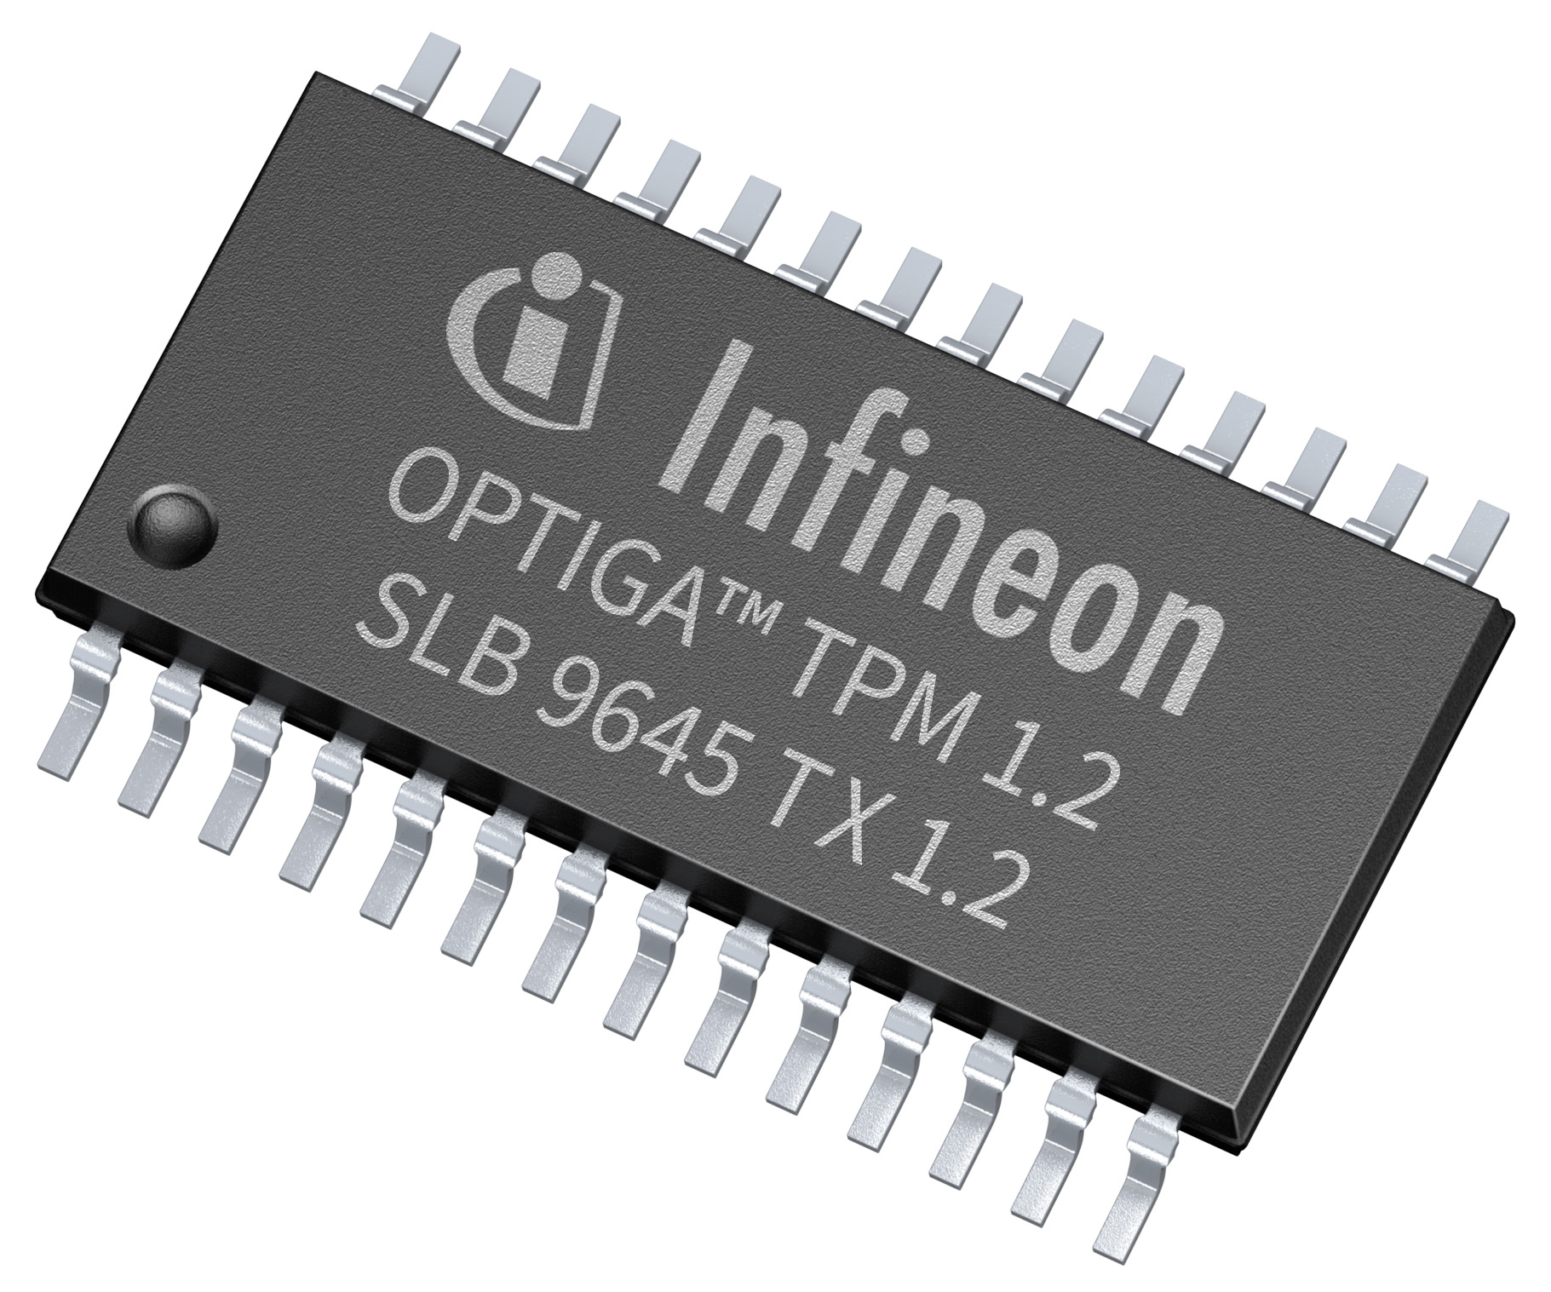
TPM 1.2 (HW Level TPM) (In TP2 we assume it is there)

Slide 26

TP1 Client Model Execution
Sandboxing
Service
Service
Containers
Main App
Client Thread)
VMS
GUEST OS
Execution Environment
DOCKER ENGINE
JRE
JRE
Client
Side SW
(in TP2)
Guest OS
GOS
Virtualization
(Hypervisor)
DOCKER ENGINE
JRE
JRE
Host OS
Attestation
Threads
HW
TLS
HOS

Slide 27
TP1 Client Model Execution
Sandboxing
Service
Service
Containers
Main App
Client Thread)
VMS
GUEST OS
Execution Environment
DOCKER ENGINE
JRE
JRE
Client
Side SW
(in TP2)
Guest OS
GOS
Virtualization
(Hypervisor)
DOCKER ENGINE
JRE
JRE
Host OS
Attestation
Threads
HW
TLS
HOS

Slide 28
TP1 Client Model Execution
Sandboxing
Service
Service
Containers
Main App
Client Thread)
VMS
GUEST OS
Execution Environment
DOCKER ENGINE
JRE
JRE
Client
Side SW
(in TP2)
Guest OS
GOS
Virtualization
(Hypervisor)
DOCKER ENGINE
JRE
JRE
Host OS
Attestation
Threads
HW
TLS
HOS

Slide 29
TP1 Client Model Execution
Service
Invocations
(Operations)
Sandboxing
Service
Service
Containers
Main App
Client Thread)
VMS
GUEST OS
Execution Environment
DOCKER ENGINE
JRE
JRE
Client
Side SW
(in TP2)
Guest OS
GOS
Virtualization
(Hypervisor)
DOCKER ENGINE
JRE
JRE
Host OS
Attestation
Threads
HW
TLS
HOS

Slide 30
Generic Reference for the Solution and Deployment Environment
Java-Based
Client Application
Remote Micro-Services
(outsourcing computing base)
Micro Service
Remote Operation
Platform:
Software
Stack
Client
PAAs Stack
Attestation
Protocol
Client Machine
Server Machine
Trusted Environment
(Client-Side)
Server-Side
Outsourced Software Stack Platform “as a Service”

Slide 31
Outline for TP2 Specification
TP2 Objectives
System model and architecture
Client / Outsourced Platform as a Service
Platform Software Stack
Adversary Model
Targeted solution and Platform for Outsourced Service Stack Components
Technology
Deployment
Complementary Specifications and experimental evaluation

Slide 32
TP2 Specifications
TP2 dates:
Until 12/June/2018
See the complementary TP2 Specifications for development, evaluation and delivering that will be available (CLIP System)

Slide 33
TP2 Evaluation (will be also referred in TP2 specification)
Client will be implemented in order to obtain a performance and latency benchmark (100 operations: SET, GET, ERASE), comparing:
The use of remote REDIS service with no confidentiality (operations on plaintext data)
The use of remote REDIS service with no confidentiality (operations on encrypted data)
Performance and latency overhead due to the attestation protocol

