Slide 1

jUCMNav Milestone Five
Quality Assurance Presentation

Slide 2
Reminder: jUCMNav important scenarios
Identified in Milestone Two:
Create UCM files
Edit UCM files
  Create / edit paths
  Create / edit elements
  Delete elements
Save UCM files
Export graphics

Slide 3
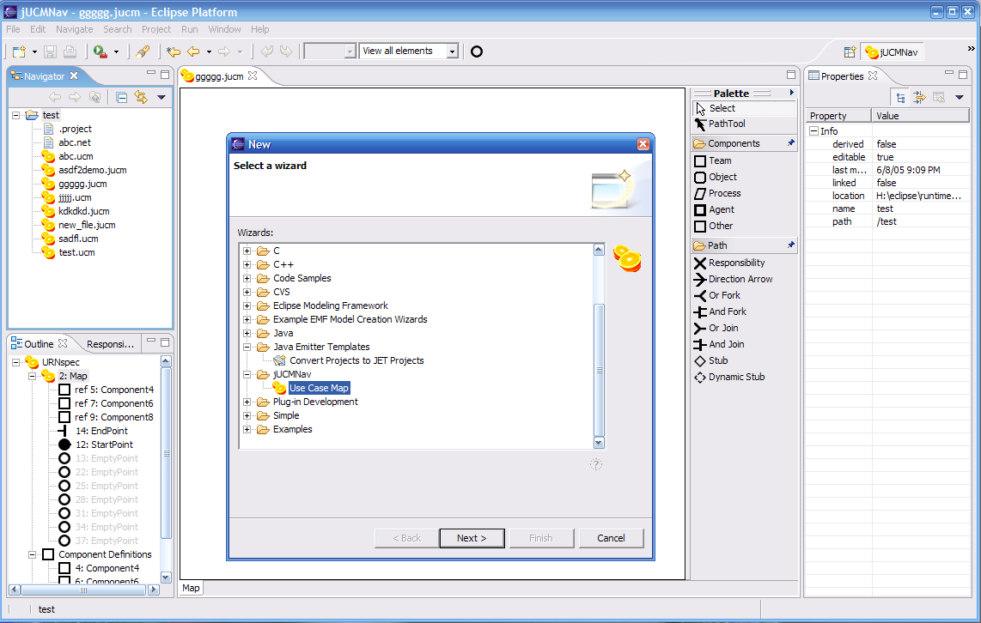
Create UCM Files

Slide 4
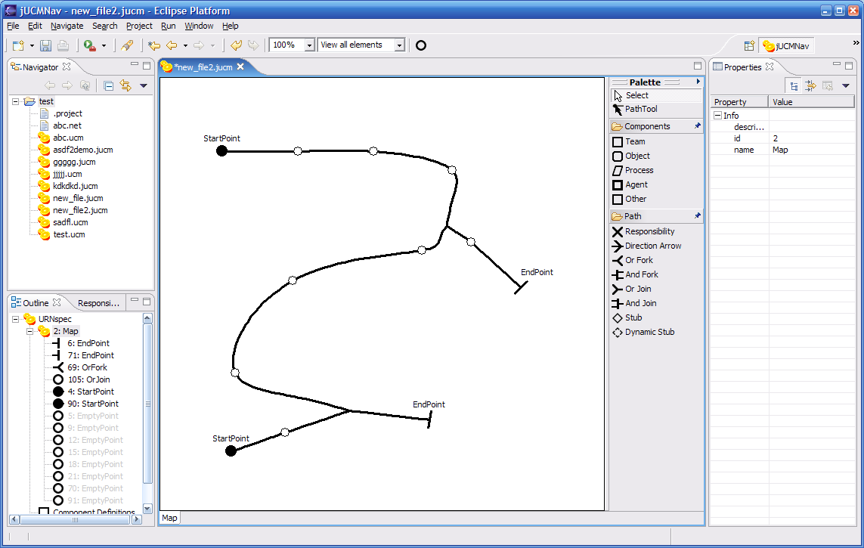
Edit UCM Files (paths)

Slide 5
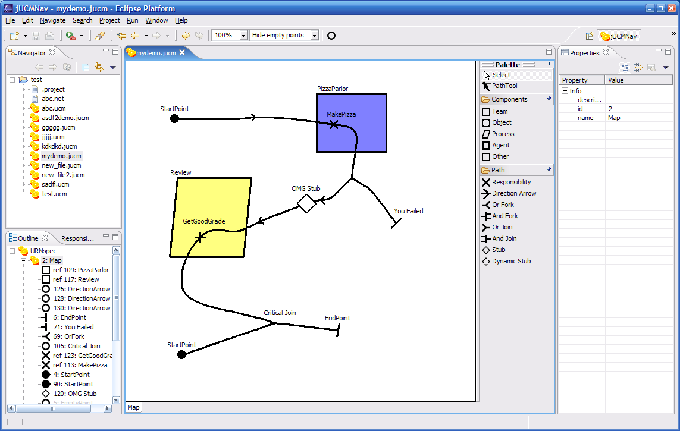
Edit UCM Files (elements)

Slide 6
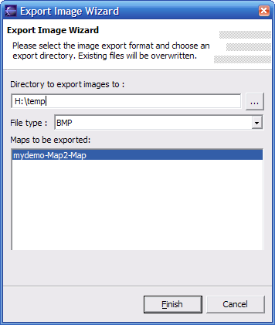
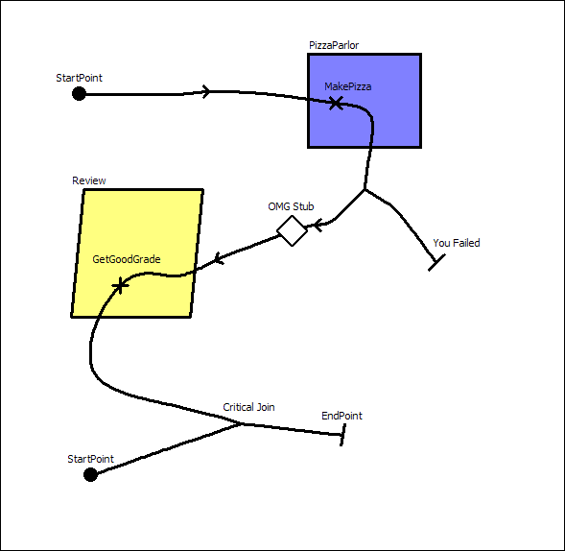
Export Graphics

Slide 7
Quality Assurance Strategy and Test Framework
Back to our initial goals:
Usability, Maintainability, Documentation
Usability
No formal UI tests, but 3 personas will be evaluating Beta1.
Daniel Amyot has rounded up a list of about ten volunteer beta testers!

Slide 8
Quality Assurance Strategy and Test Framework
Maintainability
Dev team members report that enhancing the application is easy!
Documentation is being written to explain to new devs how to enhance the system.
However, the learning curve is steep and unappealing for new developers.

Slide 9
Quality Assurance Strategy and Test Framework
Documentation
Client likes the existing docs so far, but there’s still work to be done.
Our user documentation (first draft) is done, we will be finalizing our dev. documentation during our last iteration.

Slide 10
Continuous Integration
How well does this work for driving quality?
Changes breaking the build are reported immediately, for easily assigning blame.
Unit test failures have flagged unexpected issues.
Defining useful tests in such a large framework is difficult.

Slide 11
Functionality
Does the Beta DO what the client wants?
Yes, weekly meetings with client allow reviewing functionality.
Client feedback is dealt with in the coming week.
During the last iteration, almost daily exchanges

Slide 12
Quality Assurance Report
GEF Commands
  Pre/Post conditions at runtime
  Unit tests
    Perform all commands
    Test saving, undo/redo, bindings
  Very valuable
Progress
  Test our requirements
  Less valuable because often end up testing the framework more than the actual work performed

Slide 13
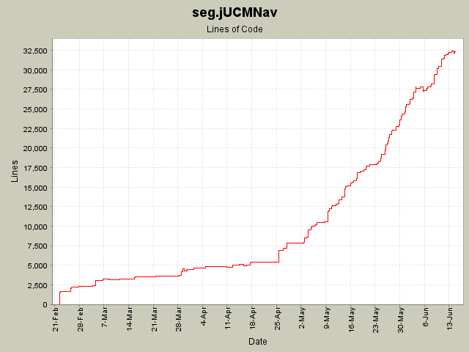
Quality Assurance Report

Slide 14
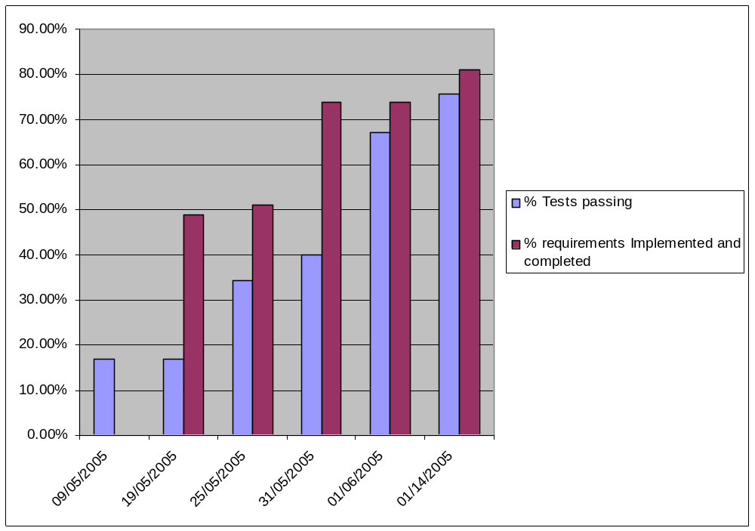
Quality Assurance Report

Slide 15
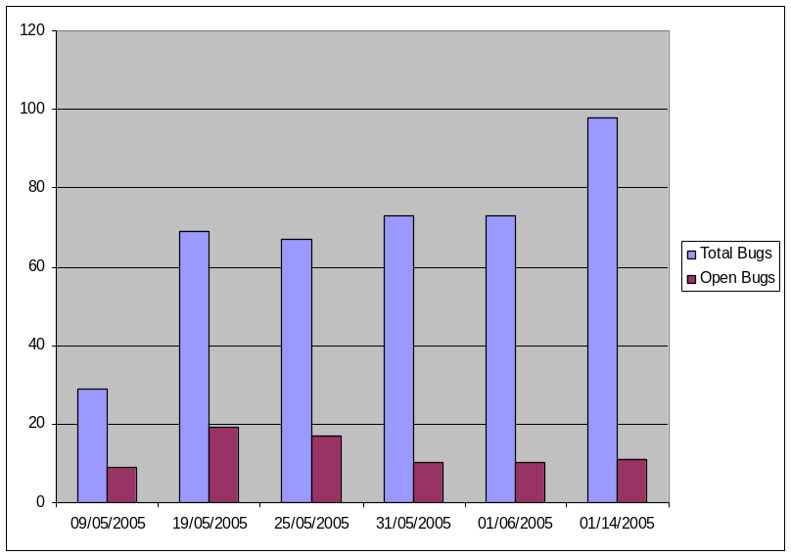
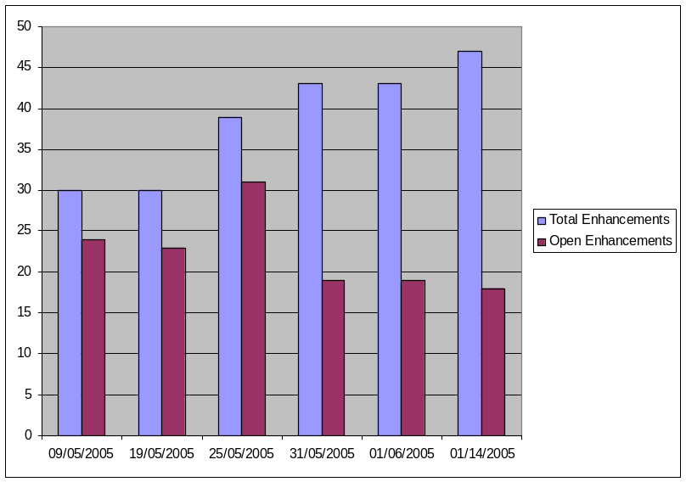
Quality Assurance Report

Slide 16

Deployment
Full build on every commit.
Builds available online.
Client reviews latest at least weekly.

Slide 17
Deployment
Issues we learned:
Carefully track versions of dependencies.
Eclipse sometimes needs to be started with –clean to flush and rebuild cached resources.
Deploying to other platforms (Linux) revealed some unknown bugs!

Slide 18
End-User Deployment
Easy as 1-2-3
Download latest build from usecasemaps.org
Extract archive to Eclipse installation
Restart Eclipse

Slide 19
Client Deployment
Development transition
Will be transferring CVS/TWiki/BugZilla to newly setup server at SITE
Will offer support to new developers to help transition

Slide 20
Project Plan
Key Tasks Remaining
UCM notation: Missing timers, waiting places, connects.
Better loop management
Developer documentation
Update site creation

