Slide 1
CS639: Data Management for Data Science
Lecture 25: EDA
Theodoros Rekatsinas

Slide 2
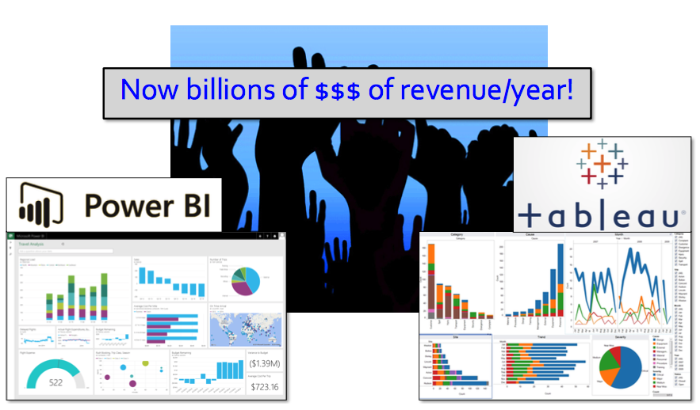
Data Visualizations Today

Slide 3
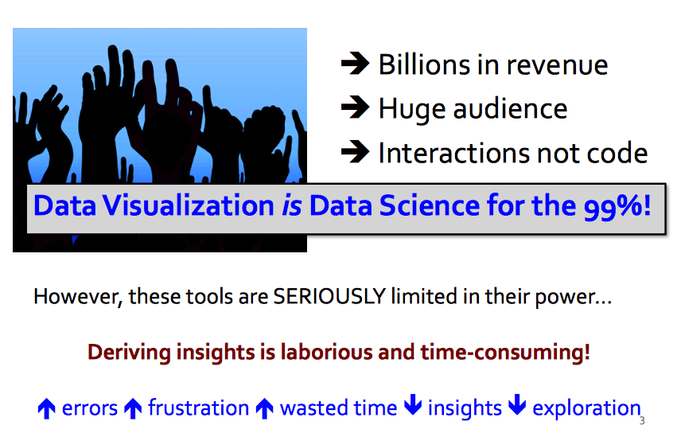
Data Visualizations Today

Slide 4
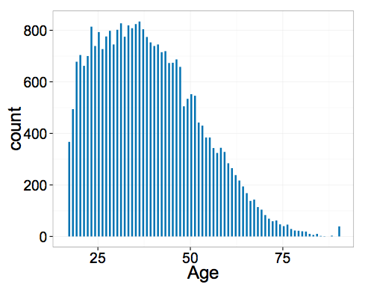
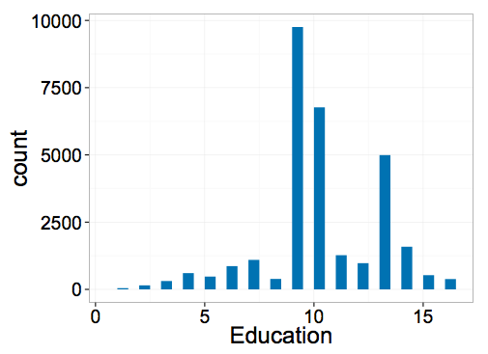
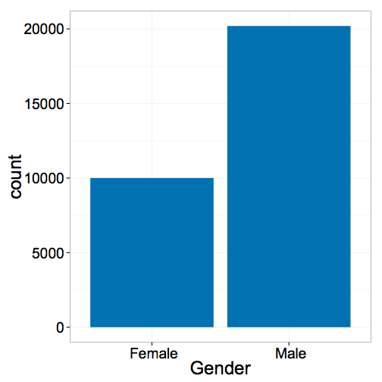
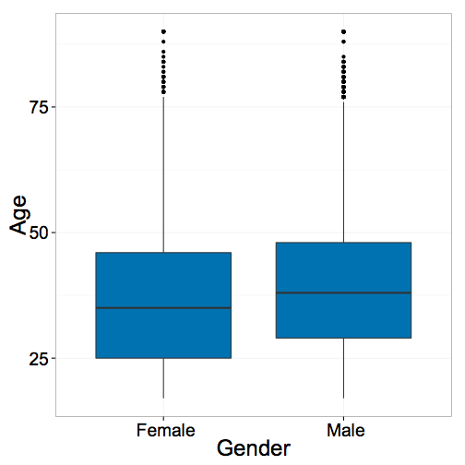
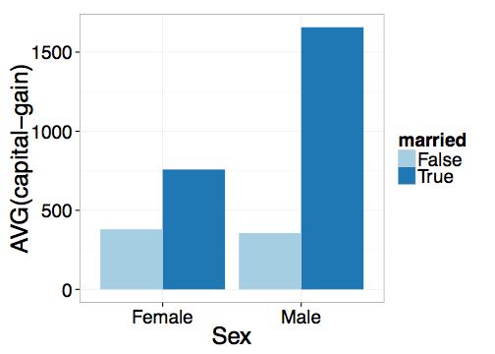
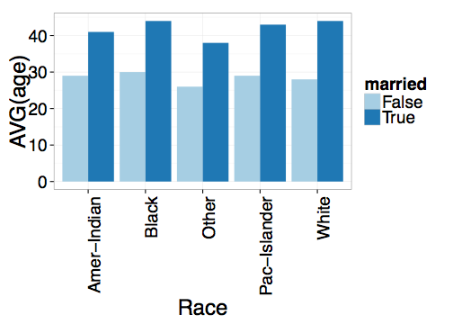
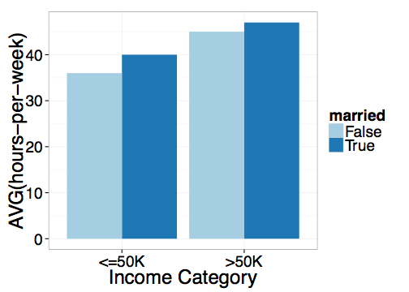
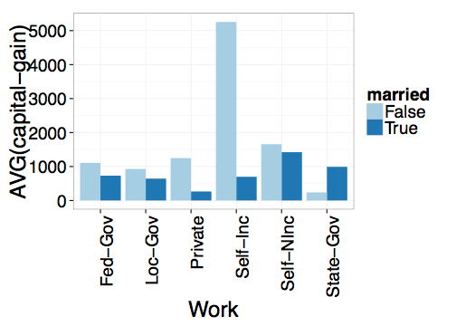
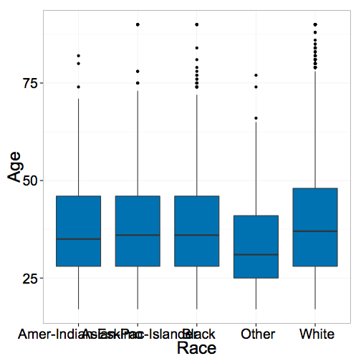
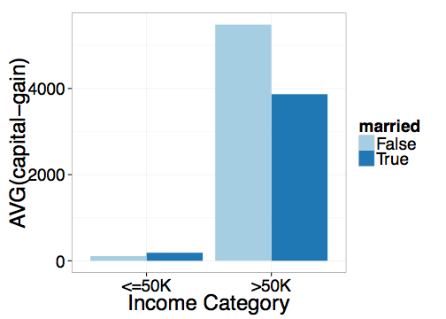
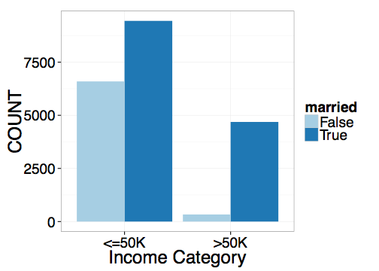
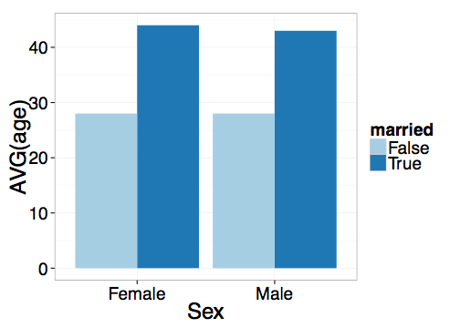
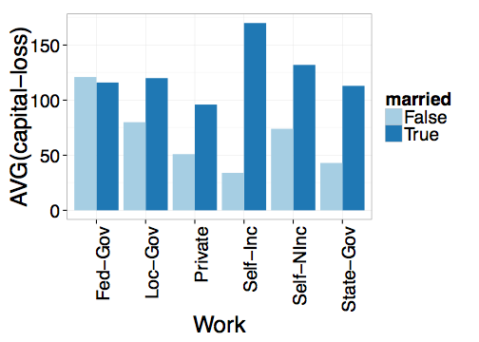
Standard Data Visualization Recipe:
Load dataset into data viz tool
Start with a desired hypothesis/pattern (explore combination of attributes)
Select viz to be generated
See if it matches desired pattern
Repeat 3-4 until you find a match

Slide 5

Tedious and Time-consuming!
Key Issue:
Visualization can be generated by:
varying subsets of data
varying attributes being visualized
Too many visualization to look at to find desired visual patterns!

Slide 6
1. Visualization recommendations

Slide 7
What you will learn about in this section
Space of Visualizations
Recommendation Metrics

Slide 8
Goal
Given a dataset and a task, automatically produce a set of visualizations that are the most “interesting” given the task
Particularly vague

Slide 9
Goal
Given a dataset and a task, automatically produce a set of visualizations that are the most “interesting” given the task

Slide 10
Example
Data analyst studying census data
age, education, marital-status, sex, race, income, hours-worked etc.
A = # attributes in table
Task: Compare on various socioeconomic indicators, unmarried adults vs. all adults

Slide 11
Space of visualizations
For simplicity, assume a single table (star schema)
Visualizations = agg. + grp. by queries
Vi = SELECT d, f(m)
FROM table
WHERE ___
GROUP BY d
(d, m, f):
dimension, measure, aggregate

Slide 12
Space of visualizations
Vi = SELECT d, f(m)
FROM table
WHERE ___
GROUP BY d
(d, m, f):
dimension, measure, aggregate
{d} : race, work-type, sex etc.
{m} : capital-gain, capital-loss, hours-per-week
{f} : COUNT, SUM, AVG

Slide 13
Goal
Given a dataset and a task, automatically produce a set of visualizations that are the most “interesting” given the task

Slide 14
Interesting visualizations
A visualization is interesting if it displays
a large deviation from some reference
Task: compare unmarried adults with all adults
Deviation-based Utility
Target
Reference
V1 = SELECT d, f(m) FROM table WHERE target GROUP BY d
V2 = SELECT d, f(m) FROM table WHERE reference GROUP BY d
V₁
V₁
Compare induced probability distributions!
V₂
V₂

Slide 15
Deviation-based Utility Metric
A visualization is interesting if it displays
a large deviation from some reference
Many metrics for computing distance between distributions
D [P( V1), P(V2)]
Earth mover’s distance
L1, L2 distance
K-L divergence
Any distance metric b/n distributions is OK!
V₁
V₂

Slide 16
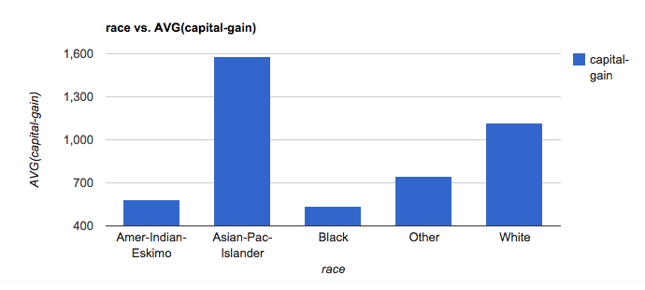
Computing Expected Trend
Race vs. AVG(capital-gain)
_{Reference Trend}
SELECT race, AVG(capital-gain) FROM census GROUP BY race
P(V₁)
Expected
Distribution

Slide 17
Computing Actual Trend
Race vs. AVG(capital-gain)
_{TargetTrend}
SELECT race, AVG(capital-gain) FROM census GROUP BY race WHERE marital-status=‘unmarried’
P(V₂)
Actual Distribution

Slide 18
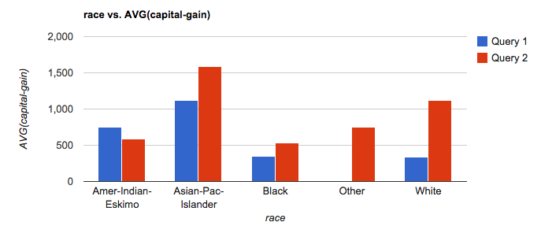
Computing Utility
U = D[P(V₁) , P(V₂)]
D = EMD, L2 etc.

Slide 19

Low Utility Visualization
Actual
Expected

Slide 20
High Utility Visualization
Actual
Expected

Slide 21
Other metrics
Data characteristics
Task or Insight
Semantics and Domain Knowledge
Visual Ease of Understanding
User Preference

Slide 22
2. DB-inspired Optimizations

Slide 23
What you will learn about in this section
Ranking Visualizations
Optimizations

Slide 24
Ranking
Across all (d, m, f), where
V1 = SELECT d, f(m) FROM table WHERE target GROUP BY d
V2 = SELECT d, f(m) FROM table WHERE reference GROUP BY d
Vi = (d: dimension, m: measure, f: aggregate)
10s of dimensions, 10s of measures, handful of aggregates
2* d * m * f
100s of queries for a single user task!
Can be even larger. How?
Goal: return k best utility visualizations (d, m, f),
(those with largest D[V1, V2])

Slide 25
Even larger space of queries
Binning
3 dimensional or 4 dimensional visualizations
Scatterplot or map visualizations
…

Slide 26
Back to ranking
Across all (d, m, f), where
V1 = SELECT d, f(m) FROM table WHERE target GROUP BY d
V2 = SELECT d, f(m) FROM table WHERE reference GROUP BY d
Goal: return k best utility visualizations (d, m, f),
(those with largest D[V1, V2])
Naïve Approach
For each (d, m, f) in sequence
evaluate queries for V1 (target), V2 (reference)
compute D[V1, V2]
Return the k (d, m, f) with largest D values

Slide 27
Issues with Naïve Approach
Repeated processing of same data in sequence across queries
Computation wasted on low-utility visualizations
Sharing
Pruning

Slide 28
Optimizations
Each visualization = 2 SQL queries
Latency > 100s
Minimize number of queries and scans

Slide 29
Optimizations
Combine aggregate queries on target and ref
Combine multiple aggregates
(d1, m1, f1), (d1, m2, f1) → (d1, [m1, m2], f1)
Combine multiple group-bys*
(d1, m1, f1), (d2, m1, f1) → ([d1, d2], m1, f1)
Could be problematic…
Parallel Query Execution

Slide 30
Combining Multiple Group-by’s
Too few group-bys leads to many table scans
Too many group-bys hurt performance
# groups = Π (# distinct values per attributes)
Optimal group-by combination ≈ bin-packing
Bin volume = log S (max number of groups)
Volume of items (attributes) = log (|a_{i}|)
Minimize # bins s.t.
Σ_{i} log (|a_{i}|) <= log S

Slide 31
Pruning optimizations
Discard low-utility views early to avoid wasted computation
Keep running estimates of utility
Prune visualizations based on estimates
Two flavors
Vanilla Confidence Interval based Pruning
Multi-armed Bandit Pruning

Slide 32
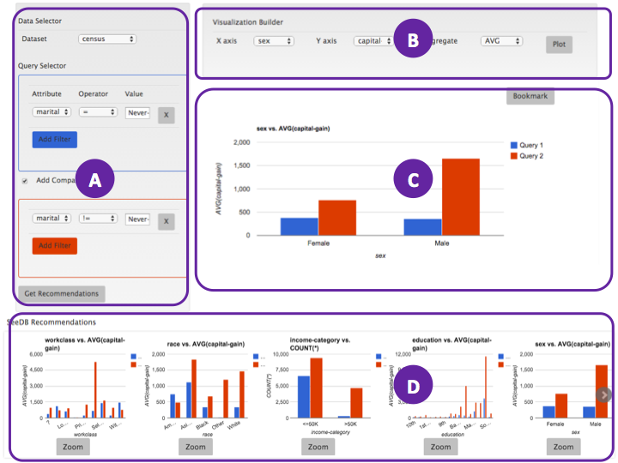
Visualizations
Middleware
Layer
Queries (100s)
Optimizer
DBMS
Sharing
Pruning

Slide 33
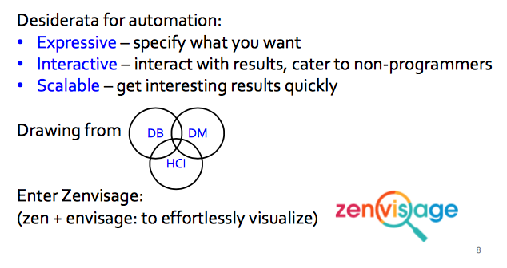
More on automated visualizations

Slide 34
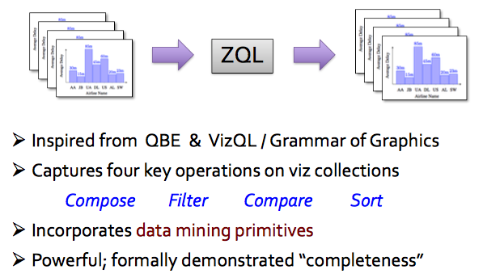
ZQL: a viz exploration language

Slide 35
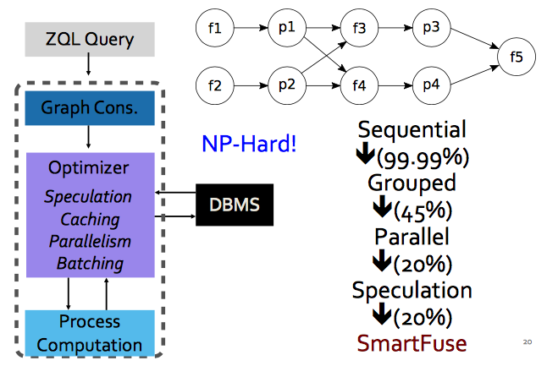
Intelligent query optimizer

Slide 36
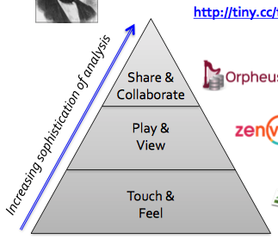
Summary
Human in the loop analytics are here to stay!

