Slide 1
CS639: Data Management for Data Science
Lecture 23: Data Cleaning
[based on slides by John Canny]
Theodoros Rekatsinas

Slide 2
Dirty Data
The Statistics View:
There is a process that produces data
We want to model ideal samples of that process, but in practice we have non-ideal samples:
Distortion – some samples are corrupted by a process
Selection Bias - likelihood of a sample depends on its value
Left and right censorship - users come and go from our scrutiny
Dependence – samples are supposed to be independent, but are not (e.g. social networks)
You can add new models for each type of imperfection, but you can’t model everything.
What’s the best trade-off between accuracy and simplicity?

Slide 3
Dirty Data
The Database View:
I got my hands on this data set
Some of the values are missing, corrupted, wrong, duplicated
Results are absolute (relational model)
You get a better answer by improving the quality of the values in your dataset

Slide 4
Dirty Data
The Domain Expert’s View:
This Data Doesn’t look right
This Answer Doesn’t look right
What happened?
Domain experts have an implicit model of the data that they can test against…

Slide 5
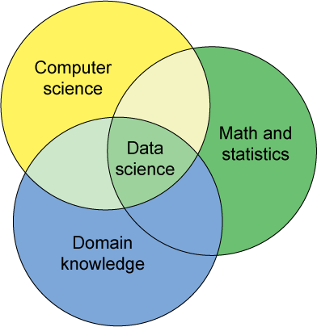
Dirty Data
The Data Scientist’s View:
Some Combination of all of the above

Slide 6
Data Quality Problems
(Source) Data is dirty on its own.
Transformations corrupt the data (complexity of software pipelines).
Data sets are clean but integration (i.e., combining them) screws them up.
“Rare” errors can become frequent after transformation or integration.
Data sets are clean but suffer “bit rot”
Old data loses its value/accuracy over time
Any combination of the above

Slide 7
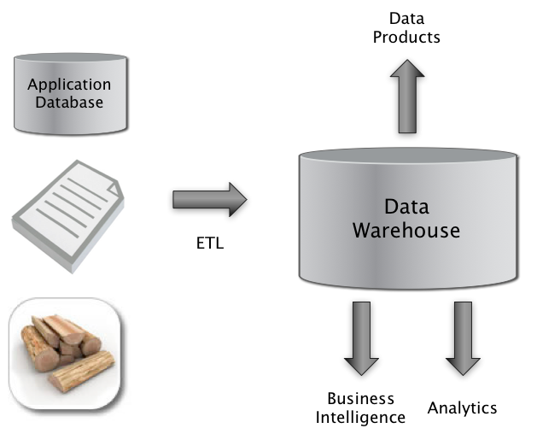

Big Picture: Where can Dirty Data Arise?
Integrate
Clean
Extract
Transform
Load

Slide 8
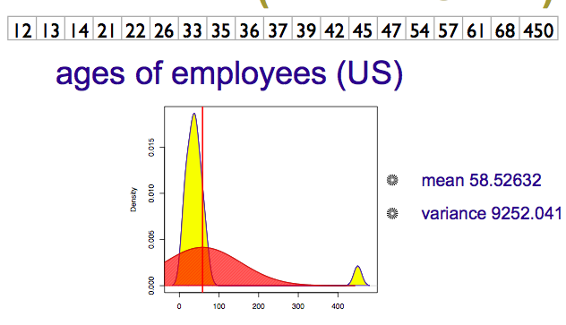

Numeric Outliers
Adapted from Joe Hellerstein’s 2012 CS 194 Guest Lecture

Slide 9
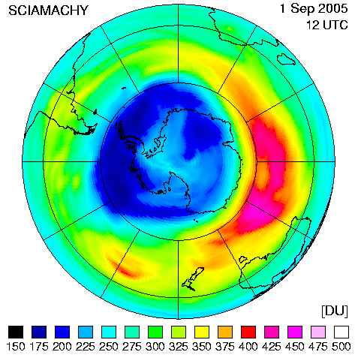
Data Cleaning Makes Everything Okay?
The appearance of a hole in the earth's ozone layer over Antarctica, first detected in 1976, was so unexpected that scientists didn't pay attention to what their instruments were telling them; they thought their instruments were malfunctioning.
National Center for Atmospheric Research
In fact, the data were rejected as unreasonable by data quality control algorithms

Slide 10
Dirty Data Problems
From Stanford Data Integration Course:
parsing text into fields (separator issues)
Naming conventions: ER: NYC vs New York
Missing required field (e.g. key field)
Different representations (2 vs Two)
Fields too long (get truncated)
Primary key violation (from un- to structured or during integration
Redundant Records (exact match or other)
Formatting issues – especially dates
Licensing issues/Privacy/ keep you from using the data as you would like?

Slide 11
Conventional Definition of Data Quality
Accuracy
The data was recorded correctly.
Completeness
All relevant data was recorded.
Uniqueness
Entities are recorded once.
Timeliness
The data is kept up to date.
Special problems in federated data: time consistency.
Consistency
The data agrees with itself.
Adapted from Ted Johnson’s SIGMOD 2003 Tutorial

Slide 12
Problems …
Unmeasurable
Accuracy and completeness are extremely difficult, perhaps impossible to measure.
Context independent
No accounting for what is important. E.g., if you are computing aggregates, you can tolerate a lot of inaccuracy.
Incomplete
What about interpretability, accessibility, metadata, analysis, etc.
Vague
The conventional definitions provide no guidance towards practical improvements of the data.
Adapted from Ted Johnson’s SIGMOD 2003 Tutorial

Slide 13
Finding a modern definition
We need a definition of data quality which
Reflects the use of the data
Leads to improvements in processes
Is measurable (we can define metrics)
First, we need a better understanding of how and where data quality problems occur
The data quality continuum
Adapted from Ted Johnson’s SIGMOD 2003 Tutorial

Slide 14
Meaning of Data Quality (2)
There are many types of data, which have different uses and typical quality problems
Federated data
High dimensional data
Descriptive data
Longitudinal data
Streaming data
Web (scraped) data
Numeric vs. categorical vs. text data
Adapted from Ted Johnson’s SIGMOD 2003 Tutorial

Slide 15
Meaning of Data Quality (2)
There are many uses of data
Operations
Aggregate analysis
Customer relations …
Data Interpretation : the data is useless if we don’t know all of the rules behind the data.
Data Suitability : Can you get the answer from the available data
Use of proxy data
Relevant data is missing
Adapted from Ted Johnson’s SIGMOD 2003 Tutorial
Notes:
Challenge in operations : many handoffs. Some processes more important than others.
Challenge in aggregate analysis: can tolerate errors, but you’re summing up over a lot of data, therefore likely to add in glitched data.
Customer relations : the fields must be accurate, but errors don’t spread.

Slide 16
The Data Quality Continuum
Data and information is not static, it flows in a data collection and usage process
Data gathering
Data delivery
Data storage
Data integration
Data retrieval
Data mining/analysis
Adapted from Ted Johnson’s SIGMOD 2003 Tutorial

Slide 17
Data Gathering
How does the data enter the system?
Sources of problems:
Manual entry
No uniform standards for content and formats
Parallel data entry (duplicates)
Approximations, surrogates – SW/HW constraints
Measurement or sensor errors.
Adapted from Ted Johnson’s SIGMOD 2003 Tutorial
Notes:
MPDS workshop, John Bates

Slide 18
Data Gathering - Solutions
Potential Solutions:
Preemptive:
Process architecture (build in integrity checks)
Process management (reward accurate data entry, data sharing, data stewards)
Retrospective:
Cleaning focus (duplicate removal, merge/purge, name & address matching, field value standardization)
Diagnostic focus (automated detection of glitches).
Adapted from Ted Johnson’s SIGMOD 2003 Tutorial

Slide 19
Data Delivery
Destroying or mutilating information by inappropriate pre-processing
Inappropriate aggregation
Nulls converted to default values
Loss of data:
Buffer overflows
Transmission problems
No checks
Adapted from Ted Johnson’s SIGMOD 2003 Tutorial

Slide 20
Data Delivery - Solutions
Build reliable transmission protocols
Use a relay server
Verification
Checksums, verification parser
Do the uploaded files fit an expected pattern?
Relationships
Are there dependencies between data streams and processing steps
Interface agreements
Data quality commitment from the data stream supplier.
Adapted from Ted Johnson’s SIGMOD 2003 Tutorial

Slide 21
Data Storage
You get a data set. What do you do with it?
Problems in physical storage
Can be an issue, but terabytes are cheap.
Problems in logical storage
Poor metadata.
Data feeds are often derived from application programs or legacy data sources. What does it mean?
Inappropriate data models.
Missing timestamps, incorrect normalization, etc.
Ad-hoc modifications.
Structure the data to fit the GUI.
Hardware / software constraints.
Data transmission via Excel spreadsheets, Y2K
Adapted from Ted Johnson’s SIGMOD 2003 Tutorial

Slide 22
Data Storage - Solutions
Metadata
Document and publish data specifications.
Planning
Assume that everything bad will happen.
Can be very difficult.
Data exploration
Use data browsing and data mining tools to examine the data.
Does it meet the specifications you assumed?
Has something changed?
Adapted from Ted Johnson’s SIGMOD 2003 Tutorial

Slide 23
Data Retrieval
Exported data sets are often a view of the actual data. Problems occur because:
Source data not properly understood.
Need for derived data not understood.
Just plain mistakes.
Inner join vs. outer join
Understanding NULL values
Computational constraints
E.g., too expensive to give a full history, we’ll supply a snapshot.
Incompatibility
Ebcdic? Unicode?
Adapted from Ted Johnson’s SIGMOD 2003 Tutorial

Slide 24
Data Mining and Analysis
What are you doing with all this data anyway?
Problems in the analysis.
Scale and performance
Confidence bounds?
Black boxes and dart boards
Attachment to models
Insufficient domain expertise
Casual empiricism
Adapted from Ted Johnson’s SIGMOD 2003 Tutorial
Notes:
Casual empiricism : use an arbitrary number to support a pre-conception.

Slide 25
Retrieval and Mining - Solutions
Data exploration
Determine which models and techniques are appropriate, find data bugs, develop domain expertise.
Continuous analysis
Are the results stable? How do they change?
Accountability
Make the analysis part of the feedback loop.
Adapted from Ted Johnson’s SIGMOD 2003 Tutorial

Slide 26
Data Quality Constraints
Many data quality problems can be captured by static constraints based on the schema.
Nulls not allowed, field domains, foreign key constraints, etc.
Many others are due to problems in workflow, and can be captured by dynamic constraints
E.g., orders above $200 are processed by Biller 2
The constraints follow an 80-20 rule
A few constraints capture most cases, thousands of constraints to capture the last few cases.
Constraints are measurable. Data Quality Metrics?
Adapted from Ted Johnson’s SIGMOD 2003 Tutorial
Notes:
Dynamic constraints often come from operational databases. But analysis data sets, CRM databases are often derived from operational data.

Slide 27
Data Quality Metrics
We want a measurable quantity
Indicates what is wrong and how to improve
Realize that DQ is a messy problem, no set of numbers will be perfect
Types of metrics
Static vs. dynamic constraints
Operational vs. diagnostic
Metrics should be directionally correct with an improvement in use of the data.
A very large number metrics are possible
Choose the most important ones.
Adapted from Ted Johnson’s SIGMOD 2003 Tutorial
Notes:
Metrics can give incentives for bad behavior : throw away data that doesn’t join.

Slide 28
Examples of Data Quality Metrics
Conformance to schema
Evaluate constraints on a snapshot.
Conformance to business rules
Evaluate constraints on changes in the database.
Accuracy
Perform inventory (expensive), or use proxy (track complaints). Audit samples?
Accessibility
Interpretability
Glitches in analysis
Successful completion of end-to-end process
Adapted from Ted Johnson’s SIGMOD 2003 Tutorial

Slide 29
Technical Approaches
We need a multi-disciplinary approach to attack data quality problems
No one approach solves all problem
Process management
Ensure proper procedures
Statistics
Focus on analysis: find and repair anomalies in data.
Database
Focus on relationships: ensure consistency.
Metadata / domain expertise
What does it mean? Interpretation
Adapted from Ted Johnson’s SIGMOD 2003 Tutorial

Slide 30
Data cleaning for structured data
Detect and repair errors in a structured dataset
University of Chicago, Cicago, IL

Slide 31
Data cleaning for structured data
Detect and repair errors in a structured dataset
University of Chicago, Cicago, IL
1. Detect
University of Chicago, Cicago, IL

Slide 32
Data cleaning for structured data
Detect and repair errors in a structured dataset
University of Chicago, Cicago, IL
1. Detect
University of Chicago, Cicago, IL
2. Repair
University of Chicago, Chicago, IL

Slide 33
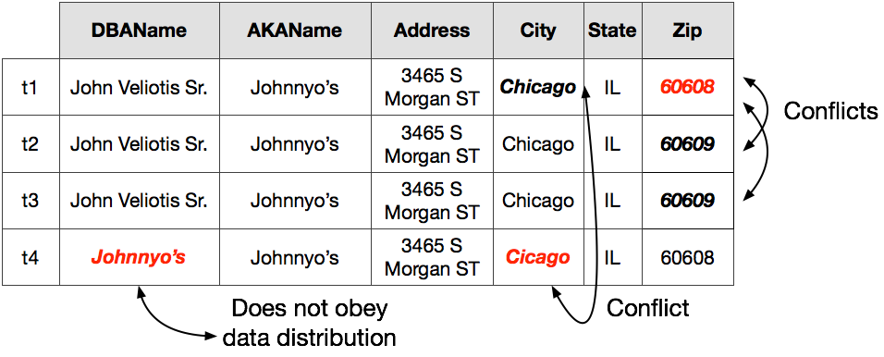
A simple example
Chicago’s food inspection dataset
Detect and repair errors in a structured dataset

Slide 34
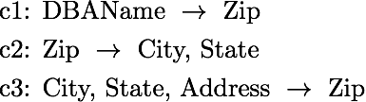
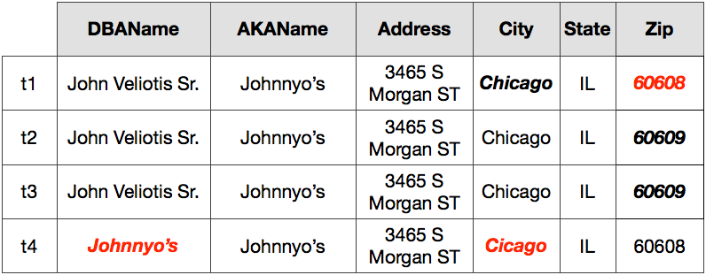
Constraints and minimality
Functional dependencies
Bohannon et al., 2005, 2007; Kolahi and Lakshmanan , 2005;
Bertossi et al., 2011; Chu et al., 2013; 2015 Fagin et al., 2015

Slide 35
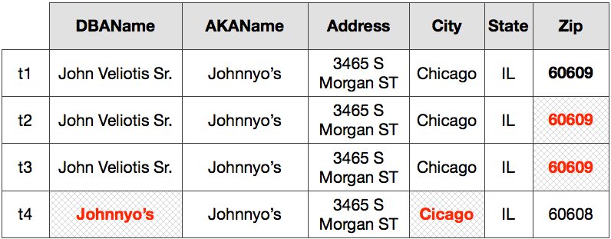
Constraints and minimality
Functional dependencies
Action: Fewer erroneous than correct cells; perform minimum number of changes to satisfy all constraints

Slide 36
Constraints and minimality
Functional dependencies
Error; correct zip code is 60608
Does not fix errors and introduces new ones.

Slide 37
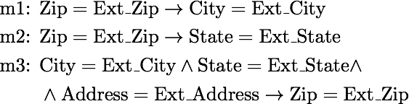
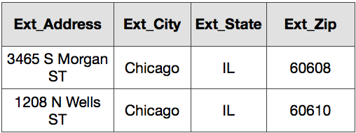
External information
Matching dependencies
External list of addresses
Fan et al., 2009; Bertossi et al., 2010; Chu et al., 2015

Slide 38
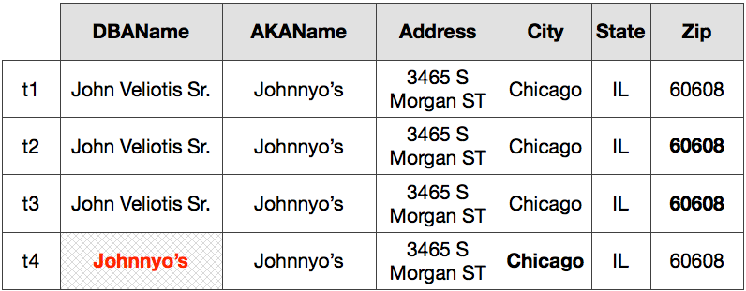
External information
Matching dependencies
External list of addresses
Action: Map external information to input dataset using matching dependencies and repair disagreements

Slide 39
External information
Matching dependencies
External list of addresses
External dictionaries may have limited coverage or not exist altogether

Slide 40
Quantitative statistics
Reason about co-occurrence of values across cells in a tuple
Estimate the distribution governing each attribute
Example: Chicago co-occurs with IL
Hellerstein, 2008; Mayfield et al., 2010; Yakout et al., 2013

Slide 41
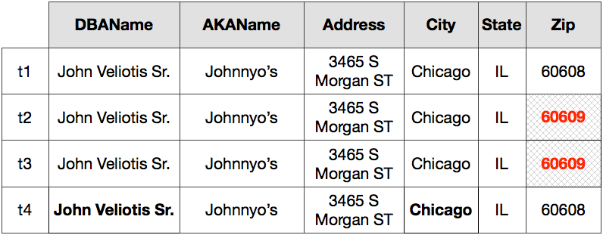
Quantitative statistics
Reason about co-occurrence of values across cells in a tuple
Estimate the distribution governing each attribute
Again, fails to repair the wrong zip code

Slide 42
Let’s combine everything
Constraints and minimality
External data
Quantitative statistics
Different solutions suggest different repairs

Slide 43
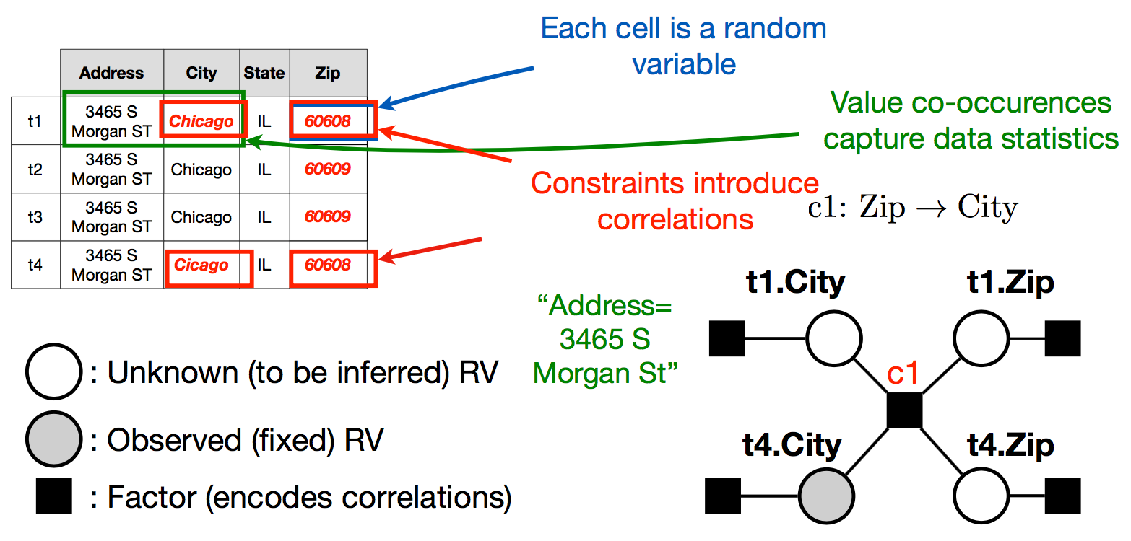
A probabilistic model for data repairs

Slide 44
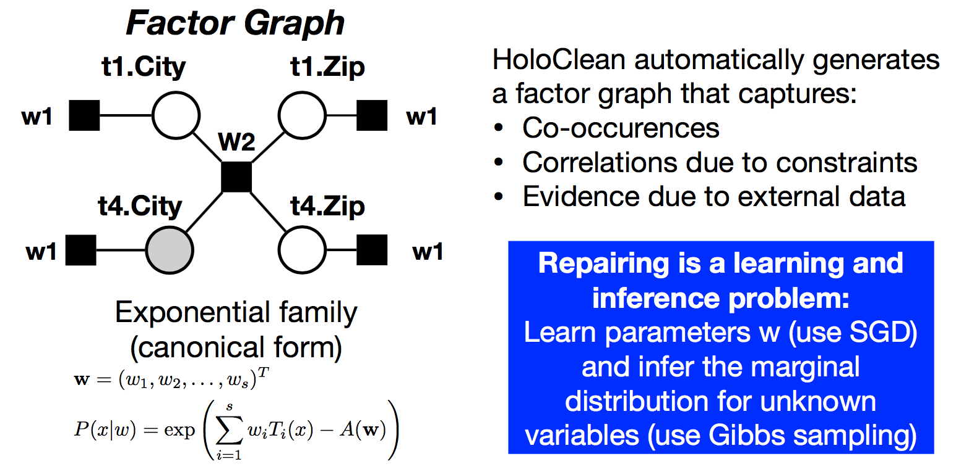
Learning the model

