Slide 1
CS639: Data Management for Data Science
Lecture 22: Entity Resolution
[slides from Getoor and Machanavajjhala]
Theodoros Rekatsinas

Slide 2
What is Entity Resolution?
Problem of identifying and linking/grouping different manifestations of the same real world object.
Examples of manifestations and objects:
Different ways of addressing (names, email addresses, FaceBook accounts) the same person in text.
Web pages with differing descriptions of the same business.
Different photos of the same object.
…
Notes:
Todo: make these more exciting/precise

Slide 3
Ironically, Entity Resolution has many duplicate names
Record linkage
Duplicate detection
Coreference resolution
Reference reconciliation
Fuzzy match
Object consolidation
Object identification
Deduplication
Entity clustering
Approximate match
Identity uncertainty
Merge/purge
Household matching
Hardening soft databases
Householding
Reference matching
Doubles

Slide 4
ER Motivating Examples
Linking Census Records
Public Health
Web search
Comparison shopping
Counter-terrorism
Knowledge Graph Construction
…
Notes:
Web search – query disambiguation

Slide 5
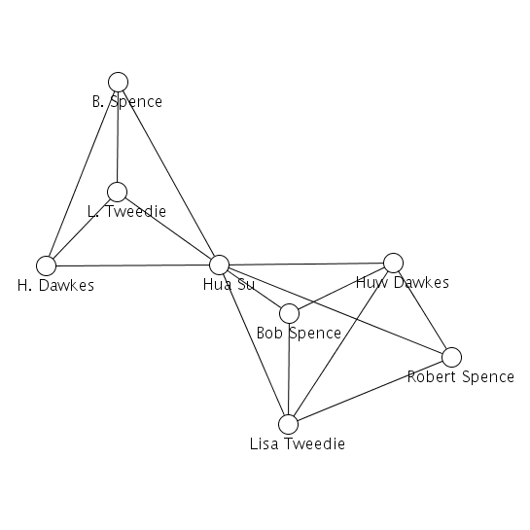
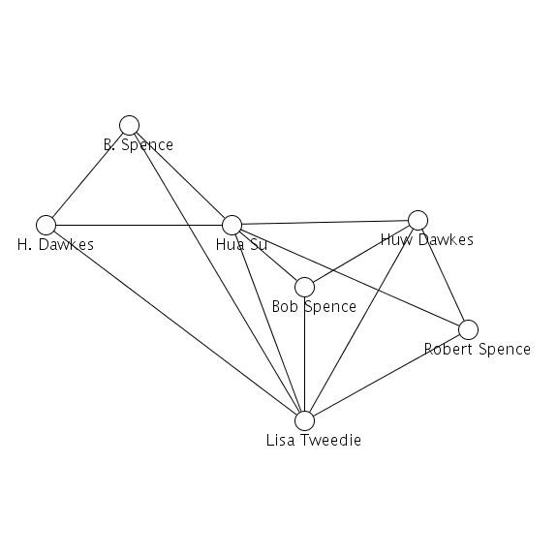
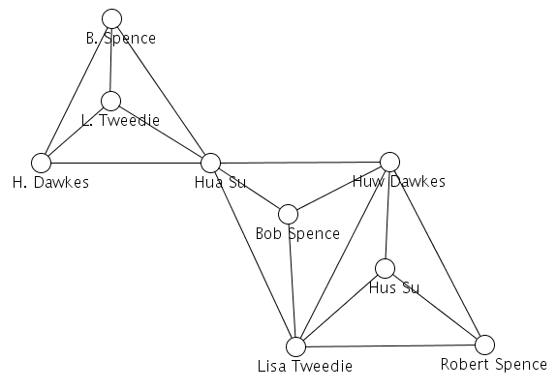
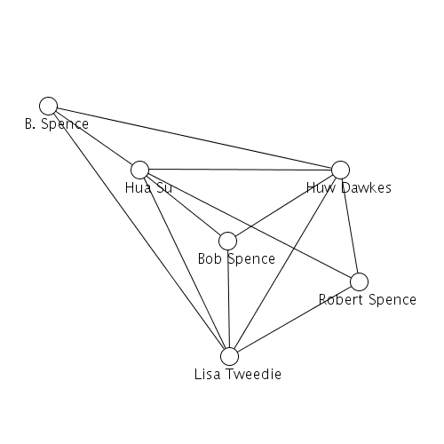
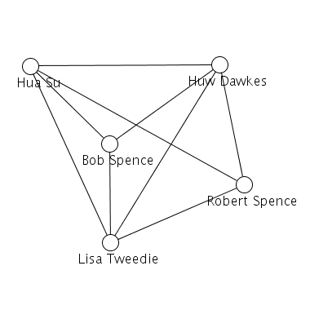
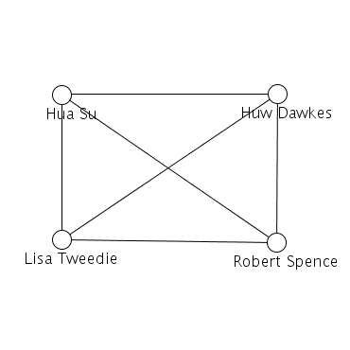
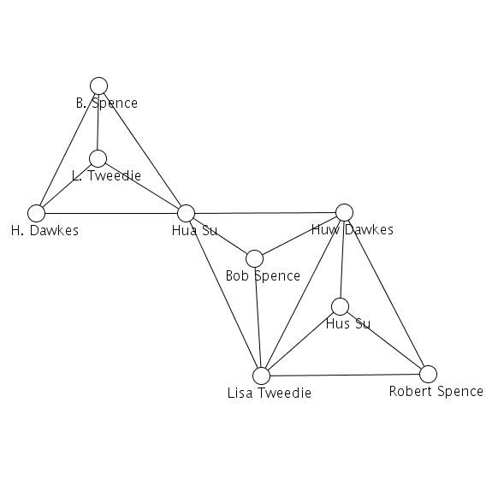
Motivation: ER and Network Analysis
before
after

Slide 6
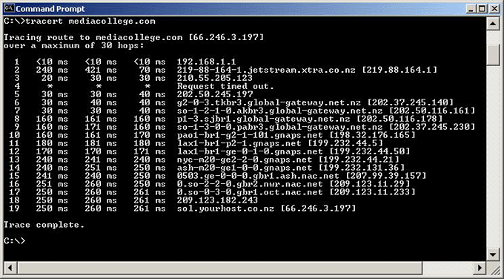
Motivation: ER and Network Analysis
Measuring the topology of the internet … using traceroute

Slide 7
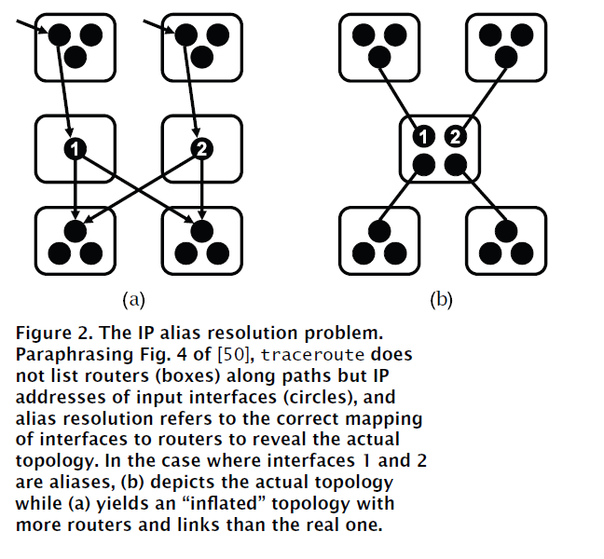
IP Aliasing Problem [Willinger et al. 2009]

Slide 8
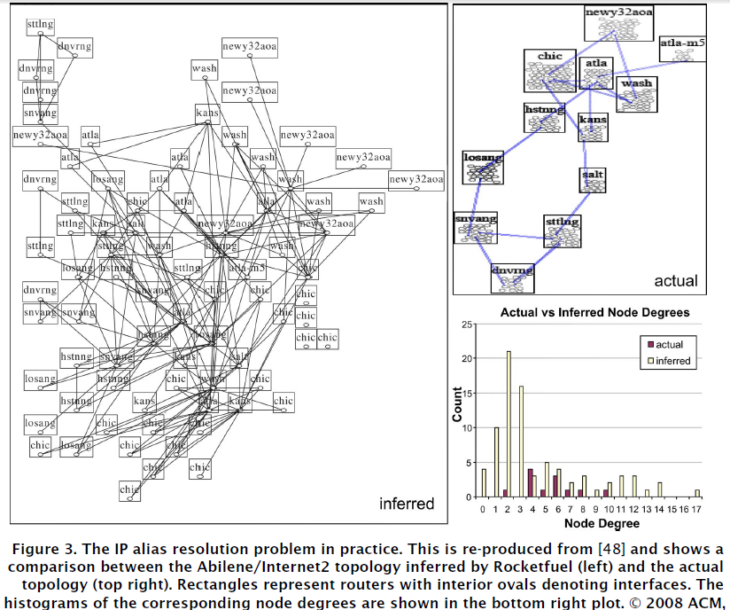
IP Aliasing Problem [Willinger et al. 2009]

Slide 9
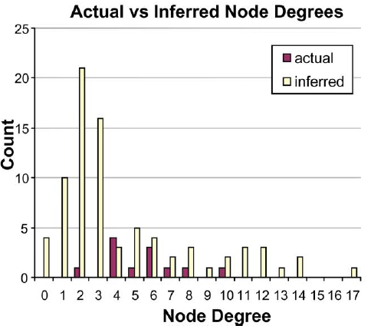
IP Aliasing Problem [Willinger et al. 2009]

Slide 10
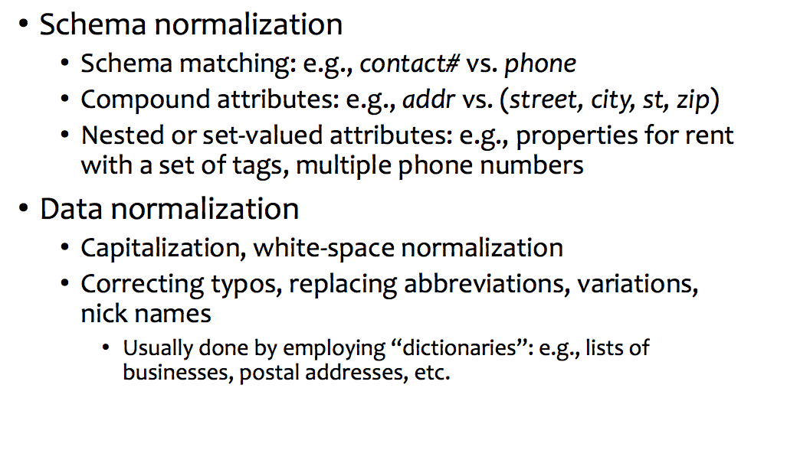
Normalization

Slide 11
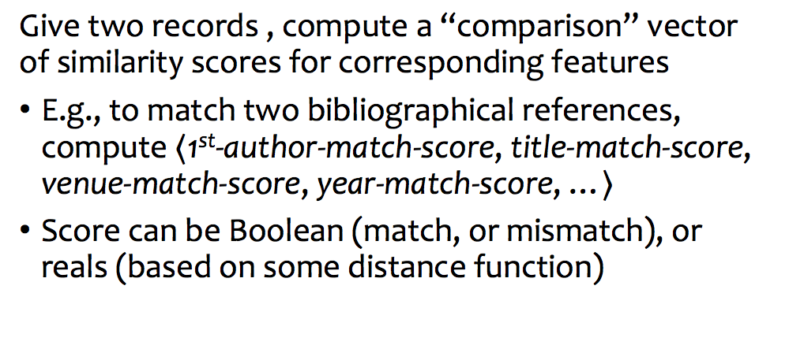
Matching Features

Slide 12
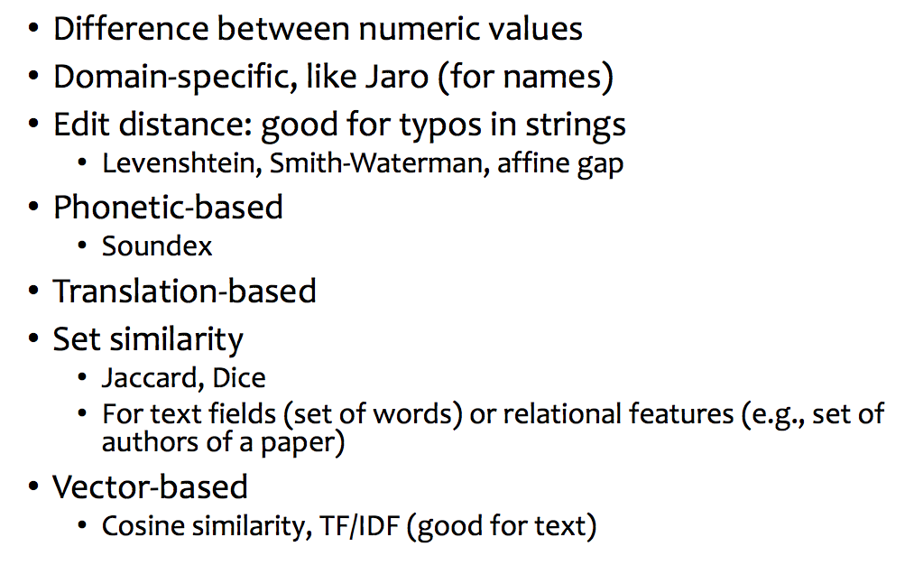
Examples of matching features

Slide 13
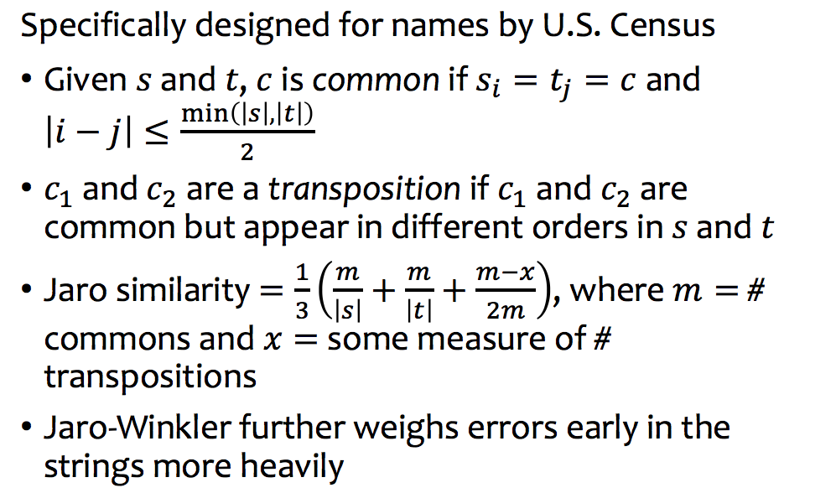
Jaro

Slide 14
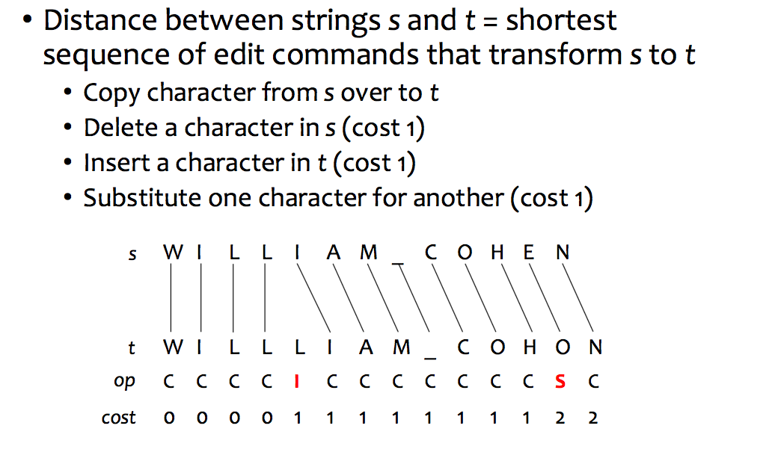
Levenshtein

Slide 15
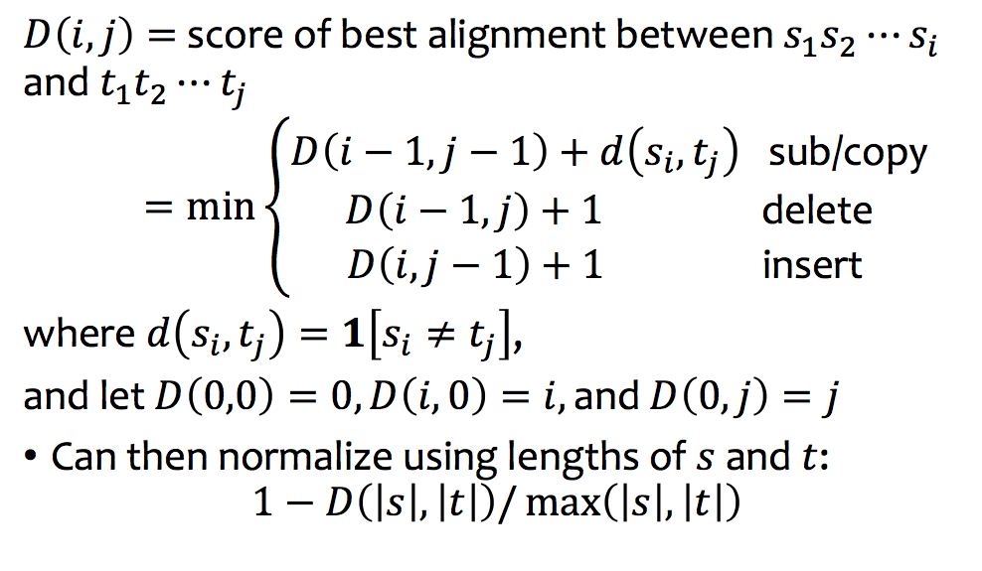
Computing Levenshtein

Slide 16
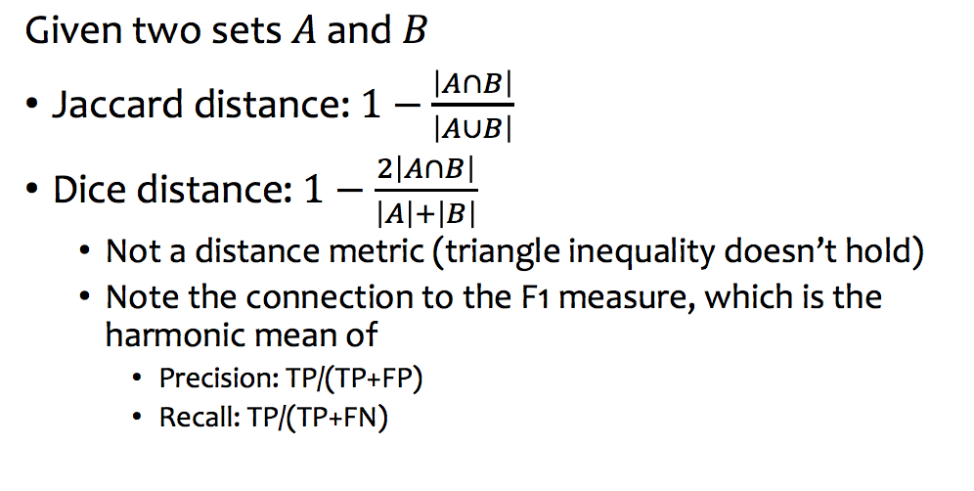
Set similarity

Slide 17
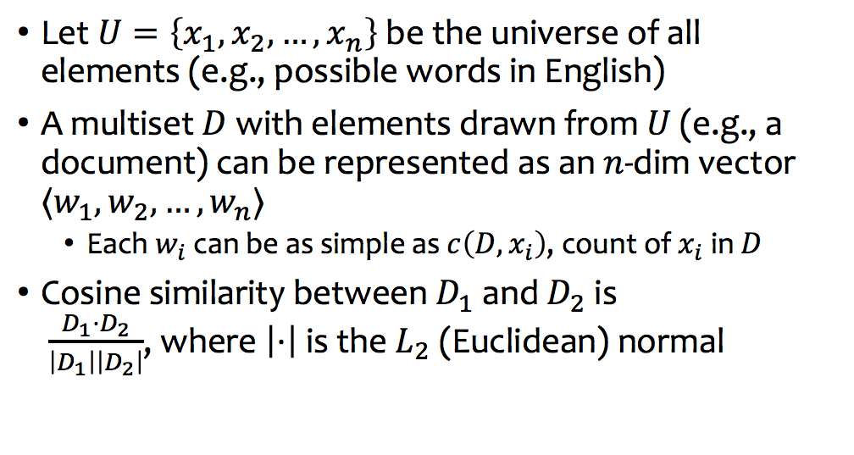
Cosine similarity and TF/IDF

Slide 18
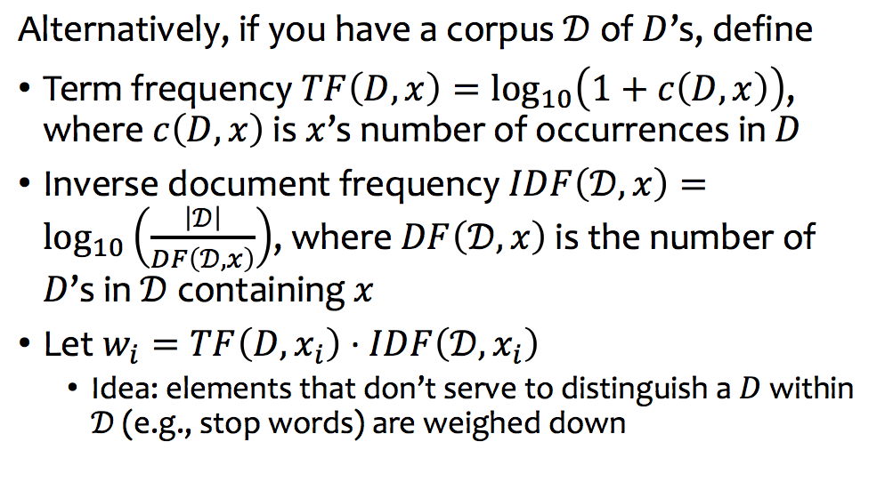
TF/IDF

Slide 19
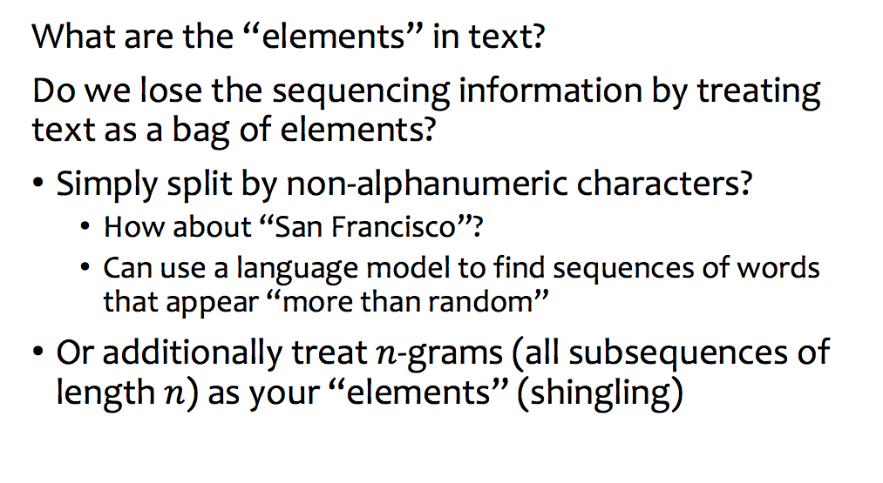
Tokening and shingling

Slide 20
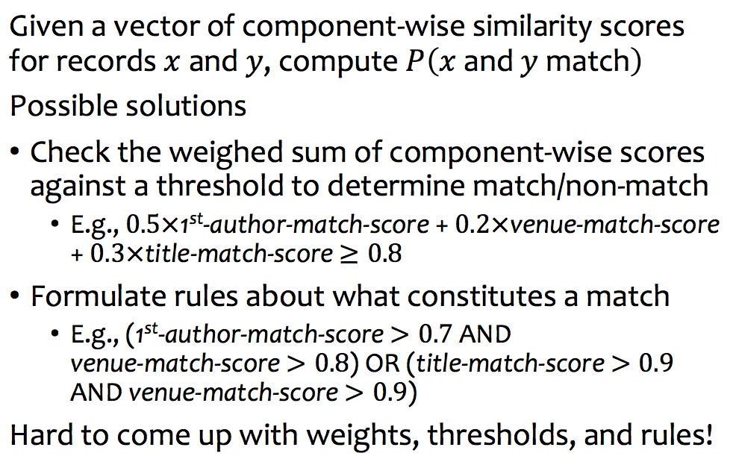
Pairwise-ER

Slide 21
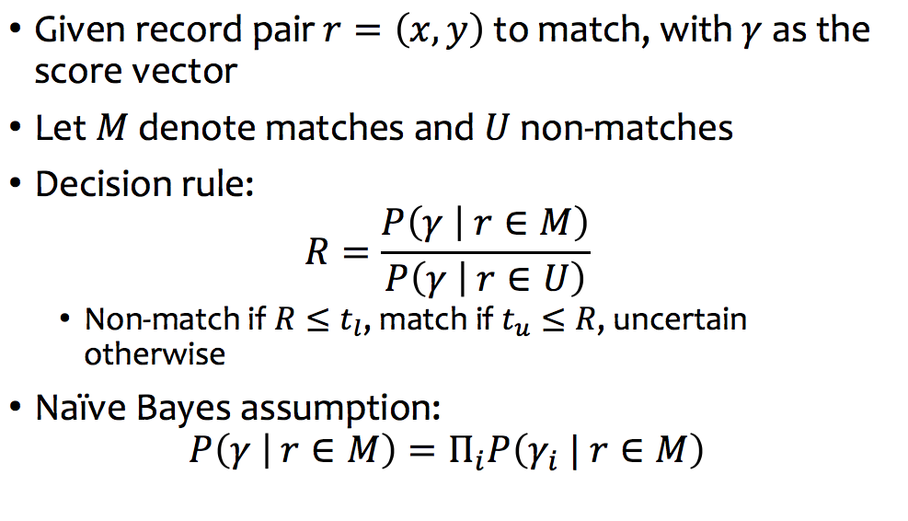
Fellegi and Sunter

Slide 22
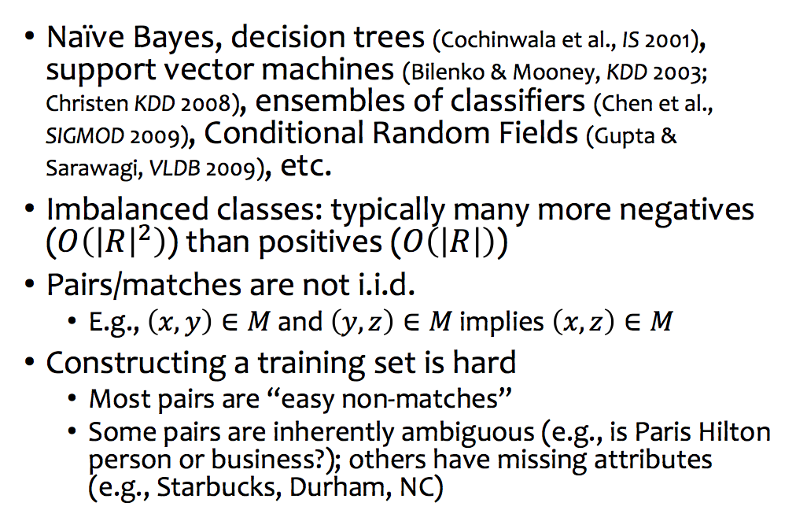
Supervised ML for pairwise ER

Slide 23
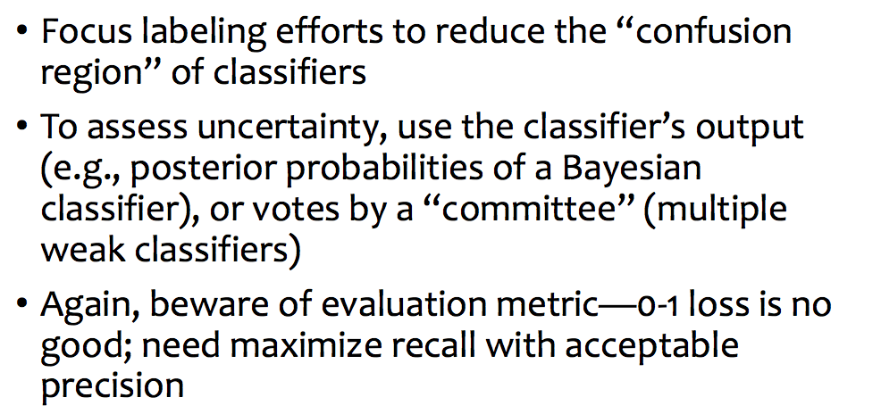
Active learning

Slide 24
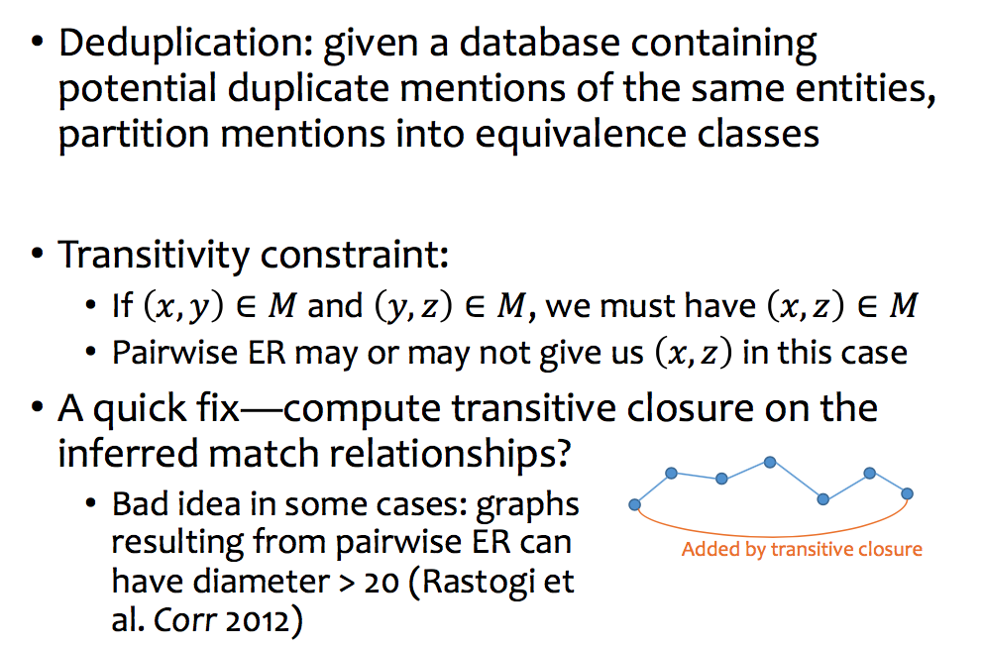
Constraints under deduplication

Slide 25
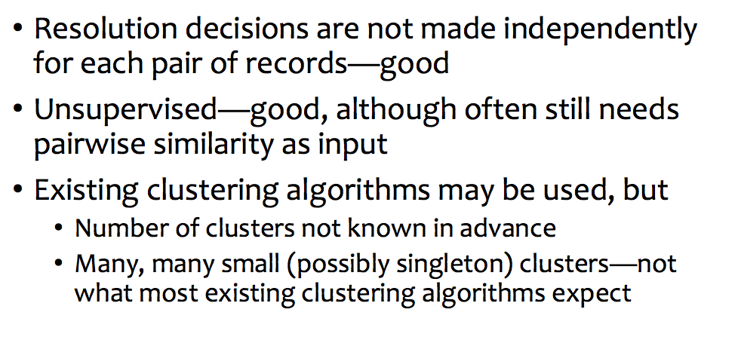
Clustering-based ER

Slide 26
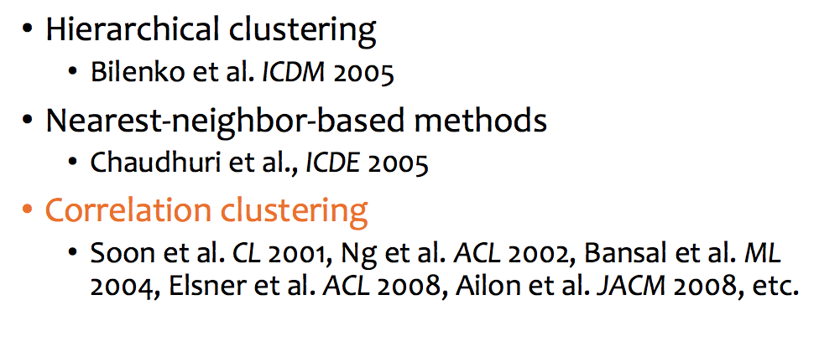
Possible clustering approaches

Slide 27
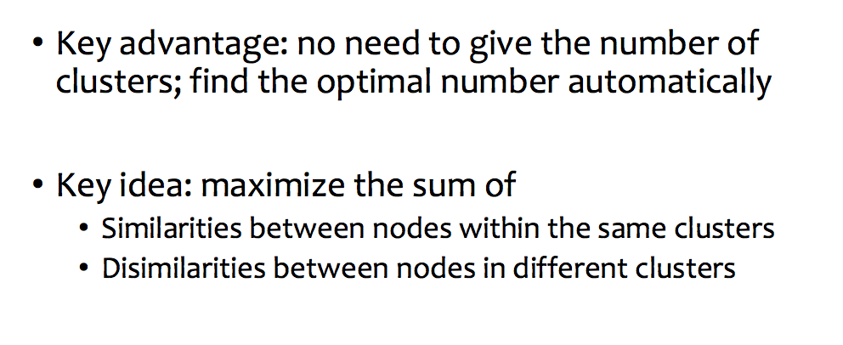
Correlation clustering

Slide 28
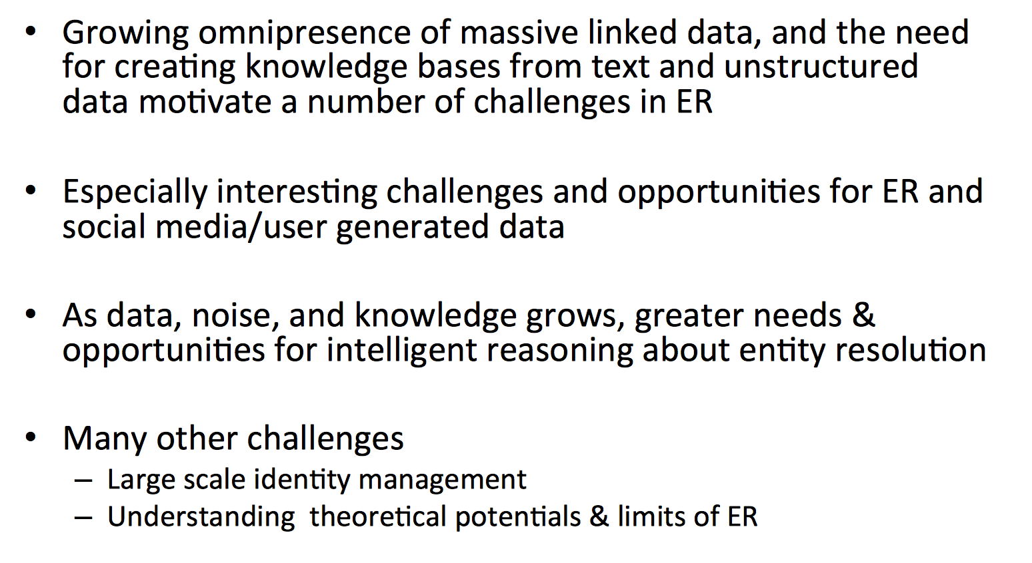
Summary

